Slide 1
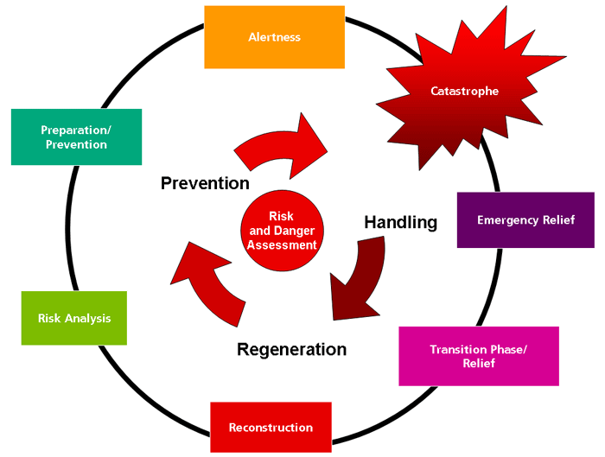
Rapid just-in-time and task-adequate geodata provision for Disaster Management
https://www.zki.dlr.de/image/937
von
Steven Fleischhauer and Franz-Josef Behr
AGSE 2017, Kish, Iran

Slide 2
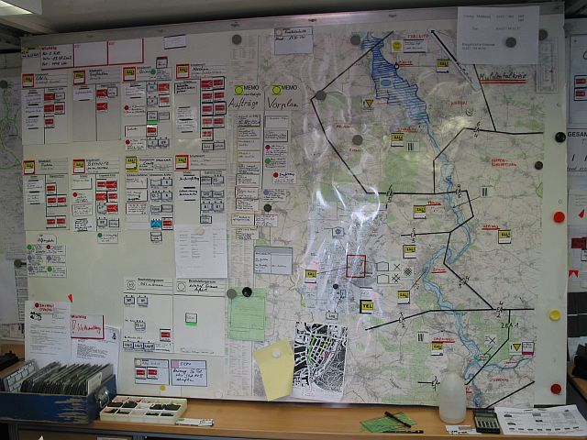
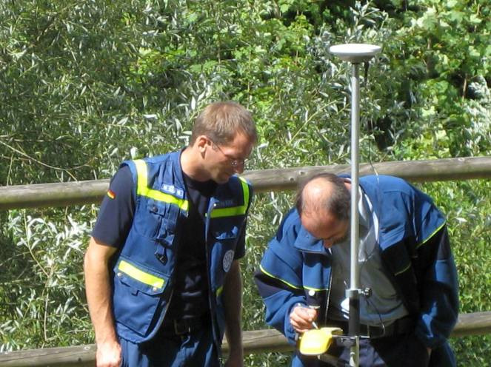
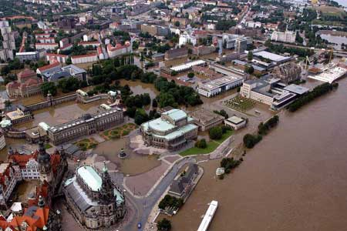
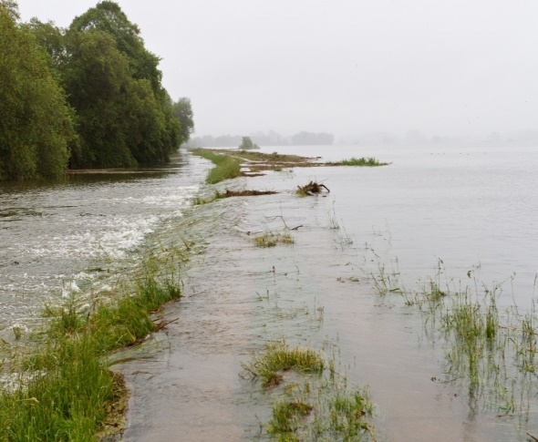
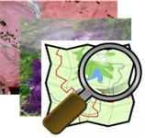

Slide 3
Outline
Relevance
Theory and existing solutions
Our approach
Result
Summary

Slide 4
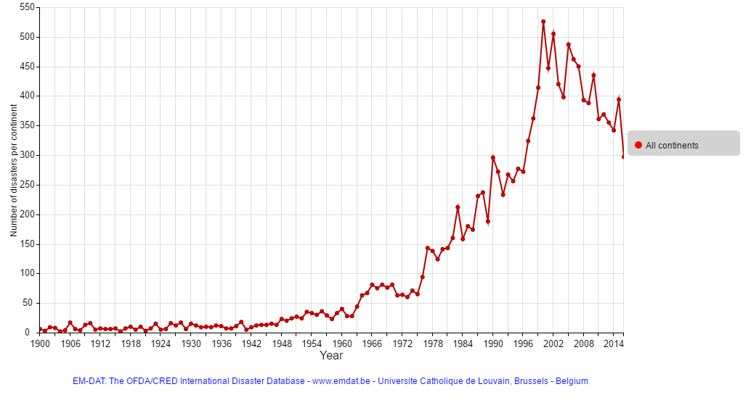
Relevance
Notes:
Ca. 300 Katastrophen in 2016

Slide 5
Relevance
http://www.prevention-web.net/files/44281_19802014paketworldusde4zu3.pdf, [08.12.2016]: S. 3

Slide 6
Relevanz der Thematik
Katastrophenmanagement
Informationsgrundlage für Entscheidungsprozesse
Geodaten

Slide 7
Definitions
Disaster: a serious disruption of the functioning of society, which poses a significant, widespread threat to human life, health, property or the environment, whether arising from accident, nature or human activity, whether developing suddenly or as the result of long-term processes, but excluding armed conflict. [IdRL 2011]
Rapid Mapping: “consists of the [… ] provision (within hours or days) of geospatial information in support of emergency management activities immediately following an emergency event. The products are standardised.”
Reference Maps: shows the boundaries, names and unique identifiers of standard geographic areas, as well as major cultural and physical features, such as roads, railroads, coastlines, rivers and lakes.
Delineation Maps: extents of the area affected by the disaster
Grading Maps: assessment of the damage grade and its spatial distribution after the disaster
[IDRL 2016] International Federation of Red Cross and Red Crescent Societies (2011): IDRL Guidelines Guidelines for the domestic facilitation and regulation of international disaster relief and initial recovery assistance
[1] http://emergency.copernicus.eu/mapping/ems/service-overview
[2] http://www.statcan.gc.ca/pub/92-195-x/2011001/other-autre/map-carte/def-eng.htm

Slide 8
According to the Emergency Mapping Guidelines drafted by the International Working Group on Satellite Emergency Mapping (IWG-SEM), Emergency Mapping can be defined as the
creation of maps, geo-information products and spatial analyses dedicated to providing situational awareness emergency management and immediate crisis information for response by means of extraction of reference (pre-event) and crisis (post-event) geographic information/data.
http://www.ithacaweb.org/projects/rapid-mapping/

Slide 9
Theoretische Vorbetrachtung
VALID-Studie
Wirtschaftlicher
Mehrwert
Strategischer und operationeller Vorteil
Altan et al. 2013: The Value of Geoinformation for Disaster and Risk Management (VALID)
Notes:
Wirtschaftlich - Fallstudie: Einsparungen ca. 40 % der Gesamtschadenssumme
Strategisch: mittel bis hoch

Slide 10
Existierende Lösungsansätze
Rapid Mapping with remotely sensed data
Crowdsourced Mapping
Waldbrandgefahrenstufenkarten
Flood risk maps
Hochwassergefahrenkarten
Deich App
OpenFloodRiskMap (OFRM)
SARONTAR
Danzeglocke 2014: Hochwasserkatastrophen – Unterstützung aus dem All
Müller et al. 2009: GIS-Einsatz zur Web-basierten Darstellung von Hochwassergefahrenkarten in Baden-Württemberg
Prüller et al. 2015: SARONTAR – ein Einsatzleitsystem für Notfälle in alpinen Regionen

Slide 11
Satellite Imagery
Example: Copernicus Emergency Management Service (EMS) Mapping (started February 2015)
Often worldwide coverage
To deal with natural or man-made disasters, i.e.
  Floods
  Earthquakes
  Landslides
  Severe Storms
  Fires
  Technological disasters
  Volcanic eruptions
  Humanitarian crises
  Tsunamis

Slide 12
International Charter 'Space and Major Disasters'
The International Charter (https://www.disasterscharter.org) is a consortium of space agencies and satellite data providers aiming at providing a unified system of rapid space data acquisition and delivery in case of natural or man-made disasters. Each member agency of the Charter has committed resources to support some specified authorised users such as relief organisations as well as civil protection and defence organisations with free of charge satellite data in order to help mitigating the effects of disasters on human life and property. The Charter data will be used by the Authorized Users directly or will be analysed by associated Value Adders, like the ZKI. The results are provided to the Authorized Users, requesting authorities and also to the public.
The „International Charter Space and Major Disasters“ was initiated by the European Space Agency ESA and the French Space Agency CNES in 1999. In 2000 also the Canadian Space Agency joined the Charter. Since then, the consortium grew up to 16 partners distributed all over the globe, providing data of approx. 30 satellite missions. Some of the missions within the Charter are: SPOT 6/7, Pléiades, Landsat-7/8, RADARSAT 2, ALOS-2, RISAT-1, KOMPSAT-2/3 or the DMC-constellation. DLR cooperates with the Charter by providing management resources and satellite images acquired by TerraSAR-X/TanDEM-X. Additionally, DLR provides satellite images from the RapidEye mission.
The tasks of DLR ZKI are grouped into two categories:
1) The provision of the technical contribution (operations) to the Charter. This task comprises the satellite tasking and data delivery of TerraSAR-X and TanDEM-X data and the ordering and delivery of RapidEye data, the Project Management for selected Charter activations and the Emergency On-Call Officer duties. This task is supported by the Federal Ministry of Economics and Technology.
2) Value adding based on Charter data. The analysis of the data is outside the scope of the Charter. These activities are realized through other mechanisms (e.g. COPERNICUS) or organizations closely linked to the Charter. If DLR/ZKI is performing the value adding, all products are provided through the ZKI website.
Additional information about the “International Charter Space and Major Disasters” can be found on the Charter homepage.

Slide 13
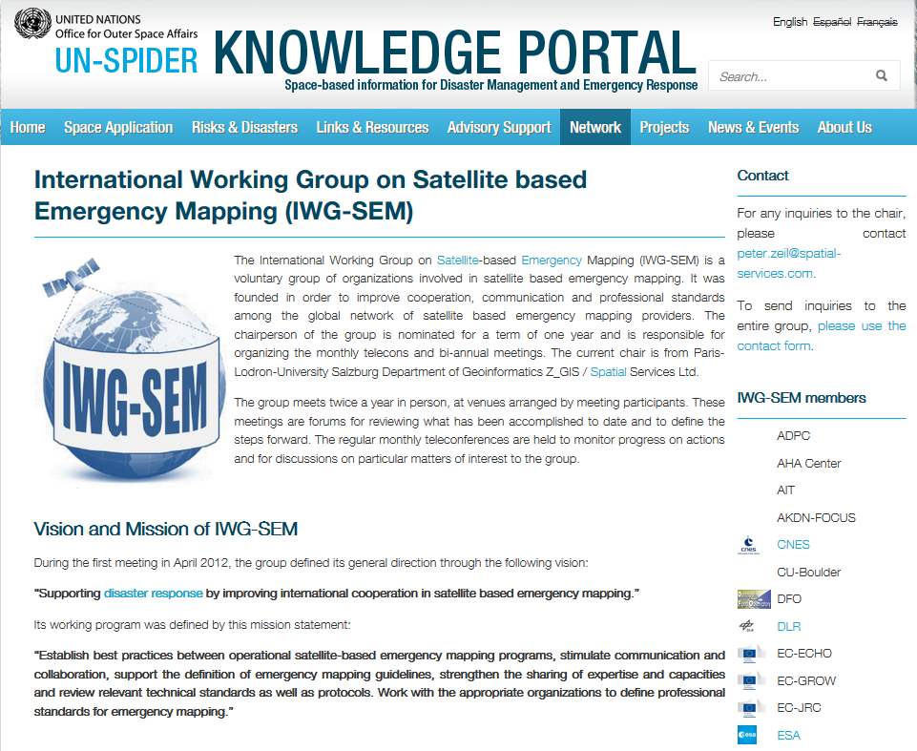

Slide 14
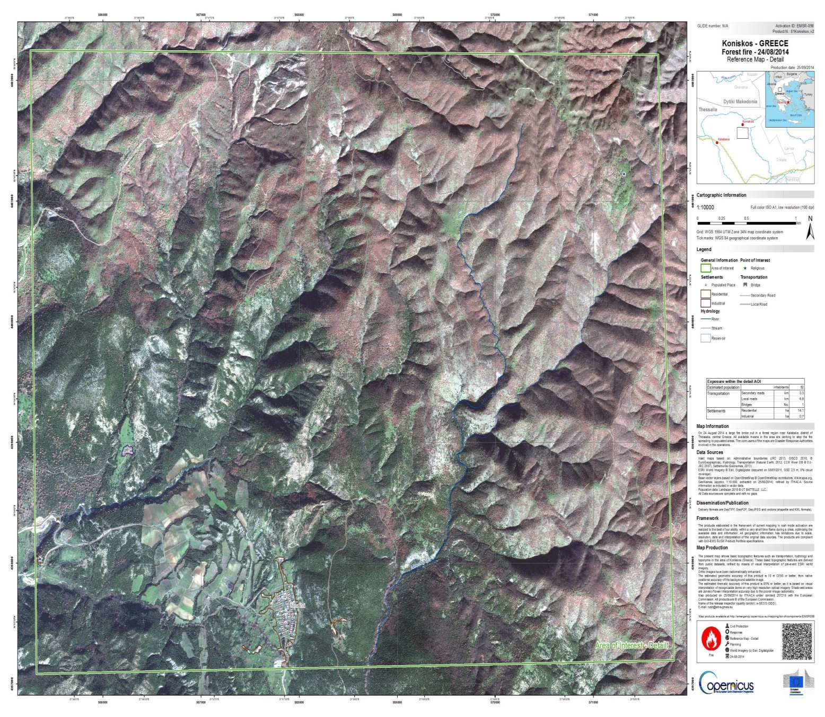
http://emergency.copernicus.eu/mapping/system/files/components/EMSR098_01KONISKOS_REFERENCE_DETAIL01_v2_100dpi.jpg

Slide 15
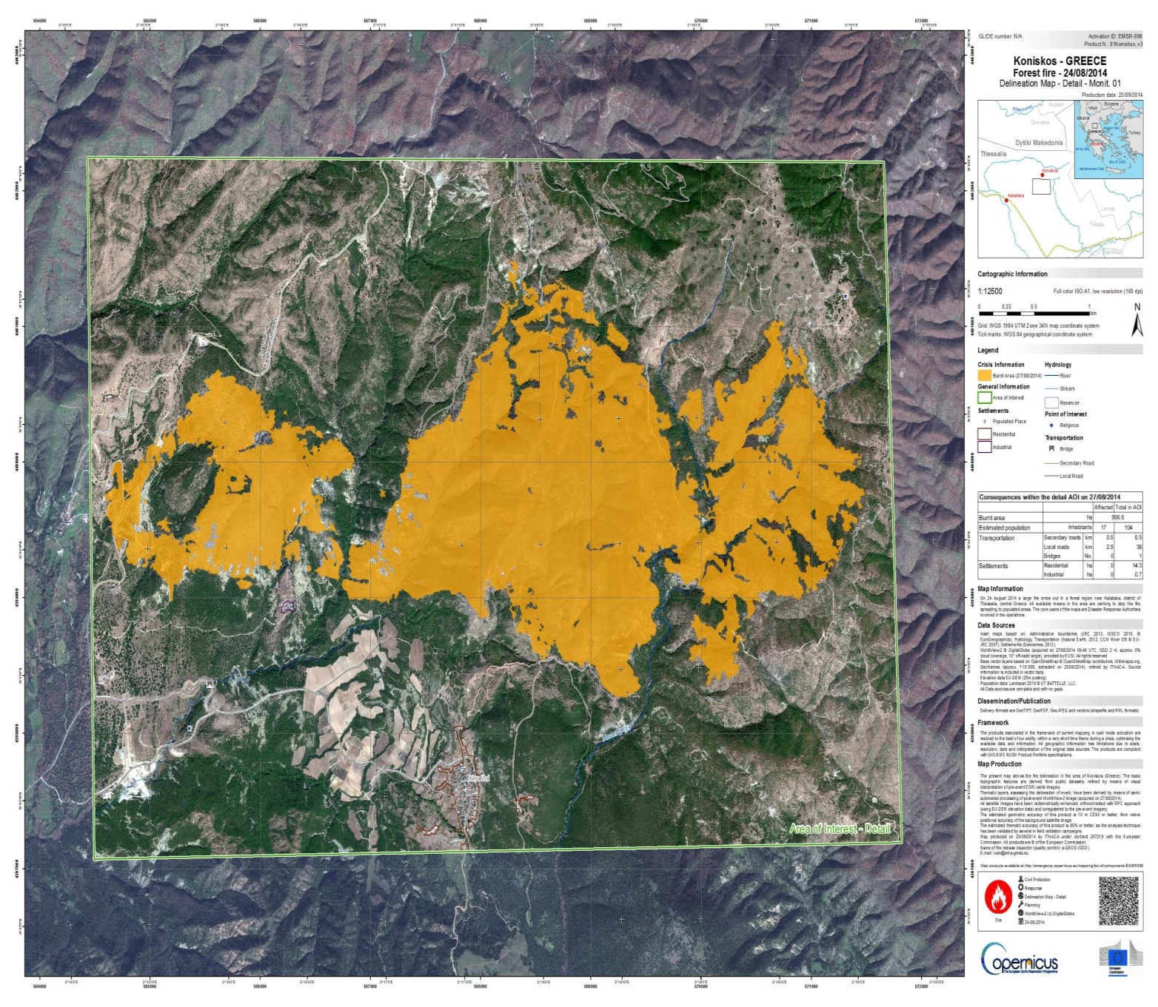
http://emergency.copernicus.eu/mapping/system/files/components/EMSR098_01KONISKOS_DELINEATION_DETAIL01-MONIT01_v3_100dpi.jpg

Slide 16
Our approach: „disaster
Open Source Software
Windows
disasterGIS
Open Data
Kommandozeilenbefehle
Batchskript
Geodata product to support disaster management

Slide 17
Our approch – „disasterGIS“
Update OSM
Initial OSM Import
Persistence Layer
Applikation
Styling
Presentation
Export
Remotely sensed Data
Data Import Tier

Slide 18
Eigener Ansatz – „disasterGIS“
Interal OSM-Database
Vektordaten
PostgreSQL + PostGIS
File System
Rasterdaten
Applikation
Tier
Data Import Tier
Data Tier
Notes:
Dateisystem: Ordnerstruktur anlegen, Pfade für Dateien
Datenbank: Erstellen, Erweiterungen hinzufügen

Slide 19
Eigener Ansatz – „disasterGIS“
Update OSM
Eigene OSM-Datenbank
Open-Layers
Map Coverage Planner
Erstimport OSM
PostgreSQL + PostGIS
Applikation
Styling
Presentation
Export
Dateisystem
Fernerkundung
Datenhaltung
Datenimport

Slide 20
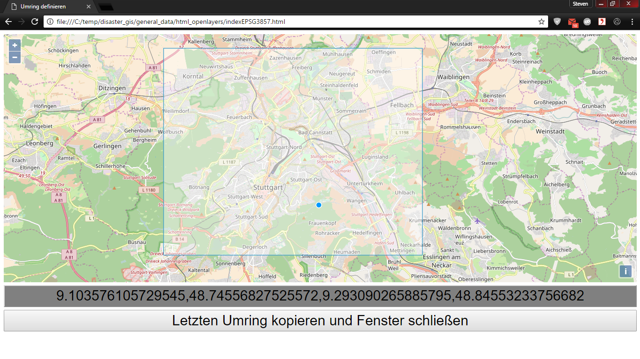
Map Coverage Planner
Notes:
Löschen

Slide 21
Eigener Ansatz – „disasterGIS“
Update OSM
OpenStreetMap
osm2pgsql
Eigene OSM-Datenbank
regional
extract
Map Coverage Planner
wget
PostgreSQL + PostGIS
XAPI
Initial OSM Import
Dateisystem
Fernerkundung
Datenhaltung
Data Import Tier

Slide 22
Eigener Ansatz – „disasterGIS“
Update OSM
OpenStreetMap
osm2pgsql
Eigene OSM-Datenbank
regional
extract
wget
Open-Layers
Definition des Umringes
Erstimport OSM
XAPI
PostgreSQL + PostGIS
USGS EarthExplorer
SNAP pconvert
GDAL gdalwarp
Dateisystem
Fernerkundung
Datenhaltung
Data Import Tier

Slide 23
Eigener Ansatz – „disasterGIS“
Update OSM
Osmosis
Eigene OSM-Datenbank
OpenStreetMap
osm2pgsql
Open-Layers
Definition des Umringes
regional
extract
PostgreSQL + PostGIS
wget
Erstimport OSM
XAPI
Dateisystem
USGS EarthExplorer
SNAP pconvert
GDAL gdalwarp
Fernerkundung
Datenhaltung
Data Import Tier

Slide 24
Eigener Ansatz – „disasterGIS“
Update OSM
Osmosis
osm2pgsql
Eigene OSM-Datenbank
Python
OpenStreetMap
Bilddatei
regional
extract
Open-Layers
Definition des Umringes
PostgreSQL + PostGIS
wget
Erstimport OSM
XAPI
Mapnik
Kacheln
Dateisystem
USGS EarthExplorer
Fernerkundung
SNAP pconvert
GDAL gdalwarp
Applikation
Styling
Präsentation
Export
Data Import Tier
Datenhaltung

Slide 25
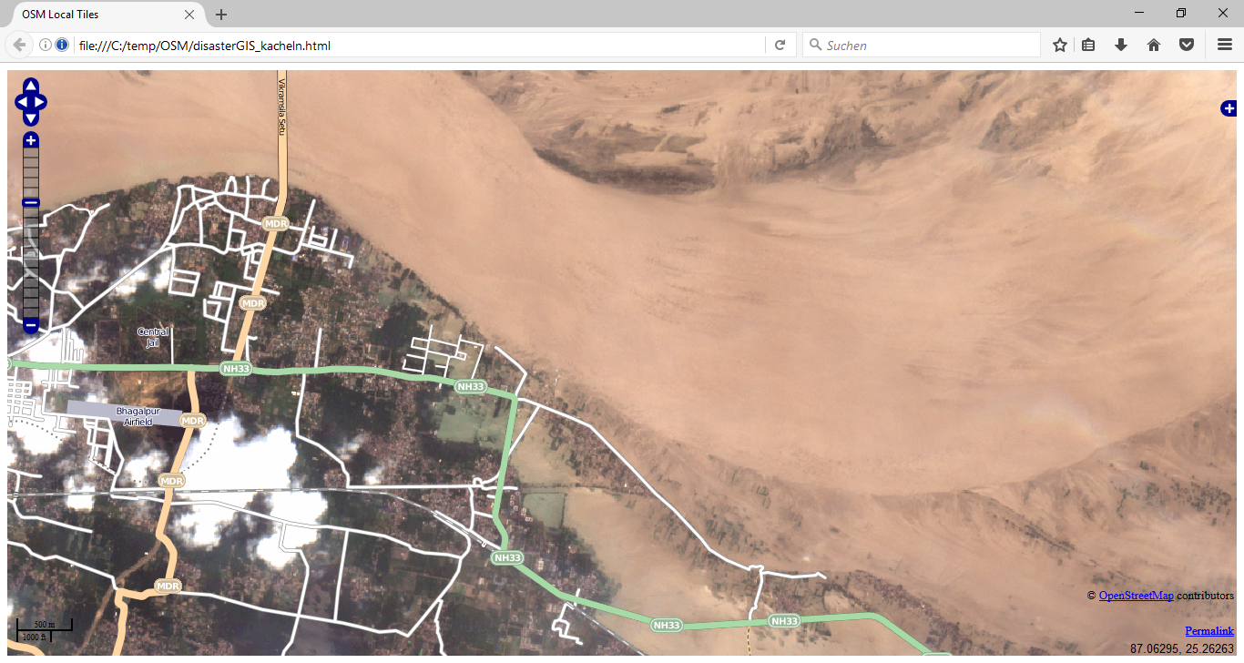

Slide 26
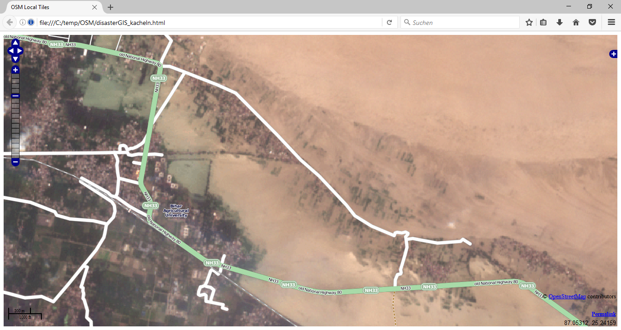

Slide 27
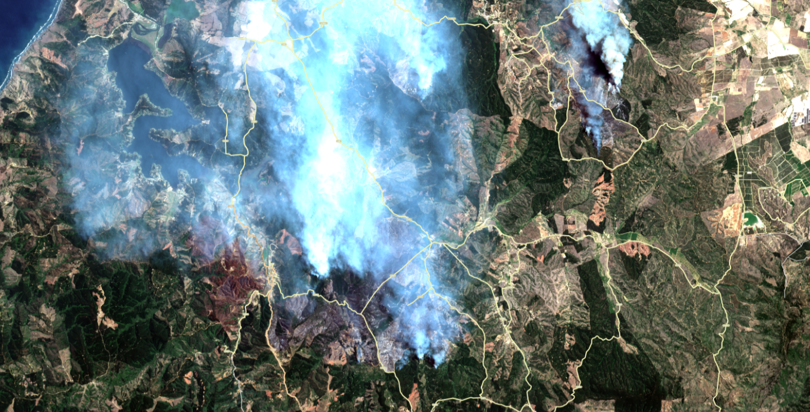

Slide 28
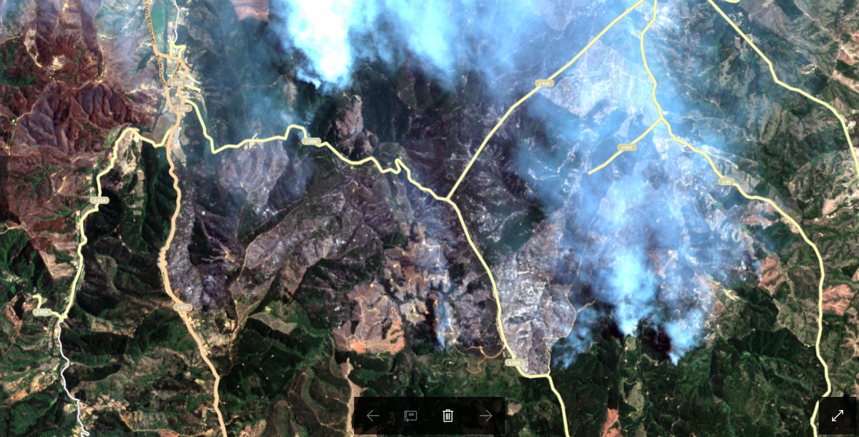

Slide 29
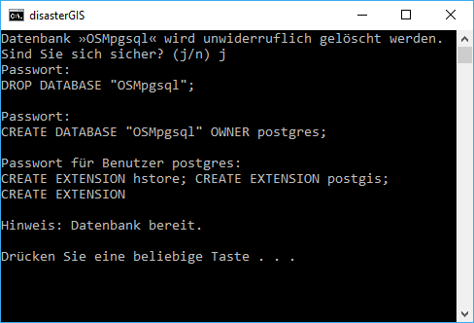
Ergebnis
zwei vordefinierte Datenquellen
skriptbasierte Nutzeroberfläche
offenes Interface
Bereitstellungszeit exklusive Downloadzeit
ca. 7 Minuten
Kacheln oder Bilddateien für das Katastrophenmanagement
Notes:
Für jede Regierungs- Nichtregierungsorganisation nutzbar

Slide 30
Summary
Reference Map created – including vector data as well as remotely sensed imagery

Slide 31
Discussion
“Domestic actors have the primary role” – the approach enables local actors to collect and provide geospatial information [1]
“Disaster” means a serious disruption of the functioning of society, which
poses a significant, widespread threat to human life, health, property or
the environment, whether arising from accident, nature or human activity,
whether developing suddenly or as the result of long-term processes, but
excluding armed conflict.
[1] International Federation of Red Cross and Red Crescent Societies (2011): IDRL Guidelines Guidelines for the domestic facilitation and regulation of international disaster relief and initial recovery assistance

