Slide 1

INSPIRE
Prof. Dr. Franz-Josef Behr
Some contens are licensed based on Creative Commons-License CC BY-NC-SA.

Slide 2
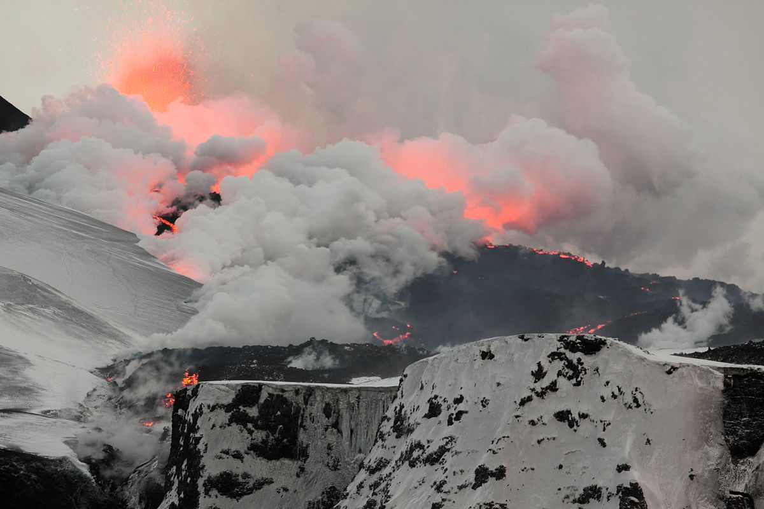
Eyjafjallajökull Eruption 2010
„Fimmvorduhals second fissure 2010 04 02“ von Boaworm - Eigenes Werk. Lizenziert unter CC BY 3.0 über Wikimedia Commons - https://commons.wikimedia.org/wiki/File:Fimmvorduhals_second_fissure_2010_04_02.JPG#/media/File:Fimmvorduhals_second_fissure_2010_04_02.JPG

Slide 3
Rationale
20% of the EU citizens (115 million) live within 50 km from a border.
70% of all fresh water bodies in Europe are part of a trans-boundary river basin.
But: Environmental phenomena (polutions and disasters) do not stop at national borders!
Vlado Cetl: INSPIRE principles, components and implementation. http://www.inspire.gv.at/dms/inspire/dateien/INSPIRE-Training-2014--Aalborg-DK/
Goals regarding the environment:
  Support high level of protection of the environment across national borders
  Enhance sensitivity of the citizens regarding environmental information and policy making/decisions
  +
Added economic value --> promotion of the (geospatial) business

Slide 4
However
The challenges regarding the lack of availability, quality, organisation, accessibility, and sharing of spatial information are common to a large number of policies and activities and are experienced across the various levels of public authority in Europe.
https://inspire.ec.europa.eu/file/1730/download?token=q3hf9SJJ [2020-01-02]

Slide 5
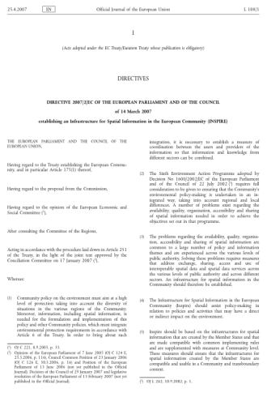
INSPIRE Directive (2007)
General rules to establish an Infrastructure for Spatial Information in Europe for Community environmental policies and policies
Policies or activities with impact on the environment
INSPIRE is built on the SDIs established and operated by the Member States + European INSPIRE portal (JRC)
Spatial data held by/on behalf of public authorities
Does not require collection of new data
http://eur-lex.europa.eu/legal-content/EN/TXT/PDF/?uri=CELEX:32007L0002&from=EN
https://eur-lex.europa.eu/legal-content/DE/TXT/HTML/?uri=CELEX:02007L0002-20190626&qid=1642582408199&from=DE
Notes:
Vlado Cetl: INSPIRE principles, components and implementation. http://www.inspire.gv.at/dms/inspire/dateien/INSPIRE-Training-2014--Aalborg-DK/INSPIRE-Training-2014---Teil-2---principles--components-and-implementation/INSPIRE%20Training%202014%20-%20Teil%202%20-%20principles,%20components%20and%20implementation.ppt
Environmental phenomena (and disasters) do not stop at national borders!
20% of the EU citizens (115 million) live within 50 km from a border.
70% of all fresh water bodies in Europe are part of a trans-boundary river basin.

Slide 6
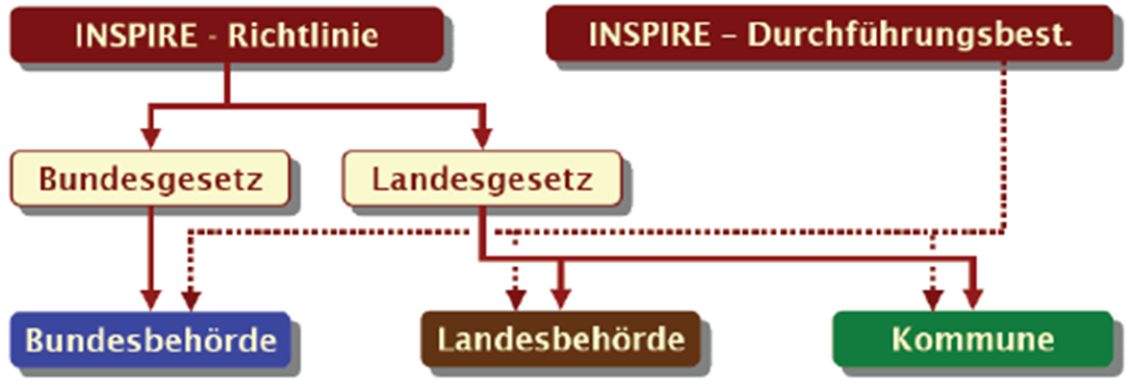
INSPIRE (Infrastructure for Spatial Information in Europe)
Short term for Dirctive 2007/2/EG of the European Parliament to set up a SDI for the EU
Ziel der Richtlinie ist es, die grenzübergreifende Nutzung von Geodaten in Europa zu erleichtern.
Set into force 15. Mai 2007, had to be transposed into national legislative systems by 15 May 2009.
built upon infrastructures for spatial information established and operated by the Member States
Spatial data held by or on behalf of a public authority operating down to the lowest level of government when laws or regulations require their collection or dissemination
http://www.imagi.de/themen/navl_inspire.html
Elmar Schröder (2010): INSPIRE@owl -
Synergieeffekte regional nutzen
Notes:
INSPIRE-Richtlinie: bildet rechtliche, organisatorische und technische Grundlage für eine gesamteuropäische Geodateninfrastruktur und wird als wesentliche Grundlage bei der Einrichtung von geodatenhaltenden Stellen im öffentlichen Bereich (wie GDIs) berücksichtigt.

Slide 7
Basic documents
Directive 2007/2/EC of the European Parliament and of the Council of 14 March 2007 establishing an Infrastructure for Spatial Information in the European Community (INSPIRE) 14.03.2007
INSPIRE is built on the SDIs established and operated by the Member States + European INSPIRE portal (JRC)
http://eur-lex.europa.eu/legal-content/EN/TXT/PDF/?uri=CELEX:32007L0002&from=EN

Slide 8
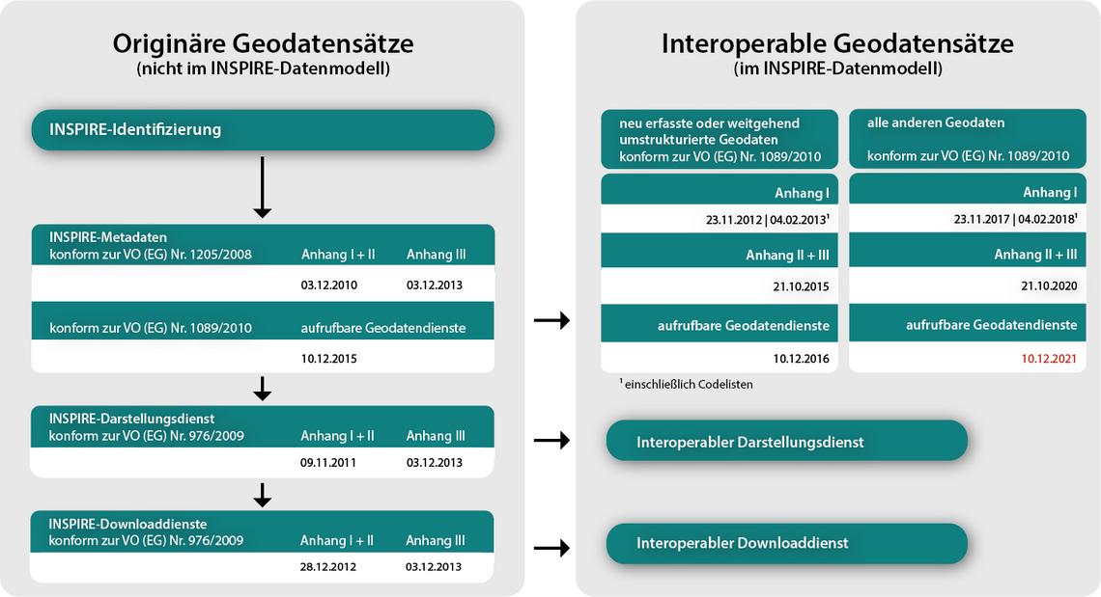
Schedule
https://www.gdi-de.org/INSPIRE/Zeitplan [2021-10-20]

Slide 9
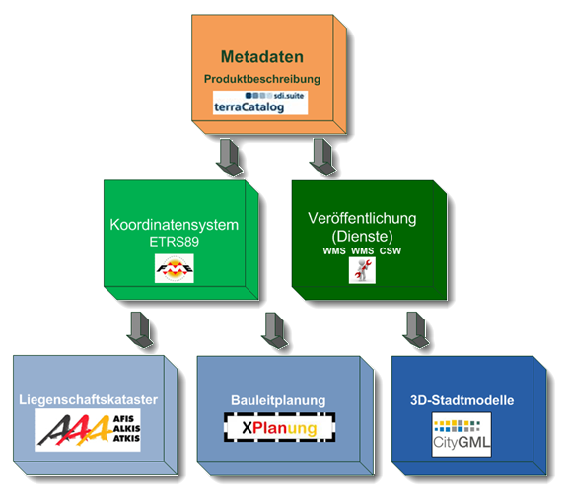
Main long-term steps for INSPIRE
Step 1: Preparation of Metadata
Step 2: Conversion to uniform spatal reference systems, introduction of services
Step 3: Introduction if new standards for cadastre, civil engineering, 3D models…
Elmar Schröder (2010): INSPIRE@owl -
Synergieeffekte regional nutzen

Slide 10
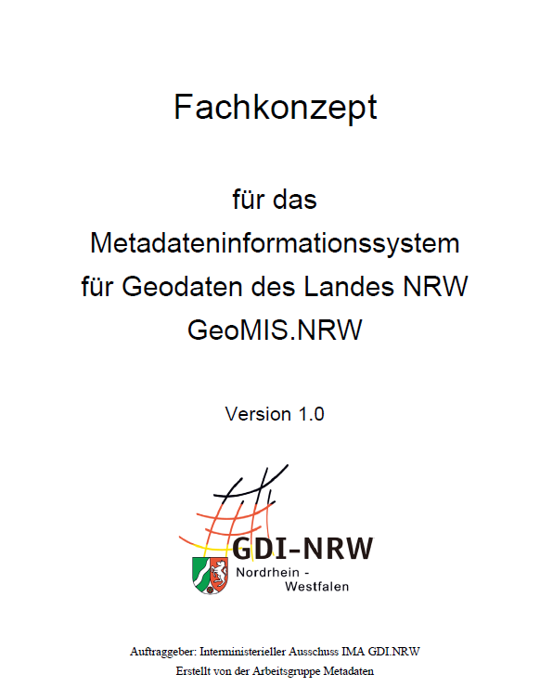
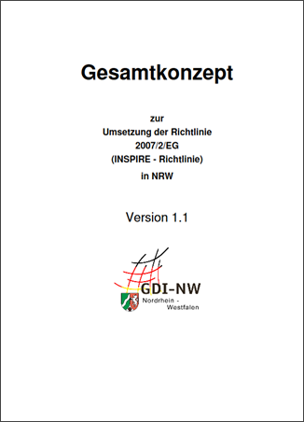
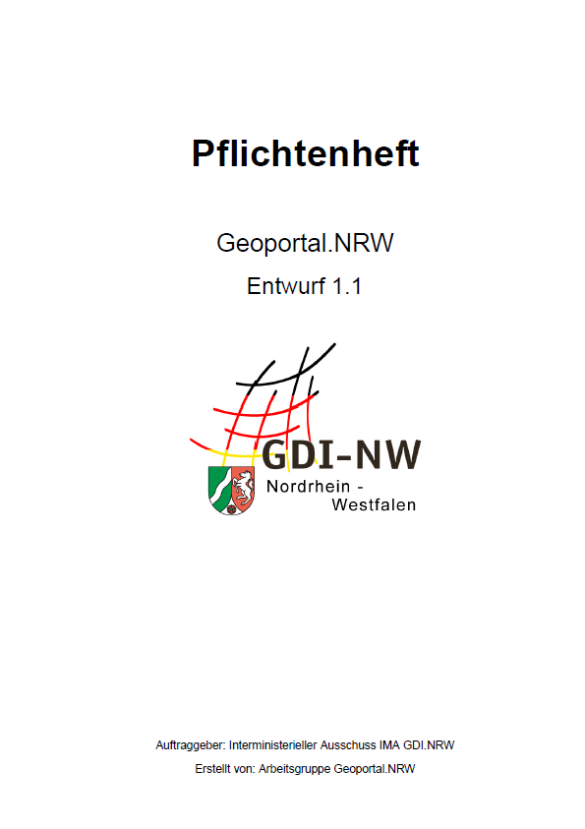
https://www.geoportal.nrw/sites/default/files/2012-02-06_Gesamtkonzept-INSPIRE-NRW_V_1_1.pdf [2020-01-02]

Slide 11
Grundprinzipien
Effizienz: Geodaten sollen nur einmal erfasst und nur dort gepflegt werden, wo dies am effektivsten erfolgen kann.
Interoperabilität: Es soll möglich sein, Geodaten aus verschiedenen Quellen über ganz Europa nahtlos zu kombinieren und sie vielen Nutzern und Anwendungen zur Verfügung zu stellen.
Vertikale Interoperabilität: Es sollen Geodaten, die von einem bestimmten Ressort oder Ebene oder Verwaltungsebene erfasst worden sind, allen anderen Ressorts und Verwaltungsebenen zur Verfügung gestellt werden.
Freie Verfügbarkeit: Geodaten, die für ein effektives Verwaltungshandeln erforderlich sind, sollten für Konditionen verfügbar sein, die eine breite Verfügbarkeit und Anwendung nicht behindern dürfen.
Zugänglichkeit: Es soll die Suche nach Geodaten einfach möglich sein, um die Brauchbarkeit für bestimmte Anwendungen überprüfen zu können. Außerdem soll für den Anwender erkennbar sein, welche Bedingungen an eine Nutzung geknüpft sind.
Concerning 34 geodata themes
Nach:
https://www.geoportal.nrw/sites/default/files/Masterarbeit_Weichand.pdf http://inspire.ec.europa.eu/index.cfm/pageid/48

Slide 12
Common principles
Efficiency: Data should be collected only once and kept where it can be maintained most effectively.
Ability of combination and sharing: It should be possible to combine seamless spatial information from different sources across Europe and share it with many users and applications.
Scale independency: It should be possible for information collected at one level/scale to be shared with all levels/scales; detailed for thorough investigations, general for strategic purposes.
Transparency: Geographic information needed for good governance at all levels should be readily and transparently available.
Accessibility: Easy to find what geographic information is available, how it can be used to meet a particular need, and under which conditions it can be acquired and used.
Concerning 34 geodata themes
After: http://inspire.ec.europa.eu/index.cfm/pageid/48

Slide 13
INSPIRE: ein Rahmenwerk von Richtlinien
Durchführungsbestimmungen (Implementing Rules, IR): rechtlich verbindend
  Metadaten
  Datenthemen
  Netzwerkbasierte Dienste (Suche, Anzeige, Download, Transformation, Aufruf und Kombination von Diensten)
  Vereinbarungen zur Bereitstellung von Daten und Diensten
  Monitoring und Reporting
Ziel: Bereitstellung und Sicherstellung der Interoperabilität von
    1) Geodaten und
    2) Diensten
Details in Technical Guidelines (TG)
Detailfolien
Notes:
Erzeugung und regelmäßige Aktualisierung von Metainformationen zu den Geodaten und Geodiensten;
Bereitstellung von Geodiensten, u. a.
zur Recherche mittels Metainformationen (Suchdienste),
zur Anzeige von Geodaten (Darstellungsdienste),
zum Herunterladen von Geodaten (Download-Dienste) und
zum Umwandeln von Geodaten zwecks Interoperabilität (Transformations- Dienste)

Slide 14
INSPIRE is a Framework Directive
Implementing Rules (IR): legal acts for
  Metadata
  Data Themes and their Specifications
  Network based Services (discovery, view, download, transform, invoke)
  Data and Service Sharing (regulations)
  Monitoring and Reporting
To achieve and to assure interoperability of
    1) spatial data sets and
    2) Services
Supported/Detailed by Technical Guidelines (TG)
Details below

Slide 15
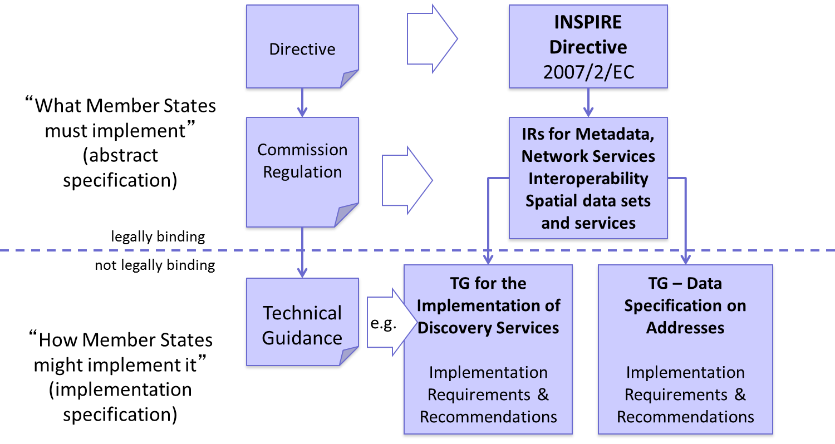
Implementation Rules (IR) vs Technical Guidelines (TG)
http://www.inspire.gv.at/dms/inspire/dateien/INSPIRE-Training-2014--Aalborg-DK/INSPIRE-Training-2014---Teil-2---principles--components-and-implementation/INSPIRE%20Training%202014%20-%20Teil%202%20-%20principles,%20components%20and%20implementation.ppt

Slide 16

1. Metadata
https://www.geoportal.nrw/sites/default/files/2020-12-04_GDI-ForumNRW1240Schlegel-INSPIREtheLastMile.pdf
DT NS
metadata for spatial data (ISO 19115)
  For discovery, evaluation and use
  keywords
  simple search criteria about key characteristics about the data set
  Spatial and temporal extent
  Must be kept consistent with the actual resource
and
metadata for services (ISO 19119)
  enables the discovery of spatial data services.
  service type
  operations parameters
  geographic information
Discovery Service
DT MD
Service
Metadata
Data Set
Metadata
Die Metadaten zu den Daten sind durch ISO 19115 spezifiziert, die für die Dienste durch ISO 19119. 19139 beschreibt die xml-Struktur des ISO 19115. Das OGC Appllication profile for csw beinhaltet ein erweitertes ISO 19139 Schema für Daten und Dienste und wird auch bei INSPIRE in den TG metadata referenziert.

Slide 17
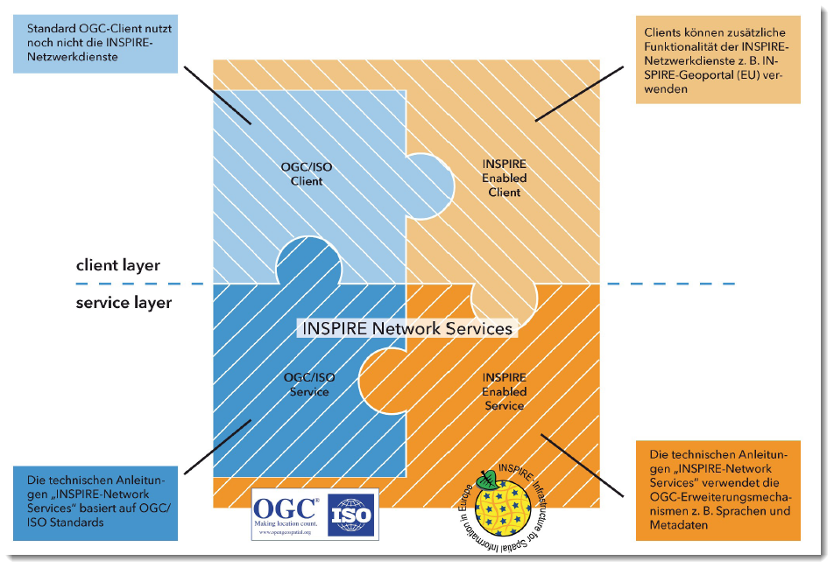
Service-Metadaten
INSPIRE requires for each geodata service a standardized service metadata description according ISO 19139. This goes beyond the OGC requirements regarding Capabilities responses!
Technical Guidance for the implementation of INSPIRE Discovery Services. http://inspire.ec.europa.eu/documents/Network_Services/TechnicalGuidance_DiscoveryServices_v3.1.pdf [2015-08-11]

Slide 18
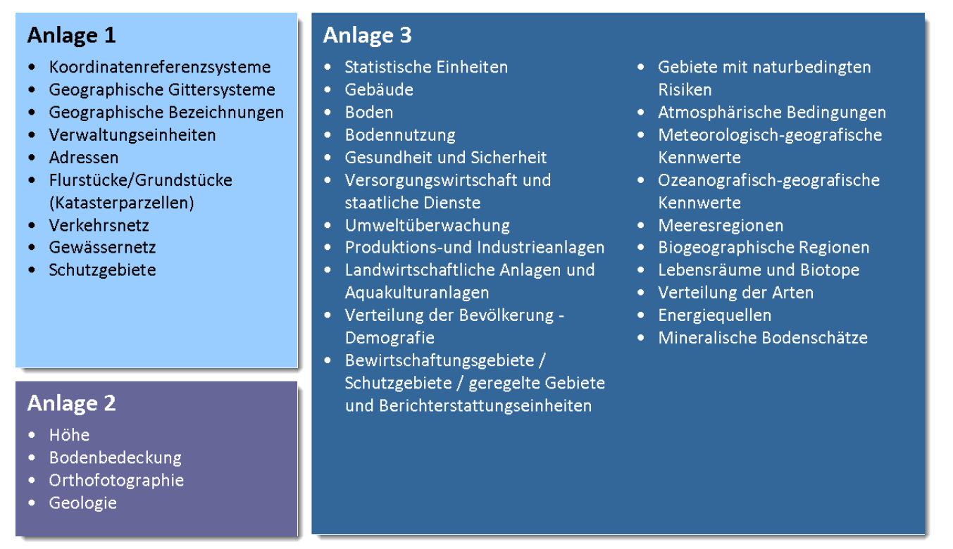
2. Data themes
http://eur-lex.europa.eu/legal-content/EN/TXT/HTML/?uri=OJ:L:2007:108:FULL&from=EN
34 Data themes, noted in 3 annexes – (required to successfully build environmental information systems)
Quelle: http://www.geoportal.hessen.de/portal/fileadmin/user_upload/GDI-Hessen/GDI/Architekturkonzept_Version_3.0.pdf, S. 14 [2016-10-18]
Notes:
1.
Coordinate reference systems
Systems for uniquely referencing spatial information in space as a set of coordinates (x, y, z) and/or latitude and longitude and height, based on a geodetic horizontal and vertical datum.
2.
Geographical grid systems
Harmonised multi-resolution grid with a common point of origin and standardised location and size of grid cells.
3.
Geographical names
Names of areas, regions, localities, cities, suburbs, towns or settlements, or any geographical or topographical feature of public or historical interest.
4.
Administrative units
Units of administration, dividing areas where Member States have and/or exercise jurisdictional rights, for local, regional and national governance, separated by administrative boundaries.
5.
Addresses
Location of properties based on address identifiers, usually by road name, house number, postal code.
6.
Cadastral parcels
Areas defined by cadastral registers or equivalent.
7.
Transport networks
Road, rail, air and water transport networks and related infrastructure. Includes links between different networks. Also includes the trans-European transport network as defined in Decision No 1692/96/EC of the European Parliament and of the Council of 23 July 1996 on Community Guidelines for the development of the trans-European transport network (1) and future revisions of that Decision.
8.
Hydrography
levation
Digital elevation models for land, ice and ocean surface. Includes terrestrial elevation, bathymetry and shoreline.
2.
Land cover
Physical and biological cover of the earth's surface including artificial surfaces, agricultural areas, forests, (semi-)natural areas, wetlands, water bodies.
3.
Orthoimagery
Geo-referenced image data of the Earth's surface, from either satellite or airborne sensors.
4.
Geology
Geology characterised according to composition and structure. Includes bedrock, aquifers and geomorphology.
Hydrographic elements, including marine areas and all other water bodies and items related to them, including river basins and sub-basins. Where appropriate, according to the definitions set out in Directive 2000/60/EC of the European Parliament and of the Council of 23 October 2000 establishing a framework for Community action in the field of water policy (2) and in the form of networks.
9.
Protected sites
Area designated or managed within a framework of international, Community and Member States' legislation to achieve specific conservation objectives.

Slide 19
2. Data themes
https://eur-lex.europa.eu/legal-content/EN/TXT/HTML/?uri=OJ:L:2007:108:FULL&from=EN [2022-10-23]
34 Data themes, noted in 3 annexes – (required to successfully build environmental information systems)
Annex III
  Statistical units
  Buildings
  Soil
  Land use
  Human health and safety
  Utility and governmental services
  Environmental monitoring facilities
  Production and industrial facilities
  Agricultural and aquaculture facilities
  Population distribution – demography
  Area management/restriction
  /regulation zones & reporting units
  Natural risk zones
  Atmospheric conditions
  Meteorological geographical features
  Oceanographic geographical features
  Sea regions
  Bio-geographical regions
  Habitats and biotopes
  Species distribution
  Energy Resources
  Mineral resources
Annex I
  Coordinate reference systems
  Geographical grid systems
  Geographical names
  Administrative units
  Addresses
  Cadastral parcels
  Transport networks
  Hydrography
  Protected sites
Annex II
  1. Elevation
  2. Land cover
  3. Ortho-imagery
  4. Geology

Slide 20
Spatial reference systems required EU-wide
ETRS89 (EPSG:4258)
For Germany according "Architekturkonzept GDI-DE:"
  Lambert-Conformal-Conic (EPSG:4839)
  For scales >1:500.000: Universal Transverse Mercator (UTM) i.e. ETRS89/UTM zone 32 N (EPSG:25832)

Slide 21
Data Sets according to Data Specifications
Required: Semantic Interoperability
  possibility to combine harmonized spatial data (and services) from different sources across the European Community in a consistent manner:
    Interoperable spatial feature types (attributes, data types, code lists, relationships)
    common system of unique identifiers
As well required:
  a common encoding (GML application schemas)
  common portrayal rules
Public bodies can transform their spatial data into the relevant INSPIRE Data Specification schema

Slide 22
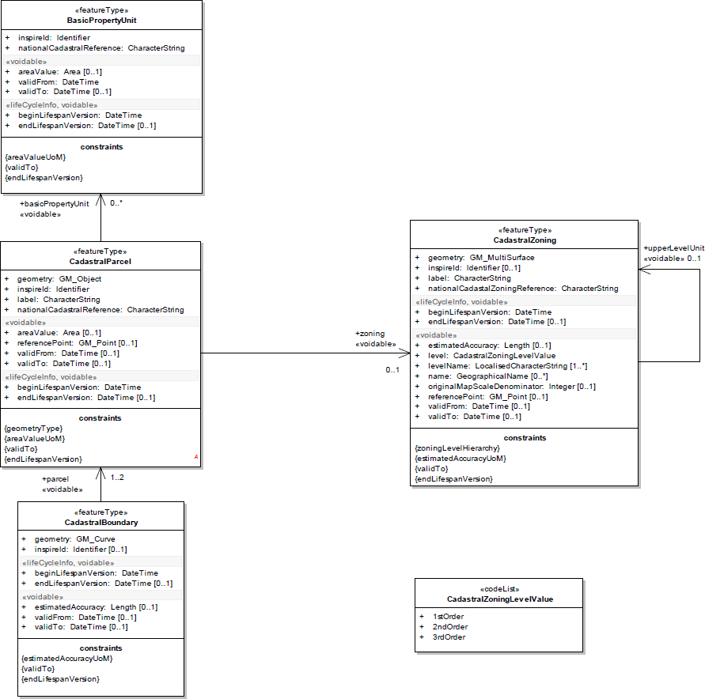
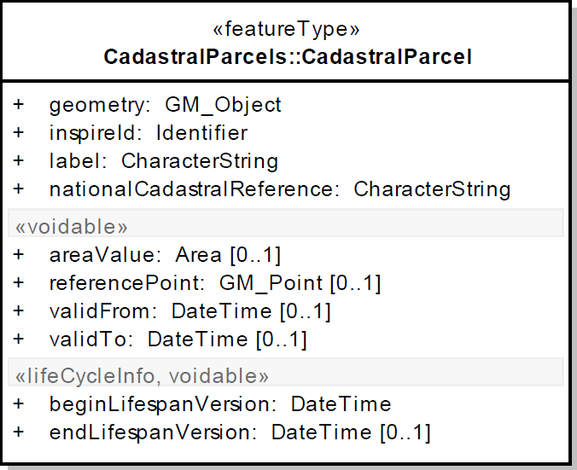
Example: INSPIRE Data Specification on Cadastral Parcels – Technical Guidelines
https://inspire.ec.europa.eu/file/1730/download?token=q3hf9SJJ [2020-01-02]
Notes:
Feature type CadastralZoning (auxiliary):
Cadastral zonings are the intermediary areas (such as municipalities, sections, blocks, …) used in order to divide national territory into cadastral parcels. In the INSPIRE context, cadastral zonings are to be used to carry metadata information and to facilitate portrayal and search of data.
Cadastral zonings have the following additional attributes:
− a geometry
− a national cadastral zoning reference
− a name, if any
− a level in the national cadastral hierarchy and the name of this level
− portrayal attributes : reference point and label
− metadata attributes : original map scale denominator and estimated accuracy
If cadastral zonings are provided, cadastral parcels shall belong to one cadastral zoning of lowest level. When several levels of zonings exist in a Member State, it must be ensured that the higher level units are composed of that of lower level.
Feature type CadastralBoundary (auxiliary):
In the INSPIRE context, cadastral boundaries are to be made available by Member States where absolute positional accuracy information is recorded for the cadastral boundary (attribute estimated accuracy).
Cadastral boundaries have the following additional attributes:
- a geometry
- metadata attribute: estimated accuracy

Slide 23
3. Services
"… are necessary for sharing spatial data between the various levels of public authority in the Community." [DIRECTIVE 2007/2/EC (17)]
Network services: service oriented architecture (SOA)
  Metadata allow the description, discovery, and automatic usage of services
  Services can be combined
  Support by additional services and functionalities (i.e. Authentication, Authorisation, DRM, eCommerce)

Slide 24
Discovery Services:
The Publish-Find-Bind Pattern
Provision of geodata: based on the Publish-Find-Bind principle:
The provider publishes a service in the catalog. Now the service is findable for consumers
The consumer searches in the catalog and receives a search result (find)
Based on the result the consumer can access the service of the provider (bind)
Service Registry/catalogue
2) search
3) find
1) publish
Provider
Client/Consumer
4) Bind
(use, consume)

Slide 25
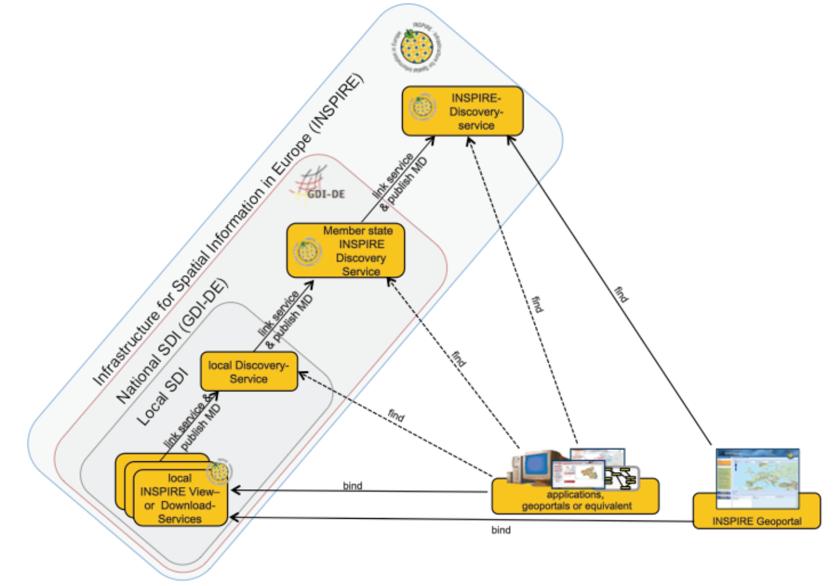
From Local to
EU-wide
PFB Pattern
HARVESTING
Source: Technical Guidance for the implementation of INSPIRE Discovery Services. http://inspire.ec.europa.eu/documents/Network_Services/TechnicalGuidance_DiscoveryServices_v3.1.pdf [2015-08-11]

Slide 26
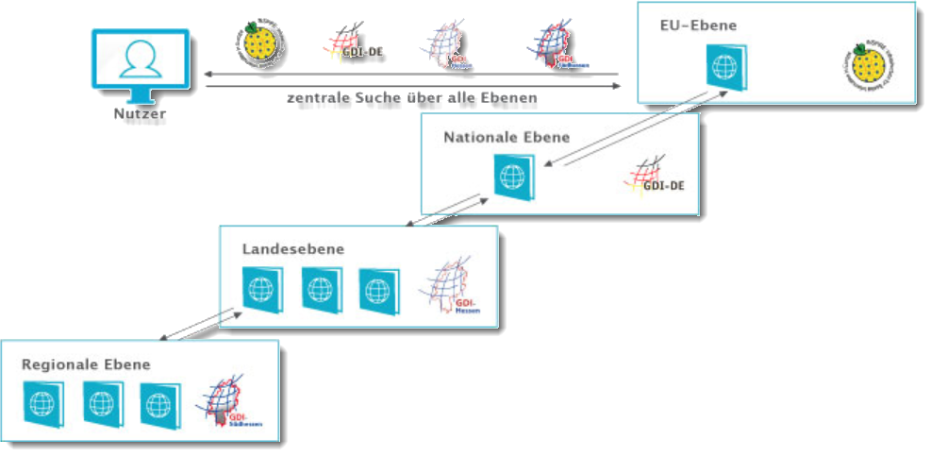
Harvesting von Metadaten
https://www.gdi-infotour.de/voraussetzungen-einer-gdi/harvesting-von-metadaten [2020-02-03]
Notes:
Sollen verteilt vorliegende Metadaten gefunden und dem Nutzer zur Verfügung gestellt werden, muss ein Metadateninformationssystem auf andere Katalogdienste zugreifen können. Die Metadatensätze der externen Kataloge werden dazu regelmäßig eingesammelt. Dieses Vorgehen bezeichnet man als "Harvesting". Dies geschieht über Schnittstelle des OGC Catalogue Service for the Web - CSW.
Nach dieser Methode kann beispielsweise ein europäisches Metadateninformationssystem die Kataloge der Mitgliedsstaaten abfragen. Der deutsche Katalog befragt dann die Kataloge der Bundesländer, und die Landeskataloge wiederum können auf weitere angeschlossene regionale Kataloge zugreifen.

Slide 27
3. Service categories
DT NS
Publish
Find
Bind
GeoRM layers
Discovery Service
View
Service
Download
Service
Transf.
Service
InvokeSD
Service
Modifiied after: INSPIRE Service Architecture, EuroGeographics Network Services Workshop, 5-6 February 2008, graham.vowles@ordnancesurvey.co.uk
Discovery services: search for spatial data sets and services on the basis of the content of corresponding metadata, and display the metadata content;
View services: as a minimum, display, navigate, zoom in/out, pan, or overlay spatial data sets and display legend information and any relevant content of metadata;
Download services: enabling copies of complete spatial data sets, or of parts of such sets, to be downloaded and where practicable, accessed directly;
---> Download predefined data sets (atom) or data objects (WFS)
Transformation services (for SRS and Data Models), enabling spatial data sets to be transformed with a view to achieving interoperability;
Invoke SD services: allowing spatial data services to be invoked.

Slide 28
Dienstkategorien
Im Artikel 11(1) der INSPIRE-Directive [1] werden diese Dienste detaillierter folgendermaßen beschrieben:
Suchdienste: ermöglichen es, auf der Grundlage des Inhalts entsprechender Metadaten nach Geodatensätzen und -diensten zu suchen und den Inhalt der Metadaten anzuzeigen;
Darstellungsdienste: ermöglichen es zumindest, darstellbare Geodatensätze anzuzeigen, in ihnen zu navigieren, sie zu vergrößern/verkleinern, zu verschieben, Daten zu überlagern sowie Informationen aus Legenden und sonstige relevante Inhalte von Metadaten anzuzeigen;
Download-Dienste: ermöglichen das Herunterladen von und, wenn durchführbar, den direkten Zugriff auf Kopien vollständiger Geodatensätze oder Teile solcher Sätze;
Transformationsdienste: zur Umwandlung von Geodatensätzen, um Interoperabilität zu erreichen;[2]
Dienste zum Abrufen von Geodatendiensten.
[1] http://eur-lex.europa.eu/legal-content/DE/TXT/PDF/?uri=CELEX:32007L0002&from=EN
[2] Ein Beispiel dazu: https://geodaesie.info/zfv/heftbeitrag/3170

Slide 29
INSPIRE Network Services Architecture
Provides more detail than the INSPIRE Technical Architecture – Overview document
Follows Services Oriented Architecture principles
Provides the Architecture within which all INSPIRE Services will be implemented – ie the context for INSPIRE Network Services Implementing Rules
Appl.
Layer
Applications and Geoportals
Service Bus
Source (modified): INSPIRE Service Architecture, EuroGeographics Network Services Workshop, 5-6 February 2008, graham.vowles@ordnancesurvey.co.uk
Service
Layer
Rights Management Layers
Registry Service
Discovery Service
View
Service
Download
Service
Transf.
Service
InvokeSD
Service
Data
Layer
Registers
Service
Metadata
Data Set
Metadata
Spatial Data Sets
Thematic DS

Slide 30
Discovery services: Search criteria
The discovery services … must accept queries based at a minimum on the following combination of search criteria
[Art. 11(2) of the INSPIRE Directive]
keywords;
classification of spatial data and services;
the quality and validity of spatial data sets;
degree of conformity with the implementing rules provided for in Article 7(1);
geographical location;
conditions applying to the access to and use of spatial data sets and services;
the public authorities responsible for the establishment, management, maintenance and distribution of spatial data sets and services.
Beispiel: https://gdk.gdi-de.org/gdi-de/srv/ger/catalog.search#/metadata/9f7be6ac-bc6d-4239-9546-d7a23c2246a7

Slide 31
Download Services
Two kinds of Download-Services:
Pre-defined Dataset Download (mandatory): Download of pre-defined datasets – a more conventional way of data provision, however supported by metadata. The following operations are required:
  Get Download Service Metadata: provision of service metadata
  Get Spatial Data Set: Download of the offered dataset
  Describe Spatial Data Set: Download of descrption of the datasets offered by this service
  Link Download Service
Direct Access Download (additional optional Operations): Download of specific data based on user defined filters.

Slide 32
Mapping INSPIRE to OGC Services
INSPIRE Service | Equivalent OGC Services
View | WMS, WMTS, WTS
Discovery | CSW, SWE
Download | ~ WFS and extensions, WCS, SOS
Transformation | ~ Coordinate Transformation Service or Coordinate Transformation as WPS Profile^{[1]} + Schema Translation^{[2]}
Invoke SD Service | ~WPS
After: INSPIRE Service Architecture, EuroGeographics Network Services Workshop, 5-6 February 2008, graham.vowles@ordnancesurvey.co.uk
[1] https://inspire.ec.europa.eu/documents/Network_Services/INSPIRE_Draft_Technical_Guidance_Coordinate_Transformation_Services_(version_2%201).pdf
[2] https://inspire.ec.europa.eu/document-tags/schema-transformation-services

Slide 33
Übung: Download Service „Unfalldaten“ https://www.geoportal.nrw/suche?lang=de&searchTerm=5d7cb58c-c4f4-4998-a7fd-2cb3abb0e512 https://www.opengeodata.nrw.de/produkte/transport_verkehr/unfallatlas/
Herunterladen, in QGIS anzeigen ;-)

Slide 34
Specific requirements partially extending / narrowing OGC‘s standards
Integration of INSPIRE Service Metadata in the Capabilities documents?
Fulfilment of quality of service (QoS) requirements: Capacity > 30 request/s, Availability: maximum unplanned downtime of 363 days per year (Service Availability is vital for SDIs!)
Support of spatial reference systems EPSG:4326 and EPSG:4258 (ETRS89) (at least) including Bounding Box elements for the data layers?
Support of cartographic projections: Lambert-Conformal-Conic (EPSG:4839) and for scales >1:500.000 Universal Transverse Mercator (UTM)
Coupling of Services, data and metadata (LayerTags <Identifier> and <MetadataURL>)
Cartographic legends for each style
Multi-language support, i.e. in the Capabilities document (LANGUAGE Parameter extension)
OGC compliant products
INSPIRE
compliant products

Slide 35
4. Agreements on sharing, access and use
Member States shall adopt measures for the sharing of spatial data sets and services between public authorities.
In addition those measures shall enable the relevant users, public and private, to gain access to spatial data sets and services, and to exchange and use those sets and services.
Jes Ryttersgaard: Overview of INSPIRE. https://www.fig.net/resources/proceedings/fig_proceedings/cairo/papers/ts_42/ts42_02_ryttersgaard.pdf [2015-08-11]

Slide 36

Geo Right Management (GeoRM)
Application and Geoportals
Service Bus
GeoRM Layers
GeoRM
Services
Identity
Price & Order
License
Registry Service
Discovery Service
View
Service
Download
Service
Transf.
Service
InvokeSD
Service
GeoRM
Data
Source: Graham Vowles (2008): INSPIRE Service Architecture. EuroGeographics Network Services Workshop, 5-6 February 2008

Slide 37
5. Monitoring & Reporting
Monitoring =ongoing process with yearly status report to the European Commission
status report comprises the list of the INSPIRE-related geodata sets and services and indicators to measure the degree of INSPIRE implementation, i. e., conformity of metadata, geodata and web services
In Germany: The required informations are requested by the contact offices of the federal government and the German states from the custodians . The informations are forwarded to the official GDI-DE (SDI Germany) contact institution. The results are published and forwarded to the EU.
Quelle: Martin Seiler (2015): Umsetzung der INSPIRE-Richtlinie aus Sicht der Koordinierungsstelle der GDI-DE. http://www.geoportal.de/SharedDocs/Downloads/DE/GDI-DE/Vortraege/2015/150430_DVGW_Umsetzung_INSPIRE_Versorgungsunternehmen_Seiler.pdf?__blob=publicationFile [2016-11-26]
Notes:
kontinuierlicher Prozess mit jährlicher Statusmeldung an Europäische Kommission
betroffenen Geodatensätze und Dienste sowie verschiedene Indikatoren zur Messung des Umsetzungsgrades von INSPIRE, z.B. Aussagen zur Konformität von Metadaten, Geodaten und Netzdiensten zu den jeweiligen Verordnungen, Anzahl der Geodatensätze, die für die Umweltberichterstattung
Die benötigten Informationen werden von den Kontaktstellen bei Bund und Ländern bei den geodatenhaltenden Stellen abgefragt und an die Kst. GDI-DE weitergegeben. Die Kst. GDI-DE veröffentlicht und übermittelt die Ergebnisse an die EU.
Das INSPIRE-Monitoring erfolgt vollständig automatisiert auf Metadatenbasis. Grundlage bilden die verfügbaren Metadaten im Metadatenkatalog des Mitgliedstaates (hier: Metada-tenkatalog der GDI-DE) (https://www.geoportal-bw.de/documents/20147/0/Handlungsempfehlungen_GDI-BW_Monitoring_2021_0_211018.pdf/379ccdd5-4229-df92-4e41-75bb86b9456e?t=1634638940843)

Slide 38
Monitoring
Indicators can be calculated to evaluate
Existence of metadata for spatial data sets and services
Conformity of metadata for spatial data sets and services with the implementing rules on metadata
Geographical coverage of spatial data sets
Conformity of spatial data sets with the data specifications and of their metadata with the implementing rules on metadata
Accessibility of metadata for spatial data sets and services through discovery services
Accessibility of spatial data sets through view and download services
Use of network services
Conformity of network services to the implementing rules on network services
http://inspire.ec.europa.eu/index.cfm/pageid/5022 and Monitoring and Reporting Drafting Team
Monitoring Indicators – Guidelines Document, http://inspire.ec.europa.eu/documents/Monitoring_and_Reporting/INSPIRE_MR_Guidelines_Reporting_2011-01-18_v%205.0.pdf

Slide 39
INSPIRE Monitoring and Reporting
INSPIRE Directive: requires Member States to monitor the implementation and use of their infrastructures for spatial information (yearly) and to report on the implementation of the Directive back to the Commission (every 3 years).
quantitative approach: list of spatial datasets and services
  Existence of metadata for spatial data sets and services
  Conformity of metadata for spatial data sets and services with the implementing rules on metadata
  Geographical coverage of spatial data sets
  Conformity of spatial data sets with the data specifications and of their metadata with the implementing rules on metadata
  Accessibility of metadata for spatial data sets and services through discovery services
  Accessibility of spatial data sets through view and download services
  Use of network services
  Conformity of network services to the implementing rules on network services
http://www.environ.ie/en/Publications/DevelopmentandHousing/Planning/FileDownLoad,27309,en.pdf
http://inspire.ec.europa.eu/index.cfm/pageid/5022 and Monitoring and Reporting Drafting Team
Monitoring Indicators – Guidelines Document, http://inspire.ec.europa.eu/documents/Monitoring_and_Reporting/INSPIRE_MR_Guidelines_Reporting_2011-01-18_v%205.0.pdf

Slide 40
Evaluation

Slide 41
Übung:
Percentage of high availability services http://servicemap.spatineo.com/

Slide 42
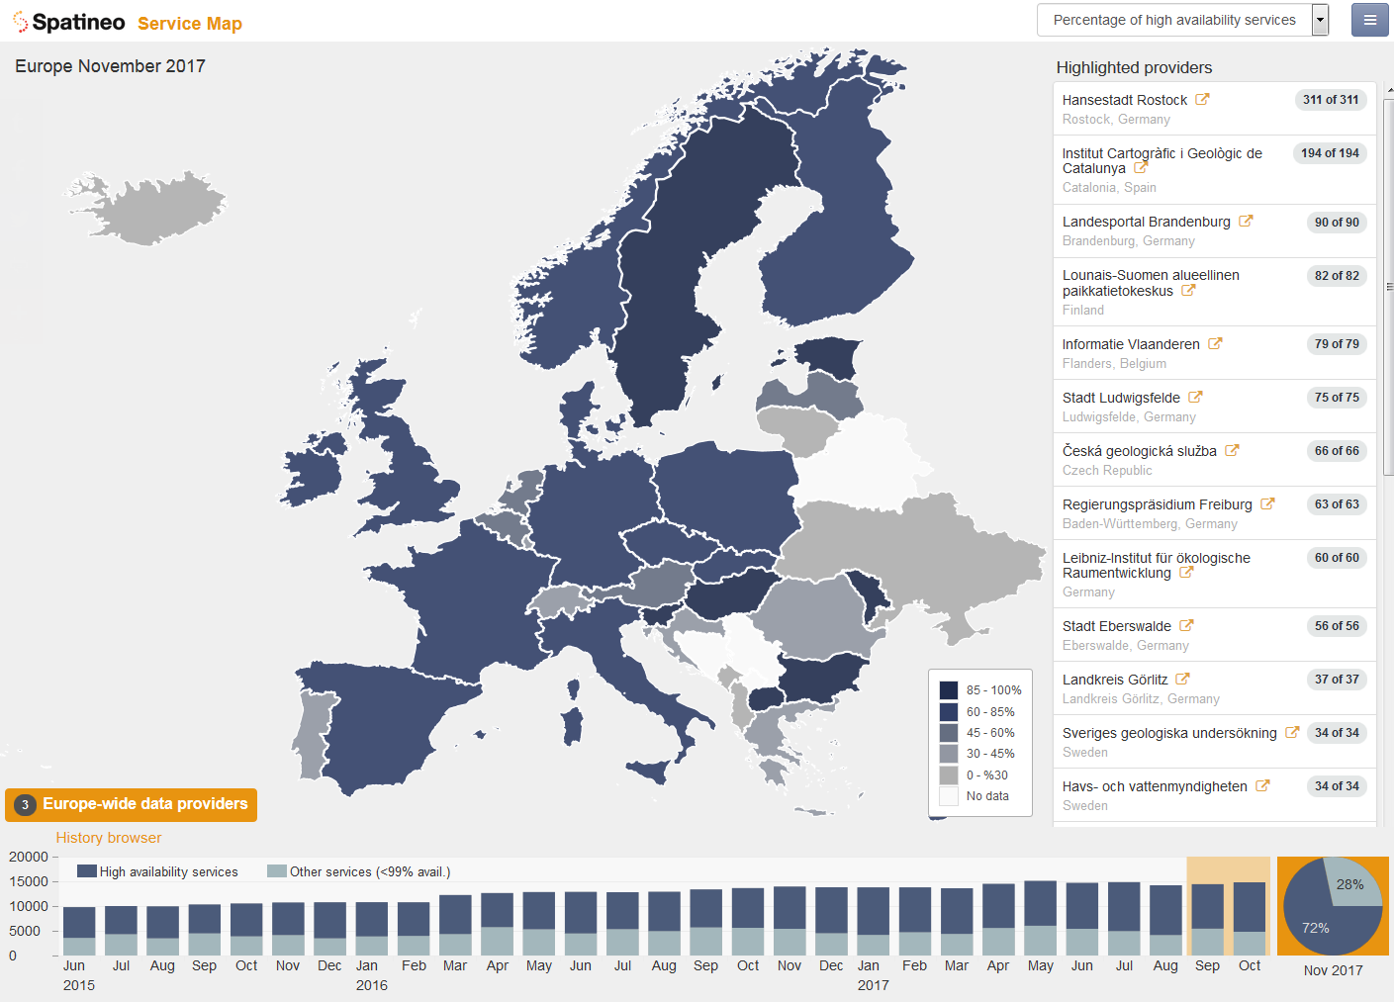
Percentage of high availability services
http://servicemap.spatineo.com/
Notes:
The high level SDI status data shown on the map immediately reveals that there is healthy growth in this sector. The quantity of spatial web services has continued to grow steadily over the past two years and the number of compliant services available is very promising.

Slide 43
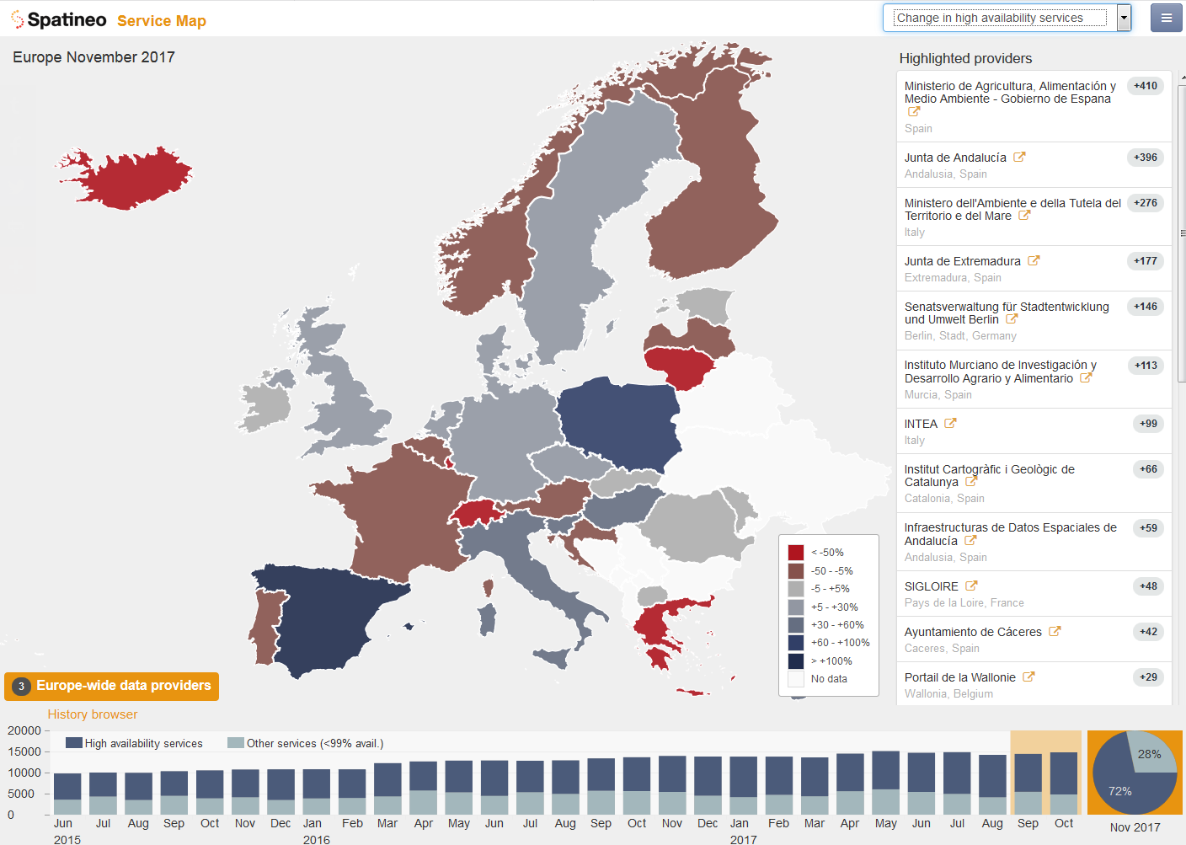
Change in total number of services
http://servicemap.spatineo.com/
Notes:
The high level SDI status data shown on the map immediately reveals that there is healthy growth in this sector. The quantity of spatial web services has continued to grow steadily over the past two years and the number of compliant services available is very promising.

Slide 44
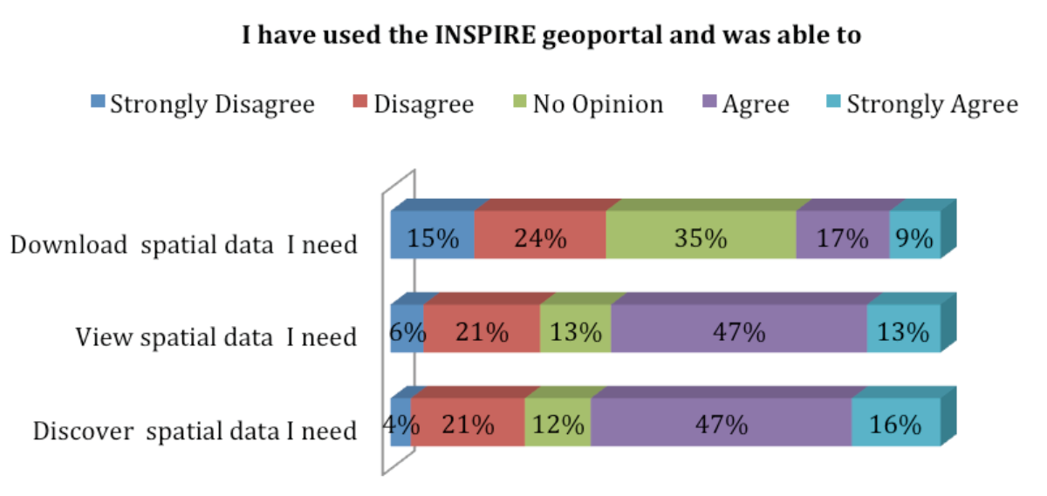
User experience in general:
Feedback on the successful use of the INSPIRE geoportal
Source: Mid-term Evaluation Report on INSPIRE Implementation (Technical report No 17/2014 ), http://www.geodaten.niedersachsen.de/download/96290/Einzelergebnis_INSPIRE_Public_Consultation_2014_7-Jahres_Online-Konsultation_.pdf [2015-08-16]

Slide 45
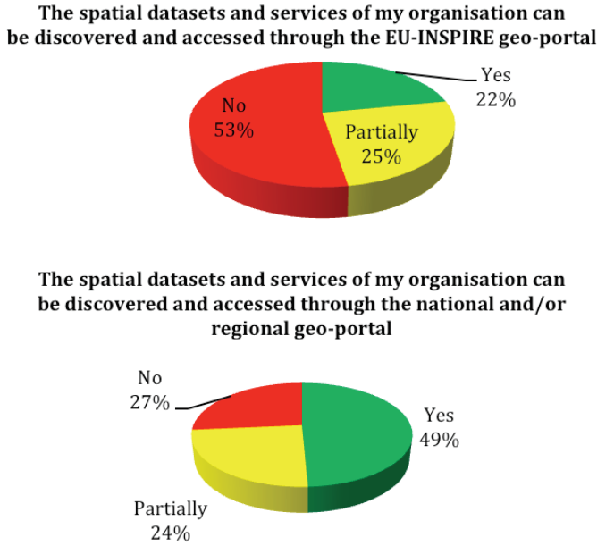
Discoverability and Accessibility of Spatial Datasets in EU Geoportal and National Geoportals
Source: Mid-term Evaluation Report on INSPIRE Implementation (Technical report No 17/2014 ), http://www.geodaten.niedersachsen.de/download/96290/Einzelergebnis_INSPIRE_Public_Consultation_2014_7-Jahres_Online-Konsultation_.pdf [2015-08-16]

Slide 46
Main obstacles to INSPIRE implementation from 2014 INSPIRE Public Consultation
Source: after Mid-term Evaluation Report on INSPIRE Implementation (Technical report No 17/2014 ), http://www.geodaten.niedersachsen.de/download/96290/Einzelergebnis_INSPIRE_Public_Consultation_2014_7-Jahres_Online-Konsultation_.pdf [2015-08-16]

Slide 47
The current level of accessibility of INSPIRE data sets through view and download services is low. One of the reasons are problems with implementing the data-service linking approach currently described in the TGs for metadata and network services, which is considered complicated and partly ambiguous, even by implementation/standards experts.
Many organisations are therefore facing difficulties to provide implementations in line with these requirements, which in turn has reflects negatively on the overall usability of the INSPIRE infrastructure, as shown by the low values (on average) of the Monitoring indicators about the data set accessibility.
https://github.com/INSPIRE-MIF/gp-data-service-linking-simplification

Slide 48
Weitere Entwicklungen

Slide 49
Die Zukunft von INSPIRE
Die Europäische Geodateninfrastruktur ist da, die GDI-DE, die
GDI-BW und die kommunalen GDIen sind Teil davon.
Die Ausrichtung von INSPIRE am European Green Deal & der
Europäischen Datenstrategie steht vor der Tür, denn Interoperabilität & Zugriff auf Geodäten sind für die Gestaltung der digitalen Zukunft Europas essentiell.
„Um tatsächlich die Probleme zu lösen gibt es noch viel zu tun, muss INSPIRE vom Proof-Of-Concept zu einem Game-Changer werden!“ [1]
„Die Richtlinienumsetzung hinkte einige Jahren aus verschiedenen Gründen jedoch den Erwartungen hinterher und musste durch verschiedene Aktionen belebt werden.“ [2]
[1] Aktuelle Entwicklungen in der europäischen Geodateninfrastruktur (INSPIRE). 28. Sitzung des Begleitausschusses Geodateninfrastruktur Baden-Württemberg (GDI-BW), 9. Dezember 2020
[2]: Markus Meinert (2020): INSPIRE – Aufbruch zu neuen Horizonten? zfv 6/2020
Notes:
Entwicklungen bei INSPIRE
28. Sitzung BAGDI-BW 9.12.2020
G DI-BW
BjJcii - .JJ Wiirt-ft-nhf-rfl
Die Zukunft von INSPIRE
Die Europäische Geodateninfrastruktur ist da, die GDI-DE, die
GDI-BW und die kommunalen GDIen sind Teil davon.
Die Ausrichtung von INSPIRE am European Green Deal & der
Europäischen Datenstrategie steht vor der Tür, denn
Interoperabilität & Zugriff auf Geodäten sind für die Gestaltung
der digitalen Zukunft Europas essentiell.
Um tatsächlich die Probleme zu lösen gibt es noch viel zu tun, muss INSPIRE vom Proof-Ot-Concept zu einem Game-Changer werden!
Mitt f»
Baden-Württemberg

Slide 50
INSPIRE und Europäischer Green Deal
Mit dem Europäischen Grünen Deal verlangt die Europäische Kommission, »dass Investoren, Versicherungsunternehmen, Städte sowie Bürgerinnen und Bürger in der gesamten EU Zugang zu Daten haben«, um diese u. a. in ihr Risikomanagement im Kontext des Klimawandels einbeziehen zu können.
Zugängliche und interoperable Daten werden als Mittelpunkt datengesteuerter Investitionen betrachtet, da diese in Verbindung mit digitalen Infrastrukturen und Lösungen für künstliche Intelligenz faktengestützte Entscheidungen erleichtern und die Fähigkeiten stärken, ökologische Herausforderungen zu verstehen und zu bewältigen.
Darüber hinaus benennt der Grüne Deal ein präzises digitales Modell der Erde als Ziel und hebt die Möglichkeiten der Fernüberwachung der Luft- und Wasserverschmutzung oder der Optimierung der Nutzung von Energie und natürlichen Ressourcen hervor, wie sie sich durch die Digitalisierung erstmals erschließen.
GreenData4All
Zum Weiterlesen: https://inspire.ec.europa.eu/conference2021/presentations
Markus Meinert (2020): INSPIRE – Aufbruch zu neuen Horizonten? zfv 6/2020

Slide 51
Übung: https://www.nid.bayern.de/grundwasser

Slide 52
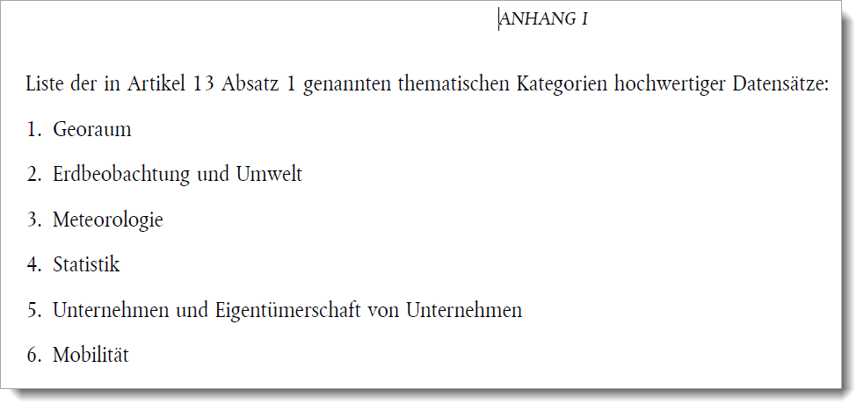
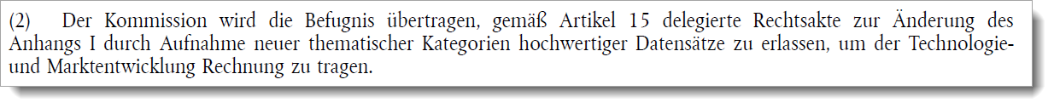
INSPIRE und die High value datasets
Sechs thematischen Kategorien gemäß PSI-Richtlinie (EU) 2019/1024 vom 20. Juni 2019 (Anhang) („über offene Daten und die Weiterverwendung von Informationen des öffentlichen Sektors“):
!

Slide 53
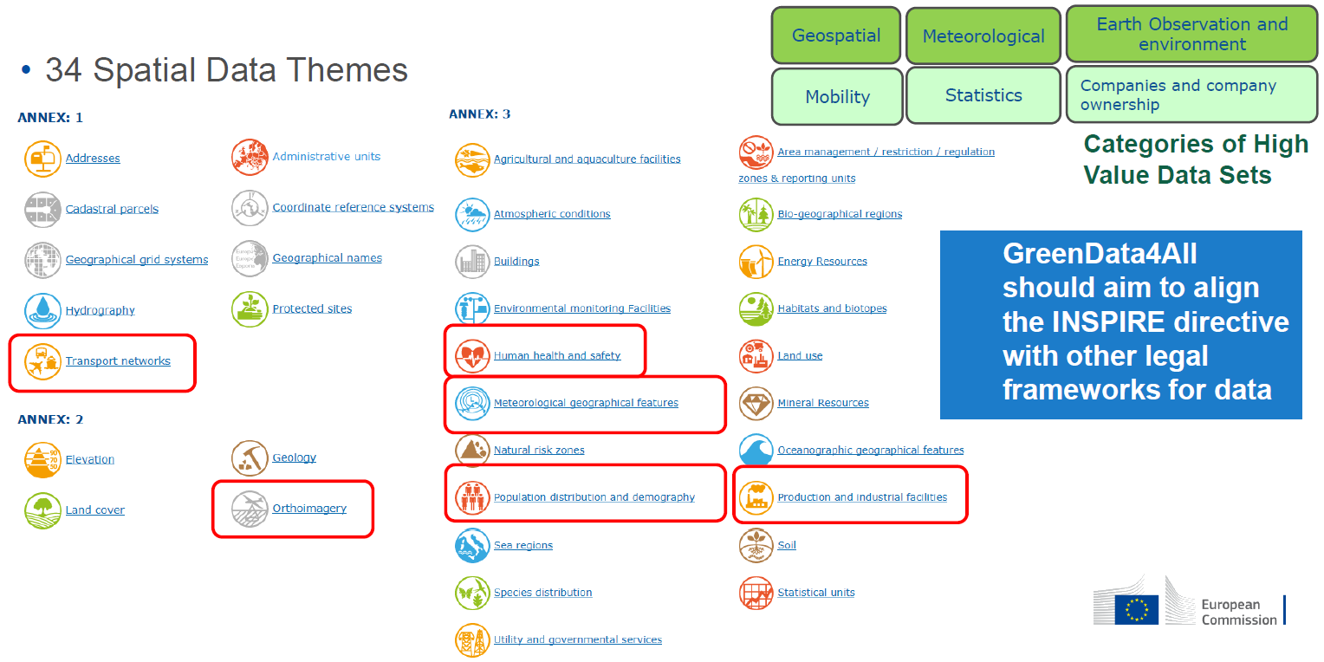
https://inspire.ec.europa.eu/sites/default/files/inspire2020_greendataspace_green_deal_data_space.pdf
Siehe auch: https://webgate.ec.europa.eu/fpfis/wikis/download/attachments/299729499/INSPIRE-PDS-proposal-update-V2.1-20200206.xlsx?version=1&modificationDate=1580922917376&api=v2

Slide 54
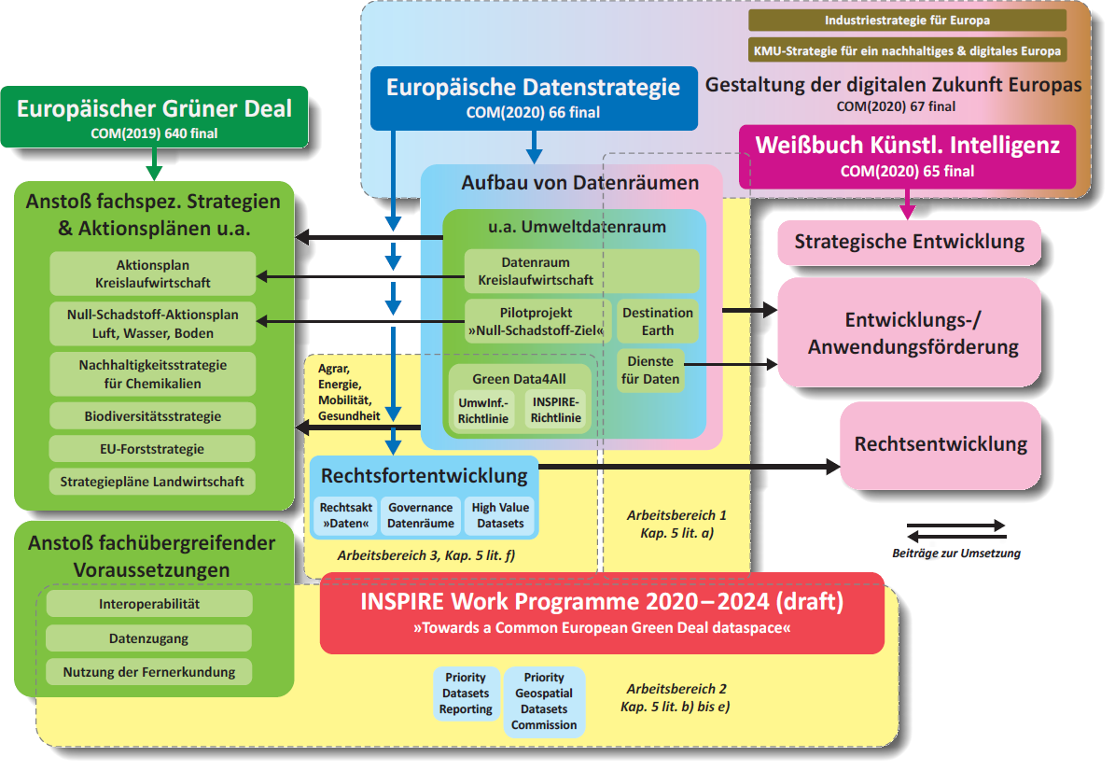

Slide 55
Summary
INSPIRE Directive – defines the requirements
INSPIRE Technical Architecture – defines the high-level architecture
INSPIRE Network Services Architecture – defines the architecture for the INSPIRE Network Services Implementing Rules
INSPIRE Network Services Implementation Rules (IR) – define how Member States implement each of the INSPIRE service types.
INSPIRE service types: Own terminology
Focus on interoperability and sharing.
Towards Green Data for All

Slide 56
Thank you!
Danke für Ihre Aufmerksamkeit!

