Slide 1

The European INSPIRE Directive: Its Approach and Lessons to Learn
Prof. Dr. Franz-Josef Behr
Stuttgart University of Applied Science
ICA Commission on SDI and Standards
International Conference on Remote Sensing, GIS and Climate Change (RSGCC–2023), University of the Punjab, Quaid-i-Azam Campus, Lahore
Some contents are licensed based on Creative Commons-License CC BY-NC-SA.

Slide 2
Outline
Introduction: The challenges of transboundary environmental data needs
INSPIRE: Overview and time frame, principles
Implementing Rules
  Metadata
  Data Themes and their Specifications
  Network based Services
  Data and Service Sharing (regulations)
  Monitoring and Reporting
Findings and recommendations

Slide 3
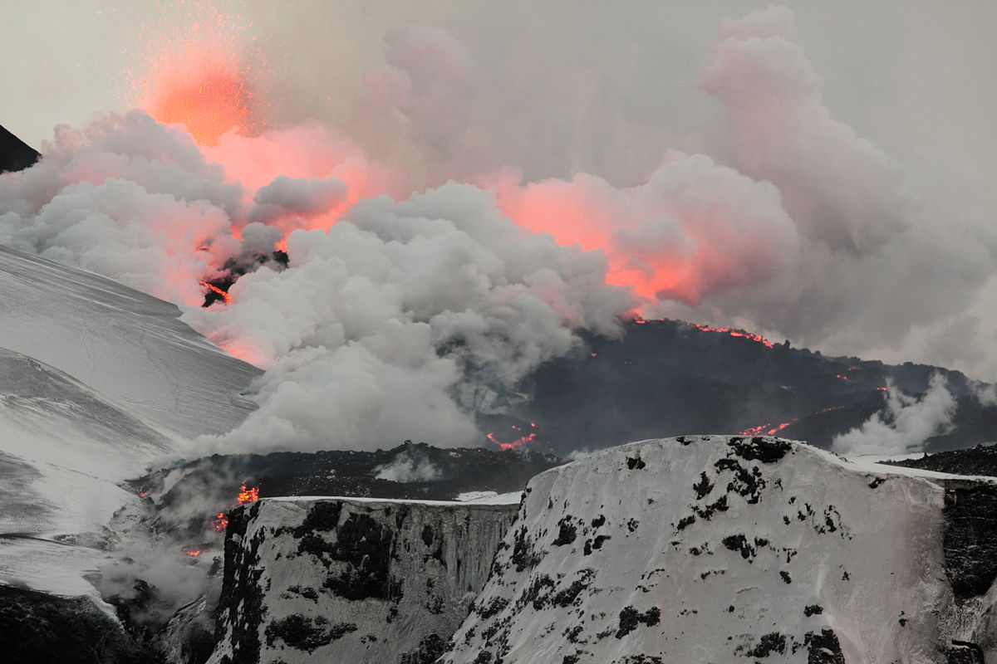
Eyjafjallajökull Eruption 2010
„Fimmvorduhals second fissure 2010 04 02“ von Boaworm - Eigenes Werk. Lizenziert unter CC BY 3.0 über Wikimedia Commons - https://commons.wikimedia.org/wiki/File:Fimmvorduhals_second_fissure_2010_04_02.JPG#/media/File:Fimmvorduhals_second_fissure_2010_04_02.JPG
Notes:
Between March and June 2010 a series of volcanic events at Eyjafjallajökull in Iceland caused enormous disruption to air travel across Western Europe.
The ash cloud that led to the closure of most of the European airports. Consequently, a very high proportion of flights within, to, and from Europe were cancelled, creating the highest level of air travel disruption since the Second World War.

Slide 4
Rationale
20% of the EU citizens (115 million) live within 50 km from a border.
70% of all fresh water bodies in Europe are part of a trans-boundary river basin.
But: Environmental phenomena (polutions and disasters) do not stop at national borders!
Vlado Cetl: INSPIRE principles, components and implementation. http://www.inspire.gv.at/dms/inspire/dateien/INSPIRE-Training-2014--Aalborg-DK/
Goals regarding the environment:
  Support high level of protection of the environment across national borders
  Enhance sensitivity of the citizens regarding environmental information and policy making/decisions
  +
Added economic value --> promotion of the (geospatial) business
Notes:
A European Spatial Data Infrastructure (ESDI) is about making it easier to find, use and share the available data from administrations and governments, in particular across border and throughout the whole of the European Union.

Slide 5
However
The challenges regarding the lack of availability, quality, organisation, accessibility, and sharing of spatial information are common to a large number of policies and activities and are experienced across the various levels of public authority in Europe.
https://inspire.ec.europa.eu/file/1730/download?token=q3hf9SJJ [2023-03-06]

Slide 6
2004 Impact Assessment: obstacles justifying trams-border action
difficulties of access to information - insufficient metadata at all levels;
different projections and scales, making existing information difficult to integrate;
unclear status of the information as to its currency;
prohibitive cost of geographical data;
lack of interoperability between data sets, and among web-enabled services;
lack of harmonisation in the data models and codes used to represent the objects described;
varying data quality from one country to another within the same layer of geographical information;
lack of long-term solutions - instead: supply of snapshots, absence of information on changes -: information became quickly outdated, followed by duplication of data collection efforts.
https://ec.europa.eu/smart-regulation/impact/ia_carried_out/docs/ia_2004/sec_2004_0980_en.pdf
https://eur-lex.europa.eu/procedure/EN/2004_175

Slide 7
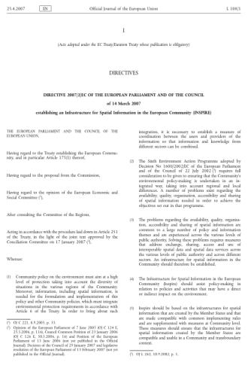
INSPIRE Directive (2007)
http://eur-lex.europa.eu/legal-content/EN/TXT/PDF/?uri=CELEX:32007L0002&from=EN
https://eur-lex.europa.eu/legal-content/DE/TXT/HTML/?uri=CELEX:02007L0002-20190626&qid=1642582408199&from=DE
Notes:
Vlado Cetl: INSPIRE principles, components and implementation. http://www.inspire.gv.at/dms/inspire/dateien/INSPIRE-Training-2014--Aalborg-DK/INSPIRE-Training-2014---Teil-2---principles--components-and-implementation/INSPIRE%20Training%202014%20-%20Teil%202%20-%20principles,%20components%20and%20implementation.ppt
Environmental phenomena (and disasters) do not stop at national borders!
20% of the EU citizens (115 million) live within 50 km from a border.
70% of all fresh water bodies in Europe are part of a trans-boundary river basin.

Slide 8
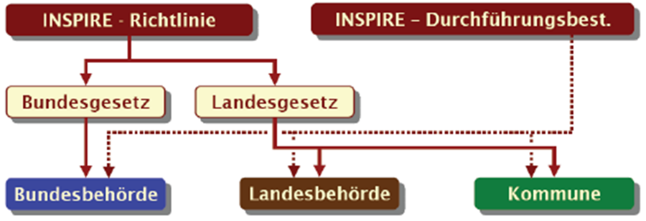
INSPIRE (Infrastructure for Spatial Information in Europe)
Short term for Directive 2007/2/EG of the European Parliament to set up a SDI for the EU
Purpose: To ease the transboundary use of environment related geospatial data in Europe
Set into force 15. Mai 2007, had to be transposed into national legislative systems by 15 May 2009.
Spatial data: held by or on behalf of a public authority (down to the lowest level of government) when laws or regulations require their collection or dissemination
Does not require collection of new data
http://www.imagi.de/themen/navl_inspire.html
Elmar Schröder (2010): INSPIRE@owl -
Synergieeffekte regional nutzen
Notes:
INSPIRE-Richtlinie: bildet rechtliche, organisatorische und technische Grundlage für eine gesamteuropäische Geodateninfrastruktur und wird als wesentliche Grundlage bei der Einrichtung von geodatenhaltenden Stellen im öffentlichen Bereich (wie GDIs) berücksichtigt.
INSPIRE has translated these principles into legislation.

Slide 9
Basic documents
Directive 2007/2/EC of the European Parliament and of the Council of 14 March 2007 establishing an Infrastructure for Spatial Information in the European Community (INSPIRE) 14.03.2007
INSPIRE is built on the SDIs established and operated by the Member States + European INSPIRE portal (JRC)
http://eur-lex.europa.eu/legal-content/EN/TXT/PDF/?uri=CELEX:32007L0002&from=EN

Slide 10
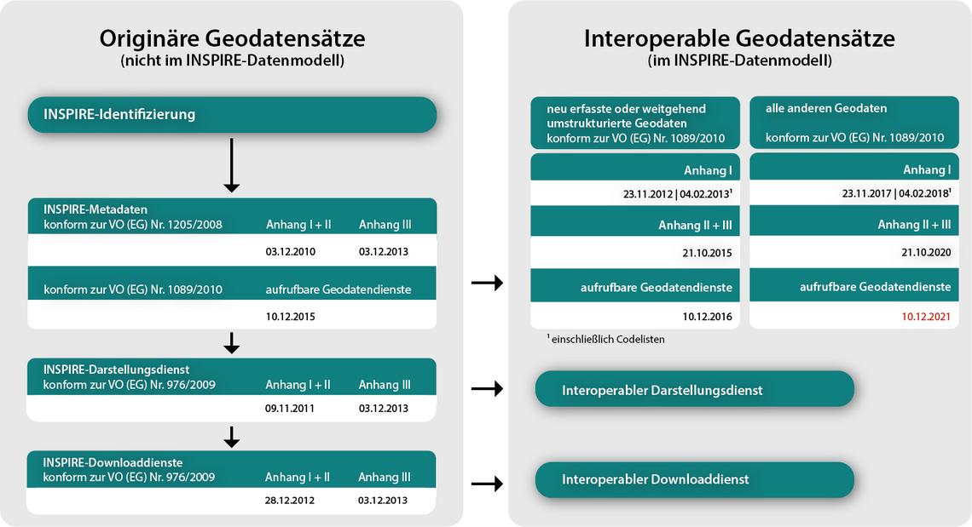
Schedule
https://www.gdi-de.org/INSPIRE/Zeitplan [2021-10-20]
Notes:
Basically we can distinguish between rules for existig data sets and, later on, for interoperable, homogenized datasets (on the right side).

Slide 11
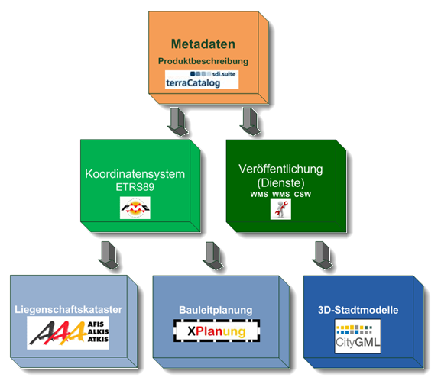
Main long-term steps for INSPIRE
Step 1: Preparation of Metadata
Step 2: Conversion to uniform spatal reference systems, introduction of services
Step 3: Introduction if new standards for cadastre, civil engineering, 3D models…
Elmar Schröder (2010): INSPIRE@owl -
Synergieeffekte regional nutzen

Slide 12
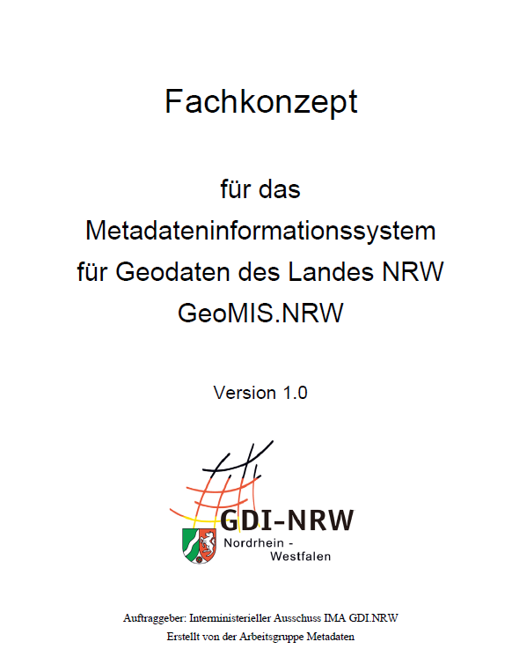
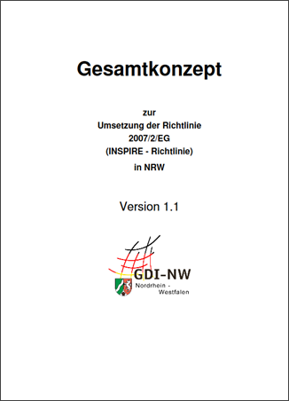
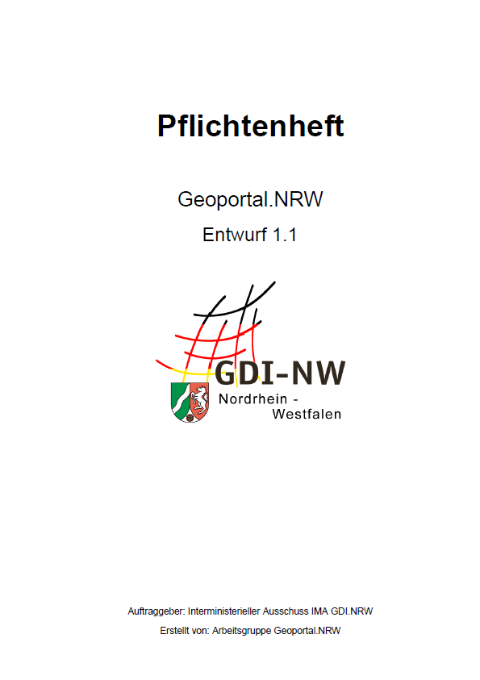
Transposition into national legislative systems
https://www.geoportal.nrw/sites/default/files/2012-02-06_Gesamtkonzept-INSPIRE-NRW_V_1_1.pdf [2020-01-02]

Slide 13
Grundprinzipien
Effizienz: Geodaten sollen nur einmal erfasst und nur dort gepflegt werden, wo dies am effektivsten erfolgen kann.
Interoperabilität: Es soll möglich sein, Geodaten aus verschiedenen Quellen über ganz Europa nahtlos zu kombinieren und sie vielen Nutzern und Anwendungen zur Verfügung zu stellen.
Vertikale Interoperabilität: Es sollen Geodaten, die von einem bestimmten Ressort oder Ebene oder Verwaltungsebene erfasst worden sind, allen anderen Ressorts und Verwaltungsebenen zur Verfügung gestellt werden.
Freie Verfügbarkeit: Geodaten, die für ein effektives Verwaltungshandeln erforderlich sind, sollten für Konditionen verfügbar sein, die eine breite Verfügbarkeit und Anwendung nicht behindern dürfen.
Zugänglichkeit: Es soll die Suche nach Geodaten einfach möglich sein, um die Brauchbarkeit für bestimmte Anwendungen überprüfen zu können. Außerdem soll für den Anwender erkennbar sein, welche Bedingungen an eine Nutzung geknüpft sind.
Concerning 34 geodata themes
Nach:
https://www.geoportal.nrw/sites/default/files/Masterarbeit_Weichand.pdf http://inspire.ec.europa.eu/index.cfm/pageid/48

Slide 14
Common principles
Efficiency: Data should be collected only once and kept where it can be maintained most effectively.
Ability of combination and sharing: It should be possible to combine seamless spatial information from different sources across Europe and share it with many users and applications.
Scale independency: It should be possible for information collected at one level/scale to be shared with all levels/scales; detailed for thorough investigations, general for strategic purposes.
Transparency: Geographic information needed for good governance at all levels should be readily and transparently available.
Accessibility: Easy to find what geographic information is available, how it can be used to meet a particular need, and under which conditions it can be acquired and used.
Concerning 34 geodata themes
After: http://inspire.ec.europa.eu/index.cfm/pageid/48
Notes:
The idea is to develop an approach which follows a number of common principles:

Slide 15
Steps
identify INSPIRE-relevant geodata ('any data with a direct or indirect reference to a specific location or geographical area‘)
capture metadata describing the spatial data4 and establish standardised access to the metadata via an INSPIRE-compliant discovery service.
establishing standardized access to the spatial data via an INSPIRE-compliant presentation service.
establishing standardised access to the geodata via an INSPIRE-compliant download service
harmonisation of spatial data and interoperable provision via the services mentioned under 3. and 4.
in order to protect public interests, access to safety-critical geodata may be restricted so that neither metadata nor geodata are accessible to the general public. Access shall be restricted to authorised persons or public authorities.

Slide 16
INSPIRE: ein Rahmenwerk von Richtlinien
Durchführungsbestimmungen (Implementing Rules, IR): rechtlich verbindend
  Metadaten
  Datenthemen
  Netzwerkbasierte Dienste (Suche, Anzeige, Download, Transformation, Aufruf und Kombination von Diensten)
  Vereinbarungen zur Bereitstellung von Daten und Diensten
  Monitoring und Reporting
Ziel: Bereitstellung und Sicherstellung der Interoperabilität von
    1) Geodaten und
    2) Diensten
Details in Technical Guidelines (TG)
Detailfolien
Notes:
Erzeugung und regelmäßige Aktualisierung von Metainformationen zu den Geodaten und Geodiensten;
Bereitstellung von Geodiensten, u. a.
zur Recherche mittels Metainformationen (Suchdienste),
zur Anzeige von Geodaten (Darstellungsdienste),
zum Herunterladen von Geodaten (Download-Dienste) und
zum Umwandeln von Geodaten zwecks Interoperabilität (Transformations- Dienste)

Slide 17
INSPIRE is a Framework Directive
The directive itself
Implementing Rules (IR): legal acts for
  Metadata
  Data Themes and their Specifications
  Network based Services (discovery, view, download, transform, invoke)
  Regulations regarding data and Service Sharing
  Monitoring and Reporting
To achieve and to assure interoperability of
    1) spatial data sets and
    2) Services
Supported/Detailed by Technical Guidelines (TG): Impleentation requirements and technical recommendations
details below

Slide 18
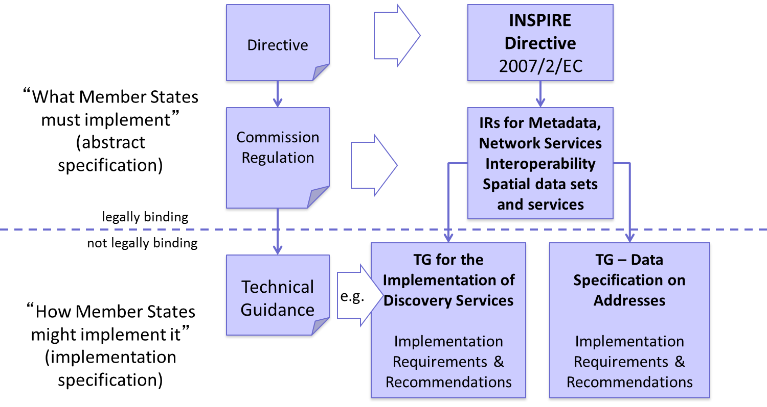
Implementation Rules (IR) vs Technical Guidelines (TG)
http://www.inspire.gv.at/dms/inspire/dateien/INSPIRE-Training-2014--Aalborg-DK/INSPIRE-Training-2014---Teil-2---principles--components-and-implementation/INSPIRE%20Training%202014%20-%20Teil%202%20-%20principles,%20components%20and%20implementation.ppt

Slide 19

1. Metadata
Metadata
Data Themes and their Specifications
Network based Services
Data and Service Sharing (regulations)
Monitoring and Reporting
metadata for spatial data (ISO 19115)
  For discovery, evaluation and use
  keywords
  simple search criteria about key characteristics about the data set
  Spatial and temporal extent
  Must be kept consistent with the actual resource
and
metadata for services (ISO 19119)
  enables the discovery of spatial data services.
  service type
  operations parameters
  geographic information
https://www.geoportal.nrw/sites/default/files/2020-12-04_GDI-ForumNRW1240Schlegel-INSPIREtheLastMile.pdf
DT NS
Discovery Service
DT MD
Service
Metadata
Data Set
Metadata
Die Metadaten zu den Daten sind durch ISO 19115 spezifiziert, die für die Dienste durch ISO 19119. 19139 beschreibt die xml-Struktur des ISO 19115. Das OGC Appllication profile for csw beinhaltet ein erweitertes ISO 19139 Schema für Daten und Dienste und wird auch bei INSPIRE in den TG metadata referenziert.

Slide 20
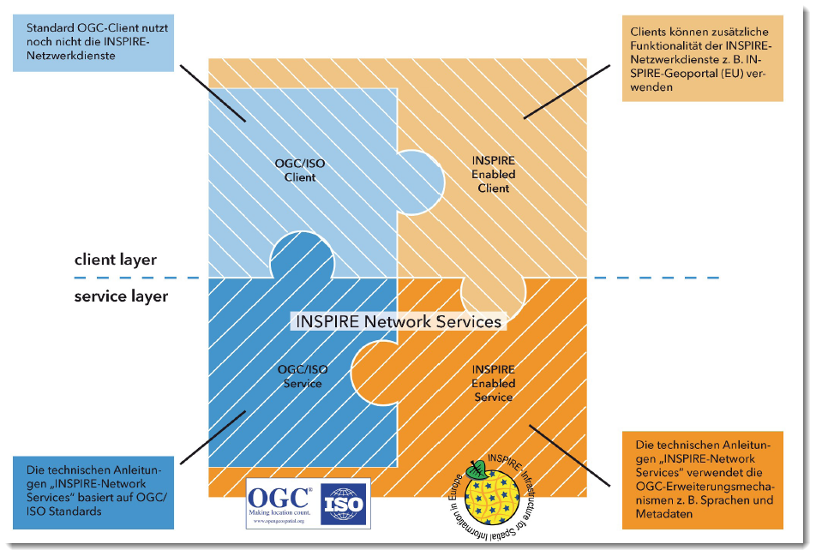
Service Metadata
INSPIRE requires for each geodata service a standardized service metadata description according ISO 19139. This goes beyond the OGC requirements regarding Capabilities responses!
Technical Guidance for the implementation of INSPIRE Discovery Services. http://inspire.ec.europa.eu/documents/Network_Services/TechnicalGuidance_DiscoveryServices_v3.1.pdf [2015-08-11]

Slide 21
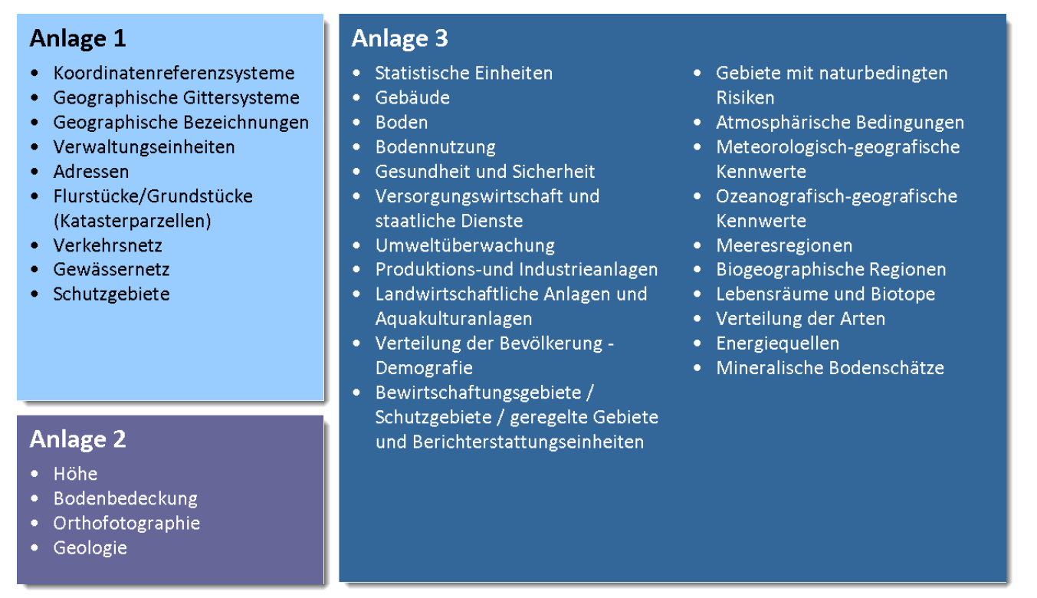
2. Data themes
Metadata
Data Themes and their Specifications
Network based Services
Data and Service Sharing (regulations)
Monitoring and Reporting
34 Data themes, noted in 3 annexes – (required to successfully build environmental information systems)
http://eur-lex.europa.eu/legal-content/EN/TXT/HTML/?uri=OJ:L:2007:108:FULL&from=EN
Quelle: http://www.geoportal.hessen.de/portal/fileadmin/user_upload/GDI-Hessen/GDI/Architekturkonzept_Version_3.0.pdf, S. 14 [2016-10-18]
Notes:
1.
Coordinate reference systems
Systems for uniquely referencing spatial information in space as a set of coordinates (x, y, z) and/or latitude and longitude and height, based on a geodetic horizontal and vertical datum.
2.
Geographical grid systems
Harmonised multi-resolution grid with a common point of origin and standardised location and size of grid cells.
3.
Geographical names
Names of areas, regions, localities, cities, suburbs, towns or settlements, or any geographical or topographical feature of public or historical interest.
4.
Administrative units
Units of administration, dividing areas where Member States have and/or exercise jurisdictional rights, for local, regional and national governance, separated by administrative boundaries.
5.
Addresses
Location of properties based on address identifiers, usually by road name, house number, postal code.
6.
Cadastral parcels
Areas defined by cadastral registers or equivalent.
7.
Transport networks
Road, rail, air and water transport networks and related infrastructure. Includes links between different networks. Also includes the trans-European transport network as defined in Decision No 1692/96/EC of the European Parliament and of the Council of 23 July 1996 on Community Guidelines for the development of the trans-European transport network (1) and future revisions of that Decision.
8.
Hydrography
levation
Digital elevation models for land, ice and ocean surface. Includes terrestrial elevation, bathymetry and shoreline.
2.
Land cover
Physical and biological cover of the earth's surface including artificial surfaces, agricultural areas, forests, (semi-)natural areas, wetlands, water bodies.
3.
Orthoimagery
Geo-referenced image data of the Earth's surface, from either satellite or airborne sensors.
4.
Geology
Geology characterised according to composition and structure. Includes bedrock, aquifers and geomorphology.
Hydrographic elements, including marine areas and all other water bodies and items related to them, including river basins and sub-basins. Where appropriate, according to the definitions set out in Directive 2000/60/EC of the European Parliament and of the Council of 23 October 2000 establishing a framework for Community action in the field of water policy (2) and in the form of networks.
9.
Protected sites
Area designated or managed within a framework of international, Community and Member States' legislation to achieve specific conservation objectives.

Slide 22
2. Data themes
https://eur-lex.europa.eu/legal-content/EN/TXT/HTML/?uri=OJ:L:2007:108:FULL&from=EN [2022-10-23]
34 Data themes, noted in 3 annexes – (required to successfully build environmental information systems)
Annex III
  Statistical units
  Buildings
  Soil
  Land use
  Human health and safety
  Utility and governmental services
  Environmental monitoring facilities
  Production and industrial facilities
  Agricultural and aquaculture facilities
  Population distribution – demography
  Area management/restriction
  /regulation zones & reporting units
  Natural risk zones
  Atmospheric conditions
  Meteorological geographical features
  Oceanographic geographical features
  Sea regions
  Bio-geographical regions
  Habitats and biotopes
  Species distribution
  Energy Resources
  Mineral resources
Annex I
  Coordinate reference systems
  Geographical grid systems
  Geographical names
  Administrative units
  Addresses
  Cadastral parcels
  Transport networks
  Hydrography
  Protected sites
Annex II
  1. Elevation
  2. Land cover
  3. Ortho-imagery
  4. Geology
Notes:
The thematic scope of INSPIRE includes 34
cross-sectoral categories, named themes (see
Figure 2), listed in the three annexes of the Directive
and reflecting two main types of data: spatial
reference data (presented in Annex I and partly in
Annex II), which define a location reference that
the remaining themes (in Annex III and partly in
Annex II) can then refer to.

Slide 23
Spatial reference systems required EU-wide
ETRS89 (EPSG:4258)
For Germany according "Architekturkonzept GDI-DE:"
  Lambert-Conformal-Conic (EPSG:4839)
  For scales >1:500.000: Universal Transverse Mercator (UTM) i.e. ETRS89/UTM zone 32 N (EPSG:25832)

Slide 24
Data Sets according to Data Specifications
Required: Semantic Interoperability
  possibility to combine harmonized spatial data (and services) from different sources across the European Community in a consistent manner:
    Interoperable spatial feature types (attributes, data types, code lists, relationships)
    common system of unique identifiers
As well required:
  a common encoding (GML application schemas)
  common portrayal rules
Public bodies can transform their spatial data into the relevant INSPIRE Data Specification schema

Slide 25
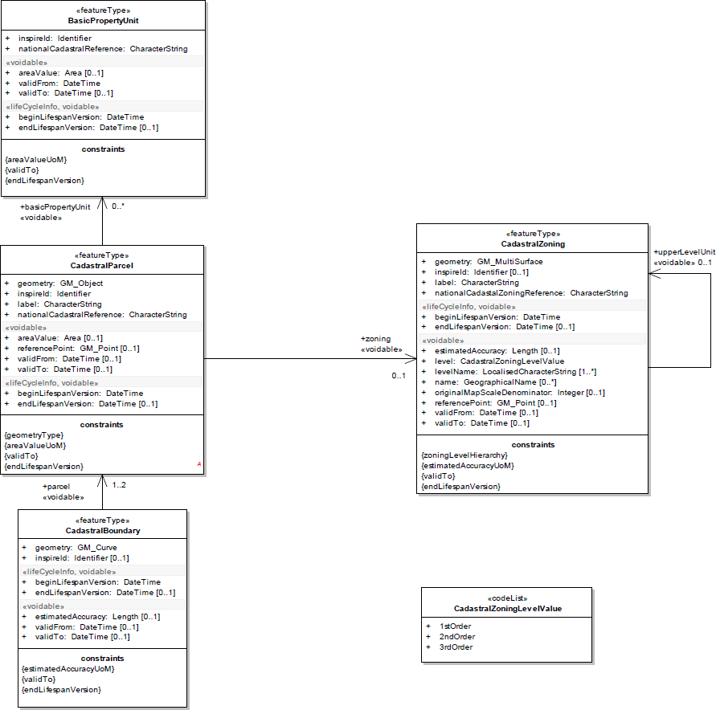
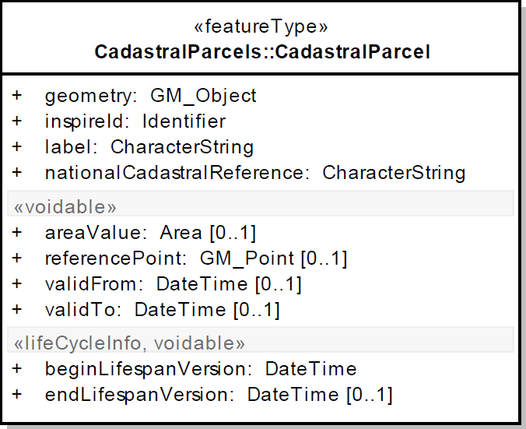
Example: INSPIRE Data Specification on Cadastral Parcels – Technical Guidelines
https://inspire.ec.europa.eu/file/1730/download?token=q3hf9SJJ [2020-01-02]
Notes:
Feature type CadastralZoning (auxiliary):
Cadastral zonings are the intermediary areas (such as municipalities, sections, blocks, …) used in order to divide national territory into cadastral parcels. In the INSPIRE context, cadastral zonings are to be used to carry metadata information and to facilitate portrayal and search of data.
Cadastral zonings have the following additional attributes:
− a geometry
− a national cadastral zoning reference
− a name, if any
− a level in the national cadastral hierarchy and the name of this level
− portrayal attributes : reference point and label
− metadata attributes : original map scale denominator and estimated accuracy
If cadastral zonings are provided, cadastral parcels shall belong to one cadastral zoning of lowest level. When several levels of zonings exist in a Member State, it must be ensured that the higher level units are composed of that of lower level.
Feature type CadastralBoundary (auxiliary):
In the INSPIRE context, cadastral boundaries are to be made available by Member States where absolute positional accuracy information is recorded for the cadastral boundary (attribute estimated accuracy).
Cadastral boundaries have the following additional attributes:
- a geometry
- metadata attribute: estimated accuracy

Slide 26
3. Services
Metadata
Data Themes and their Specifications
Network based Services
Data and Service Sharing (regulations)
Monitoring and Reporting
"… are necessary for sharing spatial data between the various levels of public authority in the Community." [DIRECTIVE 2007/2/EC (17)]
Network services: service oriented architecture (SOA)
  Metadata allow the description, discovery, and automatic usage of services
  Services can be combined
  Support by additional services and functionalities (i.e. Authentication, Authorisation, DRM, eCommerce)

Slide 27
Discovery Services:
The Publish-Find-Bind Pattern
Metadata
Data Themes and their Specifications
Network based Services
Data and Service Sharing (regulations)
Monitoring and Reporting
Provision of geodata: based on the Publish-Find-Bind principle:
The provider publishes a service in the catalog. Now the service is findable for consumers
The consumer searches in the catalog and receives a search result (find)
Based on the result the consumer can access the service of the provider (bind)
Service Registry/catalogue
2) search
3) find
1) publish
Provider
Client/Consumer
4) Bind
(use, consume)

Slide 28
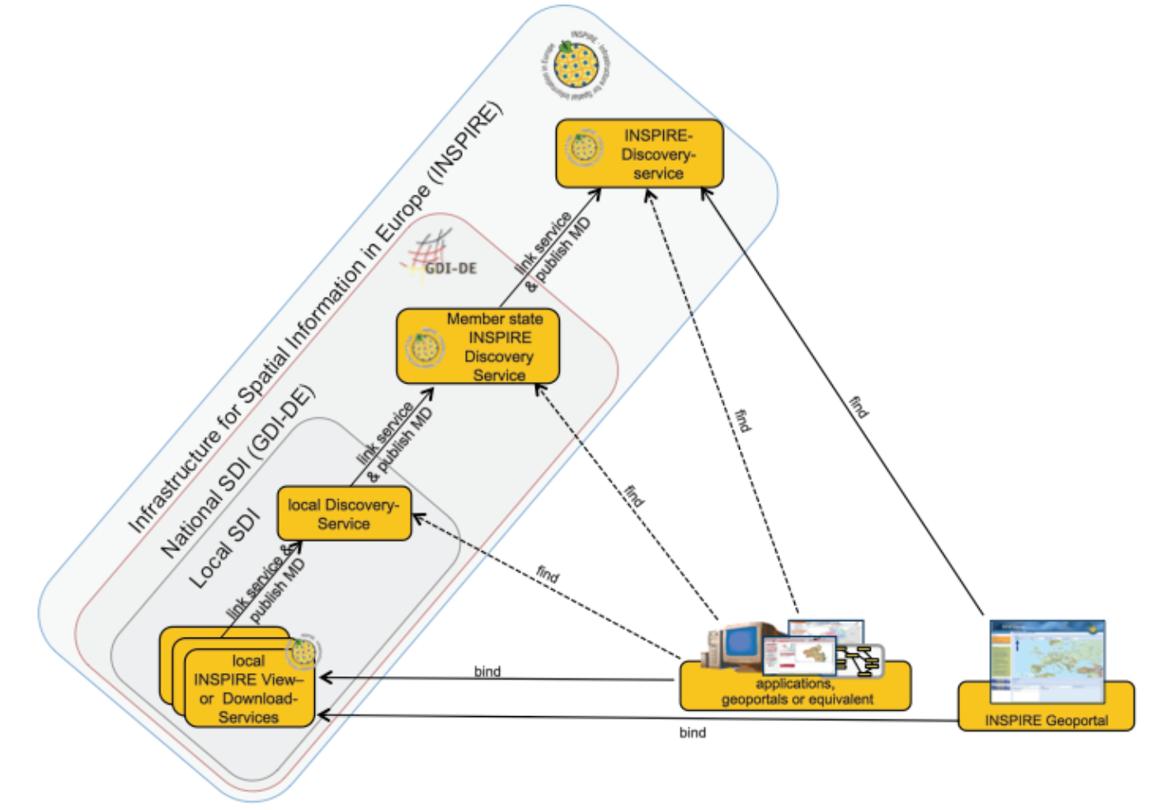
From Local to
EU-wide
PFB Pattern
HARVESTING
Source: Technical Guidance for the implementation of INSPIRE Discovery Services. http://inspire.ec.europa.eu/documents/Network_Services/TechnicalGuidance_DiscoveryServices_v3.1.pdf [2015-08-11]

Slide 29
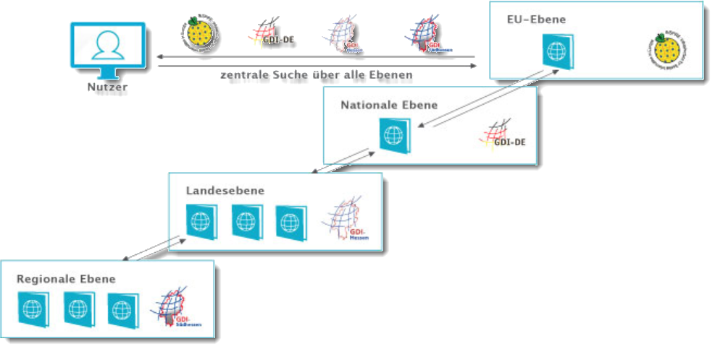
Harvesting von Metadaten
https://www.gdi-infotour.de/voraussetzungen-einer-gdi/harvesting-von-metadaten [2020-02-03]
Continue reading: https://inspire.ec.europa.eu/sites/default/files/28oct-1330-dataexchange-olijslagers-2-inspire_harvesting_in_practice.pdf
Notes:
Sollen verteilt vorliegende Metadaten gefunden und dem Nutzer zur Verfügung gestellt werden, muss ein Metadateninformationssystem auf andere Katalogdienste zugreifen können. Die Metadatensätze der externen Kataloge werden dazu regelmäßig eingesammelt. Dieses Vorgehen bezeichnet man als "Harvesting". Dies geschieht über Schnittstelle des OGC Catalogue Service for the Web - CSW.
Nach dieser Methode kann beispielsweise ein europäisches Metadateninformationssystem die Kataloge der Mitgliedsstaaten abfragen. Der deutsche Katalog befragt dann die Kataloge der Bundesländer, und die Landeskataloge wiederum können auf weitere angeschlossene regionale Kataloge zugreifen.

Slide 30
3. Service categories
DT NS
Metadata
Data Themes and their Specifications
Network based Services
Data and Service Sharing (regulations)
Monitoring and Reporting
Publish
Find
Bind
GeoRM layers
Discovery Service
View
Service
Download
Service
Transf.
Service
InvokeSD
Service
Modifiied after: INSPIRE Service Architecture, EuroGeographics Network Services Workshop, 5-6 February 2008, graham.vowles@ordnancesurvey.co.uk
Discovery services: search for spatial data sets and services on the basis of the content of corresponding metadata, and display the metadata content;
View services: as a minimum, display, navigate, zoom in/out, pan, or overlay spatial data sets and display legend information and any relevant content of metadata;
Download services: enabling copies of complete spatial data sets, or of parts of such sets, to be downloaded and where practicable, accessed directly;
---> Download predefined data sets (atom) or data objects (WFS)
Transformation services (for SRS and Data Models), enabling spatial data sets to be transformed with a view to achieving interoperability;
Invoke SD services: allowing spatial data services to be invoked.

Slide 31
Dienstkategorien
Im Artikel 11(1) der INSPIRE-Directive [1] werden diese Dienste detaillierter folgendermaßen beschrieben:
Suchdienste: ermöglichen es, auf der Grundlage des Inhalts entsprechender Metadaten nach Geodatensätzen und -diensten zu suchen und den Inhalt der Metadaten anzuzeigen;
Darstellungsdienste: ermöglichen es zumindest, darstellbare Geodatensätze anzuzeigen, in ihnen zu navigieren, sie zu vergrößern/verkleinern, zu verschieben, Daten zu überlagern sowie Informationen aus Legenden und sonstige relevante Inhalte von Metadaten anzuzeigen;
Download-Dienste: ermöglichen das Herunterladen von und, wenn durchführbar, den direkten Zugriff auf Kopien vollständiger Geodatensätze oder Teile solcher Sätze;
Transformationsdienste: zur Umwandlung von Geodatensätzen, um Interoperabilität zu erreichen;[2]
Dienste zum Abrufen von Geodatendiensten.
[1] http://eur-lex.europa.eu/legal-content/DE/TXT/PDF/?uri=CELEX:32007L0002&from=EN
[2] Ein Beispiel dazu: https://geodaesie.info/zfv/heftbeitrag/3170

Slide 32
INSPIRE Network Services Architecture
Provides more detail than the INSPIRE Technical Architecture – Overview document
Follows Services Oriented Architecture principles
Provides the Architecture within which all INSPIRE Services will be implemented – ie the context for INSPIRE Network Services Implementing Rules
Appl.
Layer
Applications and Geoportals
Service Bus
Source (modified): INSPIRE Service Architecture, EuroGeographics Network Services Workshop, 5-6 February 2008, graham.vowles@ordnancesurvey.co.uk
Service
Layer
Rights Management Layers
Registry Service
Discovery Service
View
Service
Download
Service
Transf.
Service
InvokeSD
Service
Data
Layer
Registers
Service
Metadata
Data Set
Metadata
Spatial Data Sets
Thematic DS

Slide 33
Discovery services: Search criteria
The discovery services … must accept queries based at a minimum on the following combination of search criteria
[Art. 11(2) of the INSPIRE Directive]
keywords;
classification of spatial data and services;
the quality and validity of spatial data sets;
degree of conformity with the implementing rules provided for in Article 7(1);
geographical location;
conditions applying to the access to and use of spatial data sets and services;
the public authorities responsible for the establishment, management, maintenance and distribution of spatial data sets and services.
Beispiel: https://gdk.gdi-de.org/gdi-de/srv/ger/catalog.search#/metadata/9f7be6ac-bc6d-4239-9546-d7a23c2246a7

Slide 34
Download Services
Two kinds of Download-Services:
Pre-defined Dataset Download (mandatory): Download of pre-defined datasets – a more conventional way of data provision, however supported by metadata. The following operations are required:
  Get Download Service Metadata: provision of service metadata
  Get Spatial Data Set: Download of the offered dataset
  Describe Spatial Data Set: Download of descrption of the datasets offered by this service
  Link Download Service
Direct Access Download (additional optional Operations): Download of specific data based on user defined filters.

Slide 35
Mapping INSPIRE to OGC Services
INSPIRE Service | Equivalent OGC Services
View | WMS, WMTS, WTS
Discovery | CSW, SWE
Download | ~ WFS and extensions, WCS, SOS
Transformation | ~ Coordinate Transformation Service or Coordinate Transformation as WPS Profile^{[1]} + Schema Translation^{[2]}
Invoke SD Service | ~WPS
After: INSPIRE Service Architecture, EuroGeographics Network Services Workshop, 5-6 February 2008, graham.vowles@ordnancesurvey.co.uk
[1] https://inspire.ec.europa.eu/documents/Network_Services/INSPIRE_Draft_Technical_Guidance_Coordinate_Transformation_Services_(version_2%201).pdf
[2] https://inspire.ec.europa.eu/document-tags/schema-transformation-services

Slide 36
Übung: Download Service „Unfalldaten“ https://www.geoportal.nrw/suche?lang=de&searchTerm=5d7cb58c-c4f4-4998-a7fd-2cb3abb0e512 https://www.opengeodata.nrw.de/produkte/transport_verkehr/unfallatlas/
Herunterladen, in QGIS anzeigen ;-)

Slide 37
Specific requirements partially extending / narrowing OGC‘s standards
Integration of INSPIRE Service Metadata in the Capabilities documents?
Fulfilment of quality of service (QoS) requirements: Capacity > 30 request/s, Availability: maximum unplanned downtime of 363 days per year (Service Availability is vital for SDIs!)
Support of spatial reference systems EPSG:4326 and EPSG:4258 (ETRS89) (at least) including Bounding Box elements for the data layers?
Support of cartographic projections: Lambert-Conformal-Conic (EPSG:4839) and for scales >1:500.000 Universal Transverse Mercator (UTM)
Coupling of Services, data and metadata (LayerTags <Identifier> and <MetadataURL>)
Cartographic legends for each style
Multi-language support, i.e. in the Capabilities document (LANGUAGE Parameter extension)

Slide 38
Specific requirements partially extending / narrowing OGC‘s standards
Integration of INSPIRE Service Metadata in the Capabilities documents?
Fulfilment of quality of service (QoS) requirements: Capacity > 30 request/s, Availability: maximum unplanned downtime of 363 days per year (Service Availability is vital for SDIs!)
Support of spatial reference systems EPSG:4326 and EPSG:4258 (ETRS89) (at least) including Bounding Box elements for the data layers?
Support of cartographic projections: Lambert-Conformal-Conic (EPSG:4839) and for scales >1:500.000 Universal Transverse Mercator (UTM)
Coupling of Services, data and metadata (LayerTags <Identifier> and <MetadataURL>)
Cartographic legends for each style
Multi-language support, i.e. in the Capabilities document (LANGUAGE Parameter extension)
OGC compliant products
INSPIRE
compliant products

Slide 39
4. Agreements on sharing, access and use
Metadata
Data Themes and their Specifications
Network based Services
Data and Service Sharing (regulations)
Monitoring and Reporting
Member States shall develop measures for the sharing of spatial data sets and services between public authorities.
Agreements! (in the sense of organizational interoperability)
In addition those measures shall enable the relevant users, public and private, to gain access to spatial data sets and services, and to exchange and use those sets and services.
Jes Ryttersgaard: Overview of INSPIRE. https://www.fig.net/resources/proceedings/fig_proceedings/cairo/papers/ts_42/ts42_02_ryttersgaard.pdf [2015-08-11]

Slide 40

Geo Right Management (GeoRM)
Application and Geoportals
Service Bus
GeoRM Layers
GeoRM
Services
Identity
Price & Order
License
Registry Service
Discovery Service
View
Service
Download
Service
Transf.
Service
InvokeSD
Service
GeoRM
Data
Source: Graham Vowles (2008): INSPIRE Service Architecture. EuroGeographics Network Services Workshop, 5-6 February 2008

Slide 41
5. Monitoring & Reporting
Metadata
Data Themes and their Specifications
Network based Services
Data and Service Sharing (regulations)
Monitoring and Reporting
INSPIRE Directive: requires Member States to monitor the implementation and use of their infrastructures for spatial information and to report on the implementation of the Directive back to the Commission (every 3 years).
  Monitoring =ongoing process with status report to the European Commission
Status reports: comprise the list of the INSPIRE-related geodata sets and services and indicators to measure the degree of INSPIRE implementation, i. e., conformity of metadata, geodata and web services
In Germany: The required informations are requested by the contact offices of the federal government and the German states from the custodians . The informations are forwarded to the official GDI-DE (SDI Germany) contact institution. The results are published and forwarded to the EU.
Quelle: Martin Seiler (2015): Umsetzung der INSPIRE-Richtlinie aus Sicht der Koordinierungsstelle der GDI-DE. http://www.geoportal.de/SharedDocs/Downloads/DE/GDI-DE/Vortraege/2015/150430_DVGW_Umsetzung_INSPIRE_Versorgungsunternehmen_Seiler.pdf?__blob=publicationFile [2016-11-26]
Notes:
Die INSPIRE Richtlinie sieht zusätzlich in den Artikeln 21 und 23 eine fortwährende Beobachtung der Umsetzung vor.
Die Beobachtung dient der anschließenden Steuerung und der nachträglichen Anpassung des Prozesses zur INSPIRE Umsetzung.kontinuierlicher Prozess mit jährlicher Statusmeldung an Europäische Kommission
betroffenen Geodatensätze und Dienste sowie verschiedene Indikatoren zur Messung des Umsetzungsgrades von INSPIRE, z.B. Aussagen zur Konformität von Metadaten, Geodaten und Netzdiensten zu den jeweiligen Verordnungen, Anzahl der Geodatensätze, die für die Umweltberichterstattung
Die benötigten Informationen werden von den Kontaktstellen bei Bund und Ländern bei den geodatenhaltenden Stellen abgefragt und an die Kst. GDI-DE weitergegeben. Die Kst. GDI-DE veröffentlicht und übermittelt die Ergebnisse an die EU.
Das INSPIRE-Monitoring erfolgt vollständig automatisiert auf Metadatenbasis. Grundlage bilden die verfügbaren Metadaten im Metadatenkatalog des Mitgliedstaates (hier: Metada-tenkatalog der GDI-DE) (https://www.geoportal-bw.de/documents/20147/0/Handlungsempfehlungen_GDI-BW_Monitoring_2021_0_211018.pdf/379ccdd5-4229-df92-4e41-75bb86b9456e?t=1634638940843)

Slide 42
5. Monitoring & Reporting
INSPIRE Directive: requires Member States to monitor the implementation and use of their infrastructures for spatial information and to report on the implementation of the Directive back to the Commission (every 3 years).
Quantitative approach for the indicators, regarding spatial datasets and services
  Existence of metadata for spatial data sets and services
  Conformity of metadata for spatial data sets and services with the implementing rules on metadata
  Geographical coverage of spatial data sets
  Conformity of spatial data sets with the data specifications and of their metadata with the implementing rules on metadata
  Accessibility of metadata for spatial data sets and services through discovery services
  Accessibility of spatial data sets through view and download services
  Use of network services
  Conformity of network services to the implementing rules on network services
http://www.environ.ie/en/Publications/DevelopmentandHousing/Planning/FileDownLoad,27309,en.pdf
http://inspire.ec.europa.eu/index.cfm/pageid/5022 and Monitoring and Reporting Drafting Team
Monitoring Indicators – Guidelines Document, http://inspire.ec.europa.eu/documents/Monitoring_and_Reporting/INSPIRE_MR_Guidelines_Reporting_2011-01-18_v%205.0.pdf

Slide 43
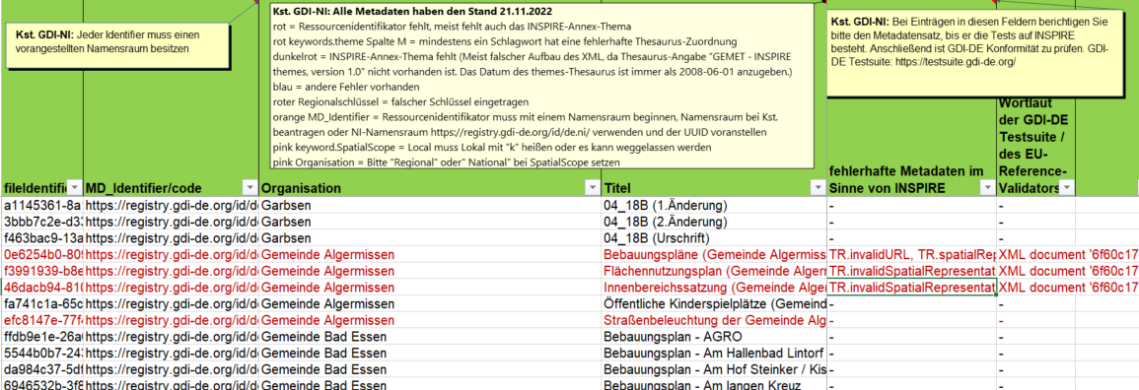
Reporting: Example
Automatic processes
https://www.geodaten.niedersachsen.de/download/96251/gemeldete_Daten_2022.xlsx

Slide 44
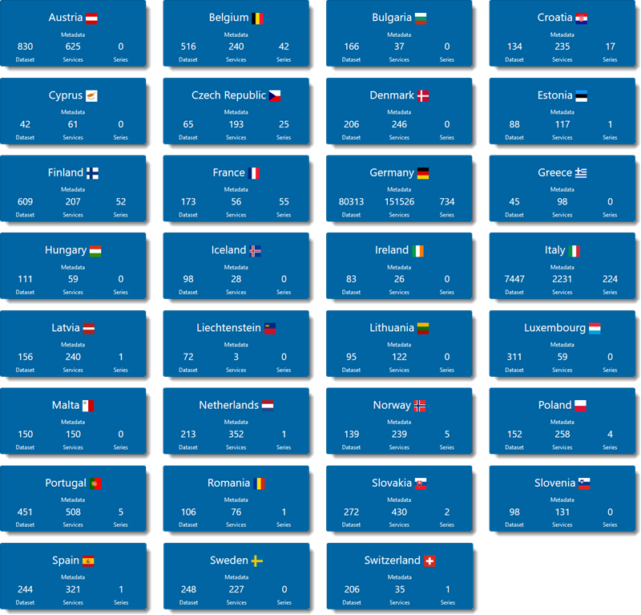
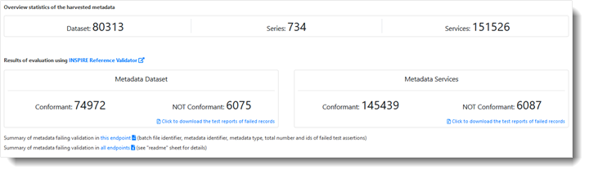

Slide 45
Übung:
Percentage of high availability services http://servicemap.spatineo.com/

Slide 46
Evaluation

Slide 47
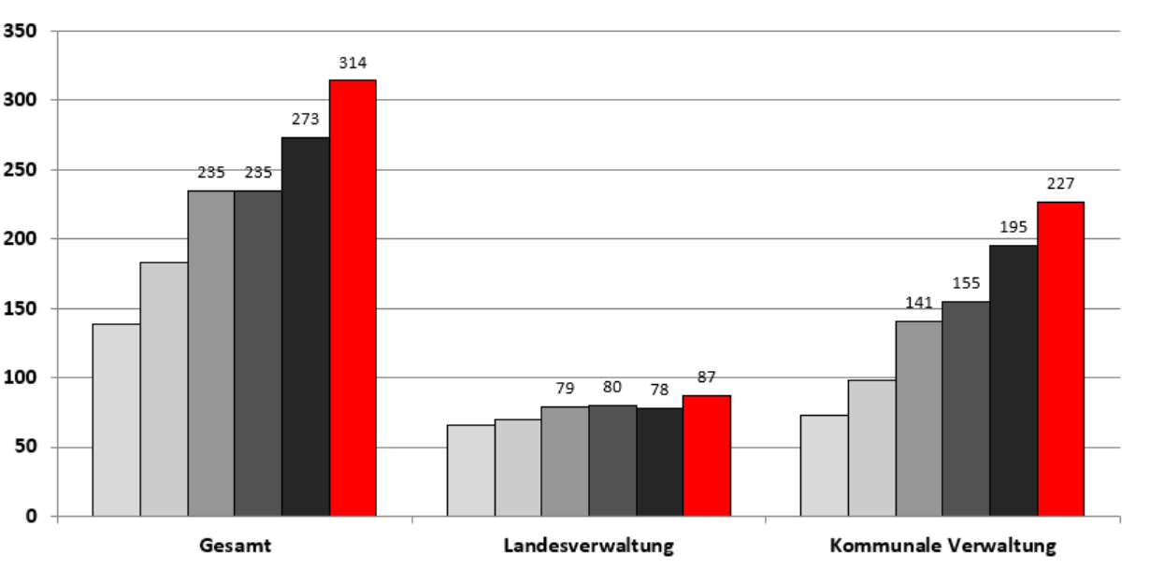
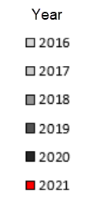
Number of Datasets in state of Hessen, Germany
https://www.geoportal.hessen.de/mediawiki/index.php/INSPIRE_Monitoring

Slide 48
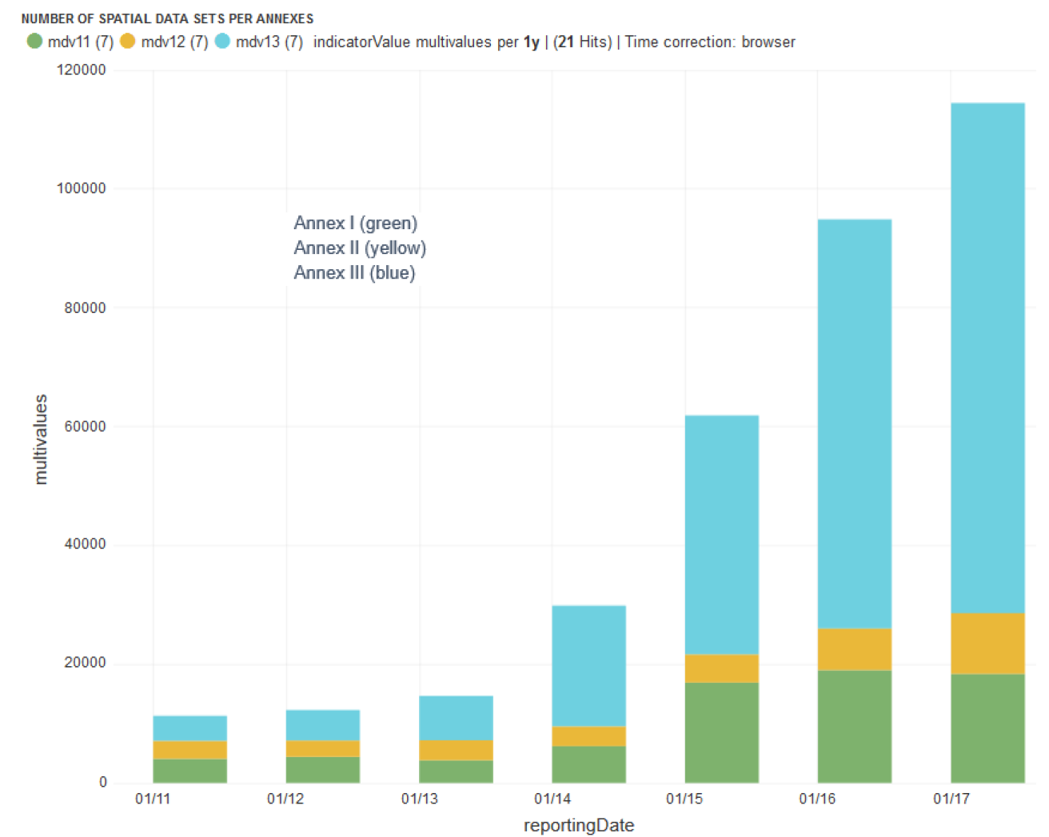
Spatial Datasets per Annex
Summary Report on Status of implementation of the INSPIRE Directive in EU. https://publications.jrc.ec.europa.eu/repository/bitstream/JRC109035/jrc109035_jrc109035_jrc_inspire_eu_summaryreport_online.pdf

Slide 49
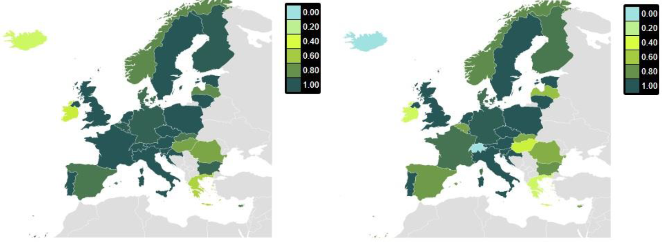
Existence of Metadata (data sets and services) and Conformity*

Slide 50
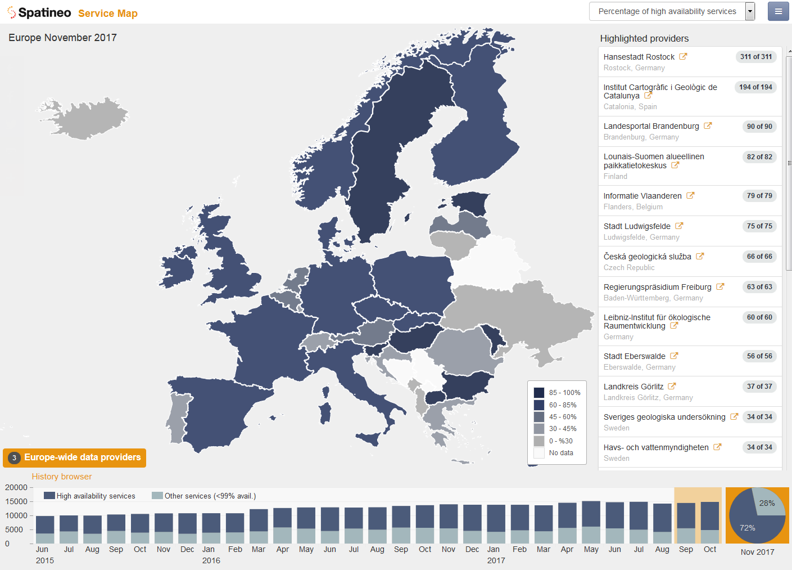
Percentage of high availability services
http://servicemap.spatineo.com/
https://directory.spatineo.com/
https://www.spatineo.com/monitor/free-trial/
Notes:
The high level SDI status data shown on the map immediately reveals that there is healthy growth in this sector. The quantity of spatial web services has continued to grow steadily over the past two years and the number of compliant services available is very promising.

Slide 51
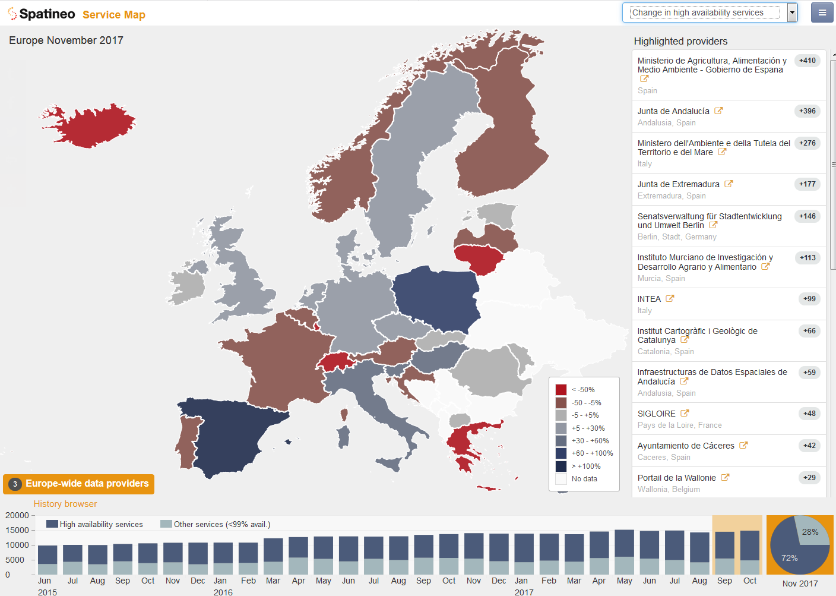
Change in total number of services
http://servicemap.spatineo.com/
Notes:
The high level SDI status data shown on the map immediately reveals that there is healthy growth in this sector. The quantity of spatial web services has continued to grow steadily over the past two years and the number of compliant services available is very promising.

Slide 52
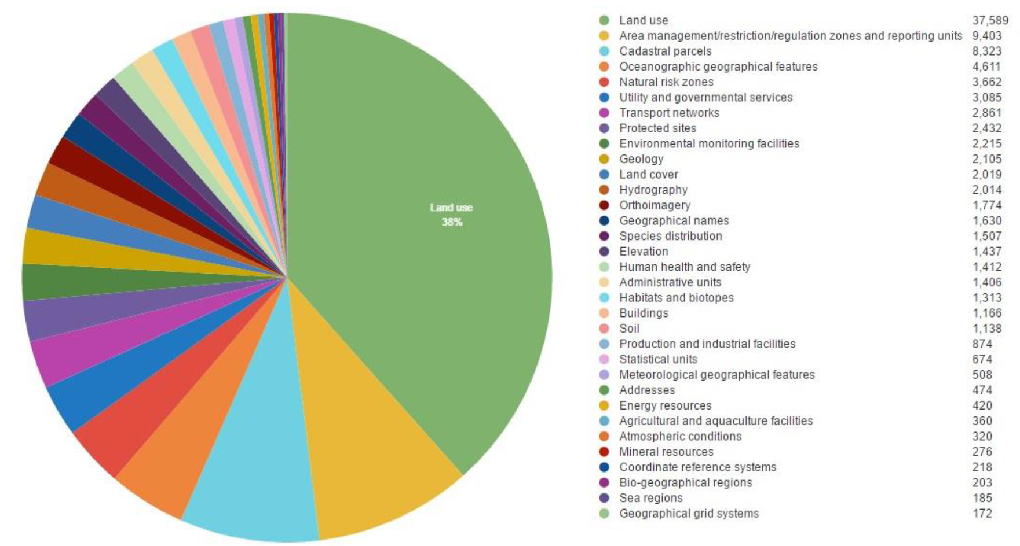
Data sets available per INSPIRE theme in 2015

Slide 53
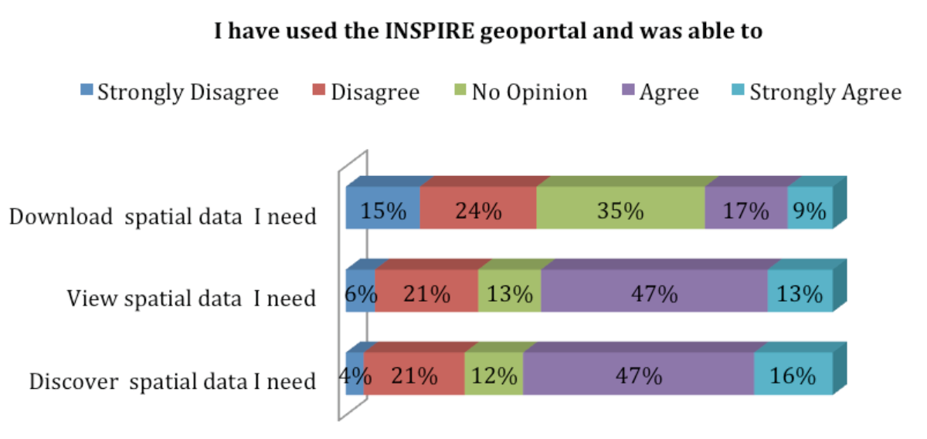
User experience in general:
Feedback on the successful use of the INSPIRE geoportal (2014)
Source: Mid-term Evaluation Report on INSPIRE Implementation (Technical report No 17/2014 ), http://www.geodaten.niedersachsen.de/download/96290/Einzelergebnis_INSPIRE_Public_Consultation_2014_7-Jahres_Online-Konsultation_.pdf [2015-08-16]

Slide 54
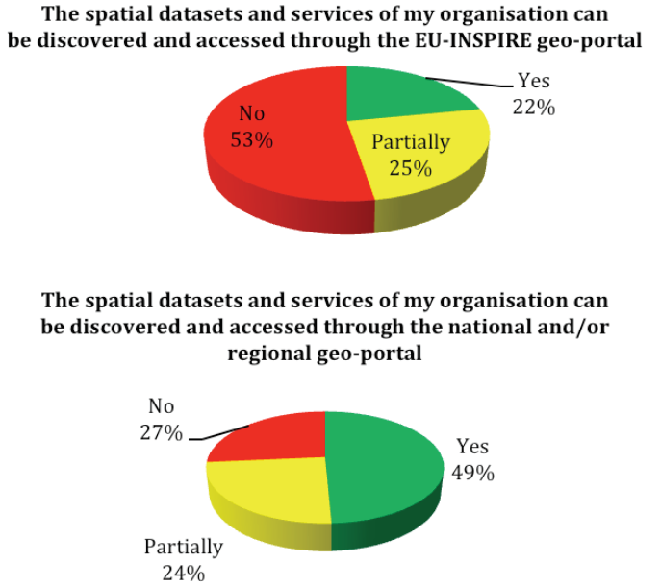
Discoverability and Accessibility of Spatial Datasets in EU Geoportal and National Geoportals
Source: Mid-term Evaluation Report on INSPIRE Implementation (Technical report No 17/2014 ), http://www.geodaten.niedersachsen.de/download/96290/Einzelergebnis_INSPIRE_Public_Consultation_2014_7-Jahres_Online-Konsultation_.pdf [2015-08-16]

Slide 55
Main obstacles to INSPIRE implementation from 2014 INSPIRE Public Consultation
Source: after Mid-term Evaluation Report on INSPIRE Implementation (Technical report No 17/2014 ), http://www.geodaten.niedersachsen.de/download/96290/Einzelergebnis_INSPIRE_Public_Consultation_2014_7-Jahres_Online-Konsultation_.pdf [2015-08-16]

Slide 56
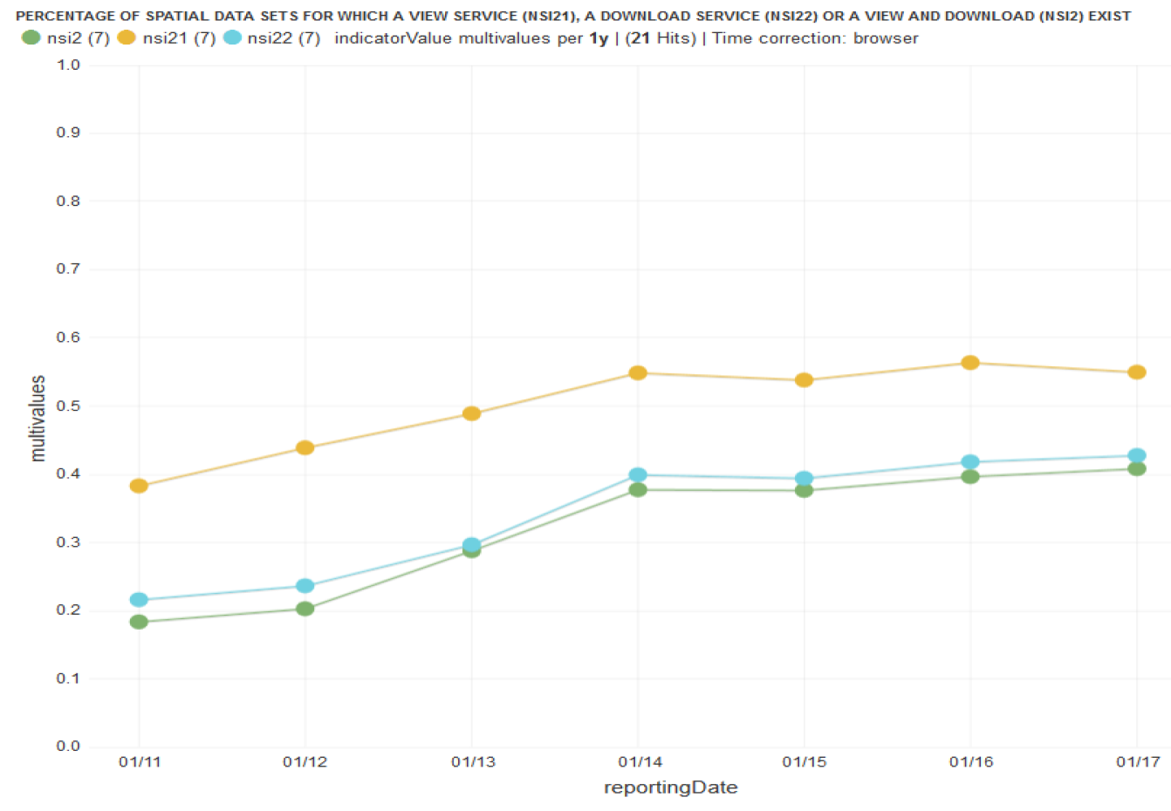
Evolution of spatial data made accessible through digital services (2017)
View
Download
View & download

Slide 57
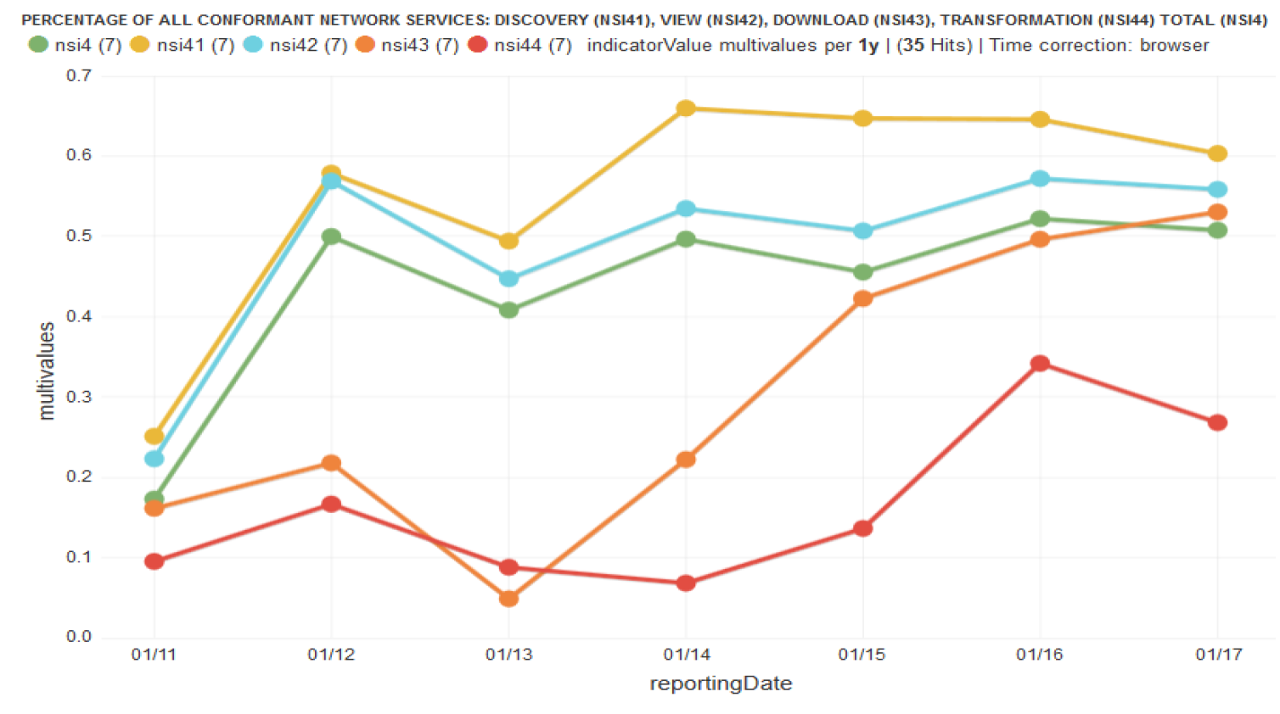
Evolution of the conformity of the digital services (2017)
Source: Vlado Cetl, Vanda Nunes de Lima, Robert Tomas and Michael Lutz (DG JRC), Joachim D'Eugenio, Adam Nagy and Joeri Robbrecht (DG ENV) 2017: Summary Report on Status of implementation of the INSPIRE Directive in EU. https://publications.jrc.ec.europa.eu/repository/bitstream/JRC109035/jrc109035_jrc109035_jrc_inspire_eu_summaryreport_online.pdf
NSv4 (green): (number of all conformant network services) / (number of all network services)
NSv4.1 (yellow): (number of conformant discovery network services) / (number of discovery network services)
NSv4.2 (blue): (number of conformant view network services) / (number of view network services)
NSv4.3 (orange): (number of conformant download network services) / (number of download network services)
NSv4.4 (red): (number of conformant transformation network services) / (number of transformation network services)
Notes:
Number of digital spatial data services across EU is evolving slowly. More than 40000 view services and more than 30000 download services are available. However, many of identified spatial data sets are still not accessible through the services and there is the space for further improvement. The overall technical conformity of the existing services is more than 50 %, which is low and should be also further improved.

Slide 58
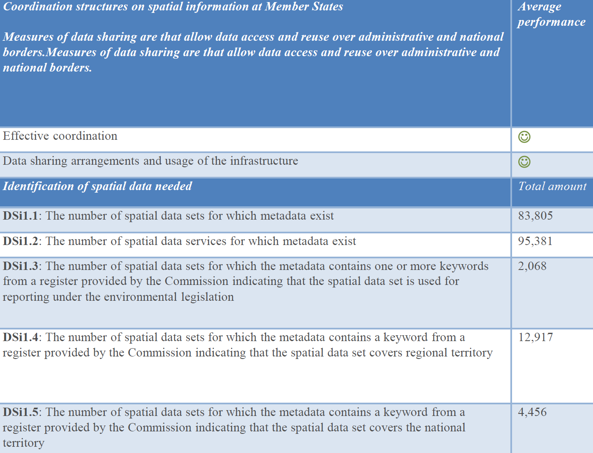
2022

Slide 59
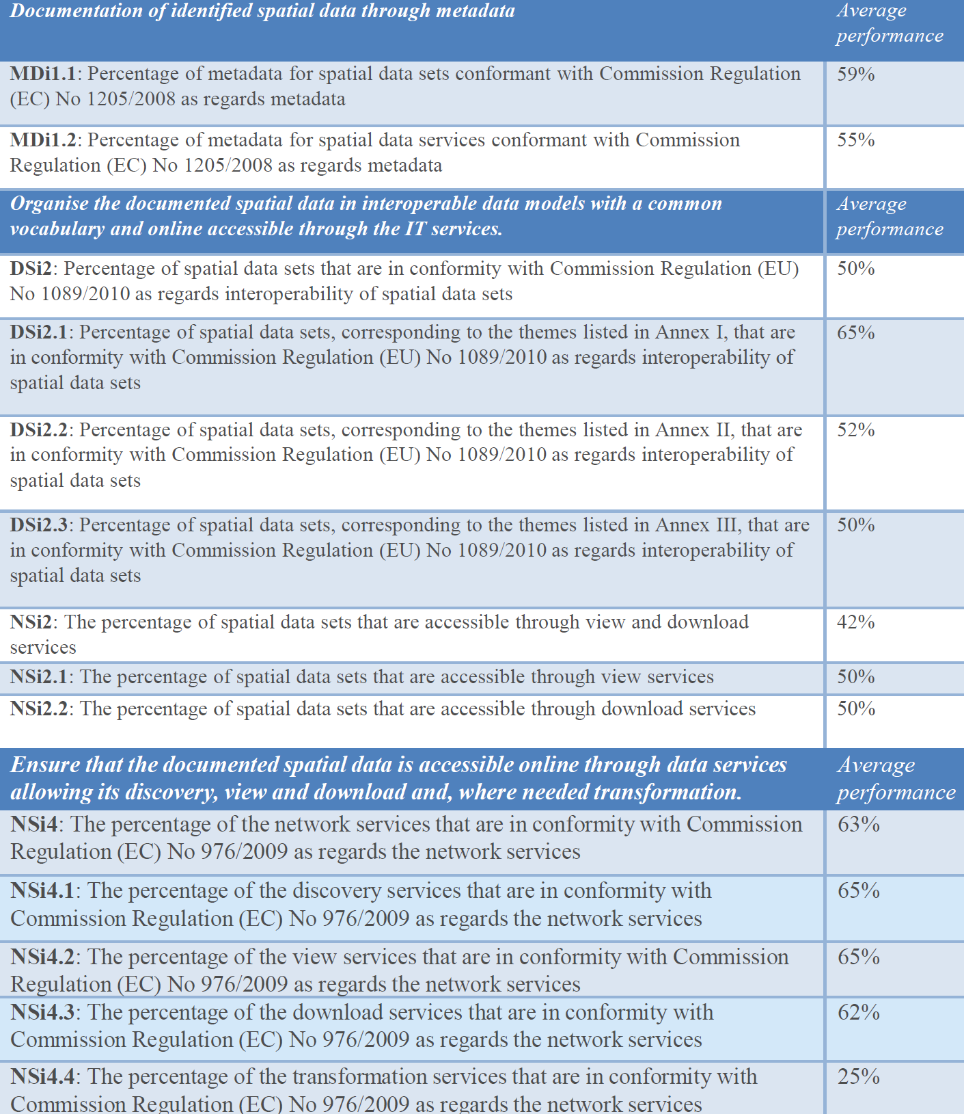
2022

Slide 60
The current level of accessibility of INSPIRE data sets through view and download services is low. One of the reasons are problems with implementing the data-service linking approach currently described in the TGs for metadata and network services, which is considered complicated and partly ambiguous, even by implementation/standards experts.
Many organisations are therefore facing difficulties to provide implementations in line with these requirements, which in turn has reflects negatively on the overall usability of the INSPIRE infrastructure, as shown by the low values (on average) of the Monitoring indicators about the data set accessibility.
https://github.com/INSPIRE-MIF/gp-data-service-linking-simplification

Slide 61
some of the technical specifications for the INSPIRE framework as a barrier to current and future implementation as well as use.
The legal framework is considered too prescriptive and rigid to respond to fast evolving technology and information needs with the necessary agility.
https://www.geodaten.niedersachsen.de/download/186627/2022_-_Bericht_Teil_1_.pdf

Slide 62
Weitere Entwicklungen
Further Developments

Slide 63
Die Zukunft von INSPIRE
Die Europäische Geodateninfrastruktur ist da, die GDI-DE, die
GDI-BW und die kommunalen GDIen sind Teil davon.
Die Ausrichtung von INSPIRE am European Green Deal & der
Europäischen Datenstrategie steht vor der Tür, denn Interoperabilität & Zugriff auf Geodäten sind für die Gestaltung der digitalen Zukunft Europas essentiell.
„Um tatsächlich die Probleme zu lösen gibt es noch viel zu tun, muss INSPIRE vom Proof-Of-Concept zu einem Game-Changer werden!“ [1]
„Die Richtlinienumsetzung hinkte einige Jahren aus verschiedenen Gründen jedoch den Erwartungen hinterher und musste durch verschiedene Aktionen belebt werden.“ [2]
[1] Aktuelle Entwicklungen in der europäischen Geodateninfrastruktur (INSPIRE). 28. Sitzung des Begleitausschusses Geodateninfrastruktur Baden-Württemberg (GDI-BW), 9. Dezember 2020
[2]: Markus Meinert (2020): INSPIRE – Aufbruch zu neuen Horizonten? zfv 6/2020
Notes:
Entwicklungen bei INSPIRE
28. Sitzung BAGDI-BW 9.12.2020
G DI-BW
BjJcii - .JJ Wiirt-ft-nhf-rfl
Die Zukunft von INSPIRE
Die Europäische Geodateninfrastruktur ist da, die GDI-DE, die
GDI-BW und die kommunalen GDIen sind Teil davon.
Die Ausrichtung von INSPIRE am European Green Deal & der
Europäischen Datenstrategie steht vor der Tür, denn
Interoperabilität & Zugriff auf Geodäten sind für die Gestaltung
der digitalen Zukunft Europas essentiell.
Um tatsächlich die Probleme zu lösen gibt es noch viel zu tun, muss INSPIRE vom Proof-Ot-Concept zu einem Game-Changer werden!
Mitt f»
Baden-Württemberg

Slide 64
INSPIRE und Europäischer Green Deal
Europäische Kommission möchte, »dass Investoren, Versicherungsunternehmen, Städte sowie Bürgerinnen und Bürger in der gesamten EU Zugang zu Daten haben«, um diese u. a. in ihr Risikomanagement im Kontext des Klimawandels einbeziehen zu können.
Zugängliche und interoperable Daten werden als Mittelpunkt datengesteuerter Investitionen betrachtet, da diese in Verbindung mit digitalen Infrastrukturen und Lösungen für künstliche Intelligenz faktengestützte Entscheidungen erleichtern und die Fähigkeiten stärken, ökologische Herausforderungen zu verstehen und zu bewältigen.
Darüber hinaus benennt der Grüne Deal ein präzises digitales Modell der Erde als Ziel und hebt die Möglichkeiten der Fernüberwachung der Luft- und Wasserverschmutzung oder der Optimierung der Nutzung von Energie und natürlichen Ressourcen hervor, wie sie sich durch die Digitalisierung erstmals erschließen.
GreenData4All
Zum Weiterlesen: https://inspire.ec.europa.eu/conference2021/presentations
Markus Meinert (2020): INSPIRE – Aufbruch zu neuen Horizonten? zfv 6/2020
Notes:
Mit dem Europäischen Grünen Deal verlangt die Europäische Kommission, »dass Investoren, Versicherungsunternehmen, Städte sowie Bürgerinnen und Bürger in der gesamten EU Zugang zu Daten haben«, um diese u. a. in ihr Risikomanagement im Kontext des Klimawandels einbeziehen zu können. Zugängliche und interoperable Daten werden als Mittelpunkt datengesteuerter Investitionen betrachtet, da diese in Verbindung mit digitalen Infrastrukturen und Lösungen für künstliche Intelligenz faktengestützte Entscheidungen erleichtern und die Fähigkeiten stärken, ökologische Herausforderungen zu verstehen und zu bewältigen. Darüber hinaus benennt der Grüne Deal ein präzises digitales Modell der Erde als Ziel und hebt die Möglichkeiten der Fernüberwachung der Luft- und Wasserverschmutzung oder der Optimierung der Nutzung von Energie und natürlichen Ressourcen hervor, wie sie sich durch die Digitalisierung erstmals erschließen.Die Europäische Datenstrategie geht mehrere Schritte weiter. Sie skizziert die Einrichtung verschiedener Europäischer Datenräume, darunter einen Energie-, einen Mobilitäts-, einen Gesundheits-, einen Agrar- und schließlich einen Umweltdatenraum; Letztgenannten speziell als Unterstützung für die Erreichung der Ziele des Grünen Deals. Ergänzend weist die Datenstrategie den Weg für einen Rechtsrahmen betreffend die Governance der Datenräume, die Verabschiedung eines Durchführungsrechtsaktes über hochwertige Datensätze und ggf. einen Vorschlag für einen Rechtsakt über Daten.

Slide 65
INSPIRE and Europan Green Deal
European Commission calls for "investors, insurers, cities and citizens across the EU to have access to data" in order to include it in their risk management in the context of climate change, among other things.
Accessible and interoperable data is seen as the focal point of data-driven investments, as it facilitates evidence-based decisions and strengthens capabilities to understand and address environmental challenges, in combination with digital infrastructures and artificial intelligence solutions.
Green Deal identifies an accurate digital model of the Earth as a goal and highlights the opportunities for remote monitoring of air and water pollution or optimizing the use of energy and natural resources, as opened up for the first time by digitalization.
https://eur-lex.europa.eu/legal-content/EN/TXT/HTML/?uri=CELEX:52019DC0640
GreenData4All
See also: https://inspire.ec.europa.eu/conference2021/presentations
Markus Meinert (2020): INSPIRE – Aufbruch zu neuen Horizonten? zfv 6/2020
Notes:
Mit dem Europäischen Grünen Deal verlangt die Europäische Kommission, »dass Investoren, Versicherungsunternehmen, Städte sowie Bürgerinnen und Bürger in der gesamten EU Zugang zu Daten haben«, um diese u. a. in ihr Risikomanagement im Kontext des Klimawandels einbeziehen zu können. Zugängliche und interoperable Daten werden als Mittelpunkt datengesteuerter Investitionen betrachtet, da diese in Verbindung mit digitalen Infrastrukturen und Lösungen für künstliche Intelligenz faktengestützte Entscheidungen erleichtern und die Fähigkeiten stärken, ökologische Herausforderungen zu verstehen und zu bewältigen. Darüber hinaus benennt der Grüne Deal ein präzises digitales Modell der Erde als Ziel und hebt die Möglichkeiten der Fernüberwachung der Luft- und Wasserverschmutzung oder der Optimierung der Nutzung von Energie und natürlichen Ressourcen hervor, wie sie sich durch die Digitalisierung erstmals erschließen.Die Europäische Datenstrategie geht mehrere Schritte weiter. Sie skizziert die Einrichtung verschiedener Europäischer Datenräume, darunter einen Energie-, einen Mobilitäts-, einen Gesundheits-, einen Agrar- und schließlich einen Umweltdatenraum; Letztgenannten speziell als Unterstützung für die Erreichung der Ziele des Grünen Deals. Ergänzend weist die Datenstrategie den Weg für einen Rechtsrahmen betreffend die Governance der Datenräume, die Verabschiedung eines Durchführungsrechtsaktes über hochwertige Datensätze und ggf. einen Vorschlag für einen Rechtsakt über Daten.

Slide 66
Übung: https://www.nid.bayern.de/grundwasser

Slide 67
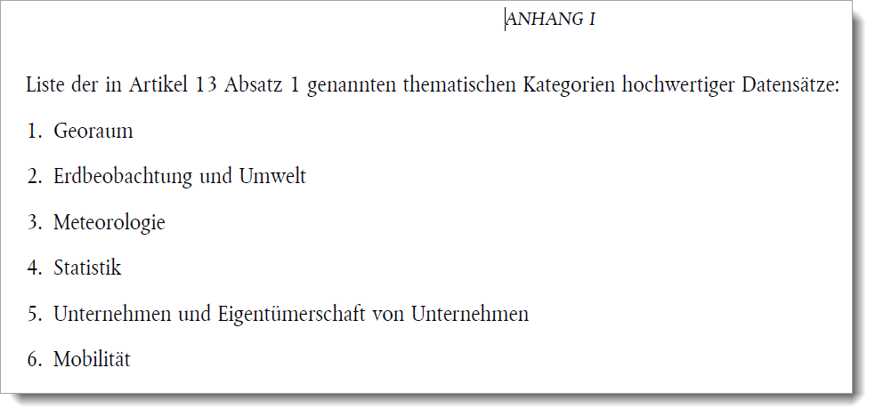
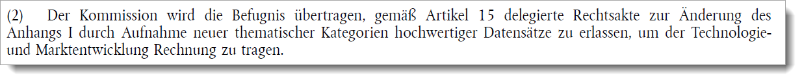
INSPIRE and High value datasets
Six thematic categories according PSI-directive (EU) 2019/1024 („about open data and the usage of informations in the public sector“):
!

Slide 68
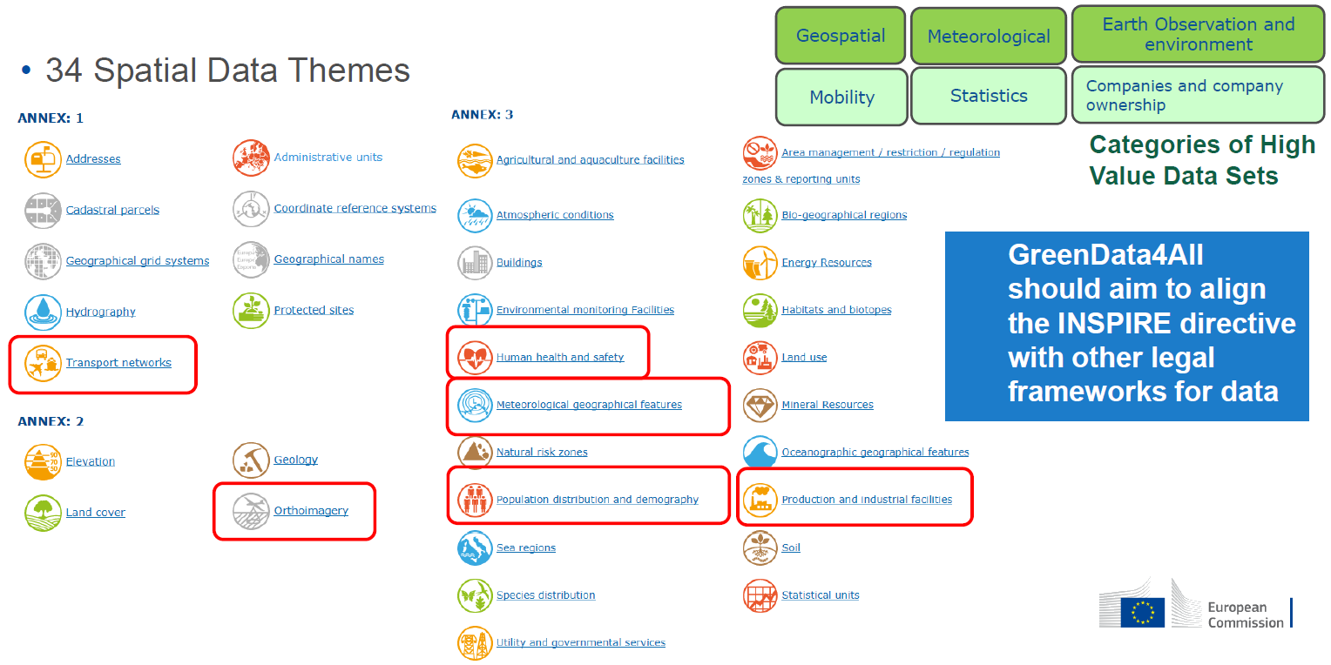
Joeri Robbrecht (2020): Building the Green Data Space.
https://inspire.ec.europa.eu/sites/default/files/inspire2020_greendataspace_green_deal_data_space.pdf
Siehe auch: https://webgate.ec.europa.eu/fpfis/wikis/download/attachments/299729499/INSPIRE-PDS-proposal-update-V2.1-20200206.xlsx?version=1&modificationDate=1580922917376&api=v2

Slide 69
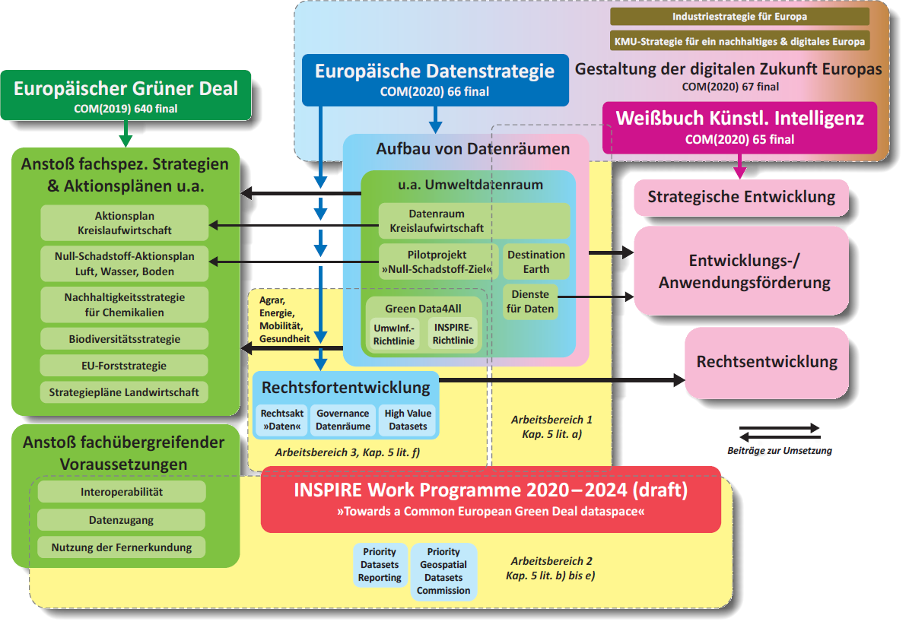

Slide 70
Destination Earth (DestinE)
“… a flagship initiative of the European Commission to develop a highly accurate digital model of the Earth on a global scale. This model will monitor, simulate and predict the interaction between natural phenomena and human activities. It will contribute to achieving the objectives of the twin transition, green and digital as part of the European Commission’s Green Deal and Digital Strategy.”
“DestinE will unlock the potential of digital modelling of the Earth systems at a level that represents a real breakthrough in terms of accuracy, local detail, access-to-information speed and interactivity. The initial focus will be on the effects of climate change and extreme weather events, their socio-economic impact and possible adaptation and mitigation strategies.”
eine Leitinitiative der Europäischen Kommission zur Entwicklung eines hochgenauen digitalen Modells der Erde auf globaler Ebene.Dieses Modell wird die Wechselwirkung zwischen Naturphänomenen und menschlichen Aktivitäten überwachen, simulieren und vorhersagen. Sie wird im Rahmen des Grünen Deals und der Digitalstrategie der Europäischen Kommission zur Verwirklichung der Ziele des doppelten Wandels beitragen.

Slide 71
Benefits of the INSPIRE Process
Legal basis for the development of GDI at European level
the only European directive that explicitly references geodata.
has established and legally anchored functioning organisational structures from the EU to local authorities,
has established standards, architectures in areas where heterogeneity was prevailing;
has attracted additional attention, also within politics and administration;
has contributed to increasing the visibility of the data of the geospatial community;
has contributed in part to the provision of additional resources (staff/organizational units, software/hardware, budgetary funds);
has underpinned the provision of central technical components (geoportals, catalogues, test suites);
has driven the Open Data process;
has created centralised access to public geodata with the obligation to set up geoportals.
has introduced a uniform European monitoring of geodata and
Burkhard Schlegel, André Caffier (2020):
INSPIRE-Umsetzung NRW auf der letzten Meile. https://geodaesie.info/zfv/zfv-archiv/zfv-145-jahrgang/zfv-2020-6/inspire-umsetzung-nrw-auf-der-letzten-meile [2023-03-09]

Slide 72
Findings
High complexity (technical, organisational)
Standard Encoding (GML) for INSPIRE is complex, requires highly specialized experts, tools and applications
complex and highly specialized geospatial data frameworks, where legal obligations are enforced by strict technical specifications

Slide 73
Recommendations
Legislation
  Review - and possibly revise - legislative rules, in particular on spatial data harmonisation, to take into account the implementing risks and complexities with a view to reducing them - simplifying requirements!
  review the effectiveness of your data policies and adopt a recognised and simple licensing framework such as Creative Commons – this will catalyse data sharing.
  increase flexibility of the legal framework to make it future and technology proof
  improve coordination between different approaches, i.e. SDI-implementation and eGovernment, open data and other relevant processes and legislative issues
  Align with other digital and policy processes (public access, open data, data spaces)to make use and data reuse easier.
Management
  establish clear Contact Points
  evaluate the shortcomings of the data policies on different administrative levels

Slide 74
Prioritization
  evolve, to flexible, open, agile, and self-sustainable data ecosystems.
  Prioritize data sets: full interoperability of those that are used/needed
  Give priority to environmental spatial datasets, in particular those linked to relevant global processes
[Kotsev et al. 2021]

Slide 75
Recommendations
Technology
  Avoid technical over-specification, instead apply agile aproaches
  Use of common tools, and promote priority setting together with the administrative members
  improve the findability (through metadata) and accessibility of the data (through network services).
  Making spatial data indexable by search engines - the discovery of data is no longer limited to those who are aware of the existence of web-based catalogues of spatial data.
  Assure the availability of interoperable information products across all partners
  Look for alternative encodings: e.g. RDF, GeoPackage, GeoJSON
  simplifying INSPIRE data models to reduce costs of harmonization and interoperability
INSPIRE action 2017.2 on Alternative Encodings, https://inspire.ec.europa.eu/sites/default/files/inspire_alternative_encodings.pdf
https://inspire.ec.europa.eu/sites/default/files/28oct-1330-dataexchange-reitz-5-inspire_and_geopackage_why-what-how-part2.pdf

Slide 76
Capacity building
  Support capacity building and explore financial opportunities arising from different programmes to help capacity building
  Assist all agencies (administrative units) in applying and implementing the directives in the sense of simplification of use
Costs
  Legal framework should be technology neutral. Implementers should have the option and the freedom to deploy cost effective off the shelf tools that apply state of the art technology to share data in a user friendly way.
  simplify of the minimal interoperability mechanisms to reduce costs needed

Slide 77
Recommendations
Close the implementation gap
  Flexible implementation: technology neutral, to allow for both well-established and emerging technological standards
  Simplify implementation: to reduce costs of harmonization and interoperability
Apply a user-driven approach
  Develop use cases
  Assess the current and future needs (content/features classes, formats and tools, products and services)
  Offer simpler views of structures and relationships between data elements (via complementary data models for non-expert users)
[ Rafaelsen & Oules 2021]

Slide 78
Summary
INSPIRE Directive – defines the requirements
INSPIRE Technical Architecture – defines the high-level architecture
INSPIRE Network Services Architecture – defines the architecture for the INSPIRE Network Services Implementing Rules
INSPIRE service types: Own terminology
Focus on interoperability and sharing.
High complexity regarding data models, CRS, homogenity
New developments: Towards Green Data for All

Slide 79
Thank you!
Danke für Ihre Aufmerksamkeit!

Slide 80
References
Kotsev, A., Minghini, M., Cetl, V., Penninga, F., Robbrecht, J. and Lutz, M. (2021): INSPIRE - A Public Sector Contribution to the European Green Deal Data Space, EUR 30832 EN, Publications Office of the European Union, Luxembourg, 2021, ISBN 978-92-76-41564-0, doi:10.2760/8563, JRC126319.
Robbrecht, Joeri (2021): Past, present and future of INSPIRE, https://inspire.ec.europa.eu/sites/default/files/inspire_conf_2021_past_present_future_joeri_robbrecht.pdf
Rafaelsen, Bettina & Oules, Lise (2021): Past, present and future of INSPIRE. https://inspire.ec.europa.eu/sites/default/files/inspire_seminar_presentation_201021_cowi.pdf [2023-03-08]

