Slide 1

“Imagine that it’s 1913 and the post office, the phone company, the public library, printing houses, the US Geological Survey mapping operations, movie houses and all atlases are largely controlled by a secretive corporation unaccountable to the public.
Jump a century and see that in the online world that’s more or less where we are. “
http://www.rebeccasolnit.net/
Solnit, Rebecca (2013): Welcome to the (Don’t Be) Evil Empire. Google eats the world. https://www.thenation.com/article/archive/welcome-dont-be-evil-empire/ [2024-11-20]

Slide 2
The World Wide Web: Its Foundations and its Threads
Prof. Dr.-Ing. Franz-Josef Behr

Slide 3
Outline
Introduction: Some facts and thoughts about the web
Threads, like political interference
The contract: Engage yourself for the web

Slide 4
Some facts and thoughts about the web

Slide 5
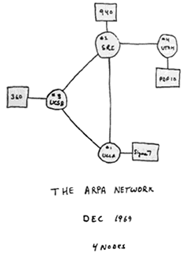
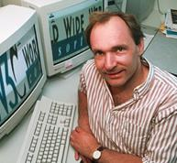
History
1965 „Hypertext“ and „Hypermedia“ (Ted Nelson)
1969 ARPANET (4 nodes)
1974 TCP protocol, 1983 „Internet“
1989 World Wide Web (Berners-Lee,
Cailliau; Release 1991)
1991: First website
1996 Hypertext Transfer Protocol (HTTP/1.0)
1993 Mosaic Browser (Web increases 341634% per year)
1995 Web exceeds FTP in transfer volume
"Web 2.0" in 2004 (first suggested in 1999): user generated content
Since 2008: The mobile revolution
Commercialization, privatization, broader access leads to the modern Internet (but creates also threads like missing net neutrality). Fakes.
http://kartoweb.itc.nl/webcartography/webbook/ch06/ch06.htm#
See also:
A Brief History of the Internet, http://www.isoc.org/internet/history/brief.shtml
https://en.wikipedia.org/wiki/History_of_the_Internet
Notes:
Die Ursprünge des heutigen Internet reichen in die 60er Jahre zurück. Es war die Zeit des Kalten Krieges zwischen den beiden Weltmächten USA und
UDSSR. Neue Impulse in der Elektronischen Datenverarbeitung (EDV) kamen in jener Zeit hauptsächlich durch militärische Initiativen zustande.
Im amerikanischen Verteidigungsministerium, wurde überlegt, wie man wichtige militärische Daten auf der Basis eines Datennetzes besser schützen könnte.
Selbst bei einem atomaren Angriff des Gegners sollten die Daten nicht zerstört werden können. Als Lösung kam nur ein elektronisches Datennetz in Frage.
Die gleichen Daten sollten dabei auf mehreren, weit entfernten Rechnern abgelegt werden. Bei neuen oder geänderten Daten sollten sich alle
angeschlossenen Rechner binnen kürzester Zeit den aktuellen Datenstand zusenden. Jeder Rechner sollte dabei über mehrere Wege mit jedem anderen
Rechner kommunizieren können. So würde das Netz auch dann funktionieren, wenn ein einzelner Rechner oder eine bestimmte Leitung durch einen Angriff
zerstört würde.
Die Advanced Research Projects Agency (ARPA), Teil der US-Militärs, realisierte das geplante Projekt. In den ersten Jahren wurde das Netz deshalb
ARPA-Net genannt. Ende 1969 waren die ersten vier Rechner an das ARPA-Net angeschlossen. Drei Jahre später waren es bereits 40 Rechner.

Slide 6
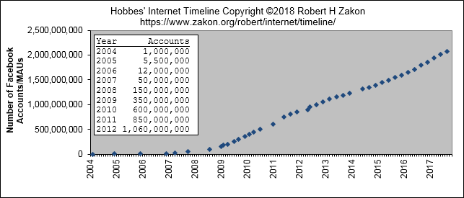
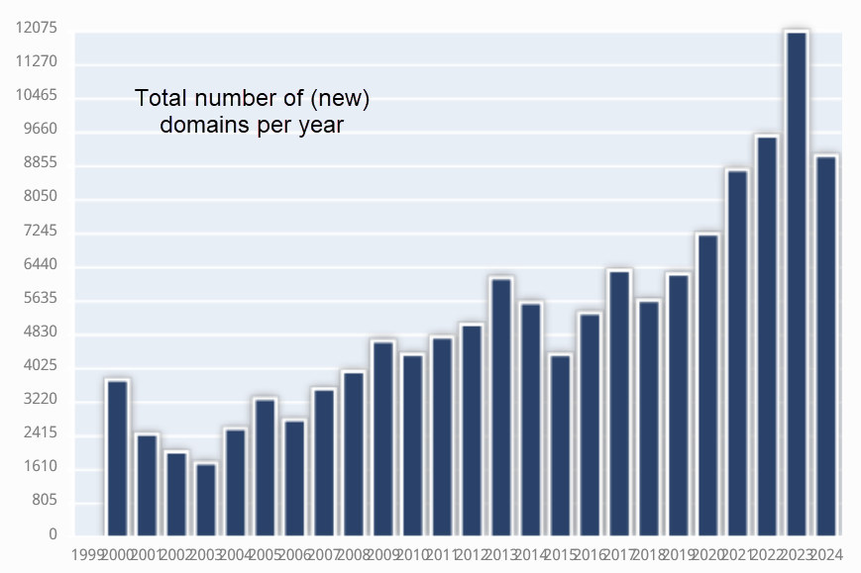
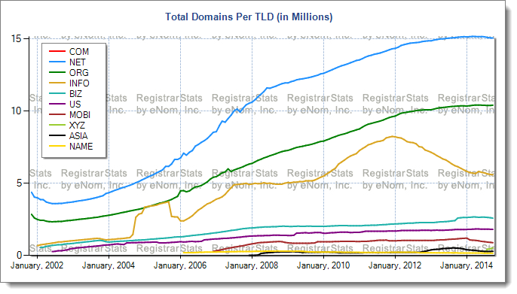
Internet Growth
https://www.zakon.org/robert/internet/timeline/#Growth [2019-12-03]
http://www.registrarstats.com/TLDDomainCounts.aspx [2014-09-26 no more available]
https://www.wipo.int/amc/en/domains/statistics/domains.jsp [2024-10-17]

Slide 7
Internet Growth II
The Internet has been one of our most transformative and fast-growing technologies.
  Check https://ourworldindata.org/internet
  Enjoy the animated graph: https://ourworldindata.org/internet#internet-access
However: What‘s about the broadband access in your country/region
According to https://www.hostingadvice.com/how-to/how-many-websites-are-on-the-internet/:
1.13 Billion Websites on the Internet. Only 18% of all websites are active

Slide 8
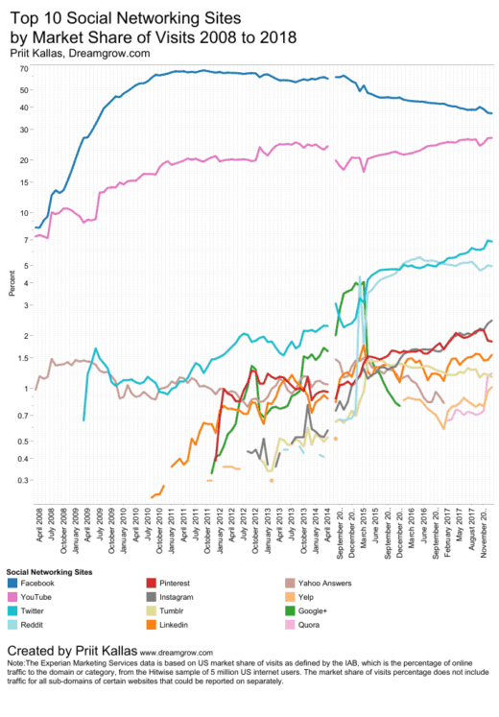
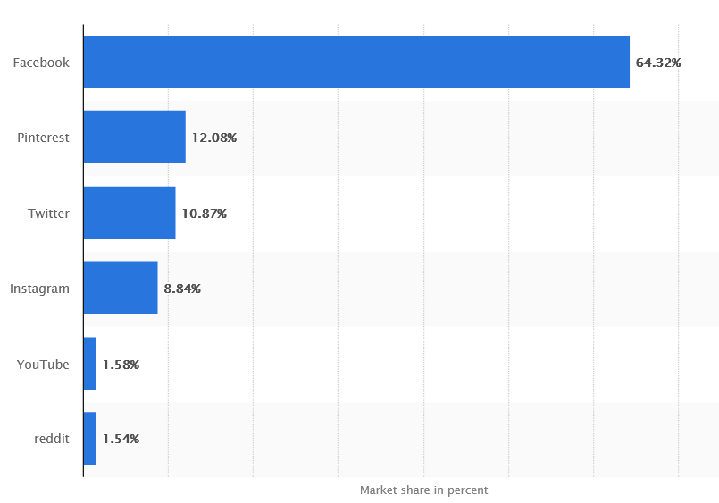
Social Media Sites
https://www.statista.com/statistics/265773/market-share-of-the-most-popular-social-media-websites-in-the-us/ [2022-10-13]
https://www.dreamgrow.com/top-10-social-networking-sites-market-share-of-visits/ [2022-10-13]

Slide 9
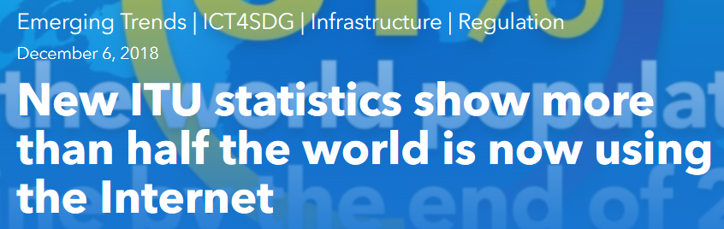
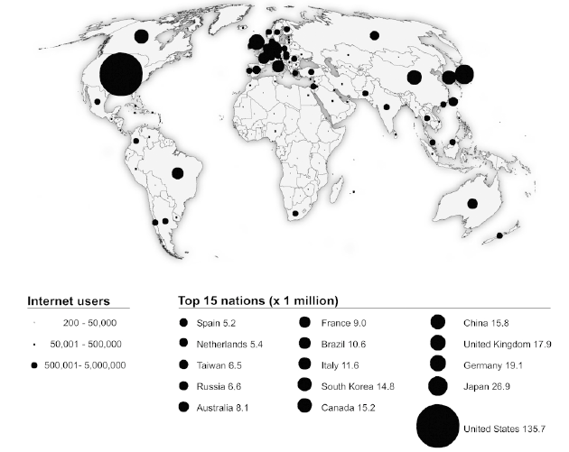
Use and Users of Maps on the Web
https://news.itu.int/itu-statistics-leaving-no-one-offline/?utm_term=RWRpdG9yaWFsX1RoZVVwc2lkZS0xOTAxMTE%3D&utm_source=esp&utm_medium=Email&utm_campaign=TheUpside&CMP=upside_email [2019-01-13]
Corné P.J.M. van Elzakker: Use and Users of Maps on the Web, http://www.nacis.org/cp/cp37/CP37_34_50.pdf [2005]

Slide 10
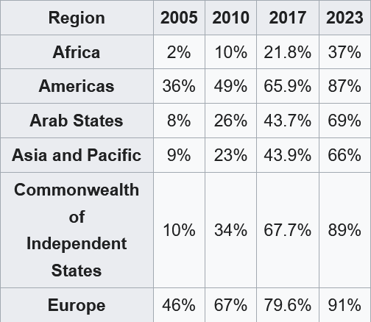
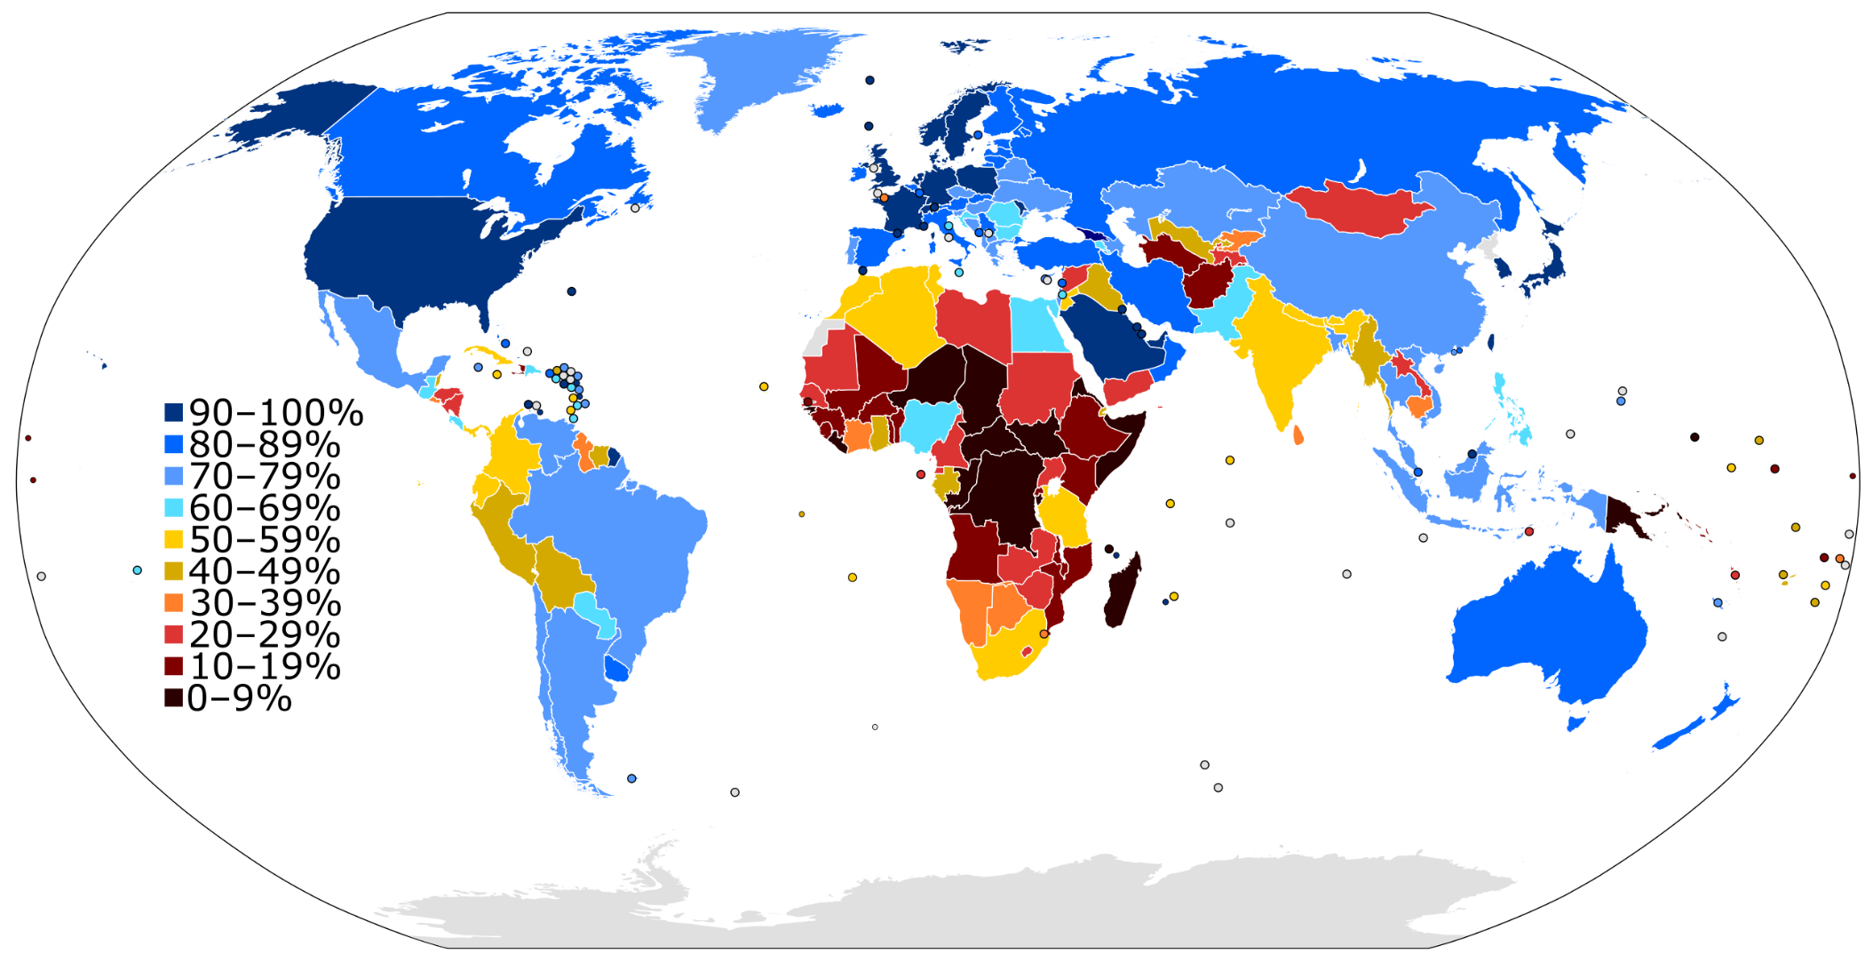
Internet users in 2023 as a percentage of a country's population
https://en.wikipedia.org/wiki/List_of_countries_by_number_of_Internet_users [2024-12-12]

Slide 11
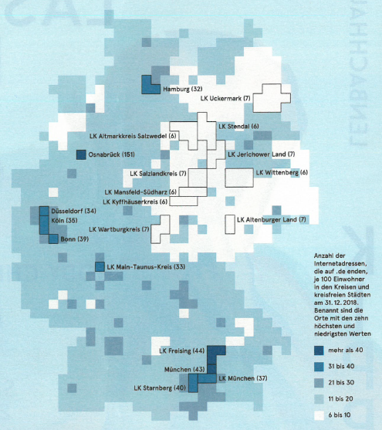
Regional
Disparities in Germany
Source: Zeit-Magazin,
Juni 2019 / DENIC

Slide 12
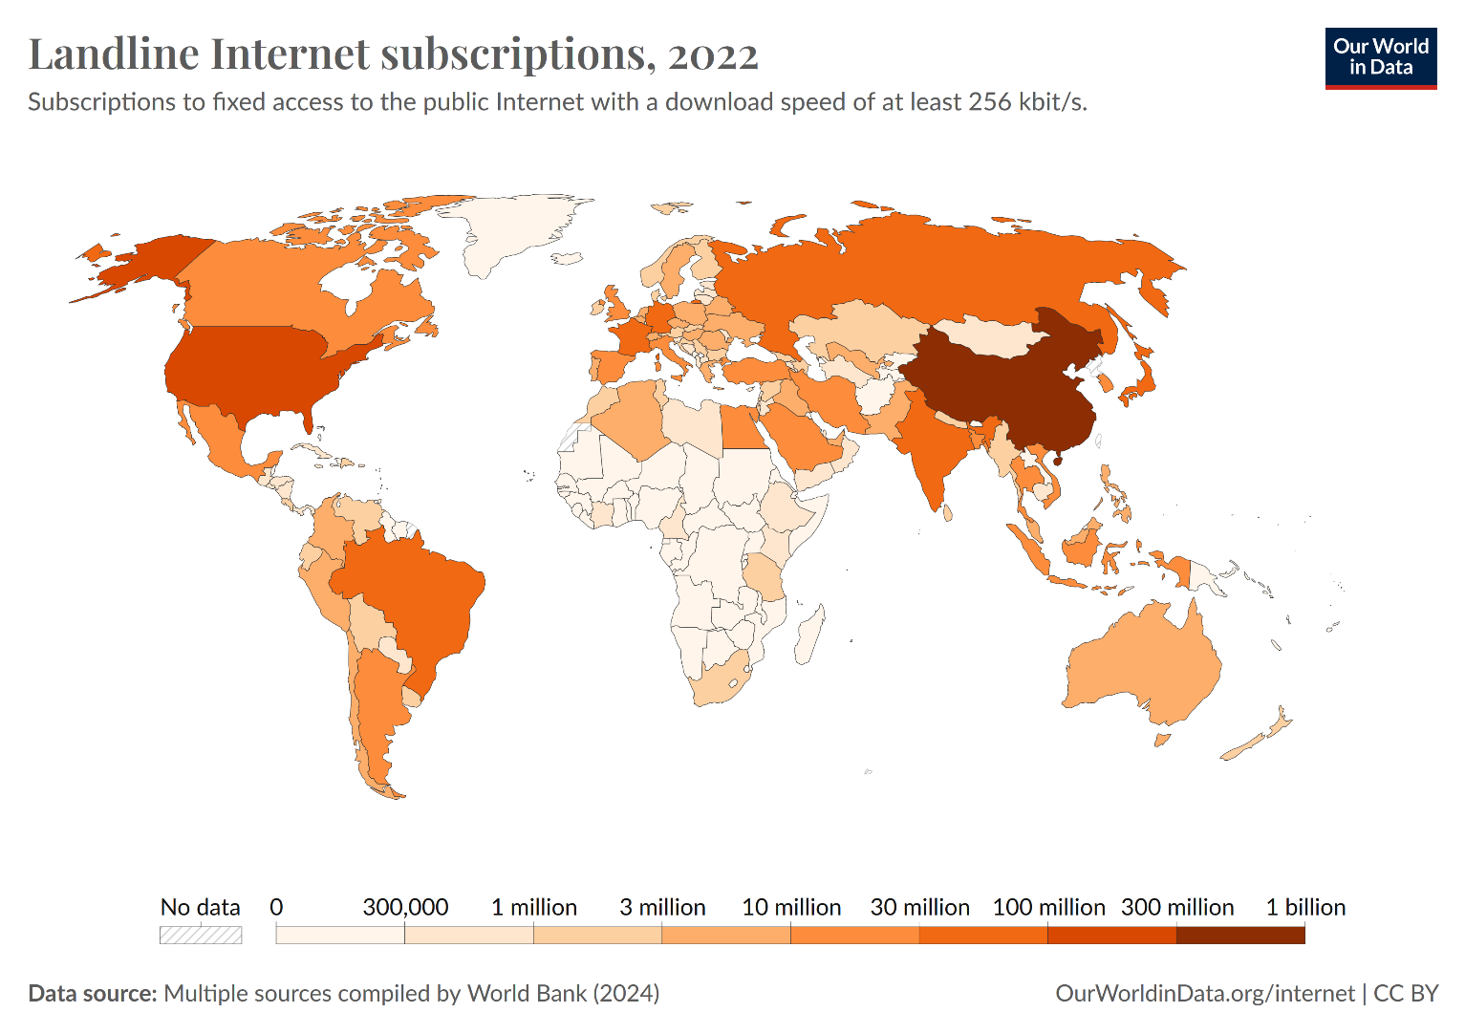
https://ourworldindata.org/grapher/landline-internet-subscriptions?time=latest [2024-10-15]

Slide 13
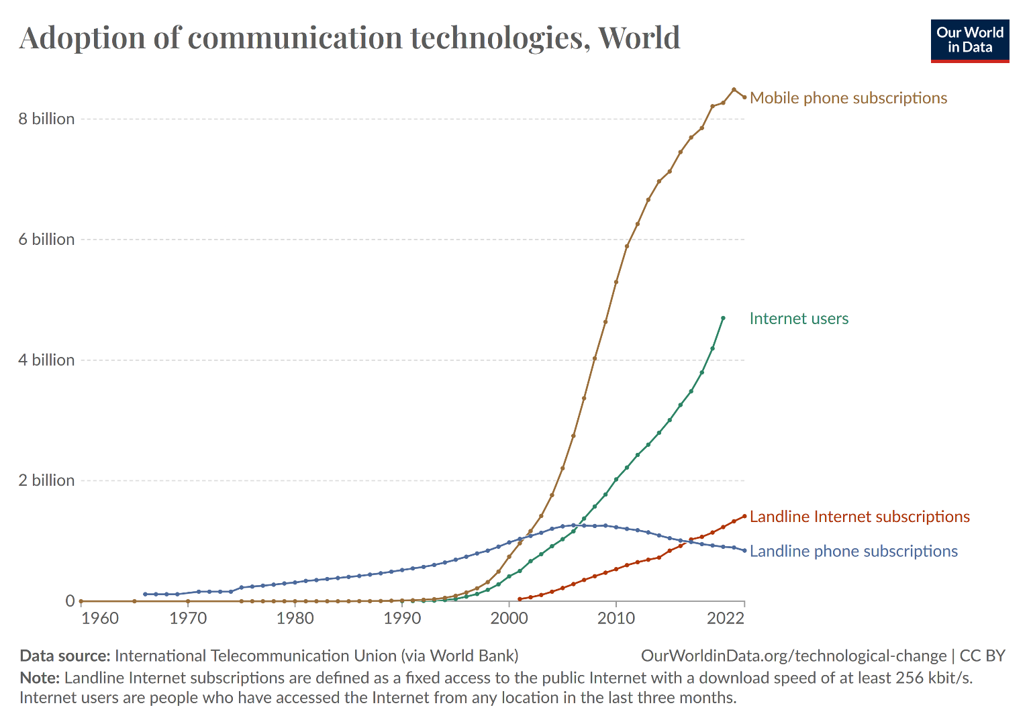
7.21 billion people worldwide use Smartphones (2024)
97% of users between 18 to 49 years use smartphones.
https://www.demandsage.com/smartphone-usage-statistics/
https://ourworldindata.org/grapher/landline-internet-subscriptions?time=latest [2024-10-15]

Slide 14
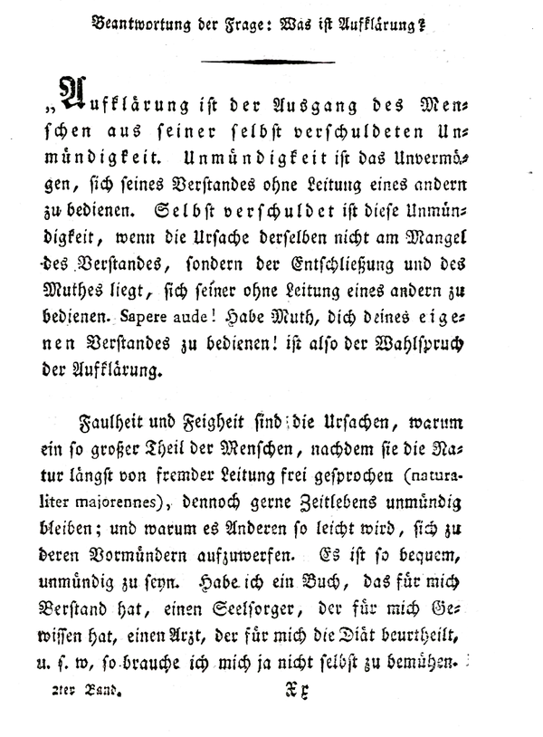
The web and Enlightenment
“Enlightenment is the departure of the human being from its self-incurred minority/ Immaturity. Minority is the inability to make use of one's understanding without direction of another. “
The Enlightenment promotes and requires individual liberty, representative government, the rule of law, and religious freedom.
Source: “What Is Enlightenment?", is a 1784 essay by the philosopher Immanuel Kant., see https://en.wikipedia.org/wiki/What_Is_Enlightenment%3F
sapere aude ('dare to know')

Slide 15
The web and Enlightenment
“Ultimately Internet access is only one component of the global digital divides that serve to amplify the differences between the privileged and underprivileged […].
However, it is a prerequisite for many types of communication, information access, and participation in nonlocal cultural, economic, and political processes.”
Graham M et al. (2012): Featured graphic: Digital divide: the geography of Internet access, Environment and Planning A 2012, volume 44, pages 1009 – 1010, doi:10.1068/a44497, http://journals.sagepub.com/doi/pdf/10.1068/a44497 [2024-12-11]
Notes:
The Web was designed to bring people together and make knowledge freely available. It has changed the world for good and improved the lives of billions. Yet, many people are still unable to access its benefits and, for others, the Web comes with too many unacceptable costs.
The Digital Divide refers to the gap between those able to benefit from the internet and those who are not

Slide 16
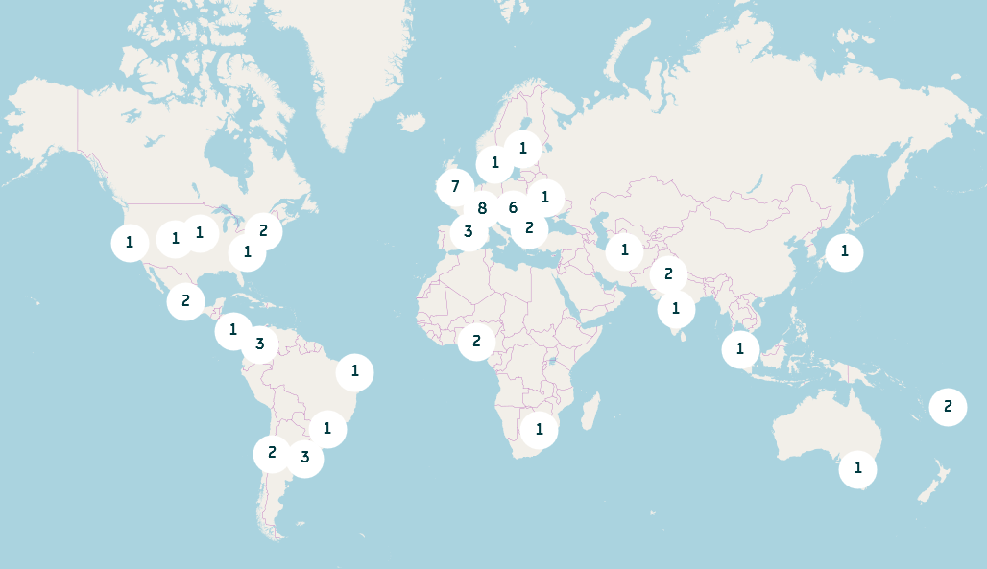
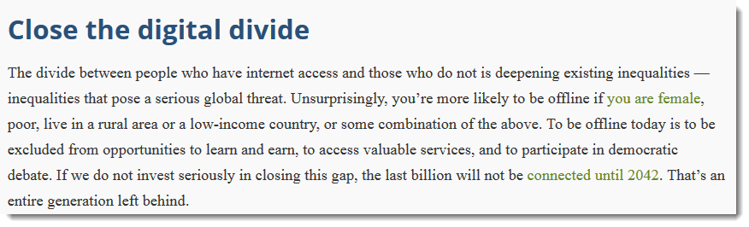

ICA/OSGeo Labs: Geo4All
Mission - "Making geospatial education and opportunities accessible to all“
  https://www.osgeo.org/initiatives/geo-for-all/ [2019-09-17]
https://webfoundation.org/2018/03/web-birthday-29/

Slide 17
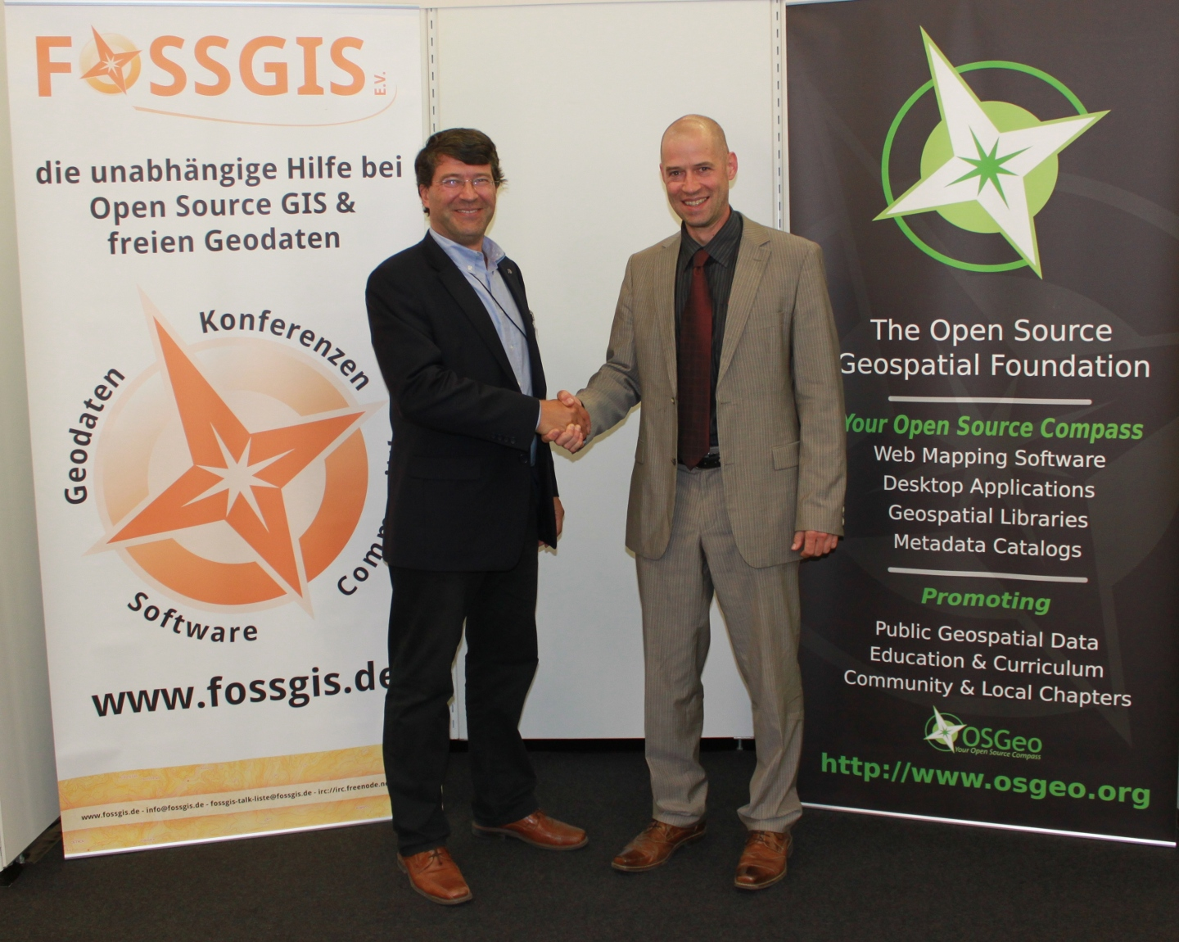
ICA & OSGeo (& ISPRS) MoU
Nuremberg, Germany - September 27, 2011
Aims: developing on a global basis collaboration opportunities for academia, industry and government organizations in open source GIS software and data
  provide expertise and support for the establishment of Open Source Geospatial Laboratories and Research Centres across the world for supporting development of open-source geospatial software technologies, training and expertise.
  to provide support for building-up and supporting development of open source GIS teaching and training materials, joint organization of open source GIS events, workshops through the ICA network for wider participation globally etc.
https://wiki.osgeo.org/images/b/b4/Mou_ica-osgeo.jpg [2018-10-15]
See https://wiki.osgeo.org/wiki/MOU_ISPRS and
https://wiki.osgeo.org/wiki/MOU_ISPRS
Notes:
Geo4All: the aim of developing on a global basis collaboration opportunities for academia, industry and government organizations in open source GIS software and data. The MoU aims to provide expertise and support for the establishment of Open Source Geospatial Laboratories and Research Centres across the world for supporting development of open-source geospatial software technologies, training and expertise. In the first phase five laboratories will be established, one each in Asia, Europe, Africa, the Americas and Australasia which will act as nodes for future expansion. It also aims to provide support for building-up and supporting development of open source GIS teaching and training materials, joint organization of open source GIS events, workshops through the ICA network for wider participation globally etc.
OSGeo is a not-for-profit organization founded in 2006 whose mission is to support and promote the collaborative development of open source geospatial technologies and data.
ICA is the world authoritative body for cartography, the discipline dealing with the conception, production, dissemination and study of maps.
ISPRS is the wordwide umbrella organisation for Photogrammetry and Remote Sensing
17

Slide 18
The Web: Basic ideas
& reality

Slide 19
Basic ideas/convictions
Decentralisation: No permission needed from a central authority to post anything on the web, no central controlling node, and so no single point of failure … and no “kill switch”! Freedom from indiscriminate censorship and surveillance.
Non-discrimination and Net Neutrality: All data on the Internet the same, and not discriminate or charge differently by user, content, website, platform, application, type of attached equipment, or method of communication
Bottom-up design: Instead of code being written and controlled by a small group of experts, it was developed in full view of everyone, encouraging maximum participation and experimentation.
Universality: For anyone to be able to publish anything on the web, all the computers involved have to speak the same languages to each other independent of hardware used; where they live; or what cultural and political beliefs they have. In this way, the web breaks down silos while still allowing diversity to flourish.
Consensus: For universal standards to work, everyone has to agree to use them through a transparent, participatory process.
After https://webfoundation.org/about/vision/history-of-the-web/ [2018-04-05]
Notes:
Internet service providers (ISPs) must treat all Internet communications equally, offering users and online content providers consistent transfer rates regardless of content, website, platform, application, type of equipment, source address, destination address, or method of communication (i.e., without price discrimination)

Slide 20
For a time, it seemed as if the internet was on democracy’s side, helping the crowds in Cairo’s Tahrir Square or Kiev’s Maidan topple terrible tyrants.
https://www.thedailybeast.com/social-media-shreds-the-social-fabric-one-click-at-a-time/
[… ]the most important thing we at Facebook can do is develop the social infrastructure to give people the power to build a global community that works for all of us.
Mark Zuckerberg (2017) https://www.weforum.org/stories/2017/02/mark-zuckerberg-building-a-global-community-that-works-for-everyone/

Slide 21
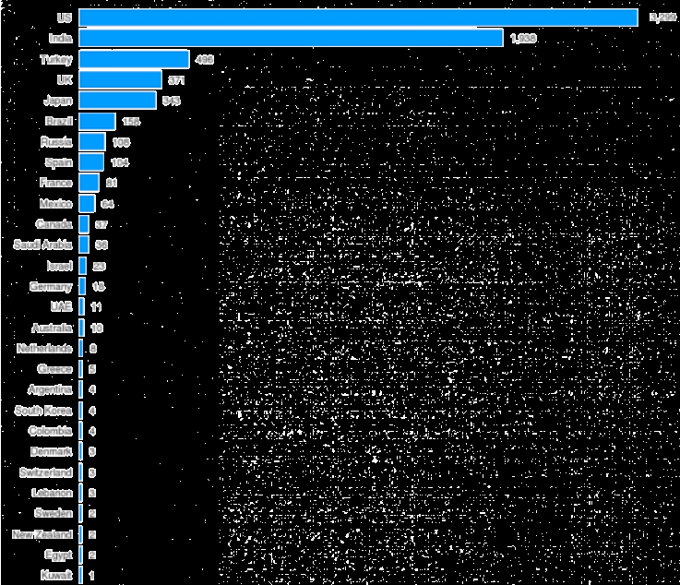
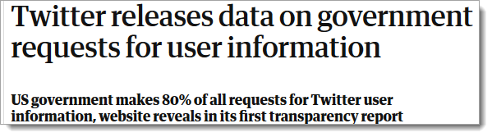
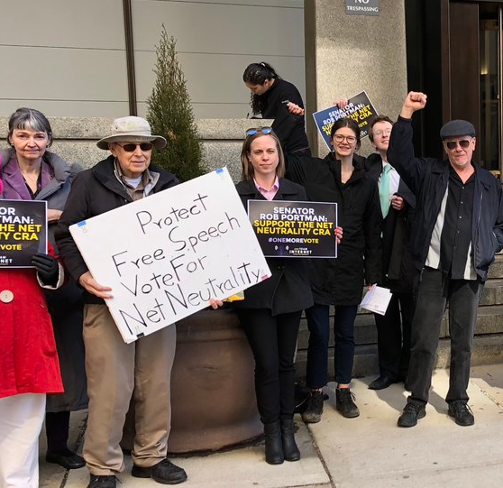

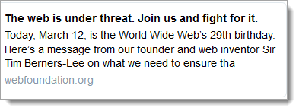
Governments that make the most requests for information from Twitter
https://www.indy100.com/article/11-maps-and-charts-to-challenge-how-you-see-the-internet--x1lOVKgIzkW
https://www.theguardian.com/technology/2012/jul/02/twitter-transparency-report [2019-12-03]
https://twitter.com/timberners_lee

Slide 22
5.17 billion social media users globally (according to https://www.demandsage.com/social-media-users/)

Slide 23
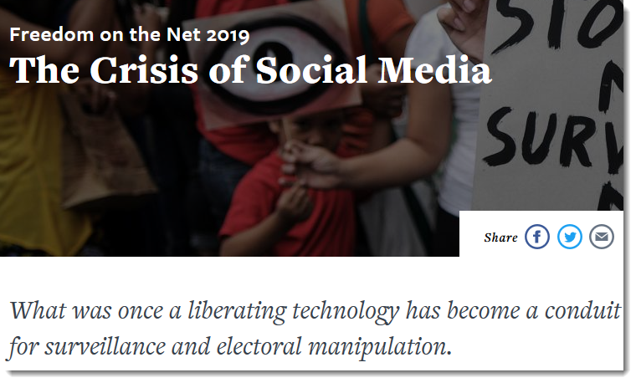
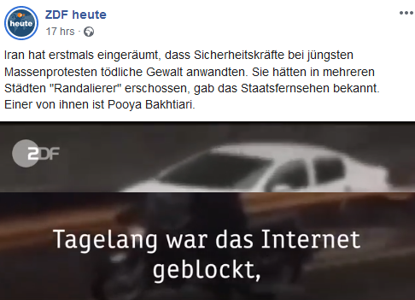
https://www.freedomonthenet.org/report/freedom-on-the-net/2019/the-crisis-of-social-media [2019-12-03]
https://rsf.org/en
https://www.facebook.com/ZDFheute/?__tn__=kCH-R&eid=ARBheoK0RV5qOaMQNrwu3BXWQRauhAvKfTkktJf53axFWYBASLsluNbpurfJ5gYgrQUi3NFxvZb2NuKc&hc_ref=ARRGWR85OUVTqouYeP0Xv3SrQDmE3y-jQJeEhBytlmxiSP7x-CT5DyzGty6TlPW4oc0&fref=nf&__xts__[0]=68.ARAP798qgThE4q8NRj_DMLMw4gLPGHIuMrWwVLZO7GAi4THTZWSc52cmFs7ILwBdM4WZkxKDsYuyM_ZCAg5Pw-AgxyF6Mnh1t2eKr6pd_OzJh1Vm42lm_qrmr3P6YVKwZ3sfJcHyFRJib2iEMSZcVjgGnCWLuiwT0LFQDVwATwcsi9L67JsQCwt_xNmxfYCiH67pH8ZGQWUCNRDX6XOBWvhL8MMjaYR0ziYJWklaESRt-T-EO-FySuDgglHI0u6CiC3qG27FfFA-EkeniLI4AZ87nGfuTamSs4yloZ6cfl_IkYQgU76sWyUv81dvW6hzIY4f1A4bTJfEAOAcpVE-qVw2pDotKxnzpHk [2019-12-04]

Slide 24
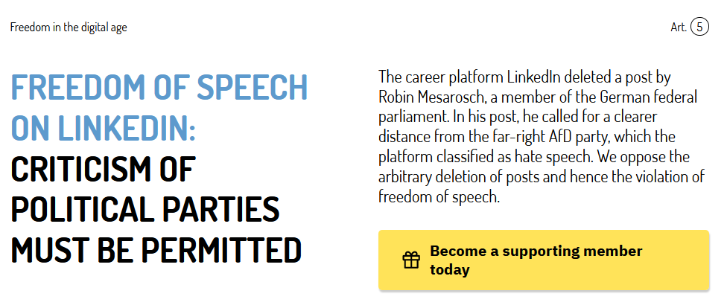
https://freiheitsrechte.org/en/themen/digitale-grundrechte/linkedin [2023-11-16]

Slide 25
Evaluate…
https://freiheitsrechte.org/en/themen/digitale-grundrechte
„Informational self-determination“ (see https://en.wikipedia.org/wiki/Informational_self-determination)
https://en.wikipedia.org/wiki/Internet_censorship_and_surveillance_by_country#Internet_censorship_and_surveillance_by_continent

Slide 26
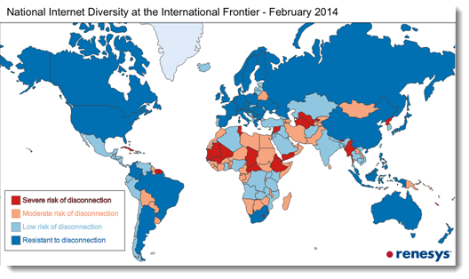
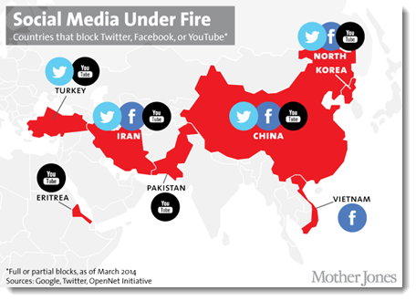
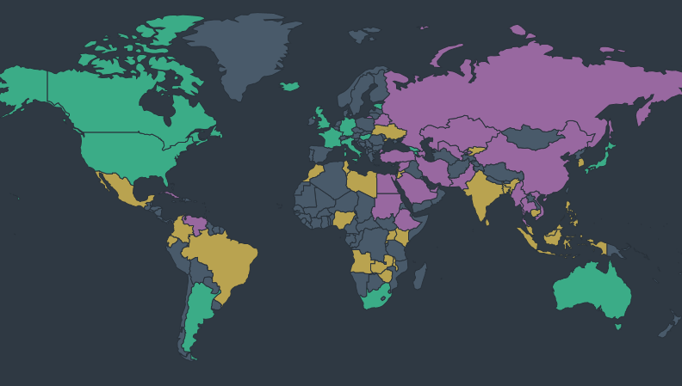

Non-discrimination
https://www.freedomonthenet.org/explore-the-map
Read more:
https://rsf.org/en
https://www.nytimes.com/2014/03/12/opinion/the-future-osf-internet-freedom.html
Notes:
Wikipedia: Internet censorship is the control or suppression of what can be accessed, published, or viewed on the Internet enacted by regulators, or on their own initiative. Individuals and organizations may engage in self-censorship for moral, religious, or business reasons, to conform to societal norms, due to intimidation, or out of fear of legal or other consequences.
The social media sites Facebook, YouTube, and Twitter are frequent targets for censorious governments. This map from Mother Jones shows which countries restrict their users from accessing these sites. China doesn't just block access to Western social media sites, it has also cultivated home-grown alternatives that are under the thumb of the Chinese authorities. These social media sites enable users to engage in relatively unfettered discusion, but the providers are required to participate in an elaborate monitoring and censorship regime to ensure that sensitive topics do not receive widespread discussion.
The extent of Internet censorship varies on a country-to-country basis. While most democratic countries have moderate Internet censorship, other countries go as far as to limit the access of information such as news and suppress discussion among citizens.
This map from Freedom House details which countries respect freedom of speech and which countries without it. Cuba and several countries in Southeast Asia and the Middle East engage in pervasive censorship and are marked in purple. China, for example, has a "great firewall" that makes it difficult for its citizens to read about sensitive topics such as the Falun Gong or the 1989 Tiananmen Square massacre. Other countries have a partially free internet. In Russia, for example, the government has engaged in more aggressive internet censorship since Vladimir Putin returned to power in 2012.

Slide 27
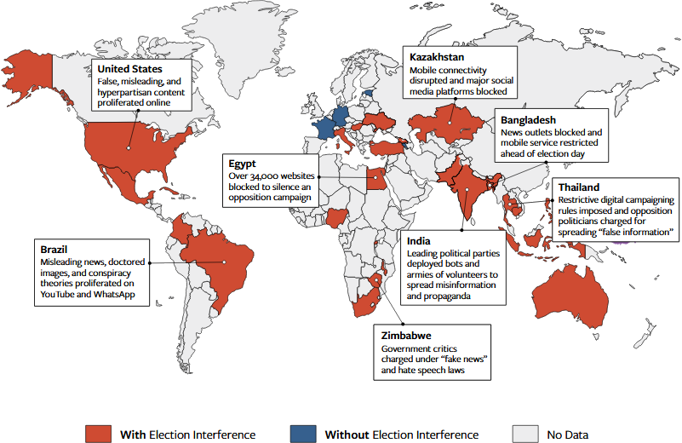
The Global Phenomenon Of Digital Election Interference
https://freedomhouse.org/sites/default/files/2019-11/11042019_Report_FH_FOTN_2019_final_Public_Download.pdf [2020-03-31]
Notes:
Digital platforms are the new battleground for democracy. Shaping the flow of information on the internet is now an essential strategy of those seeking to disrupt the democratic transfer of power through elections.
In the 30 countries that held elections or referendums during the coverage period, Freedom House found three distinct forms of digital election interference: informational measures, in which online discussions are surreptitiously manipulated in favor of the government or particular parties; technical measures, which are used to restrict access to news sources, communication tools, and in some cases the entire internet; and legal measures, which authorities apply to punish regime opponents and chill politi-cal expression.
In times of personalized social networks, election campaigns are progressively shifting into the digital realm. This development has been amplified by the pandemic. Especially in times of restricted personal contact, election campaigns remain a possibility thanks to digitalization. However, these and other opportunities show only one side of the coin. Smear campaigns using disinformation, the precise and purposeful distribution of fake news on behalf of home and foreign governments, and micro-targeting during electoral campaigns confront the law with unprecedented challenges.(https://demokratie.badw.de/en/election-interference.html)

Slide 28
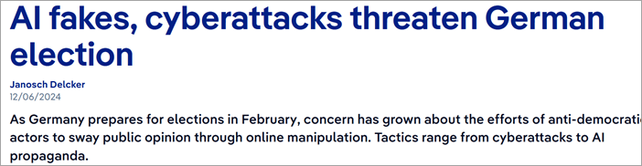
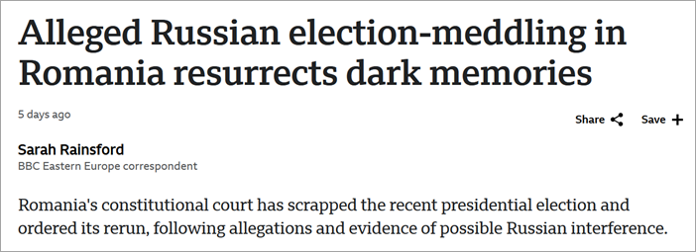
2024
https://www.dw.com/en/from-ai-fakes-to-cyberattacks-threats-to-german-elections/a-70972702 [2024-12-11]
https://www.bbc.com/news/articles/c7vee5n5lp0o [2024-12-11]

Slide 29
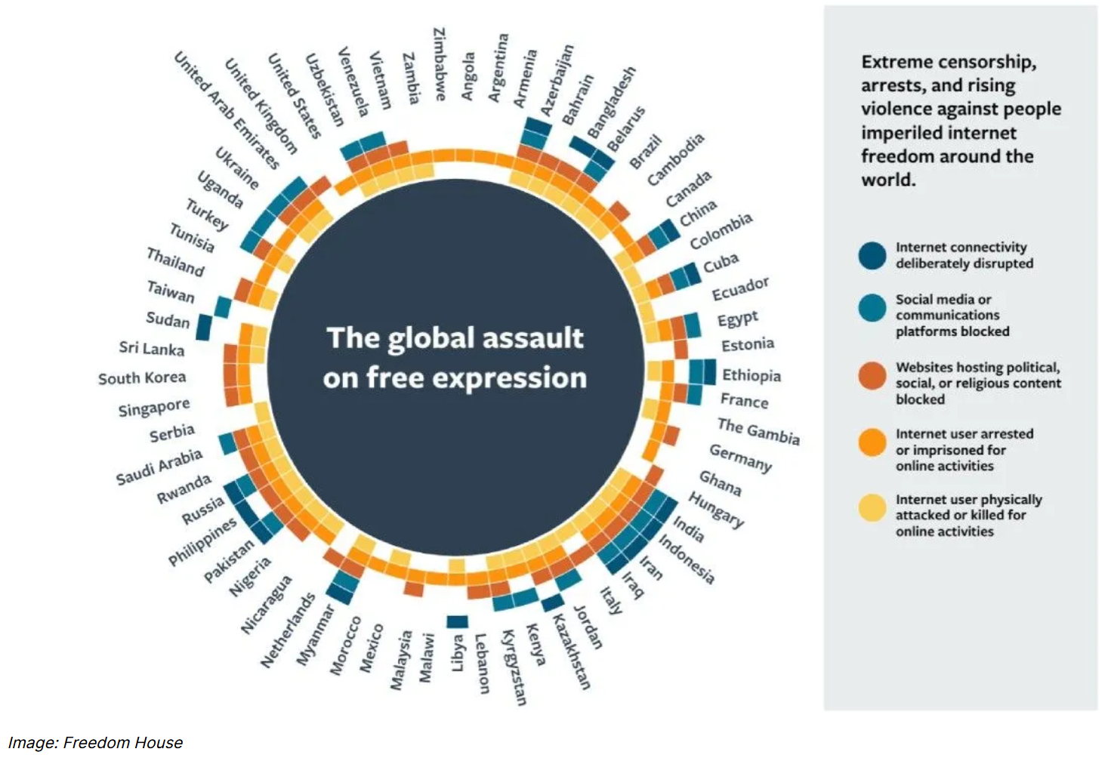
https://therecord.media/internet-freedoms-decline-2024-government-arrests-violence-outages-elections

Slide 30
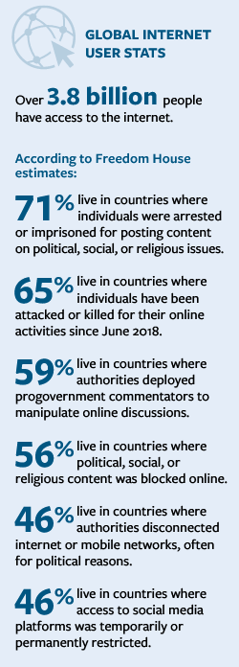
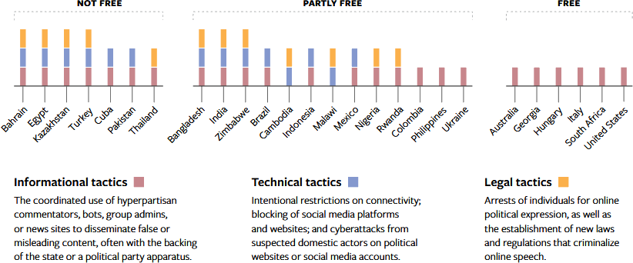
How interference happens

Slide 31
Engage yourself for the web

Slide 32
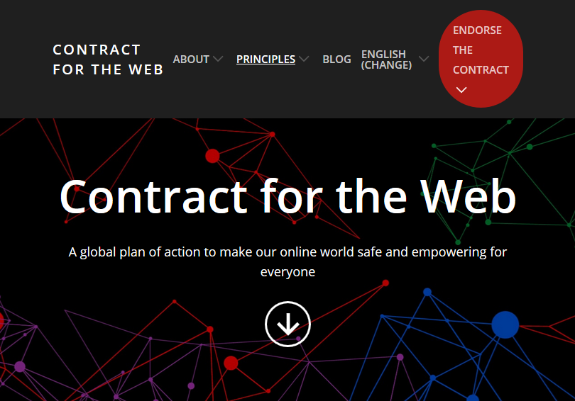
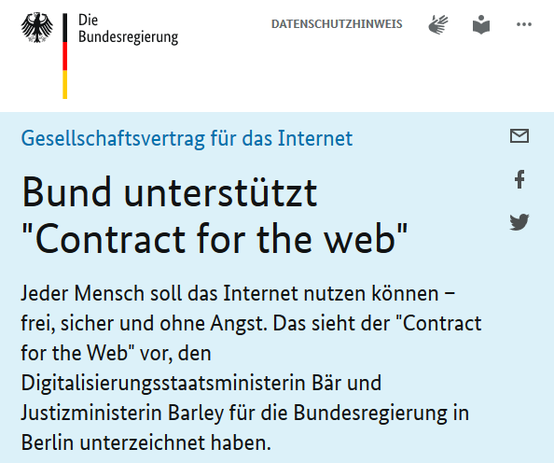
https://www.bundesregierung.de/breg-de/aktuelles/bund-unterstuetzt-contract-for-the-web--1554868
https://contractfortheweb.org/
Notes:
Everyone has a role to play in safeguarding the future of the Web.
Contract for the Web is an initiative by the World Wide Web Foundation, an international non-profit organisation advocating for a free and open web for everyone, in November 2019 to attempt to address issues of political manipulation, fake news, privacy violations, and other malign forces on the internet
The Contract for the Web was created by representatives from over 80 organizations, representing governments, companies and civil society, and sets out commitments to guide digital policy agendas. To achieve the Contract’s goals, governments, companies, civil society and individuals must commit to sustained policy development, advocacy, and implementation of the Contract text.

Slide 33
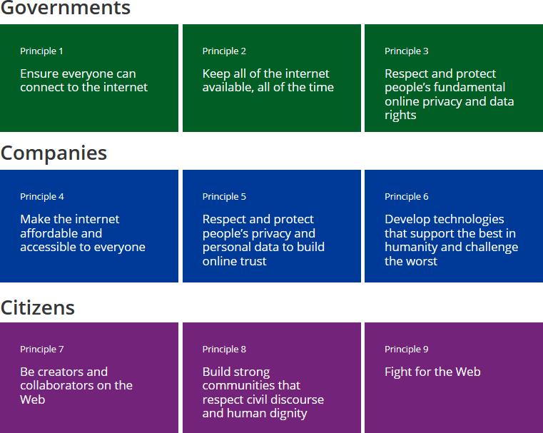
Notes:
The plan outlines nine central principles, three each directed at governments, companies and individuals.
By being active participants in shaping the Web, including content and systems made available through it, such as by
Leveraging and promoting the use of open licenses to share information of public interest.
Sharing best practices and guidelines to help create and develop a Web focused on the needs of citizens.
Advocating for standard technology that is open and accessible to all persons, regardless of their abilities.
Producing or translating content into local minority languages.
So that everyone feels safe and welcome online
By working towards a more inclusive Web:
Adopting best practices on civil discourse online and educating the next generation on these matters.
Committing to amplify the messages of systematically excluded groups, and standing up for them when they are being targeted or abused.
Taking steps to protect their privacy and security, and that of others, by choosing products and services thoughtfully, and articulating privacy preferences accordingly.
Refraining from participating in the non-consensual dissemination of intimate information that breach privacy and trust.
Fight for the Web
So the Web remains open and a global public resource for people everywhere, now and in the future
. By being active citizens of the Web:
Creating awareness amongst peers regarding threats to the open Web.
Opposing the Web’s weaponization by nation states or any other entity.
Supporting organizations, processes and people who promote the open Web.
Supporting startups and established companies that espouse the Web’s future as a basic right and public good.
Engaging political representatives and companies to ensure support and compliance with this Contract and support for the open Web.

Slide 34
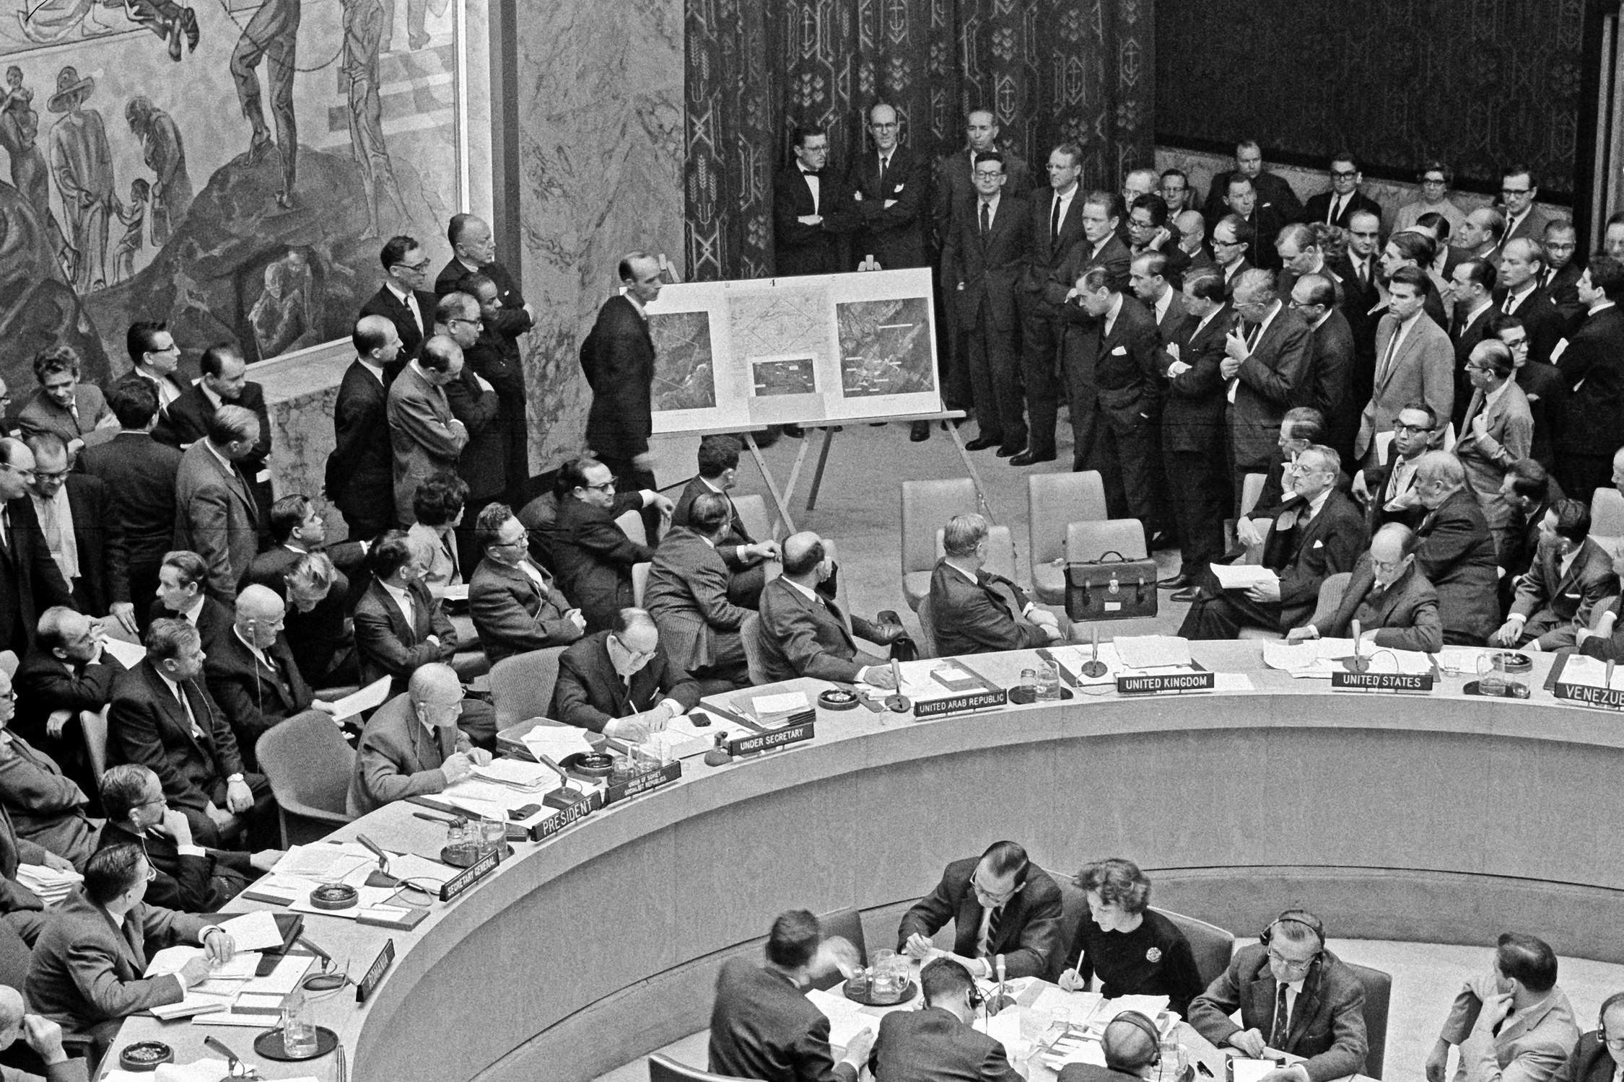
Our special mission
Security Council exhibits maps and photographs during the crisis in the Caribbean
Source. https://www.un.org/geospatial/ [2020-12-04]

