Slide 1


Architectures of Web Applications
Languages and Tools
Quelloffene Softwarekomponenten im Bereich der
raumbezogenen Datenverarbeitung
Eine Übersicht
By Hochschule für Technik Stuttgart [CC BY-SA 3.0 (http://creativecommons.org/licenses/by-sa/3.0)], via Wikimedia Commons
Franz-Josef Behr, Hochschule für Technik Stuttgart
2022
The content is licensed under a Creative Commons-Lizenz CC BY-NC-SA.

Slide 2
Gliederung
Vier-Schichten-Architektur von Client-Server-Anwendungen
Softwarelösungen für jede der Schichten
Werkzeuge, Versuche zur Beurteilung der Marktbedeutung
Zusammenfassung

Slide 3
Vier-Schichten-Modell
Four Tier Model

Slide 4
Architektur
DNS Server
IP address
IP address / Server Name / Host name
Client
"User Agent"
HTTP Server
Document root
Static
resources
HTTP-Client
HTTP-Client
HTTP-Client
HTTP
HTTP
80
Internet
80
Kommunikationsschicht
Web Tier
PNG, JPG, …
XML / SVG
Präsentationsschicht
CGI protocol
Application
Server
Apps
Local System
(GIS)
App Tier,
Geschäftslogik-Schicht
SQL
Datensammlung, Aufbereitung, Analyse
DBMS
Server
Datenschicht

Slide 5
Präsentationsschicht
Presentation Tier

Slide 6
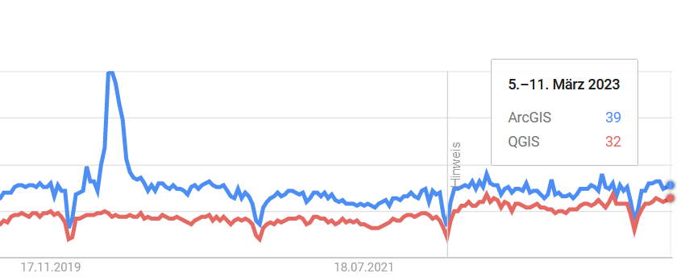

Desktop GIS
See also https://gisgeography.com/qgis-arcgis-differences/
https://trends.google.com/trends/explore?q=ArcGIS,QGIS [2023-03-15]

Slide 7
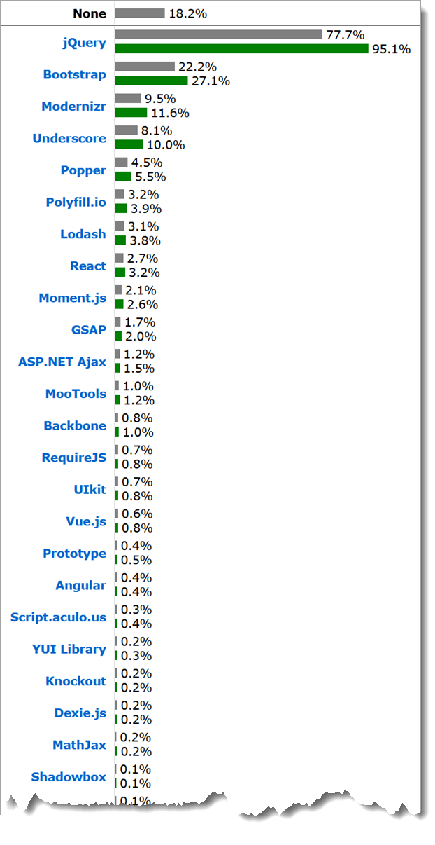
JavaScript
Libraries
https://w3techs.com/technologies/overview/javascript_library/all [2022-03-10]

Slide 8
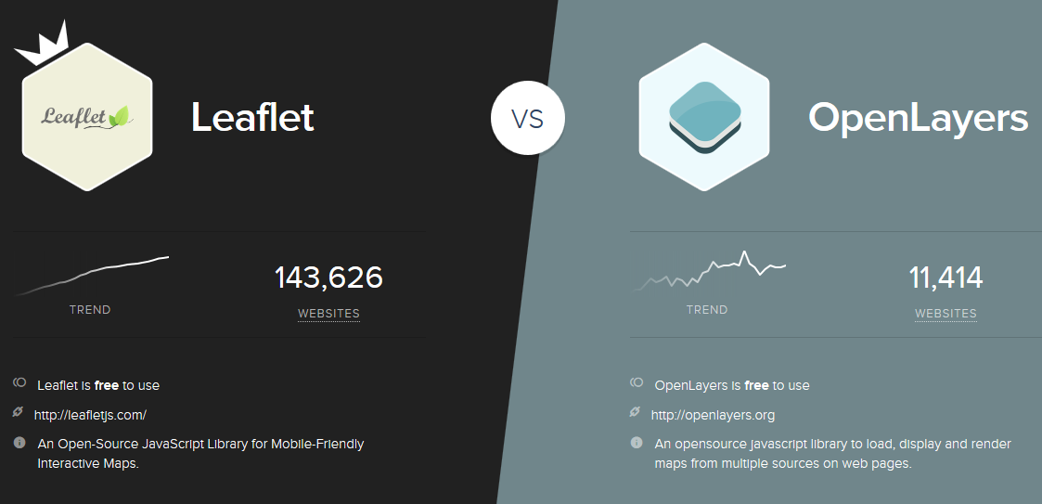
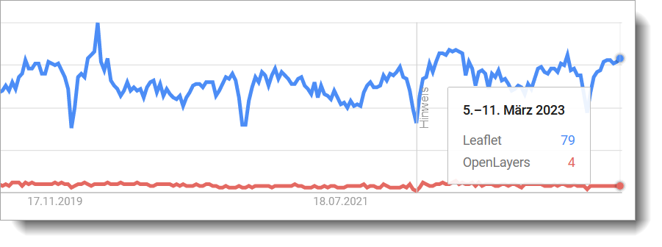
JavaScript-Bibliotheken – Mapping Libraries
https://www.similartech.com/compare/leaflet-vs-openlayers [2021-03-11]
https://trends.google.com/trends/explore?date=today%205-y&q=Leaflet,OpenLayers [2023-03-16]

Slide 9
Leaflet vs. OpenLayers
Leaflet: Easy to start
OpenLayers: More complex, but more powerful. For larger applications/organisational units.

Slide 10
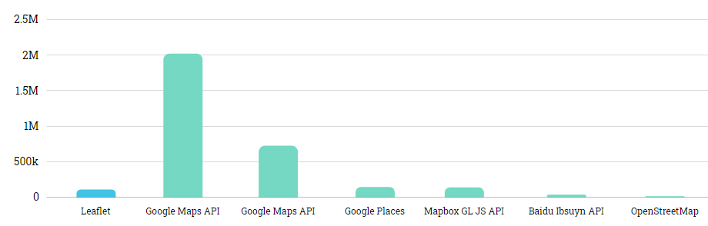
Leaflet vs. Competitors
Bar chart for Leaflet and their top competitors in datanyze universe
https://www.datanyze.com/market-share/mapping-and-gis/leaflet-market-share [2021-02-12]

Slide 11
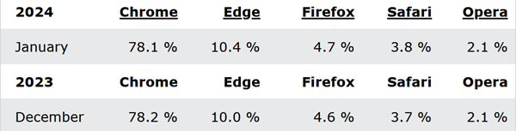
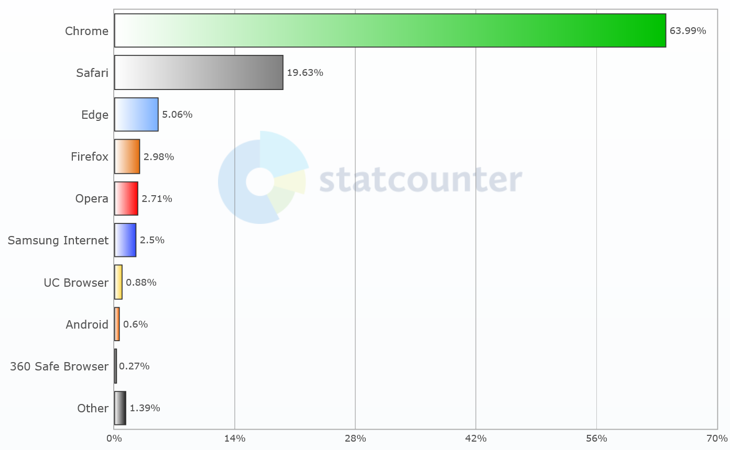
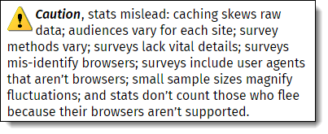
General Client Programme
HTTP clients
  Google Chrome
  Firefox
  Edge/Internet Explorer
  Opera
  Safari
FTP clients
  Filezilla
Mail Clients
  Thunderbird
  Outlook
http://www.w3schools.com/browsers/browsers_stats.asp [2024-03-04]
http://gs.statcounter.com/browser-market-share [2024-03-04

Slide 12
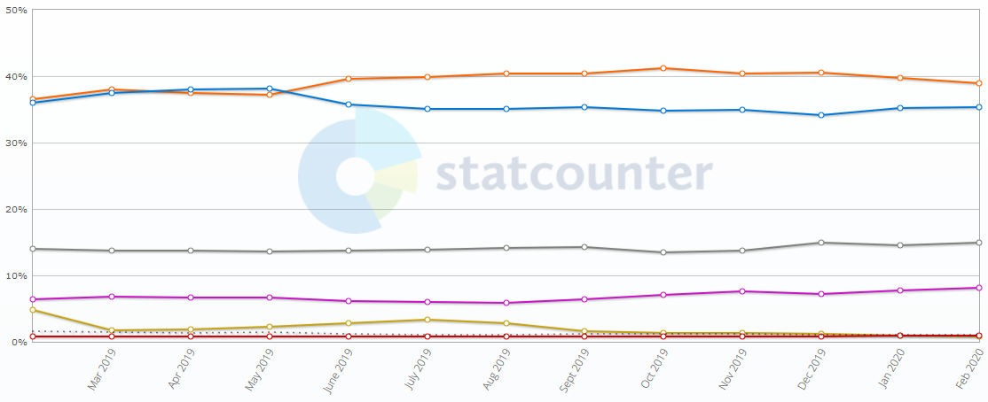
Operating System Market Share Worldwide
http://gs.statcounter.com/os-market-share [2020-03-22]

Slide 13
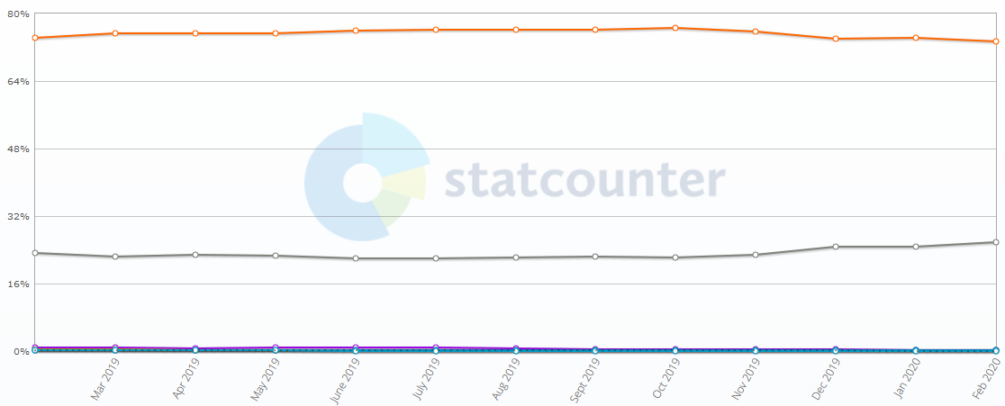
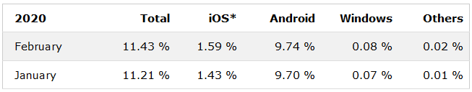
Products: Mobile Devices
https://gs.statcounter.com/os-market-share/mobile/worldwide [2020-03-22]
https://www.w3schools.com/browsers/browsers_mobile.asp [2020-03-22]

Slide 14
Kommunikationsschicht
Communication Tier

Slide 15
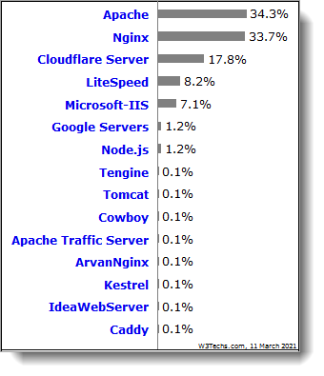
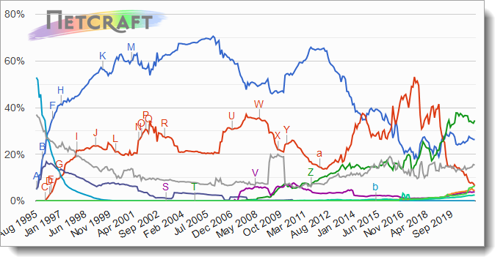
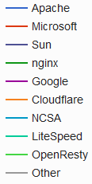
HTTP Servers
  Apache HTTP Server (open source)
  Nginx (open source)
  Internet Information Server® (Microsoft)
https://w3techs.com/technologies/overview/web_server/all [2021-03-11]
https://news.netcraft.com/archives/category/web-server-survey/, based on > 1,204,252,411 sites [2021-03-11]

Slide 16
(s)FTP
Tools for FTP based transfer
  FileZilla (Client and Server, open source)
  Tunnelier
  …

Slide 17
Applikationsschicht
Application Tier

Slide 18
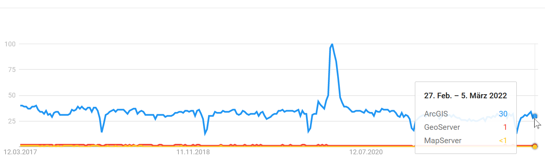
Application Server
In Geo-IT: Applikationsservers implementieren Dienste entsprechend den Empfehlungen des Open Geospatial Consortium (OGC) - Application Servers often follow the standards given by Open Geospatial Consortium (OGC)
  Web Map Service
  Web Feature Service
  Web Coverage Service
  Catalogue Services
Geospatial application servers
Closed Source Solutions
Open Source Solutions
https://trends.google.com/trends/explore?q=ArcGIS,GeoServer,MapServer [2022-03-10]

Slide 19
Application Server: Open Source
GeoServer
  „an open source software server written in Java that allows users to share and edit geospatial data. Designed for interoperability, it publishes data from any major spatial data source using open standards.“ (http://geoserver.org/display/GEOS/Welcome)
MapServer (formerly called UMN MapServer, http://www.osgeo.org/mapserver)
  Written in C, with PHP wrapper
  WMS, WFS, Strong support of Shape files
  Somehow old-fashioned, configuration by text file („map file“)
Deegree Server
  „deegree is a comprehensive geospatial software package with implementations of OGC Web Services like WMS and WFS, a geoportal, a desktop application, security mechanisms, and various tools for geospatial data processing and management. It is open source (LGPL), Java, standards-compliant (OGC, ISO) and an OSGeo project.“ (http://www.deegree.org/)
  Needs Java, and some time for configuration
QGIS Server
MapGuide Open Source - deprecated
  „enables users to develop and deploy web mapping applications and geospatial web services.“ (http://www.osgeo.org/mapguide)

Slide 20
Application Server : Closed Source
ArcGIS Server® http://enterprise.arcgis.com/de/server/latest/get-started/windows/what-is-arcgis-for-server-.htm
GeoMedia WebMap® https://www.hexagongeospatial.com/products/power-portfolio/geomedia-webmap
MapInfo MapXtreme® https://www.pitneybowes.com/us/location-intelligence/geographic-information-systems/mapxtreme.html

Slide 21
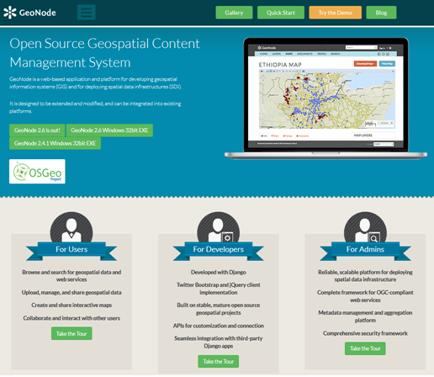
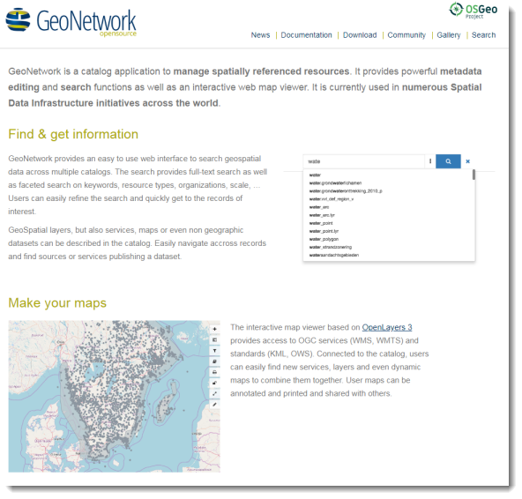
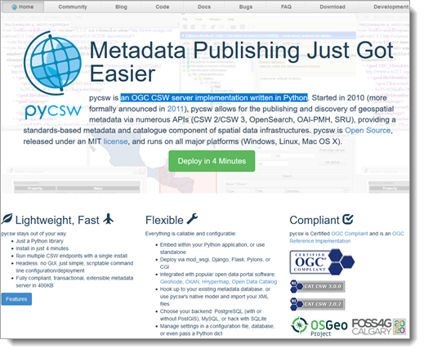
Application Server: Portal Server
Geonode: for developing geospatial information systems (GIS) and for deploying spatial data infrastructures (SDI).
Geonetwork OpenSource: a widely used catalog application to manage spatially referenced resources
Pycsw: an OGC CSW server implementation written in Python
https://pycsw.org/
https://geonode.org/
https://geonetwork-opensource.org/

Slide 22
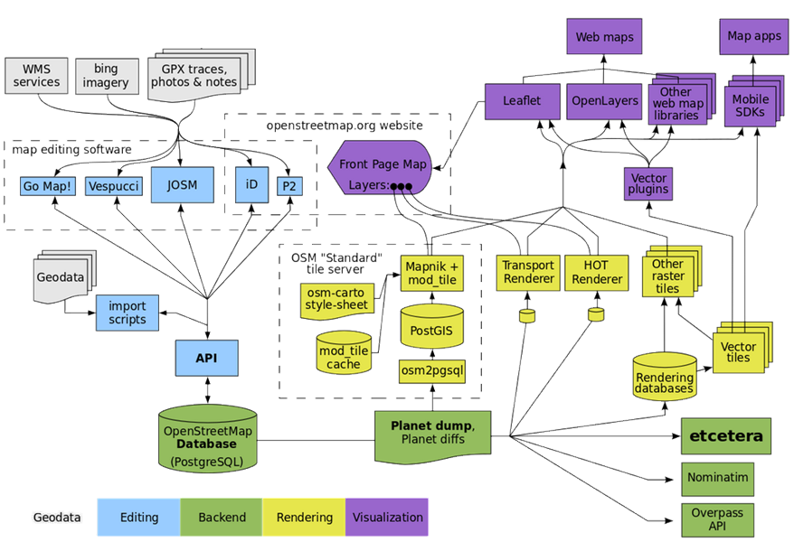
Example of an Frontend/Backend Architecture…
https://wiki.openstreetmap.org/wiki/File:OSM_Components.svg [2022-03-10]

Slide 23
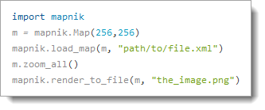
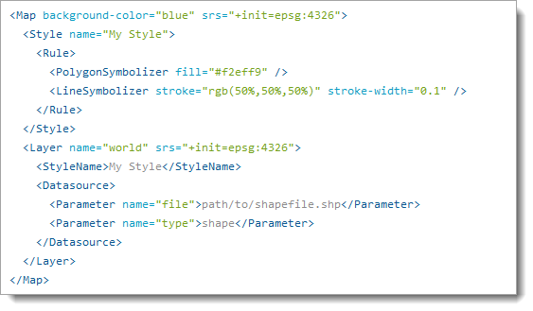
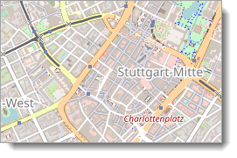
Application Server: Render Server
GeoStyler
Mapnik
  „combines pixel-perfect image output with lightning-fast cartographic algorithms, and exposes interfaces in C++, Python, and Node.“
https://mapnik.org/

Slide 24
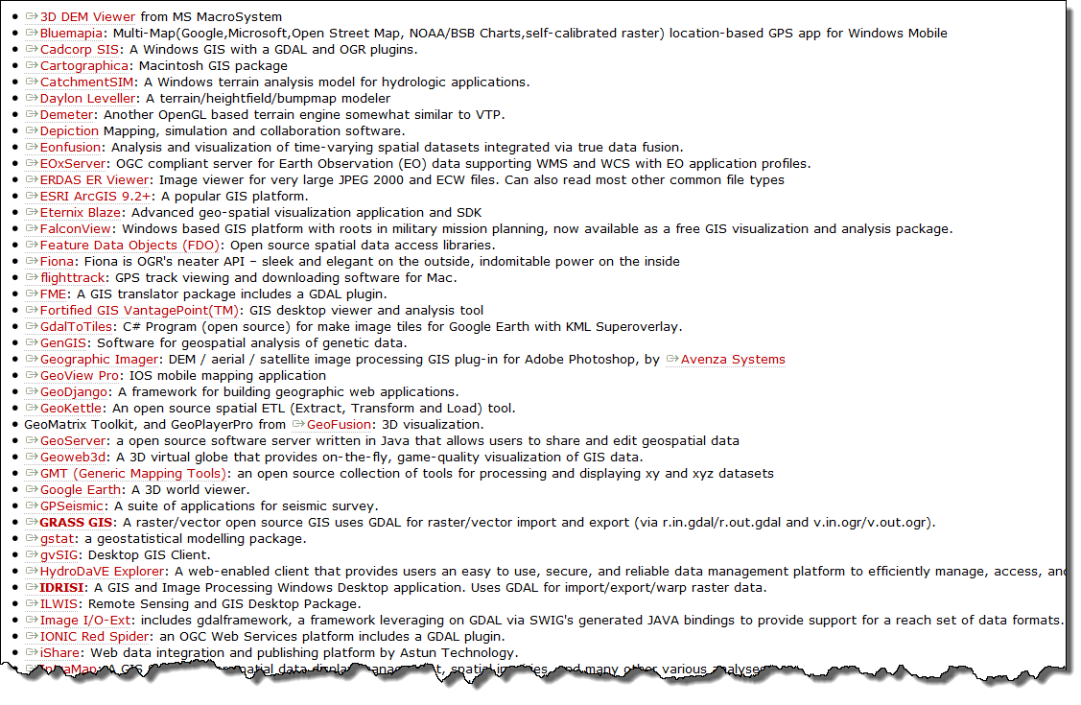
Bibliotheken - Libraries: Software using GDAL

Slide 25
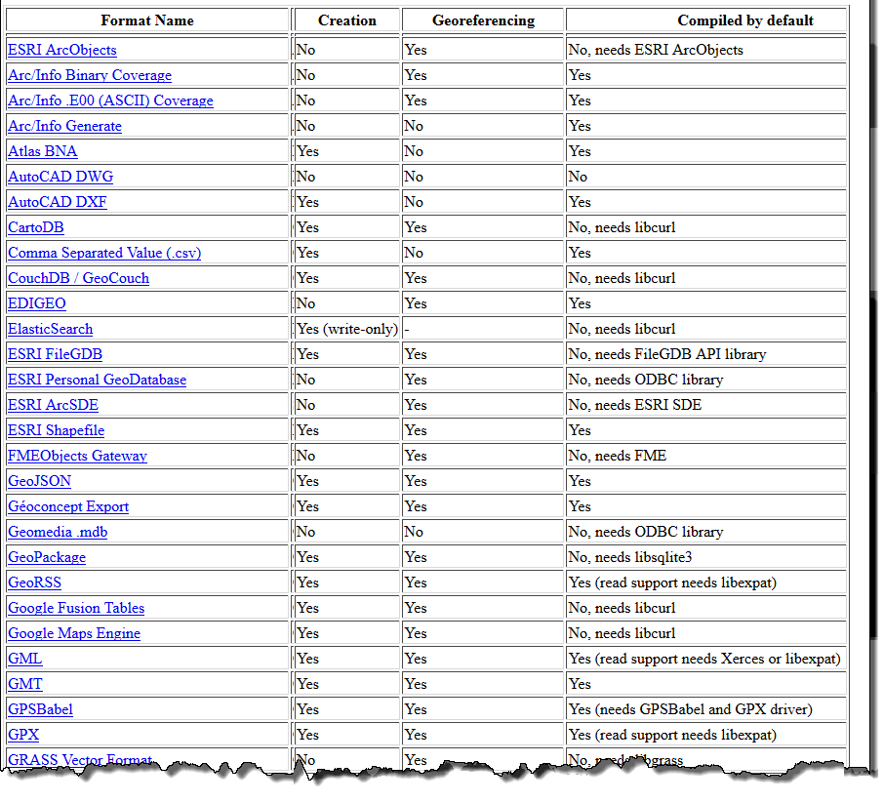
GDAL: Supported Vector formats

Slide 26
Datenhaltungsschicht
Data Tier

Slide 27
Related Products and Tools: (O)RDBMS
(O)(R)DBMS: (Object) (Relational) Database Management System
  commercial products
    Oracle,
    SQLServer (Microsoft),
    Informix, DB2 (IBM),
    …
  free
    PostGreSQL (PostGIS), fully conformant to OGC‘s Simple Feature Specification – highly recommended
    MySQL/MariaDB
    SpatialLite
    …

Slide 28
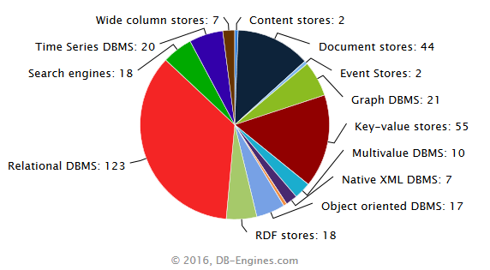
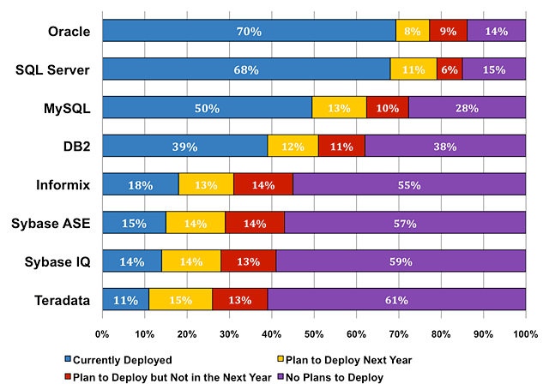
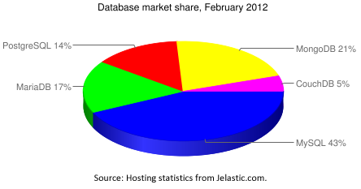
Market share
2008 (Closed Source)
2012 (FOSS)
http://blog.jelastic.com/2012/02/23/open-source-database-market-share-within-jelastic-february-2012/
http://www.mysql.com/why-mysql/marketshare/ [2008, no more available]

Slide 29
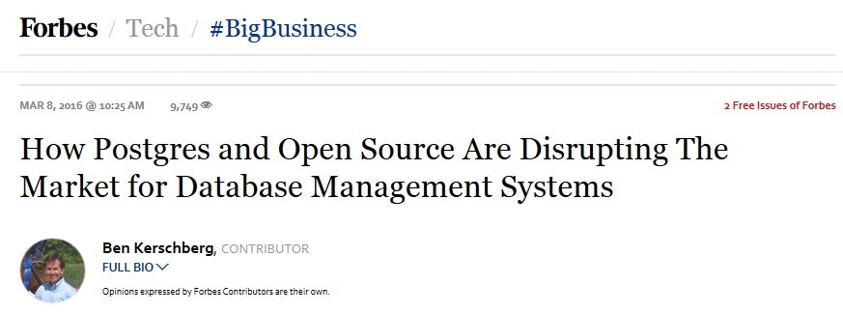
Trend of Relational DBMS Popularity
https://www.forbes.com/sites/benkerschberg/2016/03/08/how-postgres-and-open-source-are-disrupting-the-market-for-database-management-systems/#141b42e820a3

Slide 30
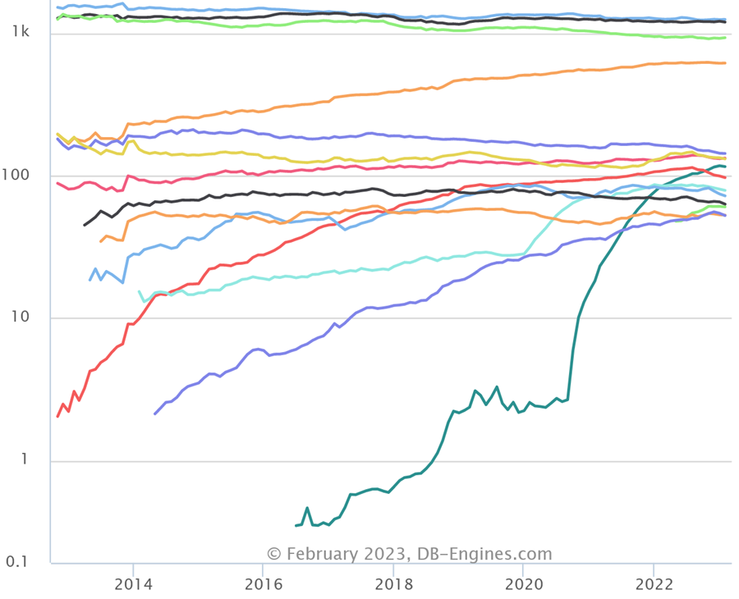
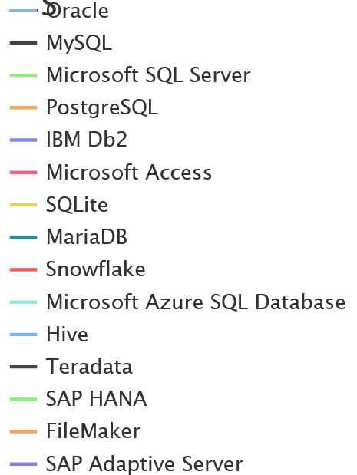
Trend of Relational DBMS Popularity
https://www.forbes.com/sites/benkerschberg/2016/03/08/how-postgres-and-open-source-are-disrupting-the-market-for-database-management-systems/#141b42e820a3
https://db-engines.com/en/ranking_trend/relational+dbms [2023-02-20]

Slide 31
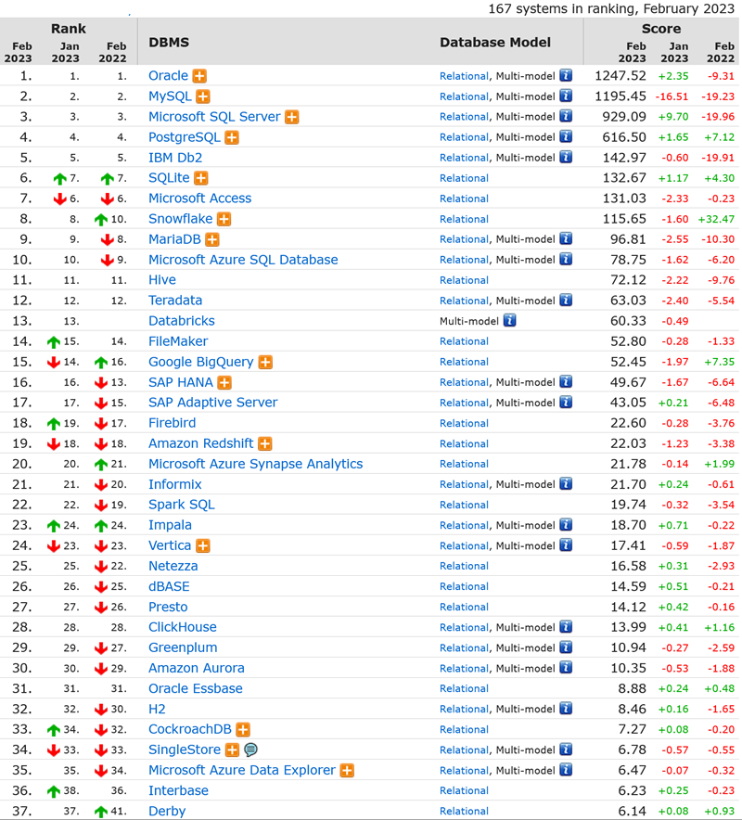
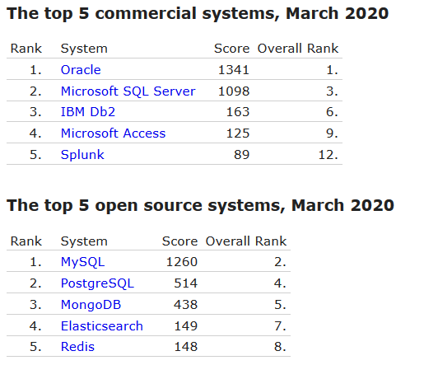
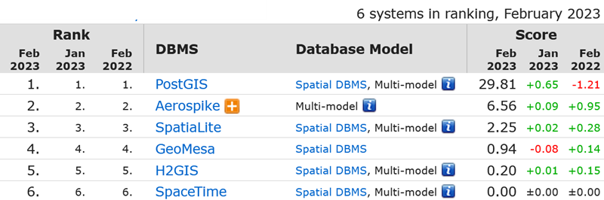
http://db-engines.com/en/ranking_categories; https://db-engines.com/en/ranking_osvsc [2022-03-11]
https://db-engines.com/en/ranking [2023-02-20]

Slide 32
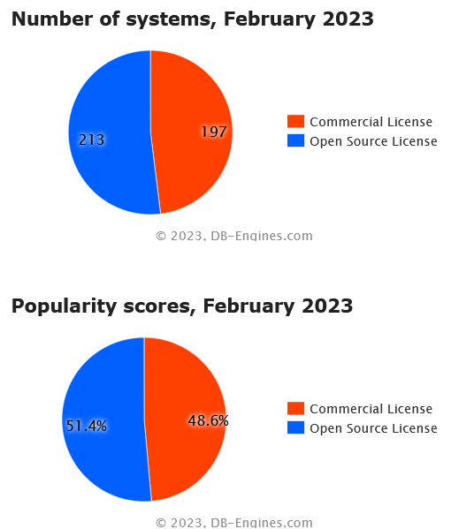
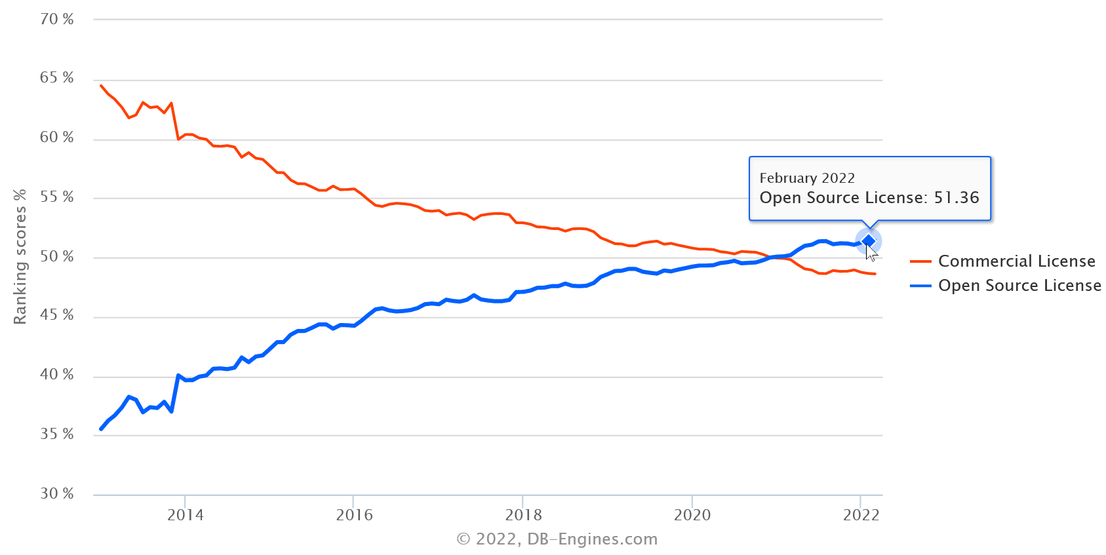
Popularity 2023
Closed Source
Open Source
https://db-engines.com/en/ranking_osvsc [2023-02-20]

Slide 33
Client-Schicht
Client Tier

Slide 34
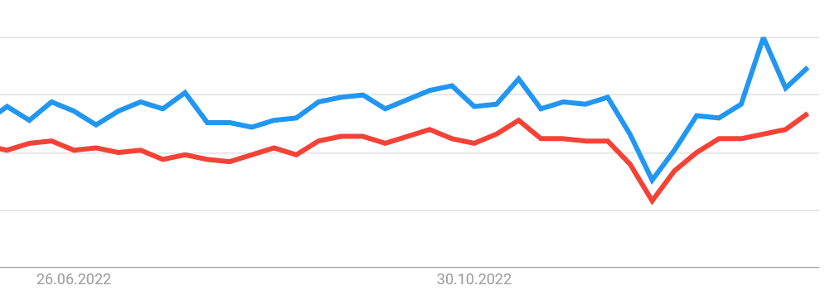

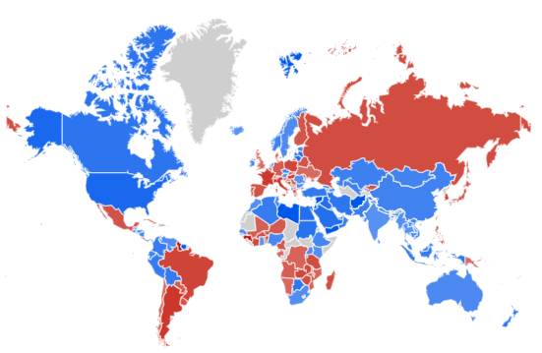
Desktop GIS
See also: https://gisgeography.com/qgis-arcgis-differences/
https://trends.google.com/trends/explore?date=today%201-m&q=ArcGIS,QGIS
[2023-02-20]

Slide 35
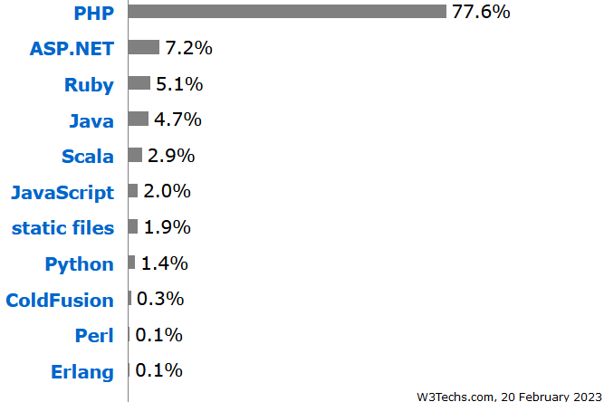
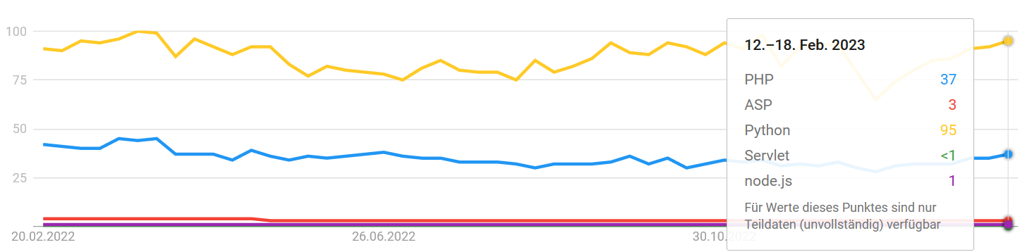
Related (Programming) Languages I
Server side:
  PHP
  Java
  ASP
  Python
  C / C++
  Ruby
  NodeJS
https://w3techs.com/technologies/overview/programming_language [2023-02-20]
PHP,ASP,Python,Servlet
https://trends.google.com/trends/explore?q=PHP,ASP,Python,Servlet,node.js [2023-02-20]

Slide 36
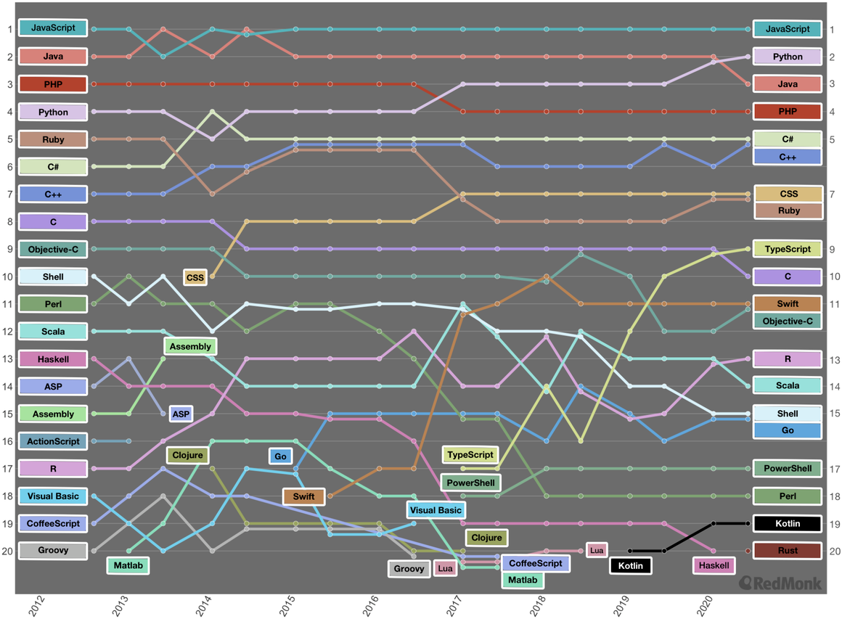
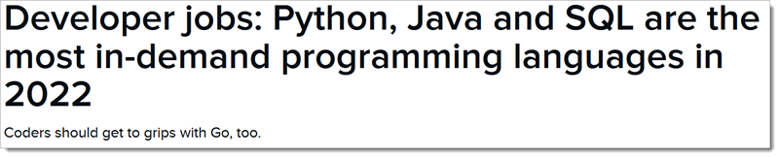
RedMonk graphic tracks the movement of the top 20 languages over the history of the rankings
https://www.zdnet.com/article/programming-language-popularity-python-overtakes-java-as-rust-reaches-top-20/

Slide 37
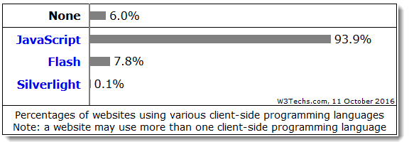
Related (Programming) Languages II
Client side
  HTML
  JavaScript (ECMAScript)
  (ActionScript (Flash)
  CSS
http://w3techs.com/technologies/overview/javascript_library/all [2022-03-10]
http://w3techs.com/technologies/overview/client_side_language/all [2016-10-11]

Slide 38
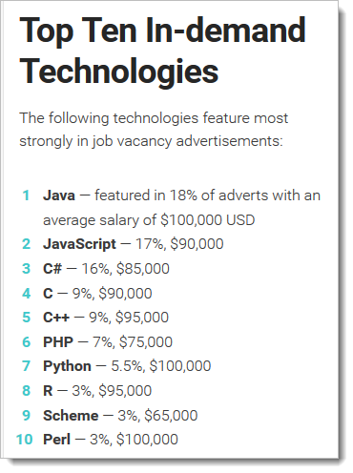
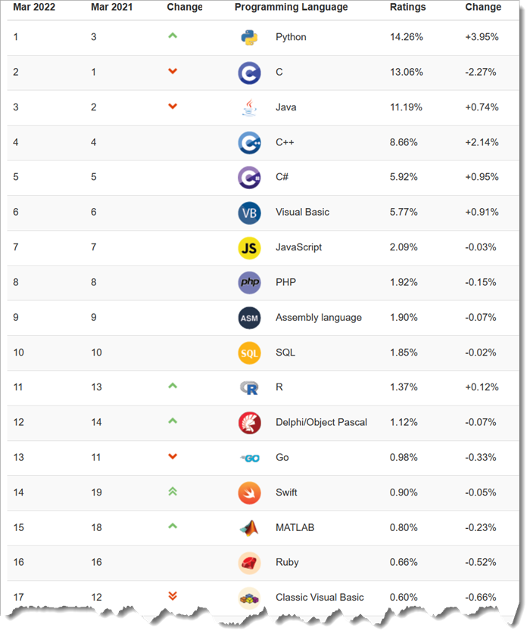
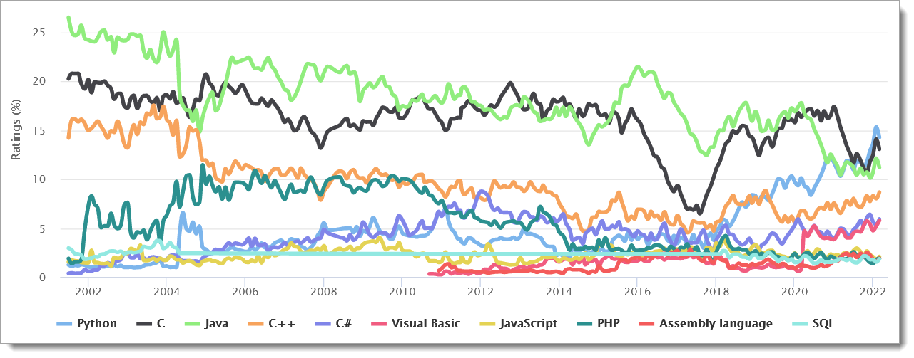
http://www.sitepoint.com/best-programming-language-learn-2015/
https://www.tiobe.com/tiobe-index/ [2022-03-10

Slide 39
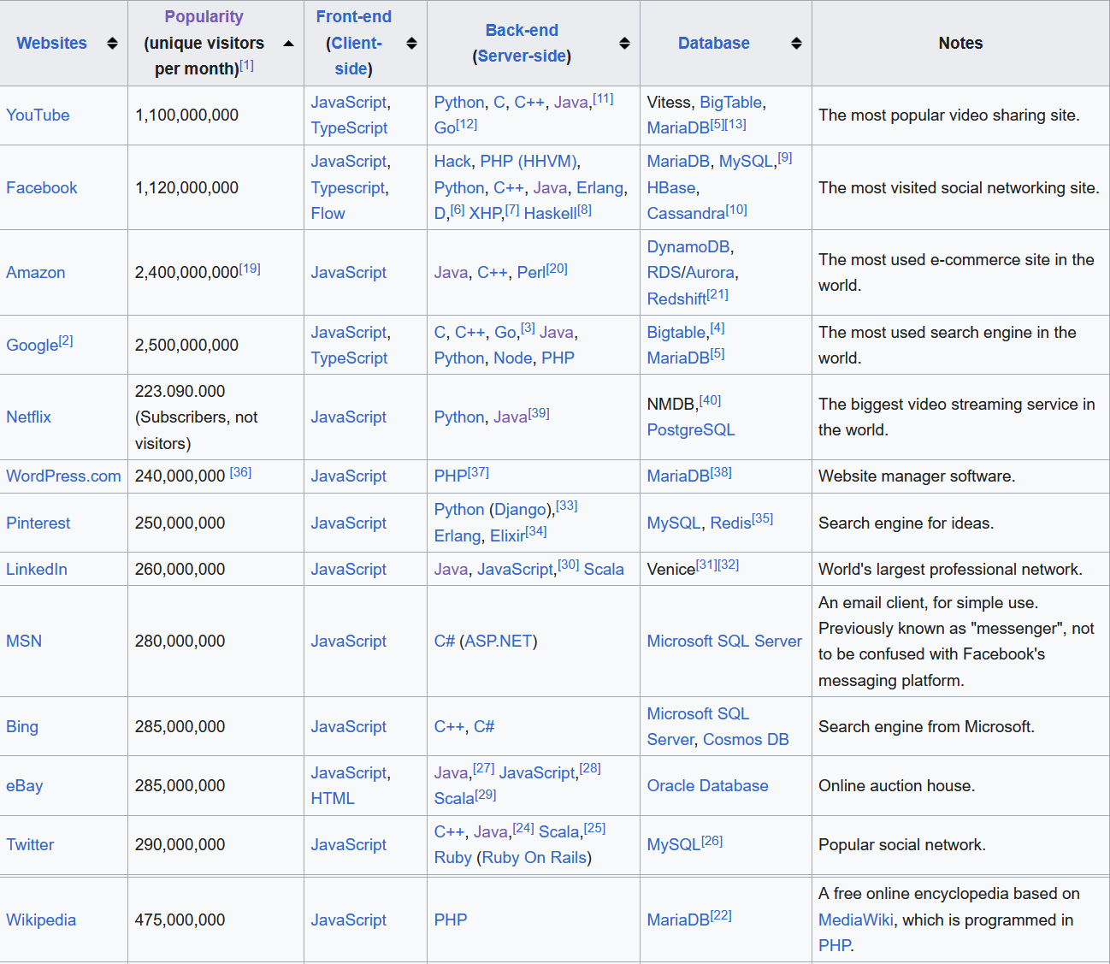
Programming languages /DBMS used in most popular websites
https://en.wikipedia.org/wiki/Programming_languages_used_in_most_popular_websites [2023-02-20]

Slide 40
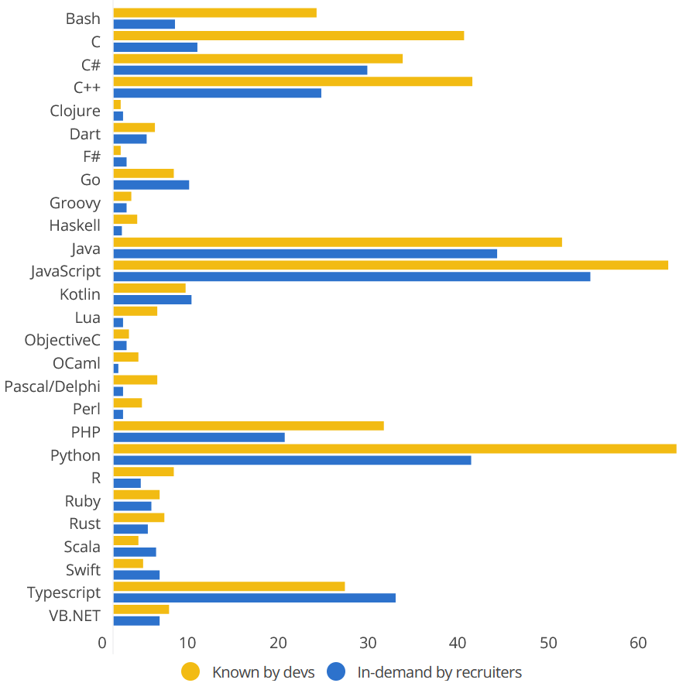
In-demand languages and frameworks
Modified after https://www.codingame.com/work/codingame-and-coderpad-tech-hiring-survey-2023/

Slide 41
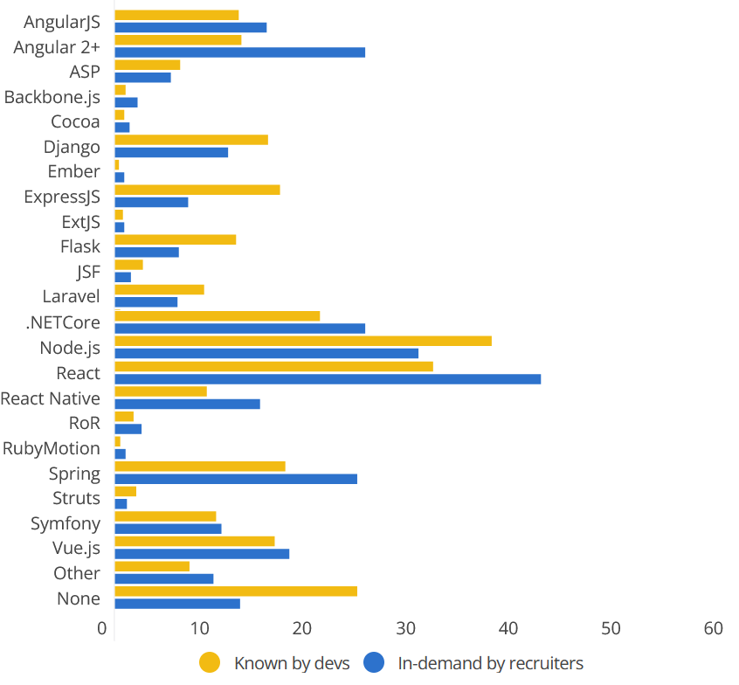
In-demand frameworks
Modified after https://www.codingame.com/work/codingame-and-coderpad-tech-hiring-survey-2023/

Slide 42

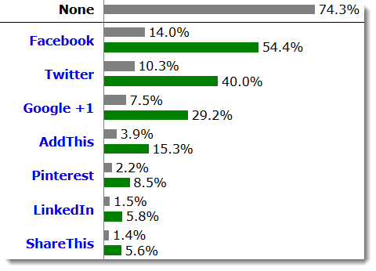
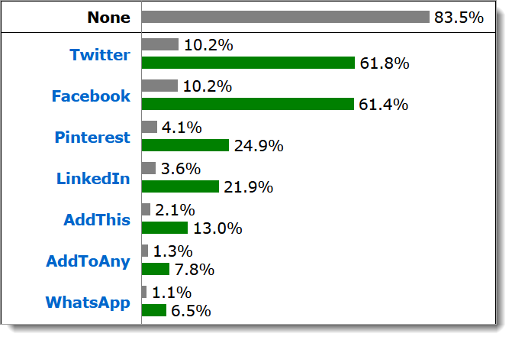
Usage of social widgets
small "programs" integrated into a website allowing people to interact with so-called "social media" in order to share information about this website.
http://w3techs.com/technologies/overview/social_widget/all
[2016-10-11]
http://w3techs.com/technologies/overview/social_widget/all
[2022-03-11]
Notes:
74.3% of the websites use none of the social widgets that we monitor.
Facebook is used by 14.0% of all the websites, that is a social widget market share of 54.4%.

Slide 43


Use of Content Management Systems
https://w3techs.com/technologies/overview/content_management/all [2022-03-10]
[2022-03-10]
https://w3techs.com/technologies/overview/content_management/all [2017-11-06]
https://websitesetup.org/popular-cms/ [2017-11-06]

Slide 44

Use of character sets
https://w3techs.com/technologies/history_overview/character_encoding [2020-03-22]

Slide 45

Use of software repositories
https://www.datanyze.com/market-share/source-code-management--315/github-market-share [2021-03-11]

Slide 46
Use cases of Open Source Solutions

Slide 47









Slide 48
Zusammenfassung
Summary

Slide 49
Vier-Schichten – Four tiers architecture
Für Erfüllung Ihrer Aufgaben stehen für jede Schicht eine Vielzahl von quelloffenen und Closed-Source-Lösungen zur Verfügung – To reach your goals you can evaluate a bunch of Open and Closed Source solutions.
Kommunkationsschicht: i. d. R. Open Source-Lösungen – For the communication tier: Usually Open Source Solutions
Beurteilung der Alternativen entsprechend – Evaluation of alternatives
  den Anforderungen der jeweiligen Institution sowie – according to the requirements
  in Bezug auf Unterstützung offener, anerkannter Standards – according relevant open standards
Tendenz zu quelloffenen Lösungen, insbesondere in der öffentlichen Verwaltung – tendency towards Open Source solutions, especially in public services
Gesamtlösung: Software + Services – The total solution comprises always software and services.

Slide 50
Further readings
http://codecondo.com/top-5-web-programming-languages-begin-learning-2014/
https://www.udemy.com/blog/best-programming-language/
S. Steiniger and A.J.S. Hunter (2012): The 2012 Free and Open Source GIS Software Map – A Guide to facilitate Research, Development and Adoption. http://www.geo.uzh.ch/~sstein/manuscripts/fosgismap_sstein_v9_web.pdf
Tim Sutton (2018): Deciding Between FOSSGIS and Proprietary Software in the Enterprise. In: Understanding the GIS Industry in 2018. https://www.gis-professional.com/magazines/gis-professional-february-2018.pdf
The Top 19 GIS Software. https://www.g2crowd.com/categories/gis#highest_rated [2022-03-10]
Comparison of geographic information systems software. https://en.wikipedia.org/wiki/Comparison_of_geographic_information_systems_software [2021-04-07]

Slide 51

Prof. Dr. Franz-Josef Behr
Hochschule für Technik Stuttgart
Stuttgart University of Applied Sciences
franz-josef.behr@hft-stuttgart.de
http://georeferenced.files.wordpress.com/2014/03/openclose_flickr_leo_reynolds_cc.jpg

