Slide 1
Technical perspective on map styling languages Workshop, ICA Commission on SDI & Standards Monday, 13 December, 2021, 9:00 - 12:30
Prof. Dr. Franz-Josef Behr Stuttgart University of Applied Sciences Co-Chair: ICA Commission on SDI & Standards
The content is licensed under a Creative Commons-Lizenz CC BY-NC-SA
Notes:
https://docs.google.com/document/d/12ouq_dcJHcy_fVy-65fQcGoxJDPLlmHjVJ8eYiX9FTg/edit

Slide 2
Overview
Short intro
OGC‘s styling standards SLD and FE
Examples
Evaluation
Other, more up-to-date standards
Summary
Supporting information and hyperlinks: https://gitlab.com/fjbehr/map-styling-languages

Slide 3
"OGC has been developing innovative standards for over 20 years, but we have more to learn."
(George Percivall, OGC Chief Technology Officer, 10 March 2017, http://www.opengeospatial.org/blog/2559)
Notes:
A monastery in Crete, or why are computer-drafted maps so lifeless Janos Szegö

Slide 4
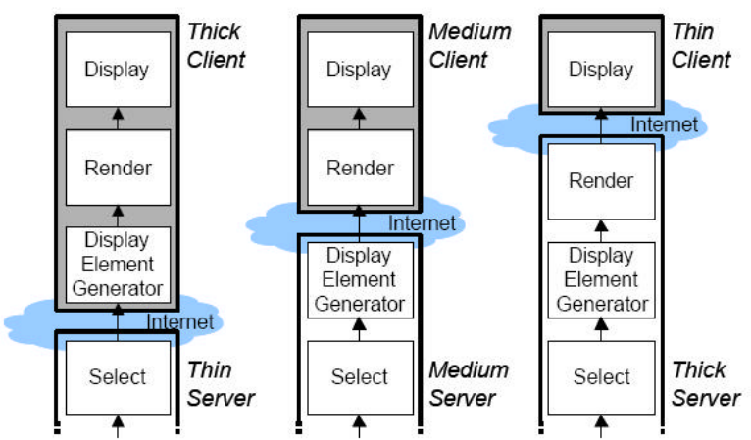
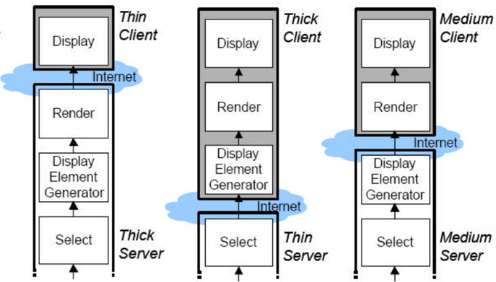
Basic approach: Styles in the Render Pipeline
Styles
Styles
Styles
After: Udo Quadt, Thomas H. Kolbe (2005): Web 3D Service. OGC™ Discussion Paper, https://www.sig3d.org/files/media/downloads/GDI-NRW.Archiv/08_05-019_Web_3D_Service.pdf
Data Base
i.e.: WMS, WMTS
WFS
W3DS

Slide 5
Styling in the cartographic production process
Styles
The four stages of the cartographic map design, inspired from Nicolas & Christine (2013). Source: SAE-TANG, ABSON, ERTZ, OLIVIER (2007). Towards Web Services Dedicated to Thematic Mapping. OSGeo Journal, 3/2007, http://journal.osgeo.org/index.php/journal/article/download/140/106 [2021-12-13]

Slide 6
OGC‘s SLD and FE standard

Slide 7
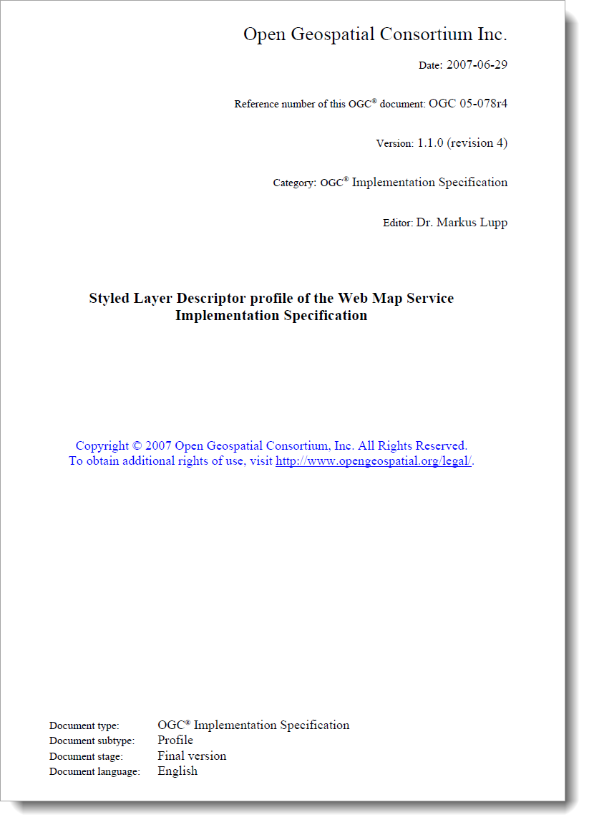
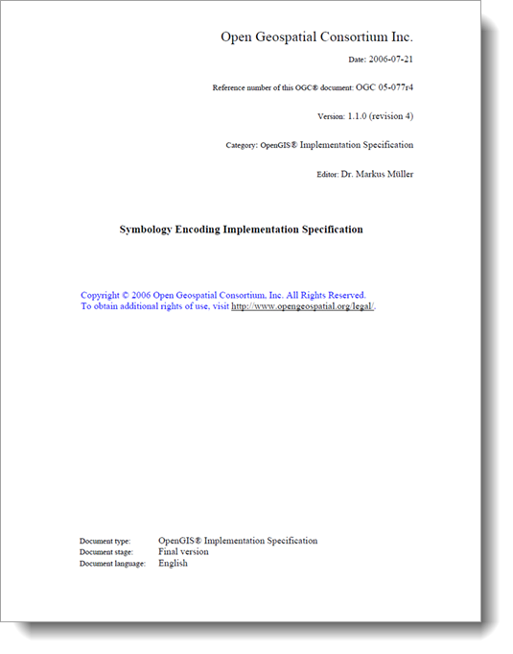
OGC‘s styling standards (2006 onwards)

Slide 8
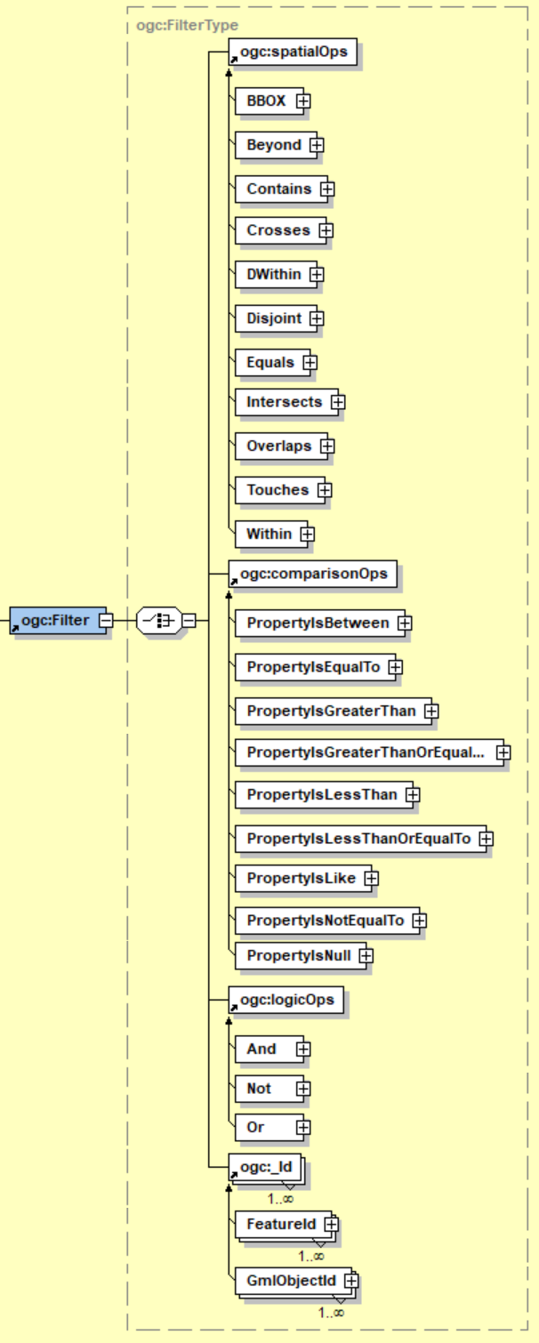
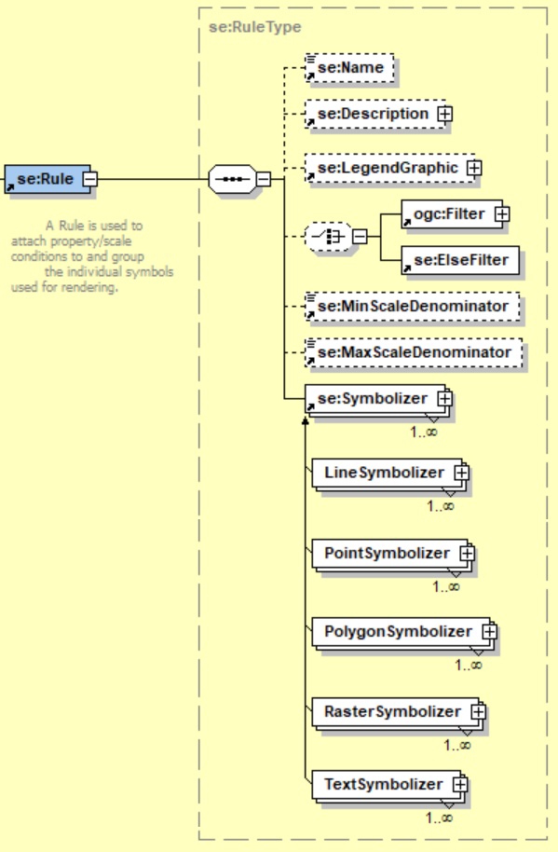

Slide 9
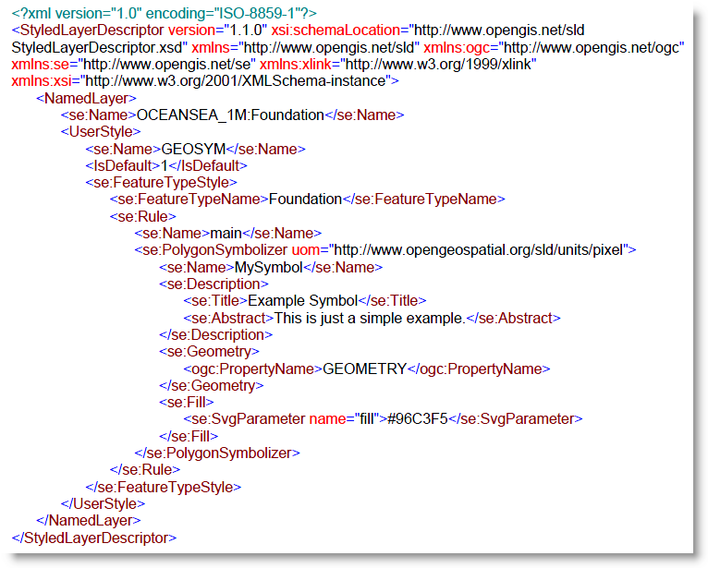
SLD Example
GDI-DE: fundamental
Supports WMS
To define the cartographic styling of the output - Ausgestaltung von Karten, die ein WMS ausliefert
Details: http://docs.geoserver.org/stable/en/user/styling/sld/cookbook/
Lupp, M. (2007): Styled Layer Descriptor profile of the Web Map Service Implementation Specification. http://portal.opengeospatial.org/files/?artifact_id=22364 [2021-01-29]

Slide 10
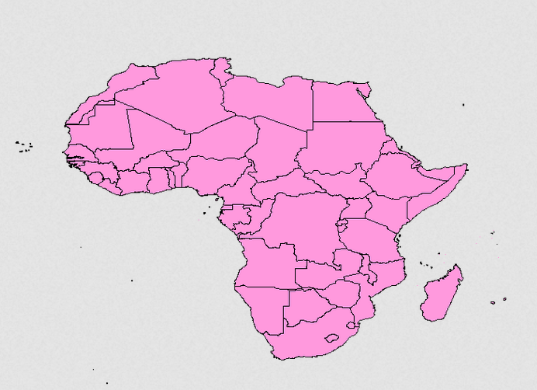
WMS GetMap with SLD I
http://gis.ibbeck.de/include/mapserver/mapserv.exe?map=/daten/mapfiles/world/World.map&LAYERS=COUNTRY&FORMAT=image%2Fpng&VERSION=1.1.1&TRANSPARENT=TRUE&SLD_BODY=%3C%3Fxml%20version%3D%221.0%22%20encoding%3D%22utf-8%22%3F%3E%3CStyledLayerDescriptor%20version%3D%221.0.0%22%20xmlns%3D%22http%3A%2F%2Fwww.opengis.net%2Fsld%22%20xmlns%3Agml%3D%22http%3A%2F%2Fwww.opengis.net%2Fgml%22%20xmlns%3Aogc%3D%22http%3A%2F%2Fwww.opengis.net%2Fogc%22%20xmlns%3Axlink%3D%22http%3A%2F%2Fwww.w3.org%2F1999%2Fxlink%22%20xmlns%3Axsi%3D%22http%3A%2F%2Fwww.w3.org%2F2001%2FXMLSchema-instance%22%20xsi%3AschemaLocation%3D%22http%3A%2F%2Fwww.opengis.net%2Fsld%20http%3A%2F%2Fschemas.opengeospatial.net%2Fsld%2F1.0.0%2FStyledLayerDescriptor.xsd%22%3E%3CNamedLayer%3E%3CName%3ECOUNTRY%3C%2FName%3E%3CUserStyle%3E%3CFeatureTypeStyle%3E%3CRule%3E%3Cogc%3AFilter%3E%3Cogc%3APropertyIsLike%20wildCard%3D%22*%22%20singleChar%3D%22%23%22%20escape%3D%22!%22%3E%3Cogc%3APropertyName%3EContinent%3C%2Fogc%3APropertyName%3E%3Cogc%3ALiteral%3EAfrica%3C%2Fogc%3ALiteral%3E%3C%2Fogc%3APropertyIsLike%3E%3C%2Fogc%3AFilter%3E%3CPolygonSymbolizer%3E%3CFill%3E%3CCssParameter%20name%3D%22fill%22%3E%235599DD%3C%2FCssParameter%3E%3C%2FFill%3E%3CStroke%3E%3CCssParameter%20name%3D%22stroke%22%3E%23000000%3C%2FCssParameter%3E%3C%2FStroke%3E%3C%2FPolygonSymbolizer%3E%3C%2FRule%3E%3C%2FFeatureTypeStyle%3E%3C%2FUserStyle%3E%3C%2FNamedLayer%3E%3C%2FStyledLayerDescriptor%3E&SERVICE=WMS&REQUEST=GetMap&STYLES=&EXCEPTIONS=application%2Fvnd.ogc.se_inimage&SRS=EPSG%3A4326&BBOX=-52,-90,76,38&WIDTH=256&HEIGHT=256
Notes:
The WMS GetMap operation allows to filter and to style a layer (parameter SLD_BODY and FILTER). Each style is related to one or more datasets attached to the WMS server and ready to be used by an end-user.

Slide 11
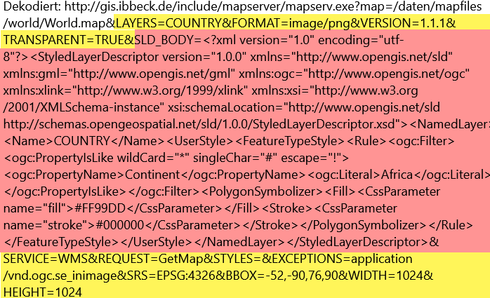
WMS GetMap with SLD I
http://gis.ibbeck.de/include/mapserver/mapserv.exe?map=/daten/mapfiles/world/World.map&LAYERS=COUNTRY&FORMAT=image%2Fpng&VERSION=1.1.1&TRANSPARENT=TRUE&SLD_BODY=%3C%3Fxml%20version%3D%221.0%22%20encoding%3D%22utf-8%22%3F%3E%3CStyledLayerDescriptor%20version%3D%221.0.0%22%20xmlns%3D%22http%3A%2F%2Fwww.opengis.net%2Fsld%22%20xmlns%3Agml%3D%22http%3A%2F%2Fwww.opengis.net%2Fgml%22%20xmlns%3Aogc%3D%22http%3A%2F%2Fwww.opengis.net%2Fogc%22%20xmlns%3Axlink%3D%22http%3A%2F%2Fwww.w3.org%2F1999%2Fxlink%22%20xmlns%3Axsi%3D%22http%3A%2F%2Fwww.w3.org%2F2001%2FXMLSchema-instance%22%20xsi%3AschemaLocation%3D%22http%3A%2F%2Fwww.opengis.net%2Fsld%20http%3A%2F%2Fschemas.opengeospatial.net%2Fsld%2F1.0.0%2FStyledLayerDescriptor.xsd%22%3E%3CNamedLayer%3E%3CName%3ECOUNTRY%3C%2FName%3E%3CUserStyle%3E%3CFeatureTypeStyle%3E%3CRule%3E%3Cogc%3AFilter%3E%3Cogc%3APropertyIsLike%20wildCard%3D%22*%22%20singleChar%3D%22%23%22%20escape%3D%22!%22%3E%3Cogc%3APropertyName%3EContinent%3C%2Fogc%3APropertyName%3E%3Cogc%3ALiteral%3EAfrica%3C%2Fogc%3ALiteral%3E%3C%2Fogc%3APropertyIsLike%3E%3C%2Fogc%3AFilter%3E%3CPolygonSymbolizer%3E%3CFill%3E%3CCssParameter%20name%3D%22fill%22%3E%235599DD%3C%2FCssParameter%3E%3C%2FFill%3E%3CStroke%3E%3CCssParameter%20name%3D%22stroke%22%3E%23000000%3C%2FCssParameter%3E%3C%2FStroke%3E%3C%2FPolygonSymbolizer%3E%3C%2FRule%3E%3C%2FFeatureTypeStyle%3E%3C%2FUserStyle%3E%3C%2FNamedLayer%3E%3C%2FStyledLayerDescriptor%3E&SERVICE=WMS&REQUEST=GetMap&STYLES=&EXCEPTIONS=application%2Fvnd.ogc.se_inimage&SRS=EPSG%3A4326&BBOX=-52,-90,76,38&WIDTH=256&HEIGHT=256

Slide 12
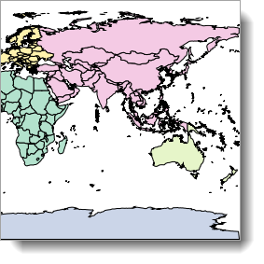
WMS GetMap with SLD II
http://gis.ibbeck.de/ginfo/apps/OLExamples/OL210/MapServer_SLD_World/world_gis_6beta.asp?LAYERS=country&FORMAT=image%2Fpng&VERSION=1.1.1&TRANSPARENT=true&SERVICE=WMS&REQUEST=GetMap&STYLES=continents&EXCEPTIONS=application%2Fvnd.ogc.se_inimage&SRS=EPSG%3A4326&BBOX=0,-90,180,90&WIDTH=256&HEIGHT=256
[2020-11-25]
Notes:
The WMS GetMap operation allows to choose one of the internal styles prepared for a layer by a map-maker (parameter STYLES). Each style is related to one or more datasets attached to the WMS server and ready to be used by an end-user.

Slide 13
SLD: Critique I
“SLD and Symbology […] are XML encodings. JSON is a more natural choice for web applications, mobile applications, and many server-side frameworks. CSS is comfortable for many front-end developers. SQL developers (think GeoPackage) want to be working with SQL predominantly.”
SLD and SE are fairly complicated. The documents are long ("verbose") and intimidating and compliance is an all-or-nothing affair.
Tools are lacking.
Lack of extensibility
http://geopackage.blogspot.de/2017/09/more-on-sld-and-se.html

Slide 14
SLD: Critique II
SLD being used mainly for producing offline tiles and thus difficult to reconcile with high performance rendering
Jérôme Jacovella-St-Louis, lists.opengeospatial.org
Message-ID: <29207f97-4430-dea9-caa0-63a3454e2e57@ecere.com> Date: Tue, 28 Nov 2017 21:40:12 -0500
“Styled Layer Descriptor (SLD) and Symbology Encoding (SE) […] have been around for over a decade but […] they have not definitively met their primary purpose - to enable the portrayal of feature data in an interoperable way. The most common complaint with these standards boils down to one thing - a high barrier to entry.“ [1]
[1] Views from the chairman of the GeoPackage Standards Working Group http://geopackage.blogspot.com/2017/09/more-on-sld-and-se.html [2020-01-24]

Slide 15
SLD: Critique III
For cartographc purposes: Difficulty of creation using SLD and SE standards (Rita et al. 2010):
Map type | difficulty
Choropleth maps | moderate
Diagram maps | hard
Proportional Symbols | easy
Overlayed Symbols | easy
Juxtaposed Symbols | impossible
Cartogram Maps | impossible
Notes:
Choropleth maps are usually used to display or visualize data that comprises of relative values. Polygons are filled entirely to show differences in geographic distribution.
Diagram maps are thematic maps on which diagrams are placed within a territorial structure. The design and size of these diagrams vary corresponding to some attribute data. The numbers
within these maps usually display absolute respectively quantitative values.

Slide 16
Extending SLD/FE
Neubauer, S., Zipf, A. (2007): Suggestions for Extending the OGC Styled Layer Descriptor (SLD) Specification into 3D – Towards Visualization Rules for 3D City Models. Proc. Of. Urban Data Management Symposium. UDMS 2007. Stuttgart. Germany, https://www.geog.uni-heidelberg.de/md/chemgeo/geog/gis/3d_sld.udms2007.sn.az.pdf
Rita, Emanuel, José Borbinha & Bruno Martins (2010): Extending SLD and SE for Cartograms. https://www.academia.edu/2672094/Extending_SLD_and_SE_for_Cartograms?email_work_card=title [2021-12-10]
Sae-Tang, Abson, Ertz, Olivier (2007). Towards Web Services Dedicated to Thematic Mapping. OSGeo Journal, 3/2007, http://journal.osgeo.org/index.php/journal/article/download/140/106 [2021-12-13]
…

Slide 17
More recent standard developments

Slide 18
SLD/SE: Alternatives
OSM's MapCSS (https://wiki.openstreetmap.org/wiki/MapCSS)
Mapnik Styles (https://github.com/mapnik/mapnik/wiki/XMLConfigReference)
Carto CartoCSS
Mapbox Mapbox Style Specification (JSON-kodiert) (https://www.mapbox.com/mapbox-gl-js/style-spec/)
ESRI Style (https://pro.arcgis.com/de/pro-app/2.7/help/projects/styles.htm)
QGIS styles (http://planet.qgis.org/planet/tag/style/)

Slide 19
OSM's MapCSS
CSS-like language for map stylesheets
canvas {
background-color: #ffffea;
default-points: false;
default-lines: false;
}
relation[boundary=administrative][admin_level=7]:closed
{
width: 1;
color: black;
opacity: 1;
fill-color: orange;
fill-opacity: 0.3;
font-size: 16;
text-color: green;
text: admin_level;
text-position: center;
}

Slide 20
CartoCSS
similar in syntax to CSS, but builds upon it with specific abilities to filter map data and by providing things like variables. It targets the Mapnik renderer and is able to generate Mapnik XML or a JSON variant of Mapnik XML.

Slide 21
“The Mapbox Vector Tile Specification […] is the current de facto standard
https://inspire.ec.europa.eu/sites/default/files/presentations/INSPIRE2017_VectorTiles.pdf
“A Mapbox style is a document that defines the visual appearance of a map: what data to draw, the order to draw it in, and how to style the data when drawing it. A style document is a JSON object with specific root level and nested properties.
https://docs.mapbox.com/mapbox-gl-js/style-spec/

Slide 22
Mapbox GL
A Mapbox style is a JSON object that defines exactly how a map should be drawn. It defines almost everything related to a map's appearance.
Every map depends on a style, so when you change a map style, any map that uses that style will be affected by your changes upon its next load.

Slide 23
A style document…
must contain the following:
References to sources containing geospatial data. For example, a style might use a URL for a GeoJSON source or a tileset ID for a tileset source. Except for raster tiles or georeferenced images and videos, sources are pure data with no inherent visual appearance.
Style layers give sources a visual appearance by specifying which layout and paint properties Mapbox GL should apply. These properties include colors, fonts, line widths, layer order, and more.
It may also include glyphs and sprite properties. These properties work automatically when you create a style with the Mapbox Studio style editor. In most cases you do not need to change them. The glyphs property tells the Mapbox map where to fetch fonts. The sprite property tells the Mapbox Map where to look for icons.

Slide 24
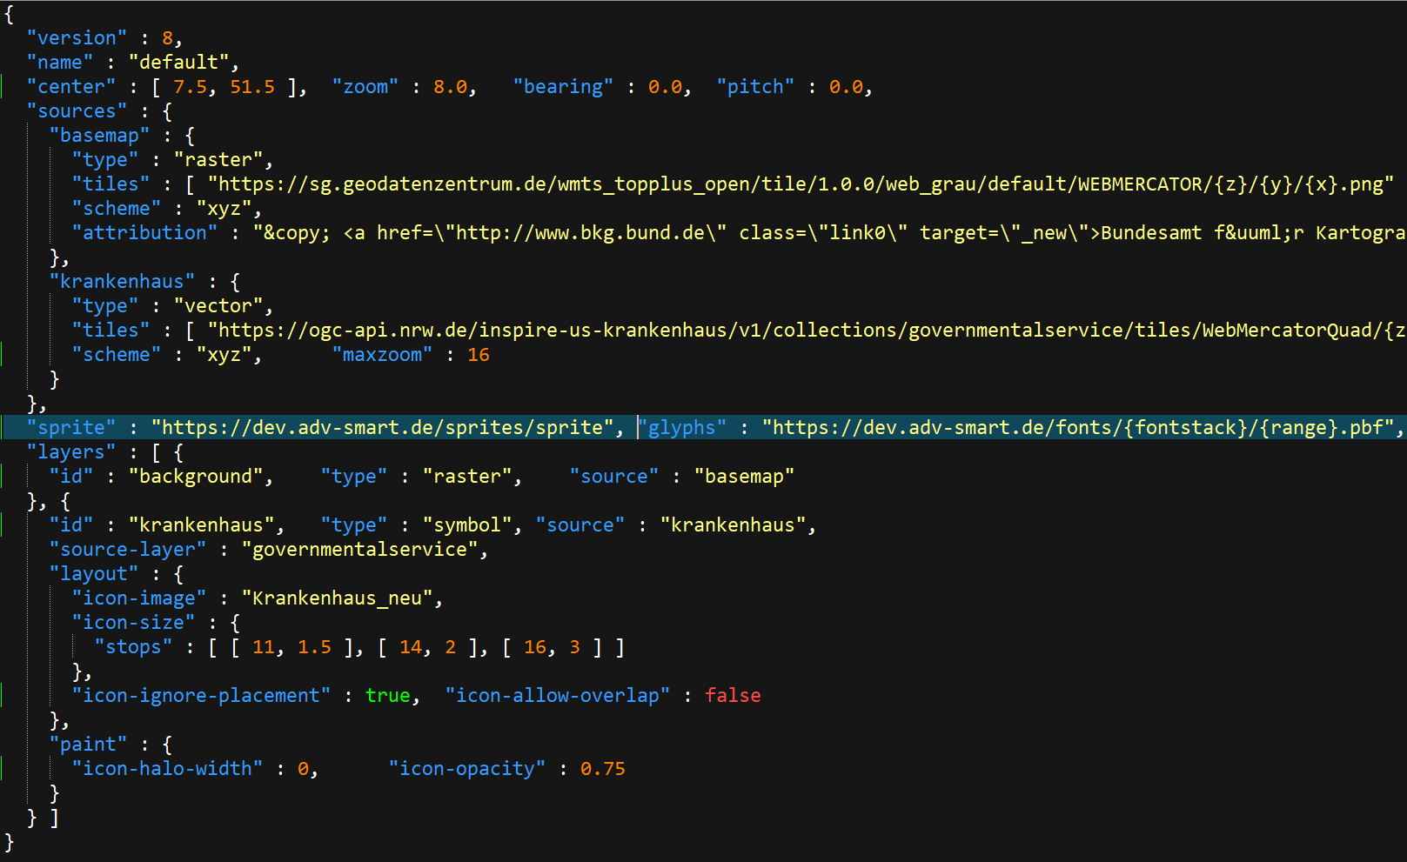

Slide 25
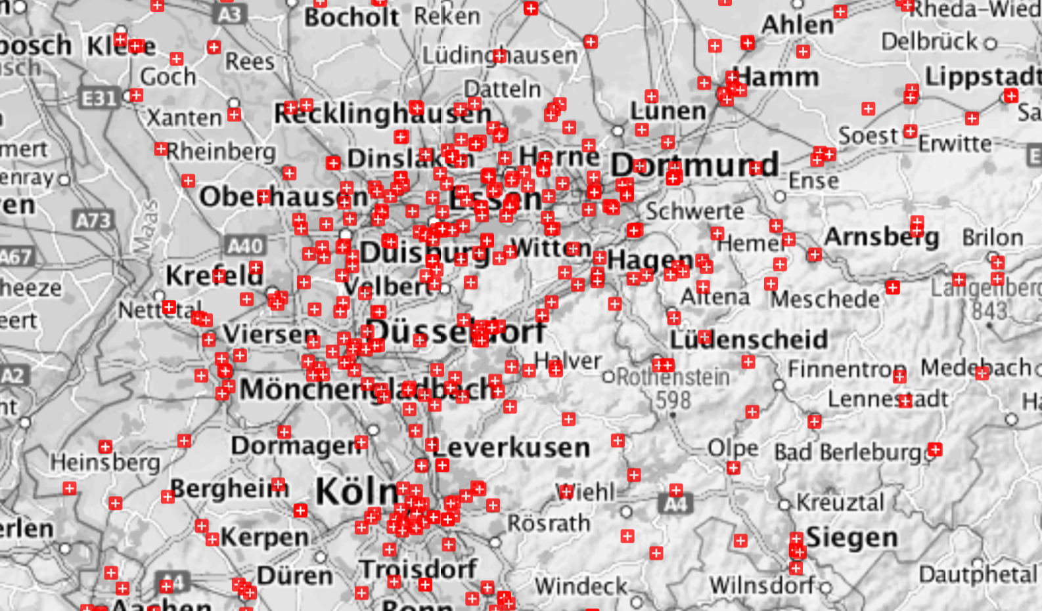
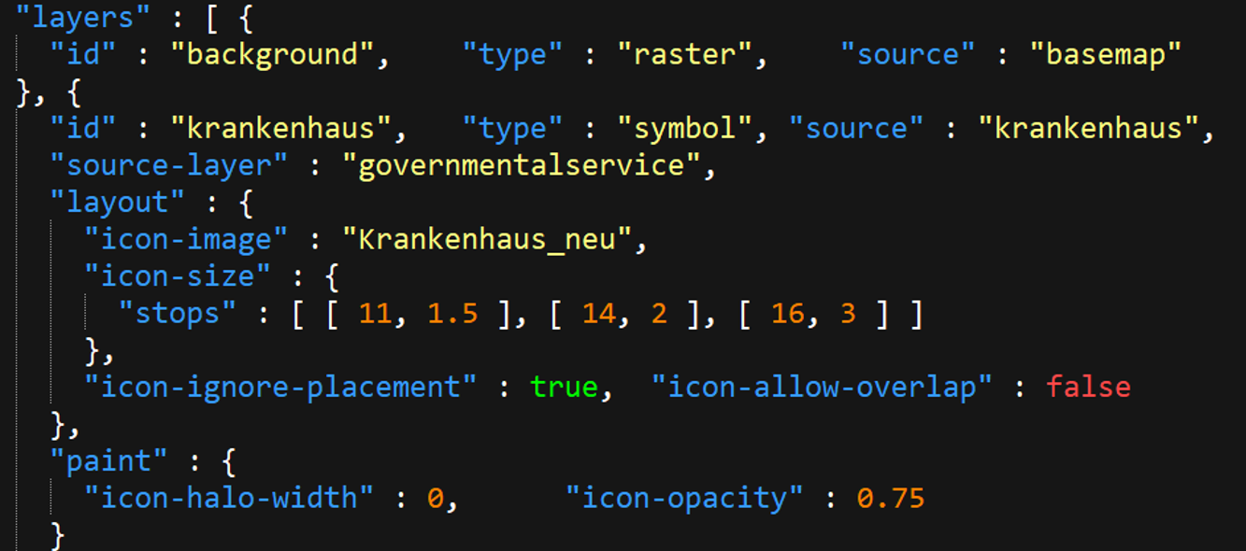
Source: https://ogc-api.nrw.de/inspire-us-krankenhaus/v1/styles/default?f=html#8/51.5/7.5 [2021-12-13]

Slide 26
Esri‘s style files
Styles are containers that store symbols, colors, color schemes, label placements, and layout items. They promote consistency and standardization across maps, scenes, and layouts.
Structurally, styles are databases that are stored as individual files in your file system or in a portal.
Different types of styles (i.e. System style, Project style, Favorites style, …)

Slide 27
OGC Styles API

Slide 28
OGC Styles API (since 2021)
Each style is available as one or more stylesheets - the representation of a style in an encoding like OGC SLD 1.0 or Mapbox Style.
Clients will use the stylesheet of a style that fits best based on the capabilities of available tools and their preferences.
For each style: metadata available, with general descriptive information about the style, structural information (e.g., layers and attributes), and so forth to allow users to discover and select existing styles for their data.
https://github.com/opengeospatial/ogcapi-styles

Slide 29
OGC API: Style-related terms and concepts
Styles organize a sequence of rules of symbolizing instructions to be applied by a rendering engine on one or more features and/or coverages.
Style encodings are specifications to express a style as one or more files. In Testbed-15 Mapbox Styles, OGC SLD versions 1.0 and 1.1 are used.
Stylesheets are representations of a style in a style encoding.
Style metadata is essential information about a style in order to support users to discover and select styles for rendering their data and for visual style editors to create user interfaces for editing a style.
https://app.swaggerhub.com/apis/cportele/opf-style-api/1.0.0

Slide 30
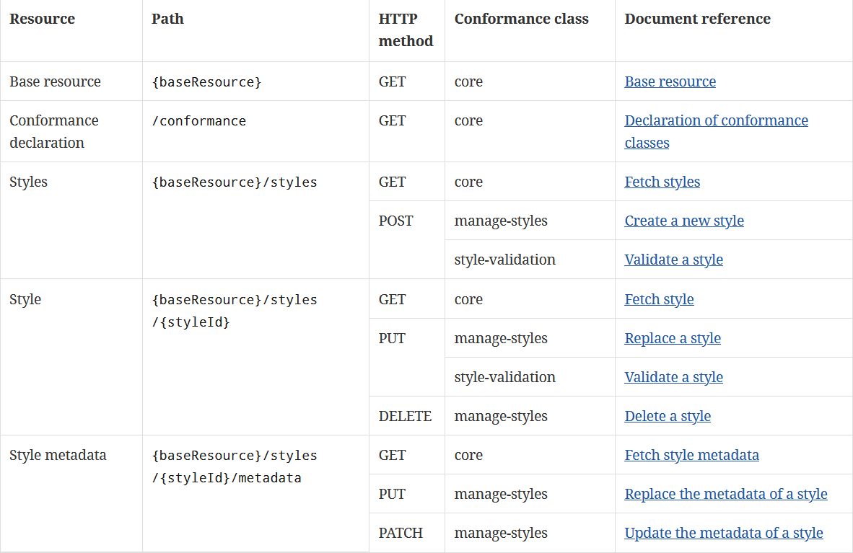
docs.opengeospatial.org/DRAFTS/20-009.html#_a_visual_style_editor_creating_a_new_style

Slide 31
Summary

Slide 32
Styling means: Filtering data and applying style properties
Long tradition of filtering and styling languages
Encoding formats:
XML
JSON (presumably the future…)
Styling nevertheless needs cartographic expertise
Handling of styles is supported my OGC‘s API

Slide 33
"A monastery in Crete, or why are computer-drafted maps so lifeless"
Janos Szegö (1988): Human Cartography: Mapping the World of Man. Swedish Council for Building Research, ‎ ISBN 978-9154047819

Slide 34
{
"version" : 8,
"name" : "default",
"center" : [ 7.5, 51.5 ],
"zoom" : 8.0,
"bearing" : 0.0,
"pitch" : 0.0,
"sources" : {
"basemap" : {
"type" : "raster",
"tiles" : [ "https://sg.geodatenzentrum.de/wmts_topplus_open/tile/1.0.0/web_grau/default/WEBMERCATOR/{z}/{y}/{x}.png" ],
"scheme" : "xyz",
"attribution" : "&copy; <a href=\"http://www.bkg.bund.de\" class=\"link0\" target=\"_new\">Bundesamt f&uuml;r Kartographie und Geod&auml;sie</a> 2017, <a href=\"http://sg.geodatenzentrum.de/web_public/Datenquellen_TopPlus_Open.pdf\" class=\"link0\" target=\"_new\">Datenquellen</a>"
},
"krankenhaus" : {
"type" : "vector",
"tiles" : [ "https://ogc-api.nrw.de/inspire-us-krankenhaus/v1/collections/governmentalservice/tiles/WebMercatorQuad/{z}/{y}/{x}?f=mvt" ],
"scheme" : "xyz",
"maxzoom" : 16
}
},
"sprite" : "https://dev.adv-smart.de/sprites/sprite",
"glyphs" : "https://dev.adv-smart.de/fonts/{fontstack}/{range}.pbf",
"layers" : [ {
"id" : "background", "type" : "raster", "source" : "basemap"
}, {
"id" : "krankenhaus", "type" : "symbol",
"source" : "krankenhaus", "source-layer" : "governmentalservice",
"layout" : {
"icon-image" : "Krankenhaus_neu",
"icon-size" : { "stops" : [ [ 11, 1.5 ], [ 14, 2 ], [ 16, 3 ] ]
},
"icon-ignore-placement" : true,
"icon-allow-overlap" : false
},
"paint" : {
"icon-halo-width" : 0,
"icon-opacity" : 0.75
}
} ]
}

Slide 35
Some references
Emanuel Rita, José Borbinha & Bruno Martins (2010): Extending SLD and SE for Cartograms. https://www.academia.edu/2672094/Extending_SLD_and_SE_for_Cartograms?email_work_card=title [2021-12-10]
Vretanos, P. A. (ed.) (2010a): OpenGIS Web Feature Service 2.0 Interface Standard (also ISO 19142). http://portal.opengeospatial.org/files/?artifact_id=39967 [2012-12-04]
Vretanos, P. (2010b): OpenGIS Filter Encoding 2.0 Encoding Standard. http://portal.opengeospatial.org/files/?artifact_id=39968 [2013-01-08]
de La Beaujardiere J. (2006): OpenGIS Web Map Service (WMS) Implementation Specification. http://portal.opengeospatial.org/files/?artifact_id=14416 [2012-11-21]

