Slide 1

From Technocracy to Data Sovereignty, Open Data and Geospatial Technologies
Franz-Josef Behr
AGSE 2025
Own Content is licensed under Creative Commons-License CC BY-NC-SA

Slide 2
Outline
Introduction: Political link between 1525 and 2025
Sovereignty
Digital Colonialism, and ist main players
What can we do – some thoughts
Degrowth, Decolonialisation, Open Source
Very short conclusions

Slide 3
Introduction

Slide 4

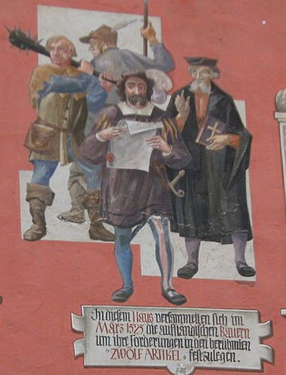
German Peasants' War - 500th anniversary of the „Twelve Articles“
Title page of the “Twelve Articles”
"12 articulos de los campesinos“
Source: Schönsperger, Johann d.J., (1525): 12 Artikel von Memmingen
https://de.wikipedia.org/wiki/Zw%C3%B6lf_Artikel
https://de.wikipedia.org/wiki/Deutscher_Bauernkrieg#/media/Datei:Memmingen-kramerzunft-12-artikel.JPG
The Twelve Articles (German: Zwölf Artikel) were part of the peasants ' (farmers') demands during the German Peasants' War of 1525.
are considered the first draft of human rights and civil liberties in continental Europe
[Schönsperger 1525]
Notes:
The German Peasants' War was a widespread popular revolt in German-speaking areas from 1524 to 1525. This uprising was organized as a democratic movement which incorporated some principles and from the emerging Protestant Reformation, finally failed because of intense opposition from the aristocracy, who slaughtered up to 100,000 of the 300,000 poorly armed peasants and farmers.

Slide 5
My modern summary of the „Twelve Articles“
1- Democracy: Each local authority has to elect its representatives independently. Political leaders should present their ideas clearly and comprehensively.
2- Prevention of corruption: Political leaders should receive sufficient financial support to ensure their independence. Any funds available beyond this should be invested in social causes.
3. Human dignity: The dignity of every human being should be recognised without distinction. Every human being is free and enjoys sovereignty.
4. & 5. Just distribution of all resources: It is unjust and antisocial when goods are distributed inappropriately. Every human being should have sufficient means to live on.
5. & 10. Application of Commons: Goods should be returned to the general public as common property. The privatisation of common goods must be reversed so that they are once again available to the general public.
6. Workloads and working conditions should be reasonable.
8. Just taxation and payment: Taxation must take into account the individual's ability to pay. Necessary goods must be affordable. Work must be fairly remunerated.
9. Justice: Every citizen must be treated fairly (including in the administration of justice). Laws must not be changed arbitrarily.
12. These demands must be examined. This list is not exhaustive.
Notes:
The revolt failed because of intense opposition from the aristocracy, who slaughtered up to 100,000 of the 300,000 poorly armed peasants and farmer.

Slide 6
500 Years later

Slide 7
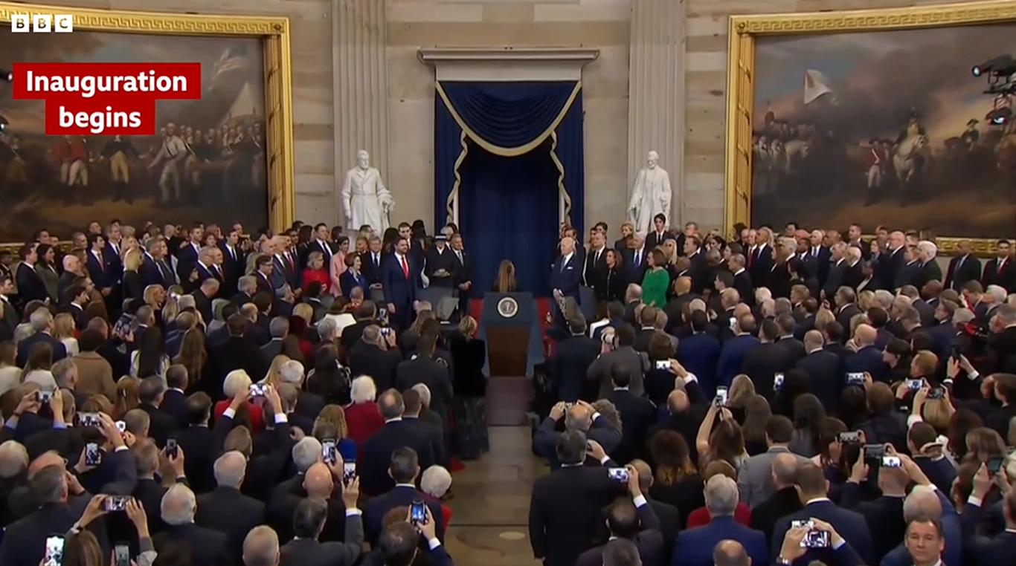
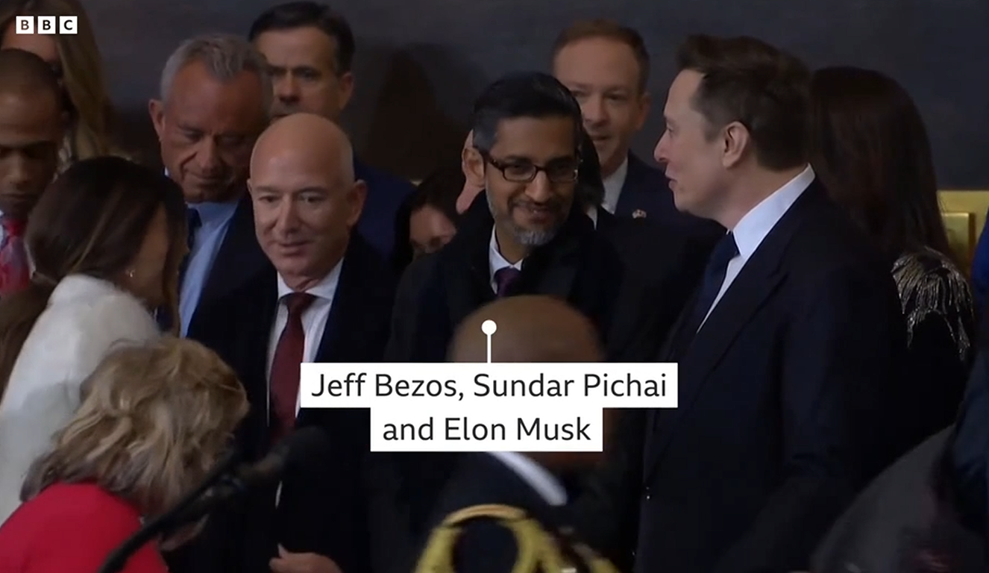
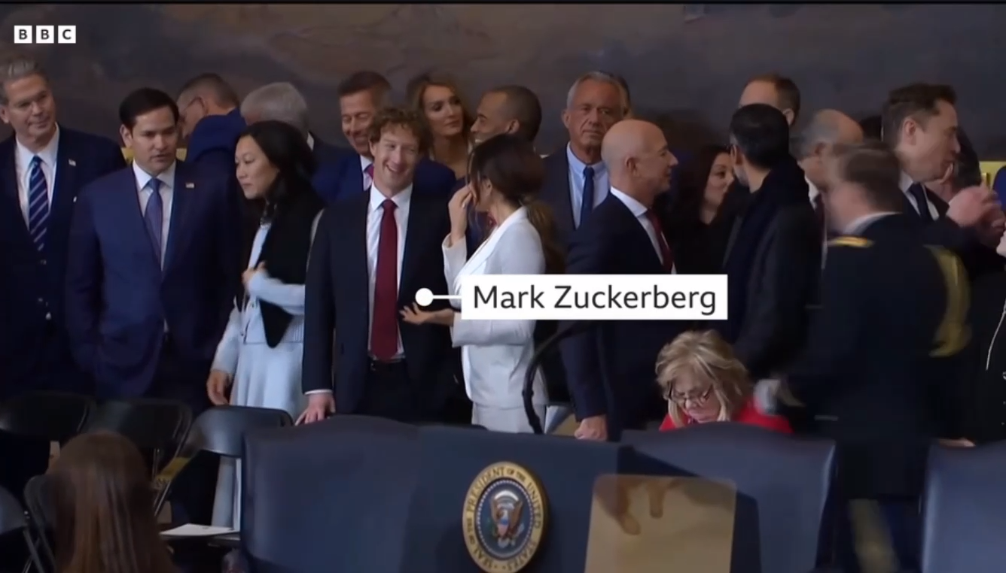
“an oligarchy is taking shape in America of extreme wealth, power and influence that literally threatens our entire democracy” “the dangerous concentration of power in the hands of a few ultra-wealthy people”
Joe Biden (2025) https://www.theguardian.com/us-news/2025/jan/15/joe-biden-farewell-address-trump-oligarchy-america
Source: https://www.bbc.com/news/videos/cd64jjvzvv9o
Notes:
During the ceremony of Donald Trump’s inauguration at the Capitol rotunda, tech leaders including Meta’s CEO, Mark Zuckerberg; Apple’s CEO, Tim Cook; Google’s CEO, Sundar Pichai; Amazon’s founder, Jeff Bezos; and Tesla’s CEO, Elon Musk, gathered together to symbolize the increasingly close relationship between the tech industry and the new American president
They had previously donated millions to the election campaign and the inauguration. Even some of them, such as Meta CEO Mark Zuckerberg, had already adapted business concepts to Trump's policies in advance. Many people were very concerned about these noble guests in the middle of the Rotunda. Joe Biden, the former president, commented it like that:

Slide 8
The relevance of GAFAM
Google/Alphabet, Apple, Facebook, Amazon and Microsoft comprise the world’s top five tech companies, with a combined market value > 3-trillion (or even 5 trillion) US dollar
GAFAM and other Big Tech corporations control most of the essential functions of the digital world:
social networking (X, TicToc, Instagram, Facebook), messaging (Meta, which owns WhatsApp),
internet search (Google),
desktop and laptop operating systems (Microsoft Windows, Apple),
smartphone and tablet operating systems (Google, Apple),
office software,
online advertising (Google, Facebook),
cloud computing (Amazon, Microsoft, Google, IBM), Software depository (Github)
Transportation/ridesharing (Uber, Lyft, Taxify) – privacy?,
lodging (Airbnb),
streaming video (Google, YouTube, Netflix, Hulu)
i.e. they limit the Digital Sovereignty of states and citizes (discussed later)
Not to forget Chinese players (discussed later)
Notes:
GAFAM and a few other Big Tech corporations control most of the critical functions that can be performed in the digital world

Slide 9
Governmental Sovereignty, Personal Sovereignty and Digital Sovereignty are threatened by technocrats and oligarchs
„[The] fullest right a person […] can have over herself provided that each other person also has just such a right.”
Supreme authority in a state.
„the ability to act and develop independently and self-determinedly in the digital world”
Decisions and exercise of power by a small group of people
Neglecting social, sociological and psychological aspects

Slide 10
Digital Sovereignty
Other terms: Data Sovereignty, Digital autonomy, Digital self-determination
Digital self-determination
Competence
Informedness
Values
Freedom of Choice
Voluntariness
Formation of opinion
Action
Mertz, Marcel, Jannes, Marc, Schlomann, Anna, Manderscheid, Enza, Rietz. Christian, Woopen, Christiane (2016): Digitale Selbstbestimmung. Cologne Center for Ethics, Rights, Economics, and Social Sciences of Health (ceres), Köln https://ceres.uni-koeln.de/fileadmin/user_upload/Bilder/Dokumente/ceres-Digitale_Selbstbestimmung_2.pdf
Notes:
Self-determination can be understood as the concrete development of a human personality or the possibility of realising one's own plans and decisions for action, namely ‘against the backdrop of the autonomy fundamentally accorded to human beings’ (Mertz et al. 2016)
Digital self-determination encompasses Competence, Informedness, Values, Freedom of choice, Voluntariness, Formation of opinion, and finally Action. That is the challenge we all face here, whether in our private lives or in our professional activities. With respect to AGSE can find many of these aspects, like providing competence, …

Slide 11
Neo-Colonialism

Slide 12
From colonialism to neo-colonialism
„
But colonialism returned in a different form: as neo-colonialism
I propose to analyse neo-colonialism, first, by examining the state of the […] continent and showing how neo-colonialism at the moment keeps it artificially poor. Next, I propose to show how in practice […] could immensely raise […] living standards. From this beginning, I propose to examine neo-colonialism generally, first historically and then by a consideration of the great international monopolies whose continued stranglehold on the neo-colonial sectors of the world ensures the continuation of the system
Kwame Nkrumah (1965) Neocolonialism. The Last Stage of Imperialism (1965) London: Thomas Nelson & Sons, Ltd. Online under https://www.marxists.org/ebooks/nkrumah/nkrumah-neocolonialism.pdf [2025-09-02]
Notes:
The term neocolonialism was coined by Kwame Nkrumah, the first president of Ghana (the location of AGSE 2026) who led his country into indepencence. In his 1966 book ‘Neo-Colonialism: The Last Stage of Imperialism’, he defines neo-colonialism as the most advanced form of imperialism, in which nominally independent states are in reality controlled economically and politically by major international powers. This is achieved through various instruments such as economic dependence, monetary control, and, in some cases, even military intervention. We can observe ^such an unilateral control of the economy and natural resources by external actors in many cases

Slide 13
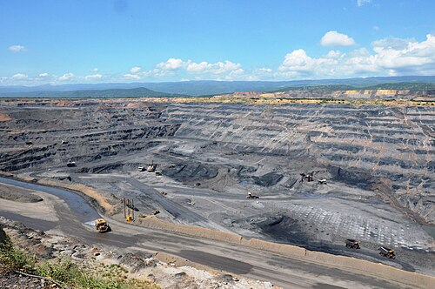
(Data) Economy: firmly in the hands of corporations from the Global North
“mechanisms of colonial appropriation, enclosure and cheapening of labour and resources” (Buch-Hansen & Nesterova 2023)
The resource curse of the Global South: Like in previous centuries countries, mainly in the Global South, rich in natural resources are still often suppliers of unprocessed raw materials needed for digitalization, generating little domestic value addition while having to pay for imported digital equipment and services to meet their own digitalization needs.
El Cerrejón coal mine in northern Colombia
Example: Glencore plc, Switzerland, is one of the world's leading commodity companies. Its business activities include the production, processing, and trading of aluminum, alumina, bauxite, iron alloys, nickel, zinc, copper, lead, coal, oil, and agricultural products. Allegations of human rights violations, tax manipulation, corruption in Iran, Congo, Brazil, and other countries, and environmental pollution are worth mentioning.
Source: https://de.wikipedia.org/wiki/Glencore https://commons.wikimedia.org/wiki/File:Cerrej%C3%B3n_mine.JPG

Slide 14
(Data) Economy II
Digital data that are generated in these countries provide opportunities for international digital platforms to produce digital intelligence, i.e. AI, that can be monetized, rather than benefit for local businesses.
Another field of work: Content Moderation

Slide 15
Digital Colonialism „data colonialism“, „techno-colonialism“

Slide 16
Digital colonialism can be observed in different aspects:
Software
Hardware
Network, i.e. the Internet and the underlying protocols
Overall: The digital ecosystems implemented in our homes, institutions, companies, and public administration
[Kwet 2018, Kwet 2019]
These (eco)systems are dominated by US American institutions and companies.
“Mostly US multinational companies exercise imperial control at the architecture level of the digital ecosystem: software, hardware and network connectivity, which then gives rise to related forms of domination.” (Kwet 2018, Kwet 2019)
Notes:
US multinationals exercise imperial control at the architecture level of the digital ecosystem: software, hardware and network connectivity, which then gives rise to related forms of domination.

Slide 17









































Example: Commercial OGC Members
17
Notes:
How many companies are located in the Global South?

Slide 18
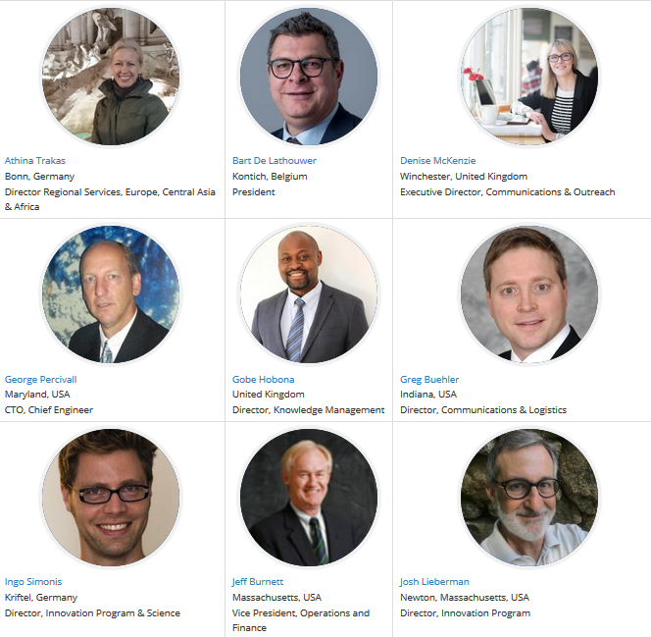
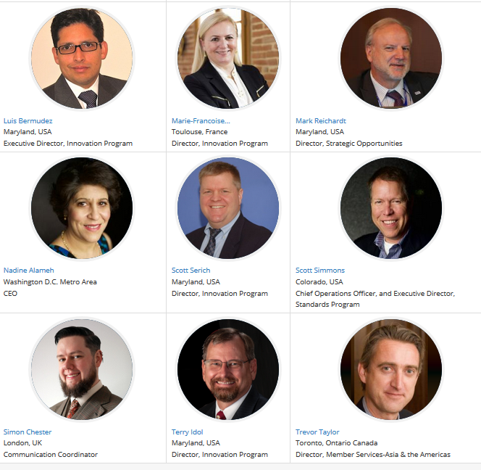
OGC staff
http://www.opengeospatial.org/ogc/organization/staff [2019-07-08]
Notes:
Who originates in the Global South?

Slide 19
Data colonialism: Where do the data flow?

Slide 20
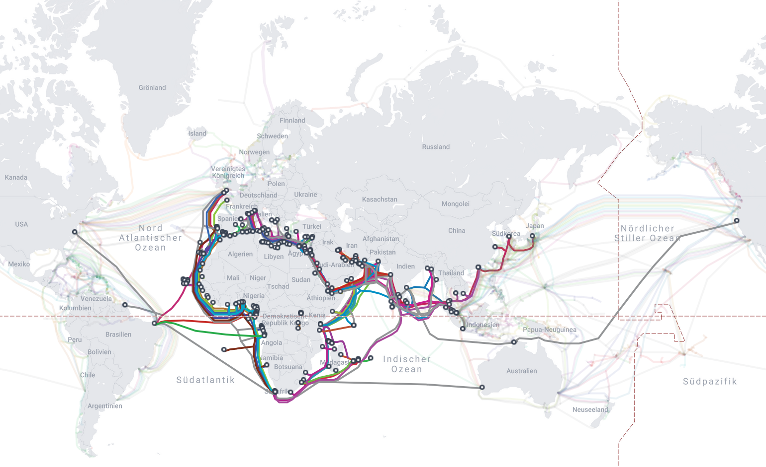
„
It may feel as if the internet is up in the clouds, but in actual fact it’s at the bottom of the ocean, in the form of 880.000 kilometers of fiber-optic cables expanding along old colonial routes, which were often also used to ship slaves to the colonies in the so-called New World.
https://frauenfilmfest.com/en/movie/deep-down-tidal/
https://www.submarinecablemap.com/region/africa

Slide 21
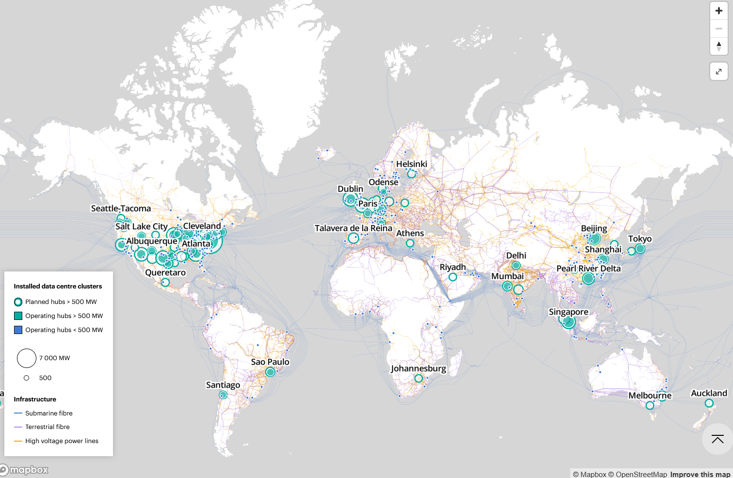
https://www.iea.org/data-and-statistics/data-tools/energy-and-ai-observatory?tab=Energy+for+AI

Slide 22
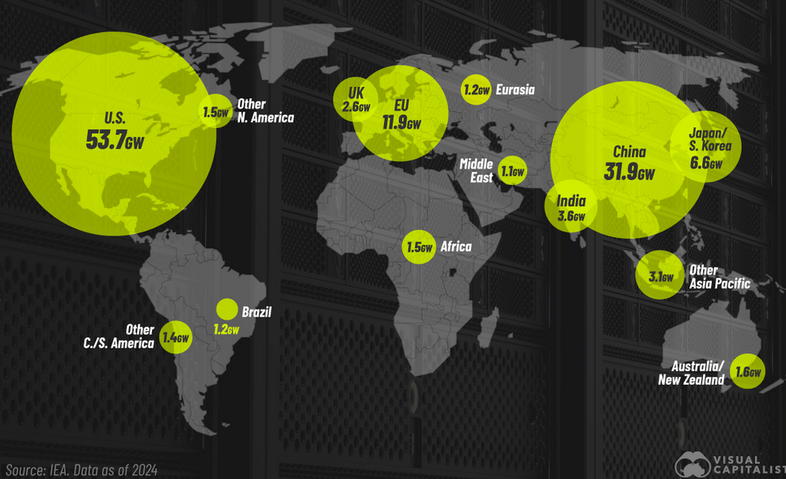
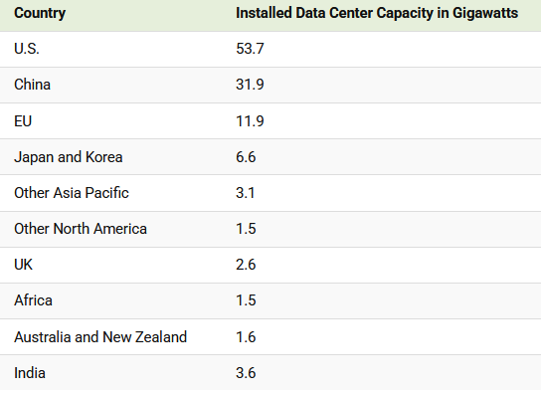
https://www.visualcapitalist.com/data-center-capacity-around-the-world/
Notes:
AWS, Google Cloud, and Microsoft Azure
U.S. and China account for 70% of the global total.
Electricity demand from data centers is expected to hit 485.4 terawatt-hours (TWh) in 2025, making up 1.7% of global electricity demand. (https://www.voronoiapp.com/technology/The-Growth-of-Global-Data-Center-Capacity-5635)

Slide 23
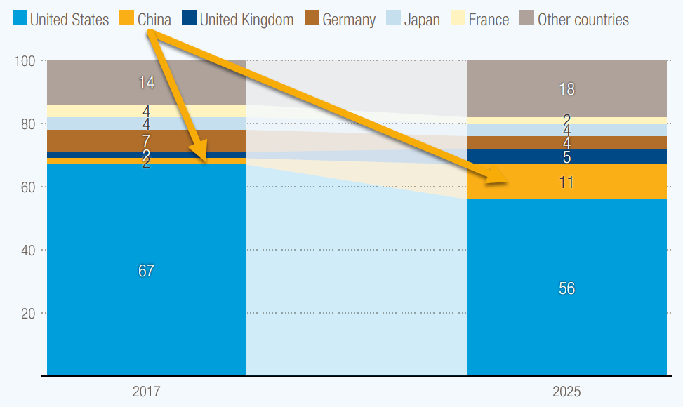
Who and where are the actors?
President Xi Jinping's strategy to transform China into a 'cyber superpower’
A major concern is that market dominance by a few firms – mostly headquartered in the US and China – stifles competition and crowds out local players.
Global companies dominate the entire global data value chain, including data collection, storage and analysis, and related digital intelligence. (UNCDTA 2024, p. 6).
Number of top digital firms in the digital economy, by home country, number of firms, 2017–2025 Source: UN Trade and Development (UNCTAD), based on FDI/MNEs database
Notes:
Digital infrastructure and digital services like telecommunications, Internet and data services, cloud services and cybersecurity protocols, platform-based activities, the sharing economy, e-commerce, fintech, artificial intelligence and automation
UNCDTA 2024: Digital Economy Report 2024. https://unctad.org/system/files/official-document/der2024_ch06_en.pdf

Slide 24
A remark regarding China
We can observe that the Chinese government and Chinese technology companies engage in a sustained effort to export the technology at the heart of the country's information-control system to nations around the globe.
„China has consistently promoted a vision for global internet governance that emphasizes governmental control over data flows, initially under the concept of “cyber sovereignty” and more recently as “data sovereignty.” (Yun 2025)
“From Smart Cities to Digital Communities, from smart industries to digital products, the tentacles of “digital” have increasingly extended to every corner, profoundly changing people’s lives.” (“Digital China Construction Series 5: Develop Efficient and Collaborative Digital Government Affairs," Beijing Party Member Education Network, April 11, 2025, https://digitalchinawinsthefuture.com/?p=14698)

Slide 25
Confrontation between unequal partners
We can see a triangle of tension here between individual citizens, the respective state, and tech companies:
Tech companies vs. Nations and vice versa
Nations vs. individuals
Tech companies vs. individuals
Individuals vs. nations and tech companies
Nations
Individuals
Tech companies
Notes:
We find interactions between nations, tech companies and individuals (Tretter 2022, Zuboﬀ 2015, Zuboﬀ 2019).
We can see a triangle of tension here between individual citizens, the respective state, and tech companies.

Slide 26
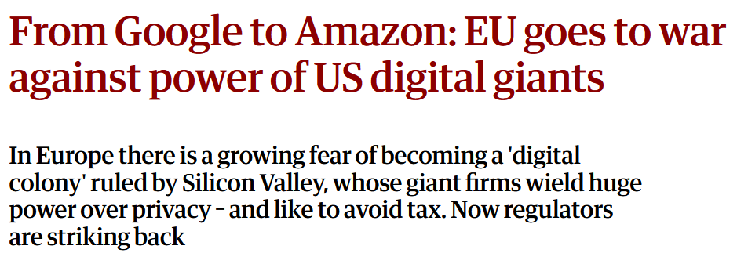
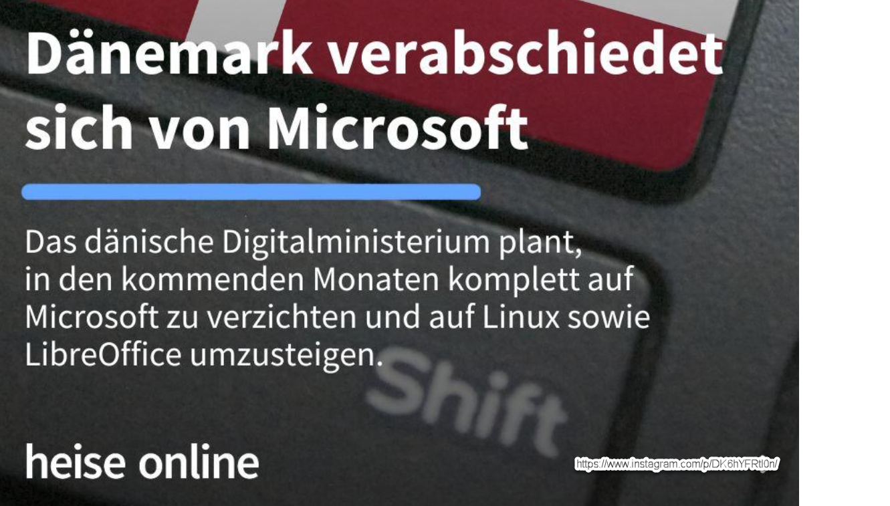
https://www.theguardian.com/technology/2014/jul/06/google-amazon-europe-goes-to-war-power-digital-giants
Denmark says good-bye to Microsoft

Slide 27
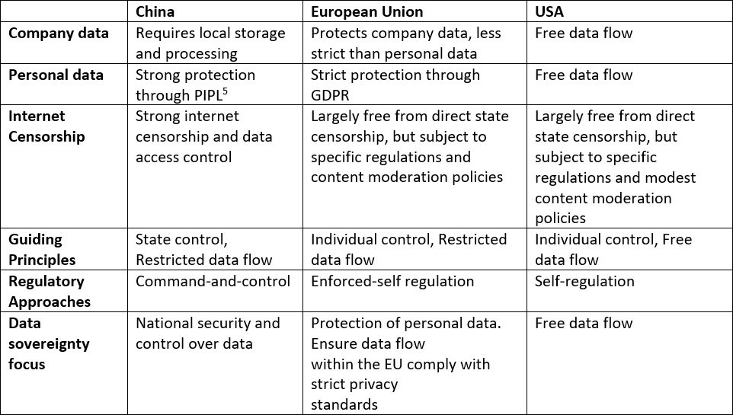
Comparison of data policies: China vs. the EU vs. the US
Source: after Yun 2025

Slide 28
„
“Data is a new important factor of production after land, labor, capital, and technology. To consolidate the foundation for constructing Digital China, we must also facilitate the grand circulation of data resources…”
“Digital China Construction Series 3: Facilitate the Grand Circulation of Data Resources,” Beijing Party Member Education Network, April 11, 2025, https://digitalchinawinsthefuture.com/?p=14698
Notes:
“Data is a new important factor of production after land, labor, capital, and technology. To consolidate the foundation for constructing Digital China, we must also facilitate the grand circulation of data resources…”

Slide 29
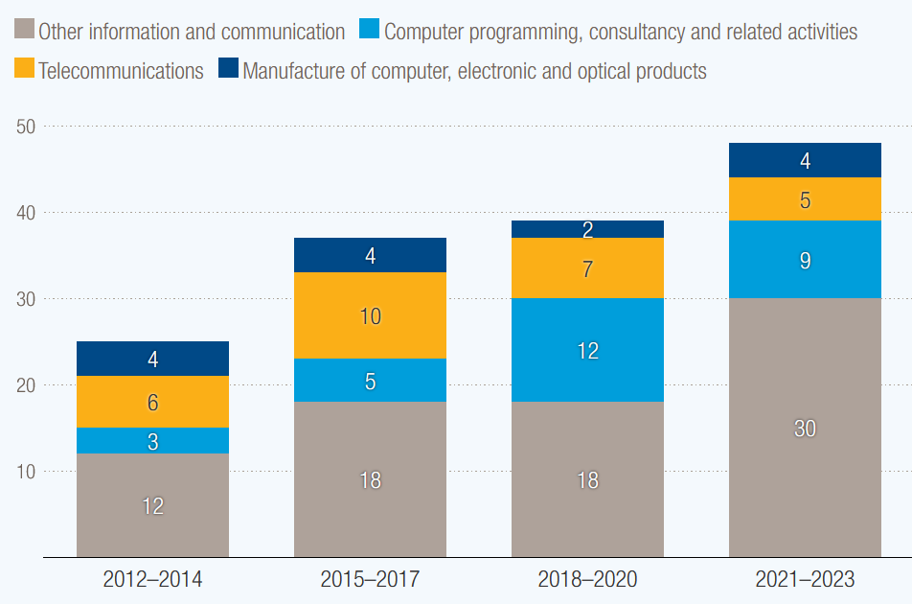
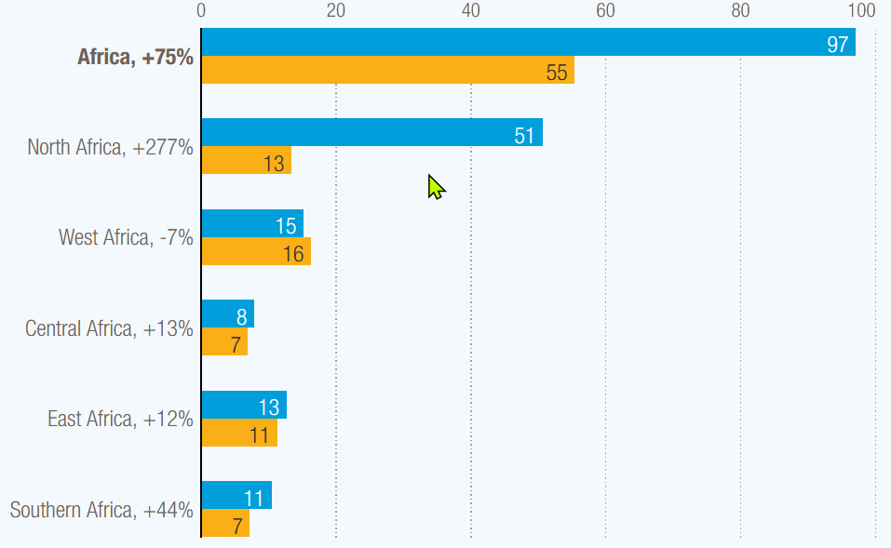
The monetary aspects
Inflows to developing countries in core sectors of the digital economy, billions of dollars, 2012–2023 Source: UN Trade and Development (UNCTAD)
Notes:
The amount of Foreign Direct Investment (FDI) can seen as an example. FDI in Africa jumped 75% in 2024, with growth across most sub-regions.
According to UNCDAT International investment in digital sectors is rising, except in telecommunications. Greenfield investment in the digital economy has nearly tripled since 2020 to $360 billion – and now accounts for nearly a third of all greenfield projects. A greenfield investment is the establishment of a completely new company or a new production facility from scratch in a foreign market, comparable to building on a ‘green field’.

Slide 30
Digital colonialism in our home
Tech-companies permanently collect data from individuals and use it, as “a new kind of sovereign power” (Zuboﬀ 2015, Zuboﬀ 2019),
to inﬂuence us in our decisions—threatening our individual sovereignty.
Instead of being an autonomous individual who has the ability to realize the vision of her or his own future, the user is trapped the circle of apps, in the bubbles created by streams of posts and advertisements targeted specifically to him or her.
Regarding data privacy: Microsoft, for example) offers no guarantee that EU data will never be shared with the US government, according to Anton Carniaux, chief legal officer at Microsoft France, at a hearing before the French Senate.

Slide 31
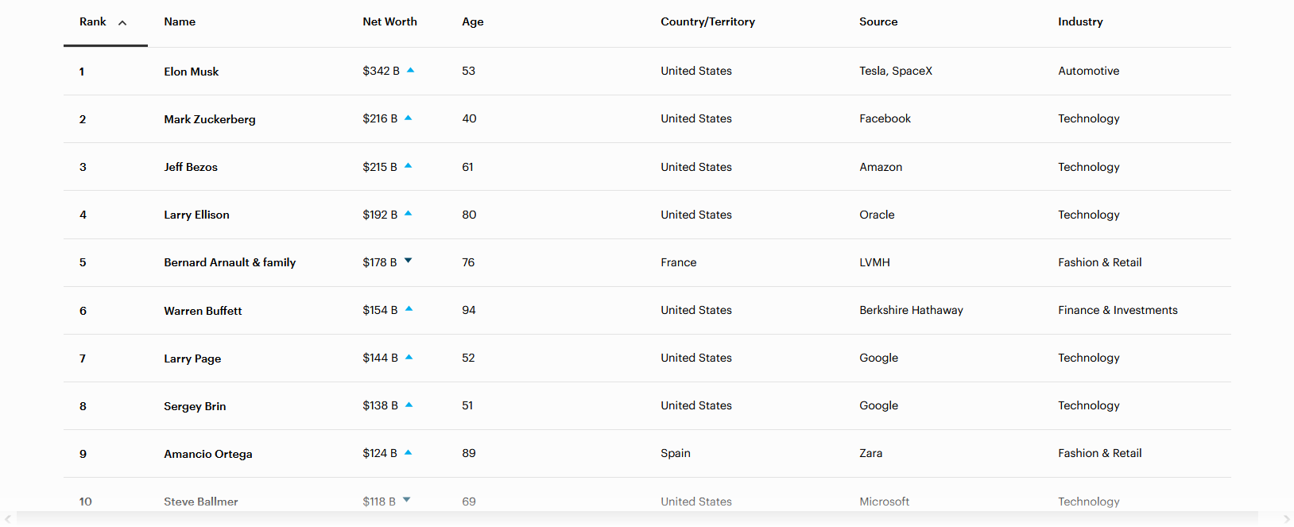
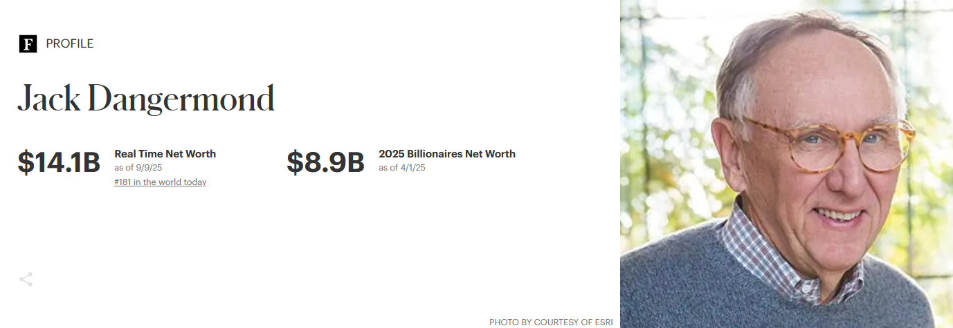
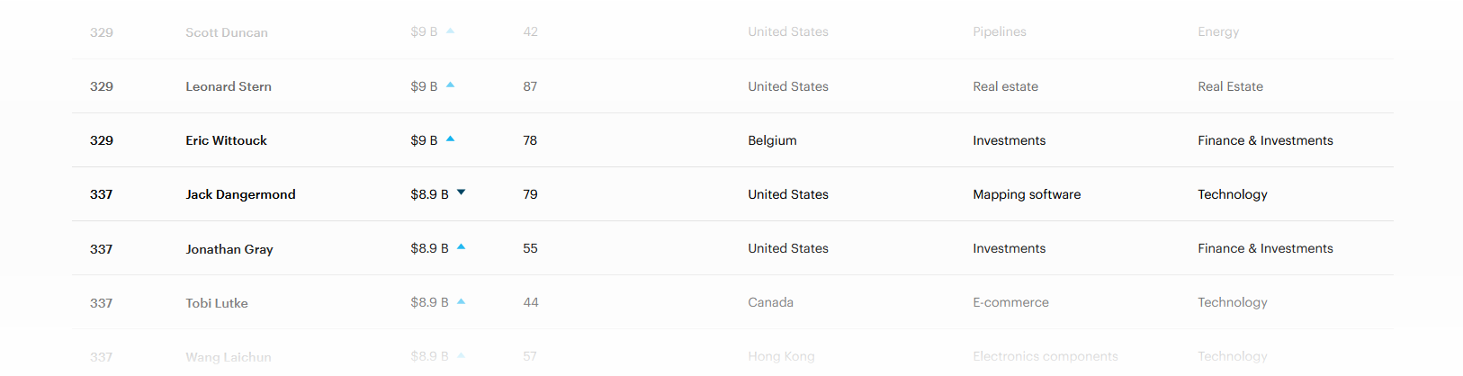
approx. 35 Trillion Pesos

Slide 32
„
While the earnings of a minority are growing exponentially, so too is the gap separating the majority from the prosperity enjoyed by those happy few. This imbalance is the result of ideologies which defend the absolute autonomy of the marketplace and financial speculation.
Francis, APOSTOLIC EXHORTATION
EVANGELII (24. November 2013), 202: AAS 105 (2013), https://www.vatican.va/content/francesco/en/apost_exhortations/documents/papa-francesco_esortazione-ap_20131124_evangelii-gaudium.html

Slide 33
Decolonialisation - What can we do?
Degrowth
#unplugtrump: Extenting digital authonomy
Focus on Open Data, Open Source, Open Education

Slide 34
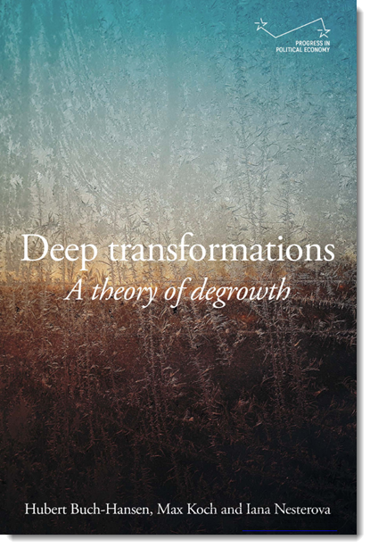
Degrowth
a socio-ecological movement and economic model that rejects the constant increase in economic output (‚growthism“), having particularly the gross domestic product (GDP) as its main goal.
Instead, the approach to degrowth strives for a society that prioritises the well-being of all people and the preservation of natural resources.
This includes a reduction in consumption and thus material production, a more equitable distribution of resources, a focus on quality, and a cultural shift towards greater frugality towards consumption, regional economies, and circular economies.
Even though degrowth tends to be more prevalent in the Global North it is a critique of the mechanisms of colonial appropriation, and cheapening of labour and resources
Buch-Hansen, Hubert; Koch, Max & Nesterova, Iana (2024). Deep transformations: A theory of degrowth. Manchester University Press, https://doi.org/10.7765/9781526173287
Notes:
enclosure

Slide 35
Four aspects and habits of degrowth
Consider our HFT Alumni Fellowship
Material transactions with nature: Cleaner energy forms, regard for nature, preservation of biodiversity and life, place-sensitivity, place-based activities/localisation, nature-based economic activities
Social interactions: Empathy, compassion, peacefulness, solidarity, sufficiency, kindness, generosity and tolerance of diversity, spontaneous right action, fellow-feeling, respect and concern for others, care, mutual learning, democracy
Social structures: Collaboration, equal distribution of economic and other resources, flat hierarchies
Inner being: Love, creativity, oneness, gentleness towards being and beings, awareness, curiosity, transcending the narrow ego/self, seeing oneself as part of the broader existence, self-realisation, fulfilment, harmony, joy (‘to be’)
As the authors point out, “it is crucial to avoid reductionism, acknowledge the interconnectedness of the planes of being and to recognise [the importance and] diversity on each plane”.
„If growthism seeks to organize the economy around the interests of capital (exchange-value) through accumulation, enclosure, and commodification, degrowth calls for the economy to be organized instead around provisioning for human needs (use-value) through de-accumulation, de-enclosure and de-commodification. Degrowth also rejects the cheapening of labour and resources.“
Buch-Hansen, Hubert & Nesterova, Iana (2023) ‘Less and more: Conceptualising degrowth transformations’. Ecological Economics, 205, 107731
Buch-Hansen, Hubert; Koch, max & Nesterova, Iana (2024). Deep transformations: A theory of degrowth. Manchester University Press, https://doi.org/10.7765/9781526173287

Slide 36
#unplugtrump: Extenting digital authonomy

Slide 37
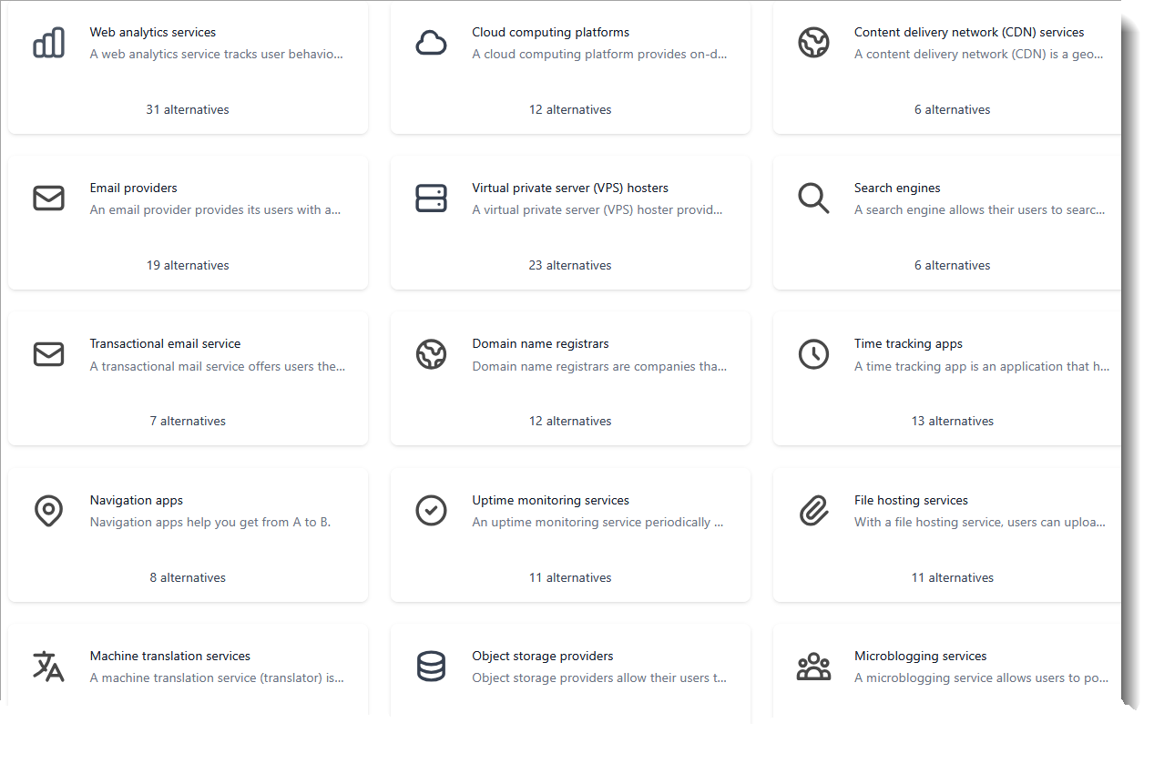

European alternatives for popular services
https://european-alternatives.eu/alternatives-to
lists of >400 European alternatives for popular services
that were developed and hosted in Europe
All products that use renewable energy to provide their services are marked with a green leaf symbol.
Assigns labels

Slide 38
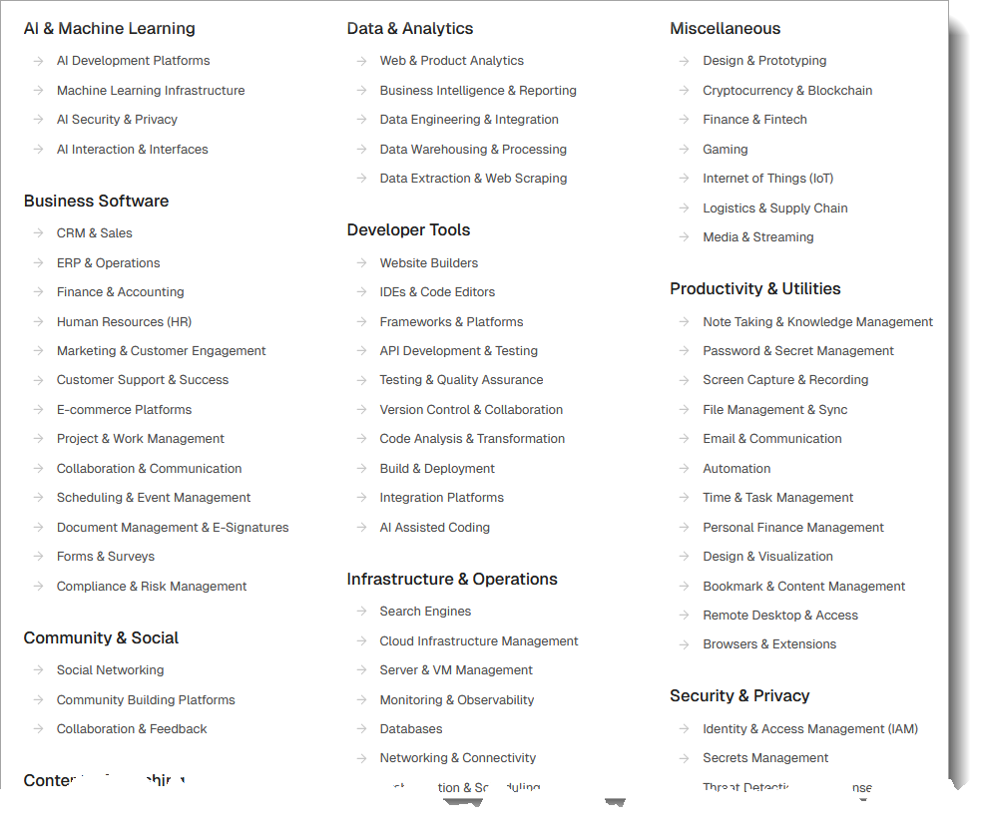
Open alternatives for popular services
Open Source alternatives https://openalternative.co/alternatives
lists of >400 apps that were developed in Europe at and therefore also comply with European data standards

Slide 39
Open Source

Slide 40
Open Source is a catalyst for Digital Sovereignty
„Open Source Software (OSS) is a key element and prerequisite for strengthening Digital Sovereignty.
It enables societies to work independently and autonomously on solutions and to adapt them as best as possible to one’s own needs. This avoids lock-in effects and expands the company’s own technical know-how. In conjunction with increasing collaboration in the OSS ecosystem, efficiency and innovation gains can be achieved in the long term. These in turn contribute to the progress of the digital transformation and enable the sustainable realisation of Digital Sovereignty.”
https://www.pwc.de/en/digitale-transformation/open-source-software-management-and-compliance/digital-sovereignty-why-it-pays-to-be-independent.html 2025

Slide 41
Digital-sovereignty principles
The availability of more than one provider ensures independence from the original manufacturer.
The flexible operation of the software guarantees independence.
Open data standards support flexible data migration and facilitates flexible and free use.
Transparent software and code enables joint advancement and control.
See also the definitions of the Free Software Foundation, https://www.gnu.org/philosophy/free-sw.html.en
After Bitkom (2023). Open Source Monitor 2023. https://www.bitkom.org/sites/main/files/2023-11/Bitkom-Open-Source-Monitor-2023-EN.pdf

Slide 42
Open Source: Visibility and Collaboration: The OSGeo Foundation

Slide 43

OSGeo's Goals
OSGeo Vision
Empower everyone with open source geospatial
OSGeo Mission Statement
Foster global adoption of open geospatial technology by being an inclusive software foundation devoted to an open philosophy and participatory community driven development.
OSGeo Goals
The following aspirational goals support the overall mission. As a foundation we seek to:
provide resources for foundation projects;
foster the use of open source geospatial software;
encourage interoperability with open and community standards;
ensure interoperability between the foundation projects;
encourage a high degree of quality and innovation in foundation projects;
champion the use of open-source and community participation through the development of an open education curriculum
enable communication and cooperation amongst OSGeo communities;
champion community building through horizontal (local chapters) engagement and through vertical (sector specific) agreements with like-minded organizations;
be a welcoming and inclusive worldwide organization at all levels;
celebrate excellence, openness and service within the OSGeo community.
Notes:
The Open Source Geospatial Foundation (OSGeo) is a not-for-profit organization whose mission is to foster global adoption of open geospatial technology by being an inclusive software foundation devoted to an open philosophy and participatory community driven development.

Slide 44
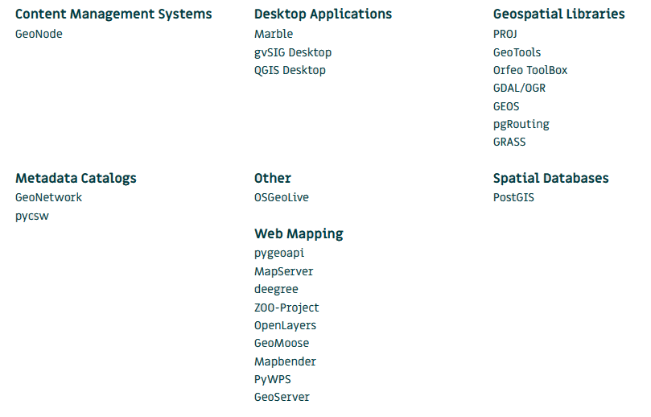
OSGeo Projects

Slide 45
Open Source is not a one-way-street.
Open Source and OSGeo require our participation and our joint support.
Partizipation comprises
Usage,
Education,
Testing, Translating,
Support of the community by hiring, financing further developments.

Slide 46
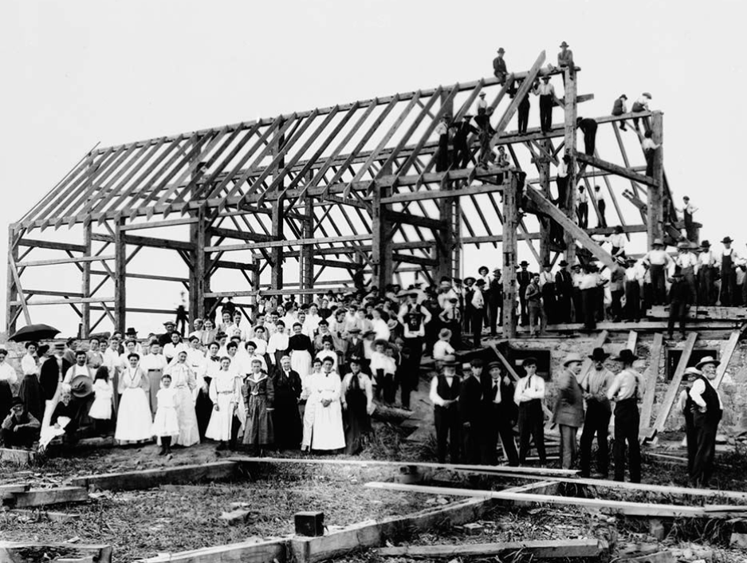
Staying together to achieve greater output
By Alexander W. Galbraith [Public domain or Public domain], via Wikimedia Commons
https://upload.wikimedia.org/wikipedia/commons/a/ab/Barn_raising_in_Lansing.jpg
Notes:
Barn raising refers to the communal construction of a barn by all members of the respective community, communities like ours. The tradition of barn raising is still continued today in Amish and Mennonite communities in the USA. In a similar way we can contribute with our personalities and knowledges in different fields of geospatial science and technology to the betterment of our societies and the environment.

Slide 47
Conclusion
Notes:
Let me come to the conclsion

Slide 48
Follow the „Planes of Degrowth“!
Seek collaboration with others in the sense of being and supporting „Open“
„Brotherhood/Sisterhood: the foundation and path to peace” [Franciscus 2014]
Support and multiply the spirit of AGSE and apply Geoinformatics for the betterment of Society and Environment.
Gracias & Thank you & Vielen Dank!
Franziscus (2014): Message for the celebration of the World day of Peace, see https://www.vatican.va/content/francesco/en/messages/peace/documents/papa-francesco_20131208_messaggio-xlvii-giornata-mondiale-pace-2014.html

Slide 49
References
Bitkom (2023). Open Source Moniitor 2023. https://www.bitkom.org/sites/main/files/2023-11/Bitkom-Open-Source-Monitor-2023-EN.pdf
Buch-Hansen, Hubert & Nesterova, Iana (2023) ‘Less and more: Conceptualising degrowth transformations’. Ecological Economics, 205, 107731
Buch-Hansen, Hubert; Koch, Max & Nesterova, Iana (2024). Deep transformations: A theory of degrowth. Manchester University Press, https://doi.org/10.7765/9781526173287
Bundestag (2025). Deutschlands Zukunft gestalten. Koalitionsvertrag zwischen CDU, CSU und SPD, 18. Legislaturperiode. https://www.bundestag.de/resource/blob/194886/696f36f795961df200fb27fb6803d83e/koalitionsvertrag-data.pdf
Cohen, G. A. (1995). Self-Ownership, Freedom, and Equality (Cambridge: Cambridge University Press, 1995), 213, cited by ohn Thrasher, “Self-Ownership as Personal Sovereignty,” Social Philosophy & Policy 36, no. 2 (2019): 116-133. https://doi.org/10.1017/S0265052519000396
Ezell, Stephen & Wu, John 2017: How Joining the Information Technology Agreement Spurs Growth in Developing Nations. https://itif.org/publications/2017/05/22/how-joining-information-technology-agreement-spurs-growth-developing-nations/
Kwet, Michael (2018). Break the hold of digital colonialism. https://mg.co.za/article/2018-06-29-00-break-the-hold-of-digital-colonialism/
Kwet, Michael (2019). Digital colonialism: US empire and the new imperialism in the Global South. Race & Class, 60(4), 3-26. https://doi.org/10.1177/0306396818823172 (Original work published 2019)
Mertz, Marcel, Jannes, Marc, Schlomann, Anna, Manderscheid, Enza, Rietz. Christian, Woopen, Christiane (2016): Digitale Selbstbestimmung. Cologne Center for Ethics, Rights, Economics, and Social Sciences of Health (ceres), Köln https://ceres.uni-koeln.de/fileadmin/user_upload/Bilder/Dokumente/ceres-Digitale_Selbstbestimmung_2.pdf
Makarychev, A., & Wishnick, E. (2022). Anti-pandemic policies in Estonia and Taiwan: Digital power, sovereignty and biopolitics.Social Sciences, 11(3), 112–134. https:// doi. org/ 10. 3390/ socsc i1103 0112
Kwame Nkrumah (1965) Neocolonialism. The Last Stage of Imperialism (1965) London: Thomas Nelson & Sons, Ltd. Online under https://www.marxists.org/ebooks/nkrumah/nkrumah-neocolonialism.pdf [2025-09-02]
Kwet, Michael (2018). Break the hold of digital colonialism. https://mg.co.za/article/2018-06-29-00-break-the-hold-of-digital-colonialism/
Kwet, Michael (2019). Digital colonialism: US empire and the new imperialism in the Global South. Race & Class, 60(4), 3-26. https://doi.org/10.1177/0306396818823172 (Original work published 2019)
PricewaterhouseCoopers (2025): Why it pays to be independent: Digital Sovereignty. https://www.pwc.de/en/digitale-transformation/open-source-software-management-and-compliance/digital-sovereignty-why-it-pays-to-be-independent.html [2025-09-05]
Tretter, Max. (2022). Sovereignty in the Digital and Contact Tracing Apps. Digital Society. 2. 10.1007/s44206-022-00030-2
UNCDTA 2024: Digital Economy Report 2024. https://unctad.org/system/files/official-document/der2024_ch06_en.pdf
Yun, Heylyung (2025): China’s Data Sovereignty and Security: Implications for Global Digital Borders and Governance. Chin. Polit. Sci. Rev. 10, 178–203 (2025). https://doi.org/10.1007/s41111-024-00269-9
Ziai, Aram (2020): Neocolonialism in the global political economy of the 21st century, in: Momentum Quarterly 9 (3), 128-140. https://www.momentum-quarterly.org/momentum/issue/view/308
Ziai, Aram (2012) Neokoloniale Weltordnung? Brüche und Kontinuitäten seit der Dekolonisation. In: Aus Politik und Zeitgeschichte, 62. Jahrgang · 44–45/2012 · 29. Oktober 2012, https://www.bpb.de/system/files/dokument_pdf/APuZ_2012-44-45_online_Kolonialismus.pdf
Zuboff, S. (2015). Big other: Surveillance Capitalism and the Prospects of an Information Civilization. Journal of Information Technology, 30(1), 75-89. https://doi.org/10.1057/jit.2015.5 (Original work published 2015)
Zuboff, Shoshana (2019). The Age of Surveillance Capitalism: The Fight for a Human Future at the New Frontier of Power. New York: PublicAffairs

Slide 50
Thank you!
Contact
Prof. Dr. Franz-Josef Behr, Stuttgart University of Applied Sciences
franz-josef.behr@hft-stuttgart.de

