Slide 1
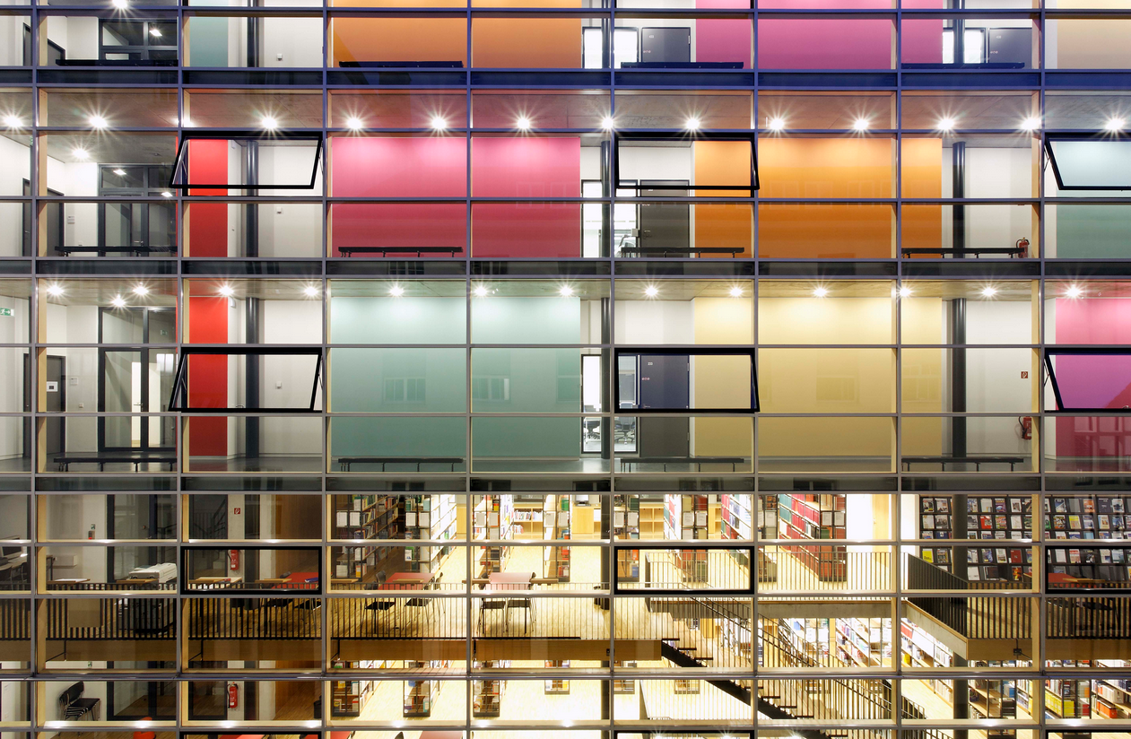

The Commons, the Open Source
and the Impact of the OSGeo Foundation
By Hochschule für Technik Stuttgart [CC BY-SA 3.0 (http://creativecommons.org/licenses/by-sa/3.0)], via Wikimedia Commons
Franz-Josef Behr, Stuttgart University of Applied Sciences
13.11.2018, AGSE 2018, Namibia University of Science and Technology
The content is licensed under a Creative Commons-Lizenz CC BY-NC-SA.

Slide 2
My Background
Academia
12 years of (closed) GIS business (plus book author)
  IBM GFIS, MapInfo
  Municipalitiies, utility sector
Professor (since 2002)
Involved in some (own) open source projects
  SUAS MapServer (WMS, WFS)
  opencts.org/, opengeocodng.org, http://geoweb.hft-stuttgart.de/)
  Initiator of FOSS4G SEA 2012 and FOSS4F Local Chapter Malaysia
  Co-organizer of FOSS4G 2013, FOSS4G 204, FOSS4G 2916
  ICA/OSGEo lab at HFT Stuttgart

Slide 3
Outline
In some parts inspried by a presentation of Arnulf Christl, formerOSGeo President,
http://www.metaspatial.net
Short intro
The Commons and The Tragedy of Commons
Open Source
  Freedom
  Psycho-social Aspects of Motivation
Economical and technical aspects
Being represented: Structure and impact of the OSGeo Foundation
Outlook
  Academic educatio

Slide 4
Commons - Common-Pool Resources (CPRs)

Slide 5
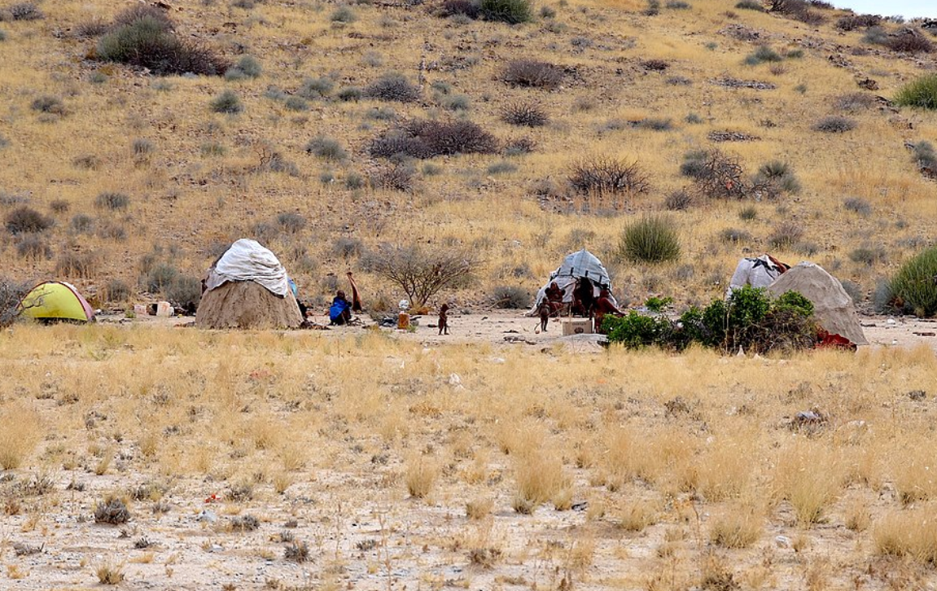
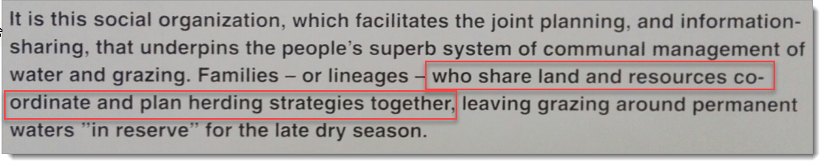
Commons of the Himba People
Source: Museum of Swakopmund
Olga Ernst [CC BY-SA 4.0 (https://creativecommons.org/licenses/by-sa/4.0)], from Wikimedia Commons
https://upload.wikimedia.org/wikipedia/commons/7/75/Himba_village%2C_Namibia_%282014%29.jpg

Slide 6
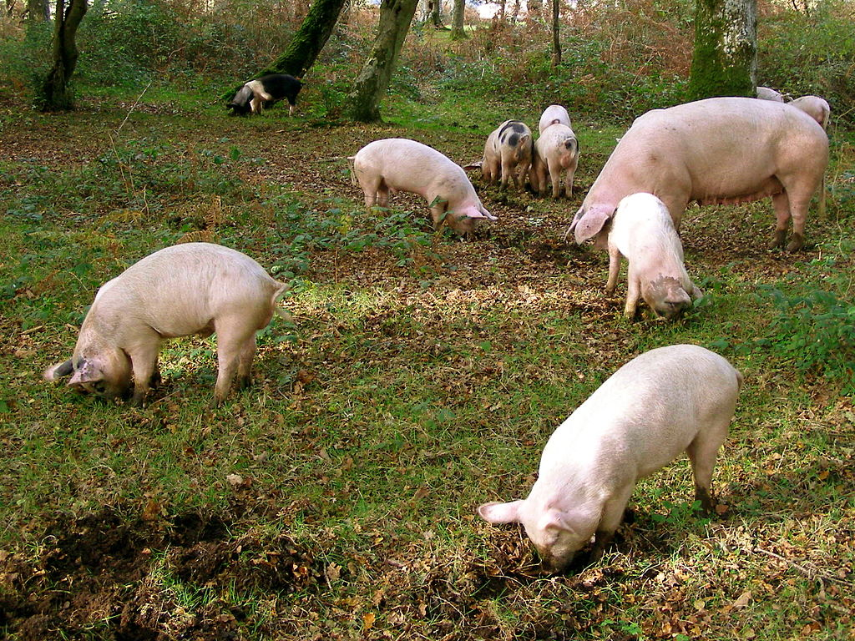

Slide 7
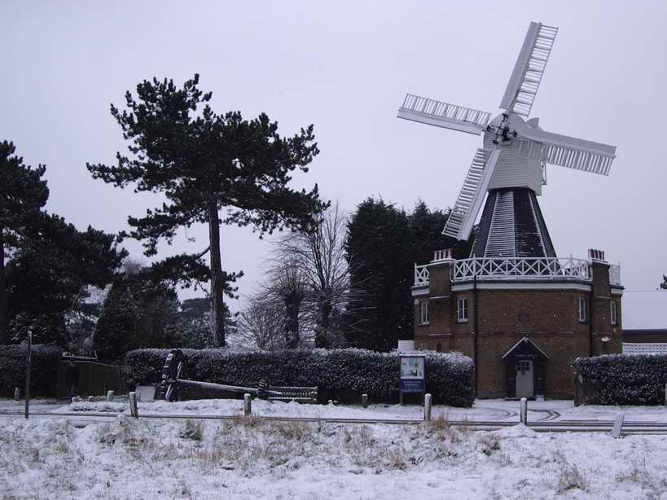
The windmill on Wimbledon Common..By Adrian Robson at English Wikipedia - Transferred from en.wikipedia to Commons by Small-town hero., Public Domain, https://commons.wikimedia.org/w/index.php?curid=4116885

Slide 8
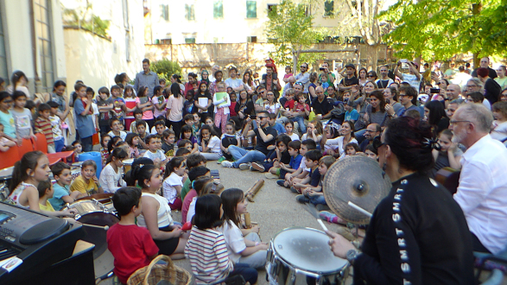
https://commons.blog/2018/06/14/commoning-florence-the-city-the-commons-the-flower/

Slide 9
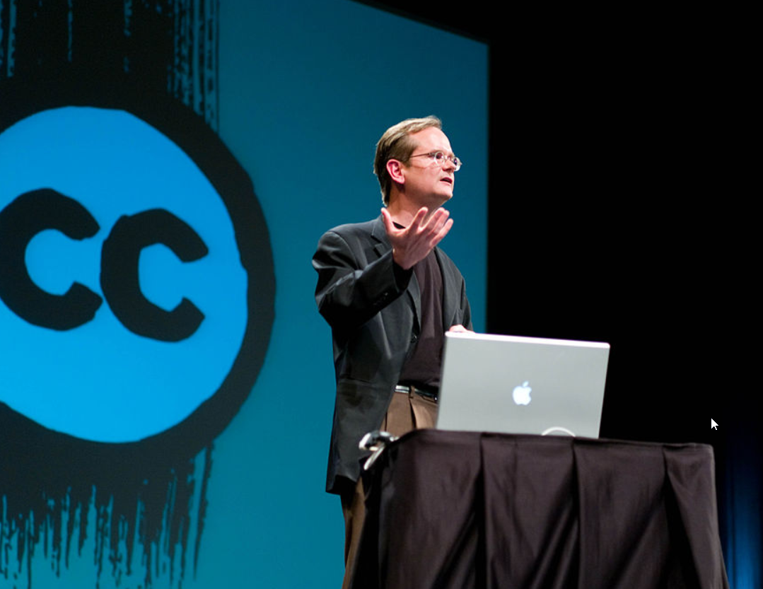
Creative Commons Licenses
By Joi [CC BY 2.0 (https://creativecommons.org/licenses/by/2.0)], via Wikimedia Commons, https://commons.wikimedia.org/wiki/File:Lawrence_Lessig_(9).jpg [2018-10-15]

Slide 10
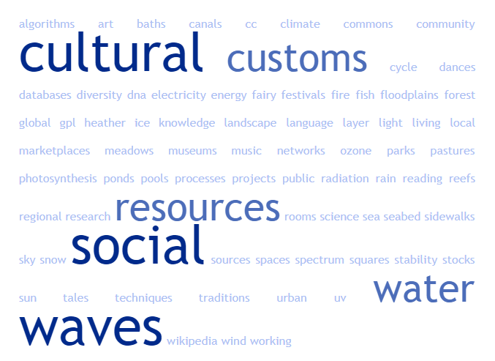
Commons – Allmende - everywhere
local, regional or global natural, social and cultural resources and processes, floodplains, ponds, cultural techniques (reading, writing, algorithms), photosynthesis, sky, forest, meadows, pastures, reefs, spectrum, DNA, water (and water cycle), sun, wind, rain, ice, snow, electricity, fire, silence, heather, canals, biodiversity, sense, waves (light waves, waves of the sea, ...), landscape, seabed, fish stocks, energy sources, UV radiation, stability of the climate, cultural diversity (music, Dances, language, customs), ozone layer, urban commons and public spaces (squares, parks, sidewalks), Wikipedia, GPL / CC, museums, knowledge resources (libraries, research results / pools, databases), science, customs and traditions, festivals, marketplaces ,
Community projects on living & working, art, baths, time, fairy tales, social networks, social rooms and much more
After https://commons.blog/was-sind-commons/ [2018-10-11]
Notes:
https://commons.blog/was-sind-commons/:
Der Begriff der Gemeinschaftsgüter bezieht sich auf zwei zentrale Kategorien. Erstens auf endliche, materielle, natürliche Ressourcen wie Rohstoffe, Energieträger, Wasser, Wald u.v.m. und zweitens auf nicht fassbare, immaterielle, intellektuelle Ressourcen wie Wissen und Ideen – die codes der Informationsgesellschaft (Software) und die codes des Lebens; die Wissensallmende.
… local, regional oder global. Natürliche, soziale und kulturelle Ressourcen und Prozesse wie….Auen, Teiche, Kulturtechniken (Lesen, Schreiben, Algorithmen), Fotosynthese, Organe, Moore, Firmament, Wald, Wiesen, Weiden, Spektrum, DNA, Wasser (und Wasserkreislauf), Regen, Eis, Schnee, Elektrizität, Feuer, Stille, Heide, Kanäle, Artenvielfalt, Sinnsprüche, Wellen (Lichtwellen, Wellen des Meeres…), Land (-schaft), Meeresboden, Fischbestände, Energieträger, UV Strahlung, Stabilität des Klimas, kulturelle Vielfalt (Musik, Tänze, Sprache, Bräuche), Ozonschicht, städtische commons (Plätze, Parks, Gehsteige), Triften, Wikipedia, GPL/CC, Museen, Wissensbestände (Bibliotheken, Forschungsergebnisse/-pools, Datenbanken), Wissenschaft, Bräuche und Traditionen, Festivals, Marktplätze, Gemeinschaftsprojekte zum Leben & Arbeiten, Kunst, Bäder, Zeit?, Riffe, Märchen, soziale Netze und Räume u.v.m.

Slide 11
The Tragedy of Commons
"Therein is the tragedy. Each man is locked into a system that compels him to increase his herd without limit - in a world that is limited".
(Hardin 1968, p. 1.244, cited after Ostrom 1999)

Slide 12
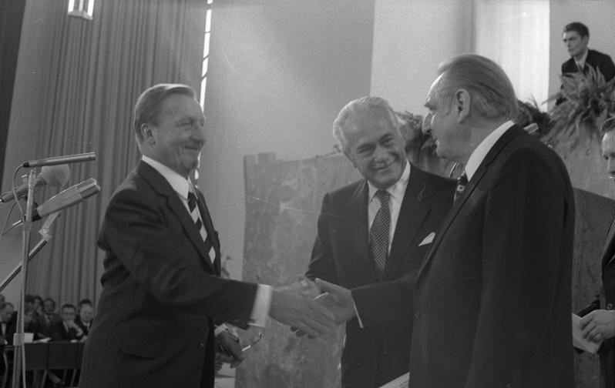

The Limits to Growth (1972)
Von Bundesarchiv, B 145 Bild-F041173-0013 / Reineke, Engelbert / CC-BY-SA 3.0, CC BY-SA 3.0 de, https://commons.wikimedia.org/w/index.php?curid=5456321
By Source, Fair use, https://en.wikipedia.org/w/index.php?curid=14973229
Notes:
The Limits to Growth (LTG) is a 1972 report on the computer simulation of exponential economic and population growth with a finite supply of resources.[2] Funded by the Volkswagen Foundation[3] and commissioned by the Club of Rome, the findings of the study were first presented at international gatherings in Moscow and Rio de Janeiro in the summer of 1971.

Slide 13
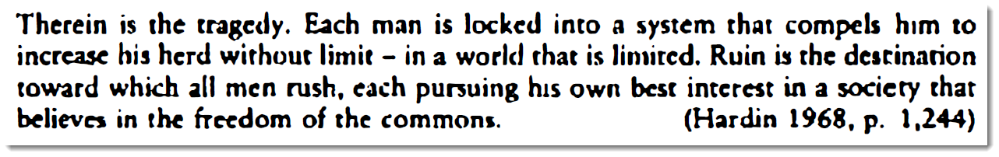
The Tragedy of Commons
"Ruin is the destination toward which all men rush, each pursuing his own best interest in a society that believes in the freedom of the common".
(Hardin 1968, p. 1.244, cited after Ostrom 1999)

Slide 14
The Tragedy of Commons
"Overgrazing."
"Taking too much from limited resources."

Slide 15
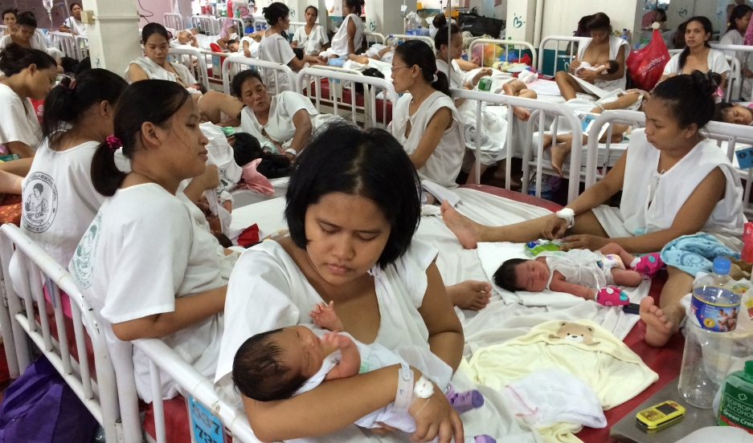
Fabella Hospital in Manila. Credit: Sonia Narang: https://www.pri.org/stories/2015-03-05/manila-baby-factory-why-women-put-crowding-four-or-more-bed-after-giving-birth [2018-10-11]
Notes:
"The crowded maternity ward at Fabella Hospital in Manila overflows with hundreds of new moms. There aren’t enough beds for everyone, so they share, four or five to a bed.
The babies, some of them wrapped in blankets, lie in the middle. Young mothers sit in blood-streaked, thin, white hospital gowns that curl up on their sides. Most of the women who give birth at Fabella come from poor communities around Manila. Here, they only have to pay what they can afford."
Former Congresswoman Risa Hontiveros: “If you had just a minimum wage in a day would you spend it for a pack of pills or a pack of condoms, or would you spend it for a kilo of rice?”

Slide 16

Octopus built-in 2003 … is owned by Paul Allen, co-founder of Microsoft. who also owns another of the world's 100 largest yachts, and RV Petrel, a highly advanced deep water research vessel "… costs $384,000 a week to run" [1]
By Plyd (talk) - Own work, Public Domain, https://commons.wikimedia.org/w/index.php?curid=7856650 [2018-0
[1] https://www.theguardian.com/lifeandstyle/shortcuts/2018/aug/01/why-the-super-rich-are-taking-their-mega-boats-into-uncharted-waters?utm_source=esp&utm_medium=Email&utm_campaign=GU+Today+main+NEW+H+categories&utm_term=282592&subid=21316034&CMP=EMCNEWEML6619I2 8-04]

Slide 17
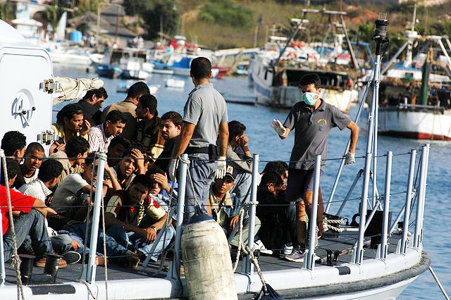
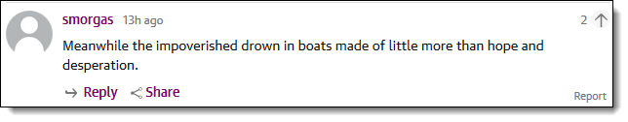
By Sara Prestianni / noborder network - https://www.flickr.com/photos/noborder/2495544558/, CC BY 2.0, https://commons.wikimedia.org/w/index.php?curid=13291993

Slide 18
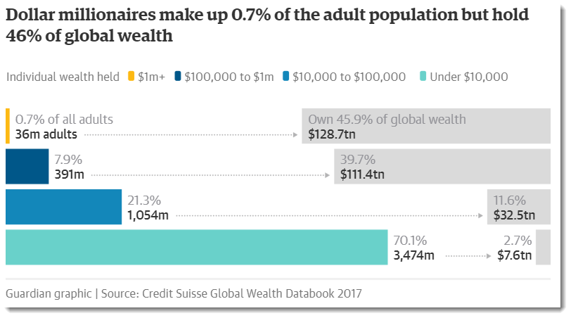
https://www.theguardian.com/inequality/2017/nov/14/worlds-richest-wealth-credit-suisse [2018-10-11]

Slide 19
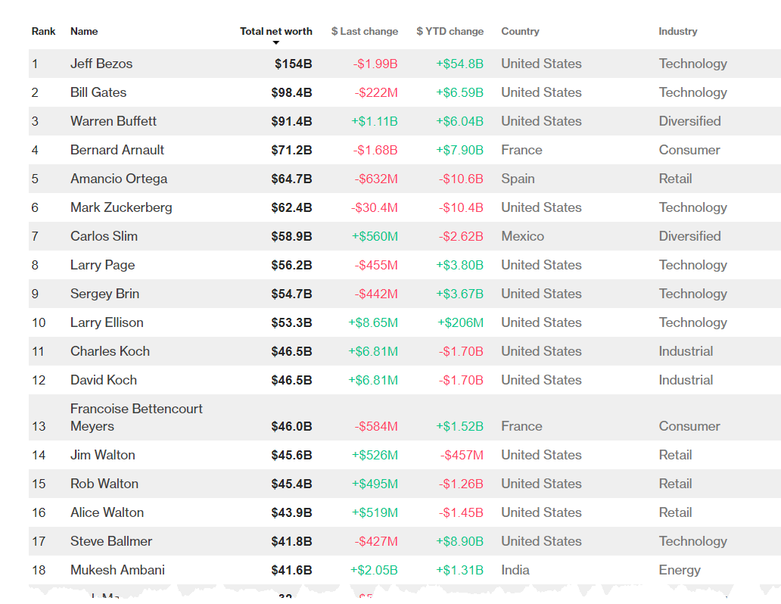
https://www.bloomberg.com/billionaires/ [2018-10-09]
Notes:
Bezos is the founder and largest shareholder of Amazon, the world's biggest online retailer.
Ballmer is the former CEO of Microsoft, the world’s biggest software maker.

Slide 20
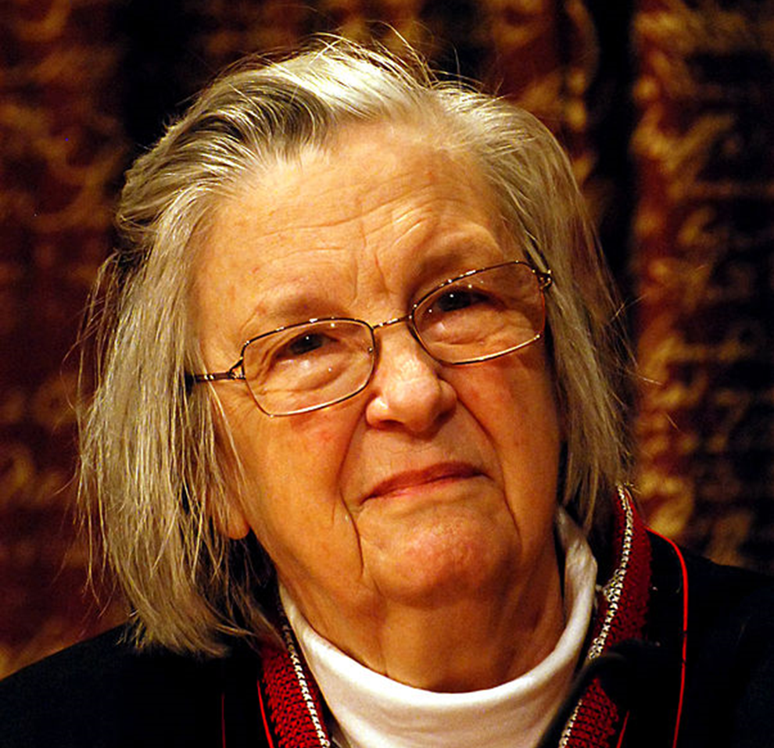
Elinor Ostrom, Nobel Laureat about "analysis of economic governance, especially the commons"
By © Holger Motzkau 2010, Wikipedia/Wikimedia Commons (cc-by-sa-3.0), CC BY-SA 3.0, https://commons.wikimedia.org/w/index.php?curid=10997825

Slide 21

What one can observe in the world, however, is that neither the state nor the market is uniformly successful in enabling individuals to sustain long-term, productive use of natural resource systems.

Slide 22
Design principles of stable local Common Pool Resource management
Clear definition of the contents of the common pool resource and effective exclusion of external un-entitled parties);
The appropriation and provision of common resources that are adapted to local conditions;
Collective-choice arrangements that allow most resource appropriators to participate in the decision-making process;
Effective monitoring by monitors who are part of or accountable to the appropriators;
Ostrom, Elinor (1990). Governing the Commons: The Evolution of Institutions for Collective Action. Cambridge University Press.

Slide 23
Design principles of stable local Common Pool Resource management
A scale of graduated sanctions for resource appropriators who violate community rules;
Mechanisms of conflict resolution that are cheap and of easy access;
Self-determination of the community recognized by higher-level authorities; and
In the case of larger common-pool resources, organization in the form of multiple layers of nested enterprises, with small local CPRs at the base level.
Ostrom, Elinor (1990). Governing the Commons: The Evolution of Institutions for Collective Action. Cambridge University Press.

Slide 24
Source
Data
Open
Standards
Education

Slide 25
Psycho-social Aspects

Slide 26
Freedom

Slide 27
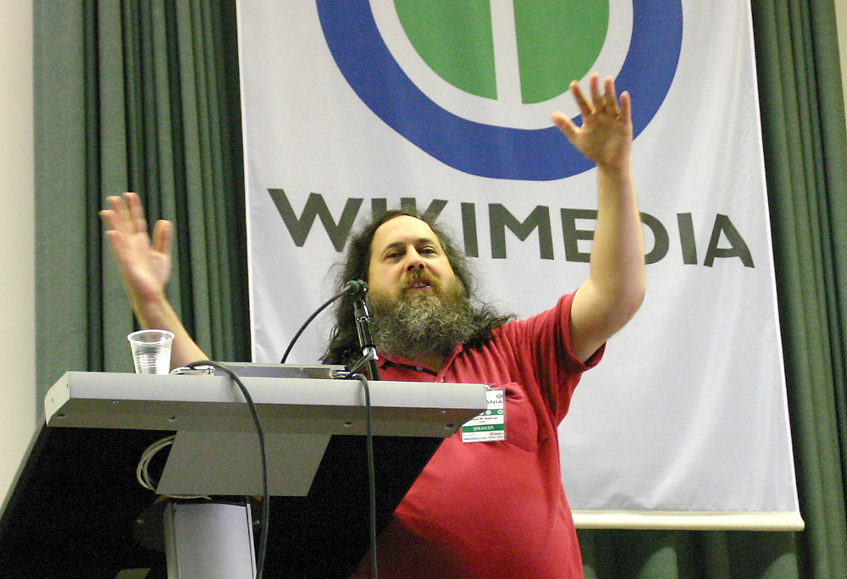
Richard Matthew Stallman
US-american activist and software developer; GNU = Gnu is not Unix (gcc, emacs, ..)
Proclaiming exchange, independence, community, collaboration, solidary
Academic background (MIT)
Founder and President of the Free Software Foundation
„Wikimania stallman keynote2“ von Elke Wetzig - Eigenes Werk. Lizenziert unter CC BY-SA 3.0 über Wikimedia Commons - http://commons.wikimedia.org/wiki/File:Wikimania_stallman_keynote2.jpg#mediaviewer/File:Wikimania_stallman_keynote2.jpg
Notes:
, Unabhängigkeit, Gemeinschaft, Zusammenarbeit, Solidarität

Slide 28
Richard Matthew Stallman
Open source is a development methodology; free software is a social movement.
Why Open Source misses the point of Free Software [https://www.gnu.org/philosophy/open-source-misses-the-point.en.html [2018-10-07]]
CopyLeft: all amendments have to be published under (almost) identical license rules [http://www.gnu.org/copyleft/copyleft.de.html]
„Wikimania stallman keynote2“ von Elke Wetzig - Eigenes Werk. Lizenziert unter CC BY-SA 3.0 über Wikimedia Commons - http://commons.wikimedia.org/wiki/File:Wikimania_stallman_keynote2.jpg#mediaviewer/File:Wikimania_stallman_keynote2.jpg
Notes:
, Unabhängigkeit, Gemeinschaft, Zusammenarbeit, Solidarität

Slide 29
“Free Software Foundation” and its for degrees of Freedom
The freedom to run the program as you wish, for any purpose (freedom 0).
The freedom to study how the program works, and change it so it does your computing as you wish (freedom 1).
Access to the source code is a precondition for this.
The freedom to redistribute copies so you can help your neighbor (freedom 2).
The freedom to distribute copies of your modified versions to others (freedom 3).
http://www.gnu.org/philosophy/free-sw.html
https://fsf.org/

Slide 30
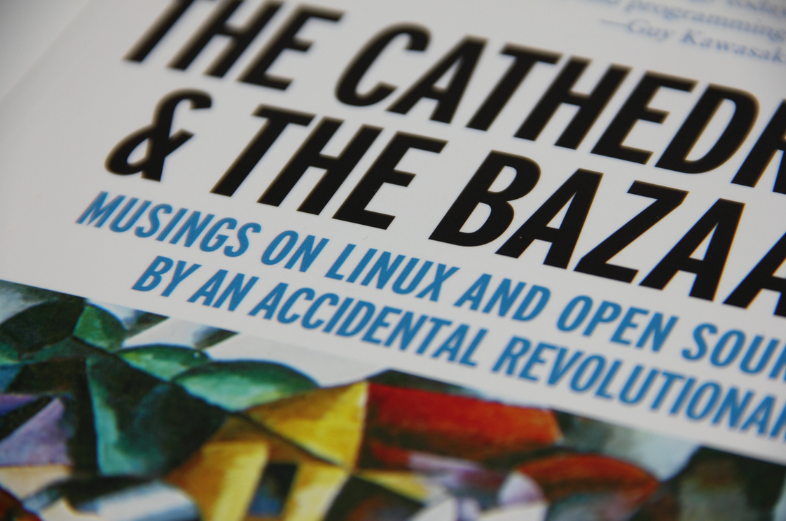
Eric S. Raymond: The Cathedral and the Bazaar (1987)
1) Every good software is written by a developer seeking to solve a personal problem.
4) If you have the right attitude, interesting problems will find you.
5) When you lose interest in a program, your last duty to it is to hand it off to a competent successor.
6) Treating your users as co-developers is your least-hassle route to rapid code improvement and effective debugging.
7) Release early. Release often. And listen to your customers.
8) Given a large enough beta-tester and co-developer base, almost every problem will be discovered quickly and be fixed by someone.
19) Given a communications medium like the Internet and the development coordinator's intelligence to lead without coercion: many heads are inevitably better than one.
https://www.flickr.com/photos/hades2k/7001927337/ CC BY-SA 2.0
Notes:
Jede gute Software wird von einem Entwickler geschrieben, der ein persönliches Problem lösen will.
Wenn du die richtige Einstellung hast, werden dich interessante Probleme finden.
Wenn du das Interesse an einem Programm verlierst, ist es deine Pflicht, dieses einem kompetenten Nachfolger zu übergeben.
Wenn du deine Benutzer als Mitprogrammierer betrachtest, ist dies der einfachste Weg zu schneller Verbesserung und effizientem Debugging.
Veröffentliche früh. Veröffentliche häufig. Und höre auf die Benutzer.
Mit einer hinreichend großen Gruppe von Betatestern und Mitentwicklern wird fast jedes Problem schnell erkannt und die Lösung von jemandem gefunden.
Mit genügend guter Kommunikation, wie über das Internet, und Führung ohne Zwang sind viele Köpfe immer besser als einer.

Slide 31
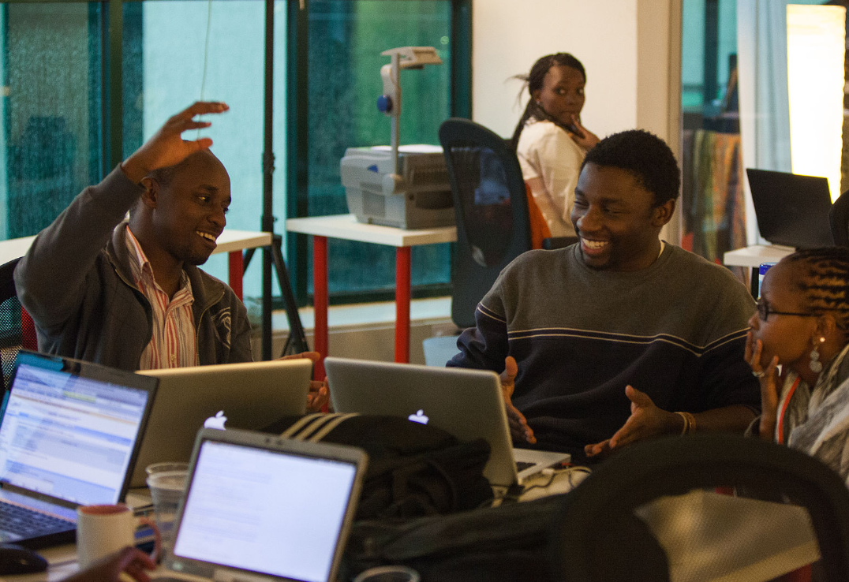
By Matt Biddulph from UK - late night hackers at Science Hack Day, CC BY-SA 2.0, https://commons.wikimedia.org/w/index.php?curid=37715888
https://upload.wikimedia.org/wikipedia/commons/0/0d/Science_Hack_Day_Nairobi_2012.jpg [2018-10-17]

Slide 32
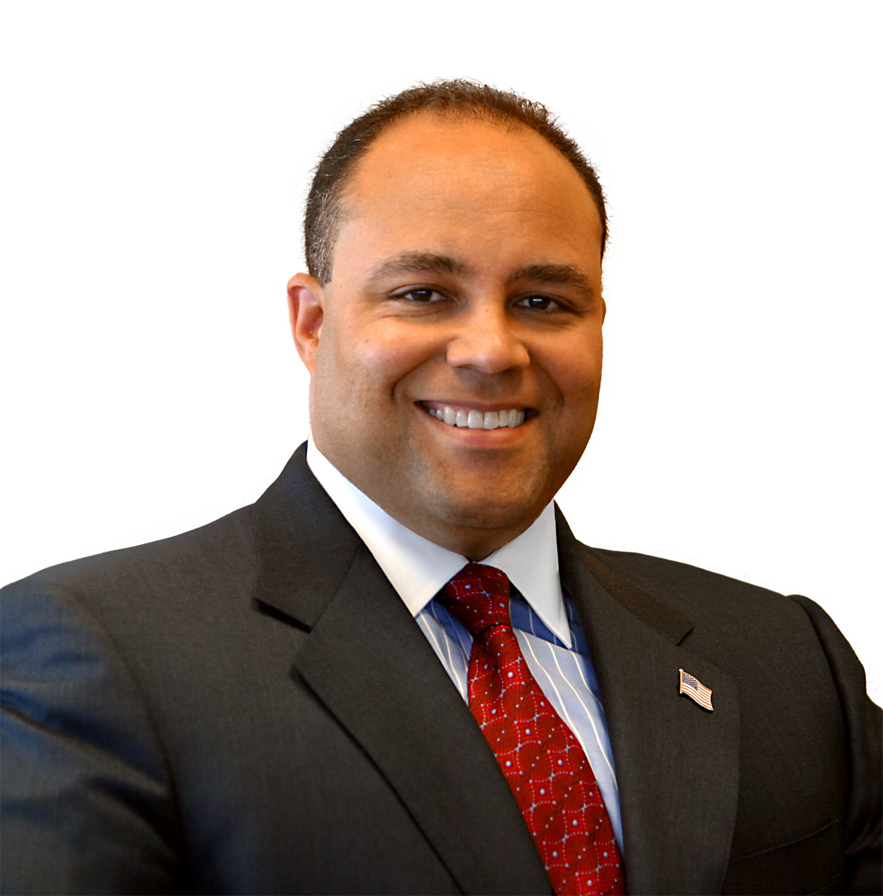
Michael Powell
former chairman of the Federal Communications Commission
"Net Freedoms":
Freedom to Access Content
Freedom to Use Applications
Freedom to Attach Personal Devices.
Freedom to Obtain Service Plan Information
By Unknown - Source: http://www.fcc.gov/commissioners/previous/powell/biography.htmlDirect URL to photo: http://www.fcc.gov/commissioners/photos/ppmkp.jpg, Public Domain, https://commons.wikimedia.org/w/index.php?curid=29458976
Michael K. Powell (2008): PRESERVING INTERNET FREEDOM: GUIDING PRINCIPLES FOR THE INDUSTRY. https://docs.fcc.gov/public/attachments/DOC-243556A1.pdf [2018-10-15]

Slide 33
Membership in a community

Slide 34
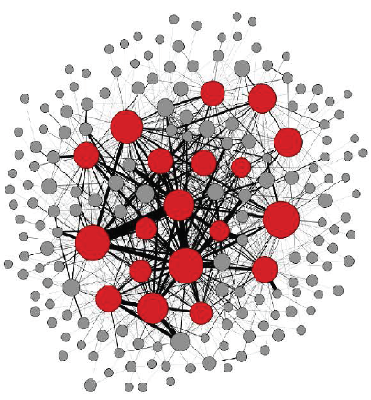
User
Developers
(contributer)
Committer
[Bosu & Carver 2014]
All of these developers collaborate using the Internet in a virtual coherent community associated to the product and its technology.
[Holk & Zigari 2007]

Slide 35
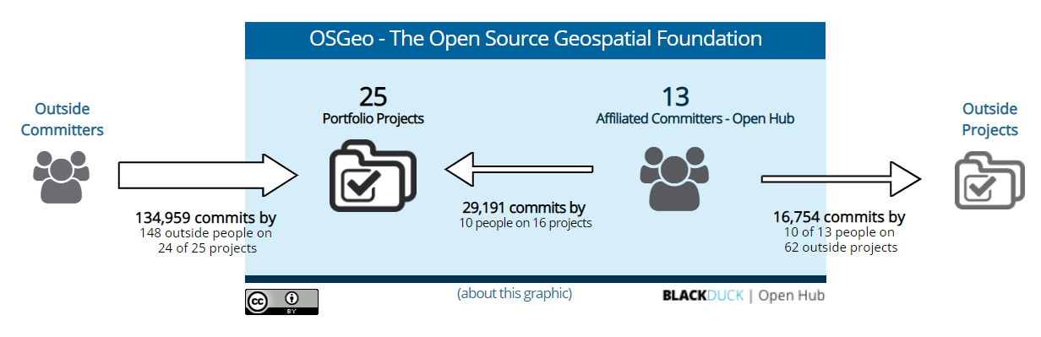
Committers and Commits (OSGeo Environment"
https://www.openhub.net/orgs/OSGeo

Slide 36
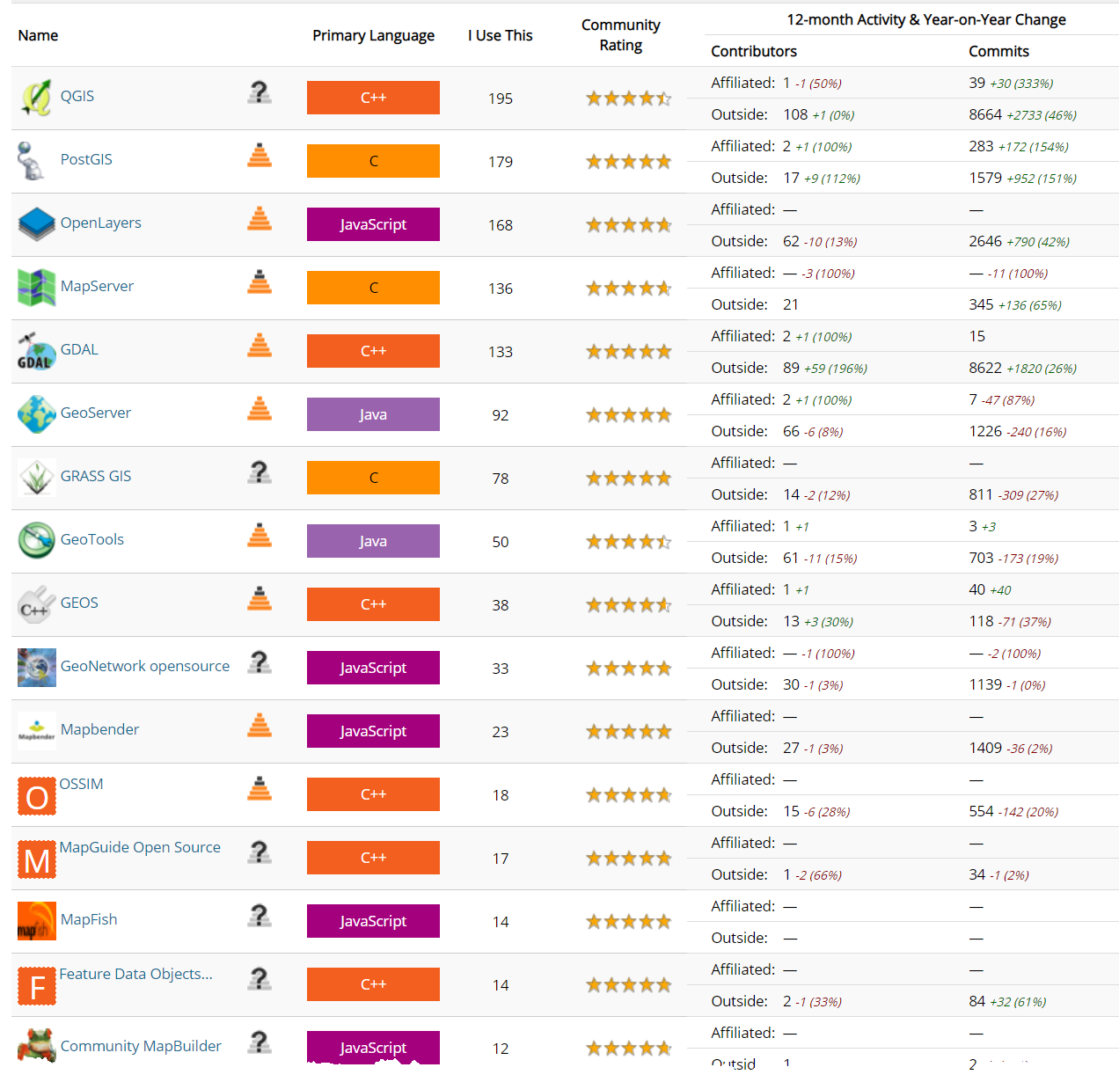
https://www.openhub.net/orgs/OSGeo [2018-10-10]

Slide 37
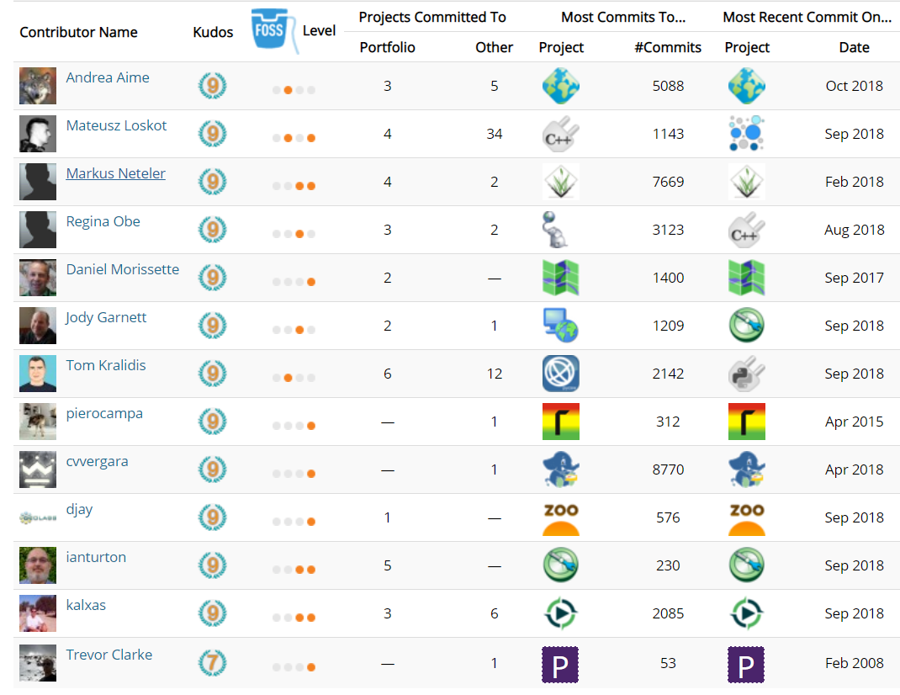
Affiliated Committers
https://www.openhub.net/orgs/OSGeo/affiliated_committers [2018-10-11]

Slide 38
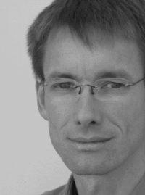
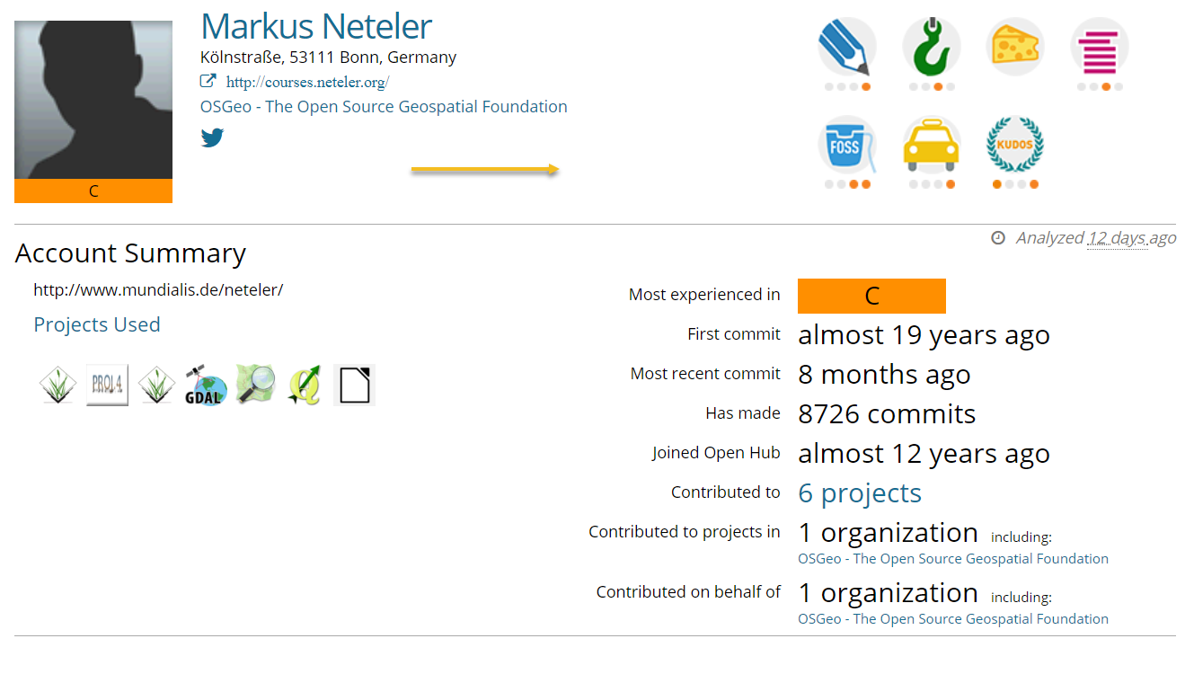
Markus's Account Summary
https://www.openhub.net/accounts/neteler
https://wiki.osgeo.org/wiki/Markus_Neteler

Slide 39
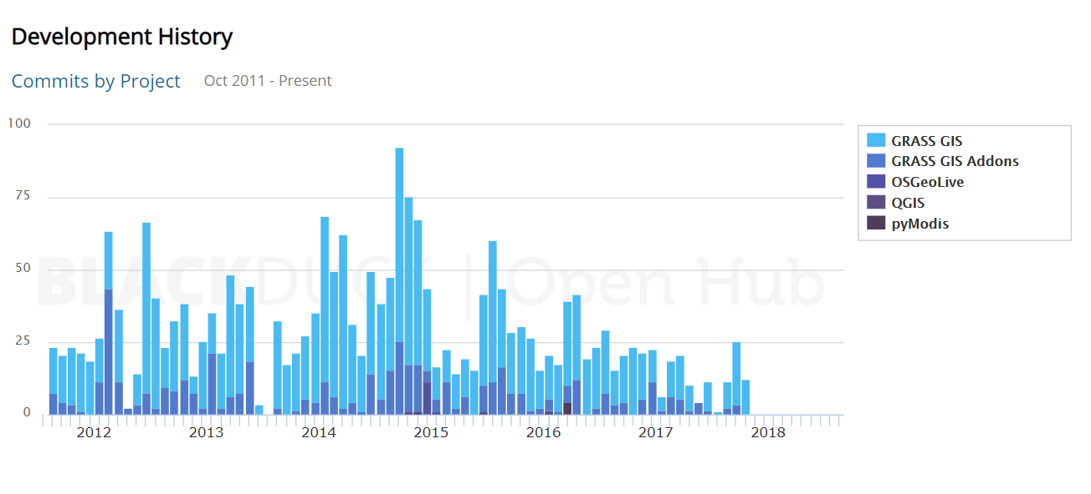
Development History

Slide 40
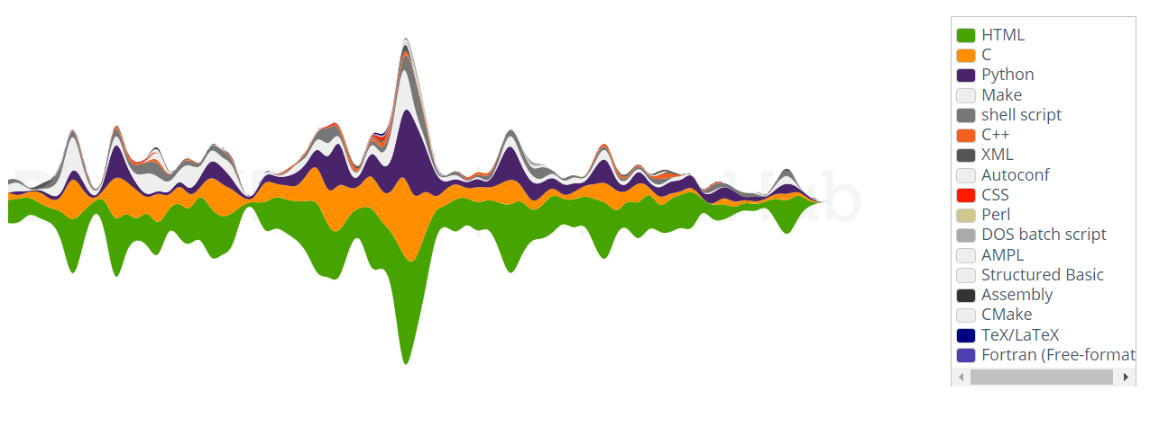
Commits by langauage

Slide 41
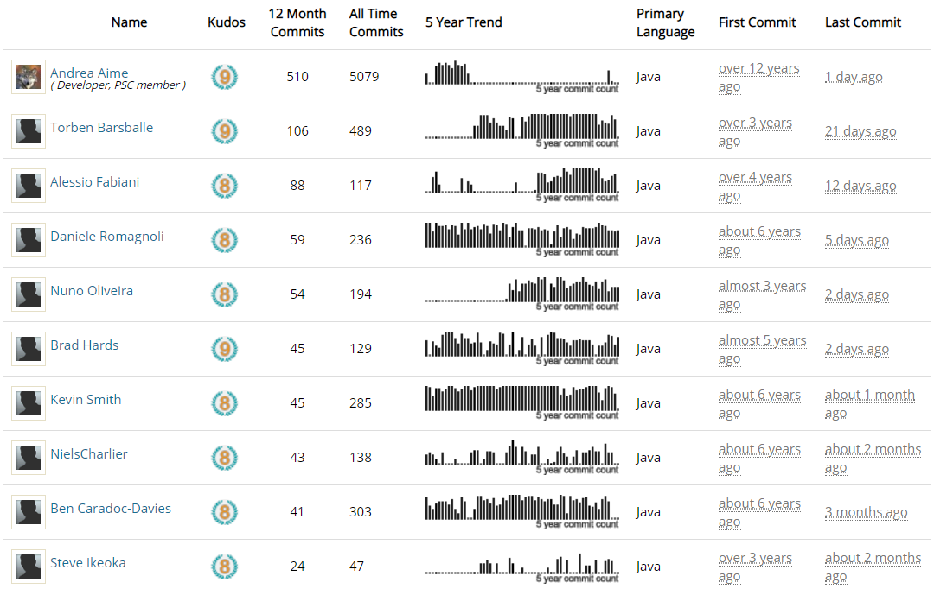
Reputation as "Top Developer"
https://www2018-1010.openhub.net/p/geoserver/contributors/summary []

Slide 42
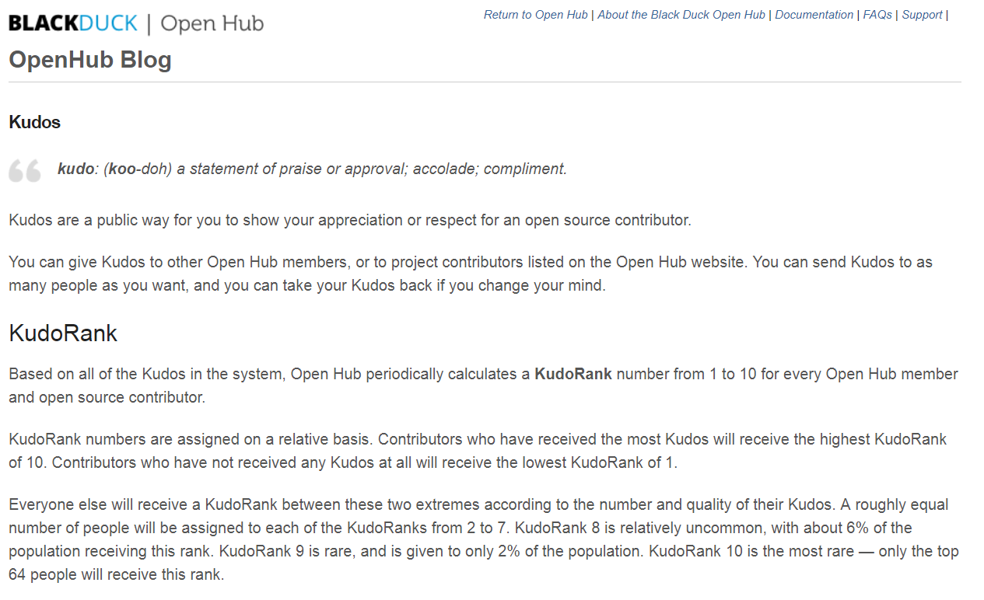
https://blog.openhub.net/kudos/ [2018-10-11]

Slide 43
Project
Kernel
Member
Members leaving
Internal communication

Slide 44
Technical Interest

Slide 45
Technical Interest: The Hacker
Hacker [RFC 1983]
A person who delights in having an intimate understanding of the internal workings of a system, computers and computer networks in particular.
The term is often misused in a pejorative context, where "cracker" would be the correct term.
https://tools.ietf.org/html/rfc1983
Notes:
cracker A cracker is an individual who attempts to access computer systems without authorization. These individuals are often malicious, as opposed to hackers, and have many means at their disposal for breaking into a system. See also: hacker, Computer Emergency Response Team, Trojan Horse, virus, worm.

Slide 46
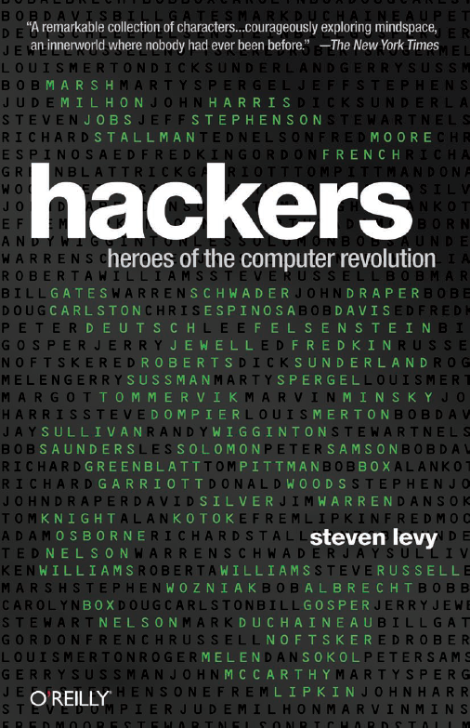
Hacker ethics
Access to computers - and anything which might teach you something about the way the world really works - should be unlimited and total. Always yield to the Hands-On Imperative!
All information should be free.
Mistrust authority - promote decentralization.
Hackers should be judged by their acting, not bogus criteria such as degrees, age, race, or position.
You can create art and beauty on a computer.
Computers can change your life for the better.
Don't litter other people's data.
Make public data available, protect private data.
After Steven Levy: Hackers (1985:27) and
https://www.ccc.de/en/hackerethics?language=en
Notes:
Der Zugang zu Computern und allem, was einem zeigen kann, wie diese Welt funktioniert, sollte unbegrenzt und vollständig sein.
Alle Informationen müssen frei sein.
Misstraue Autoritäten - fördere Dezentralisierung
Beurteile einen Hacker nach dem, was er tut und nicht nach üblichen Kriterien wie Aussehen, Alter, Rasse, Geschlecht oder gesellschaftlicher Stellung.
Man kann mit einem Computer Kunst und Schönheit schaffen.
Computer können dein Leben zum Besseren verändern.
http://www.ccc.de/hackerethics?language=de

Slide 47
Further Motivational Factors
 | Community Believers | Learning & Fun | Hobbyists | Professionals
 | 19% | 29% | 27% | 25%
Key Motivators | “I believe source code should be open” | “My activity on this project improves my programming skills” | Non-work needs for the code | Work needs for the code Enhances prof. and OS community status
Work & Lifestyle | Hacking is central to lifestyle | Most likely to be a student | Closely identifies with hacker community | Most likely to hack as part of their job Extensive programming experience
Creativity & Leadership | Finding projects to be as creative as anything they have done Report experiences similar to “flow” and other creativity-related phenomena Want peer leaders, not traditional project managers
[Lakhani, Wolf & Bates (2002)]

Slide 48
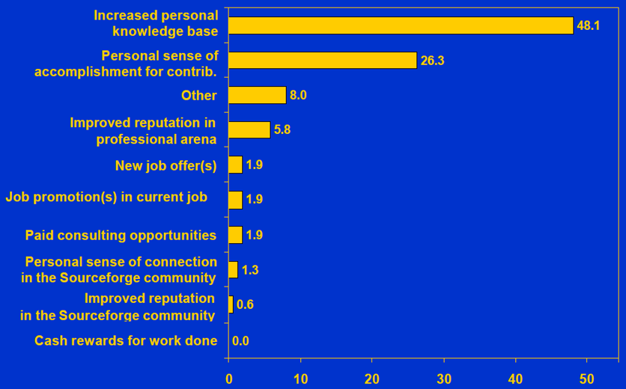
Further Motivational Factors
[Lakhani, Wolf & Bates (2002)]

Slide 49
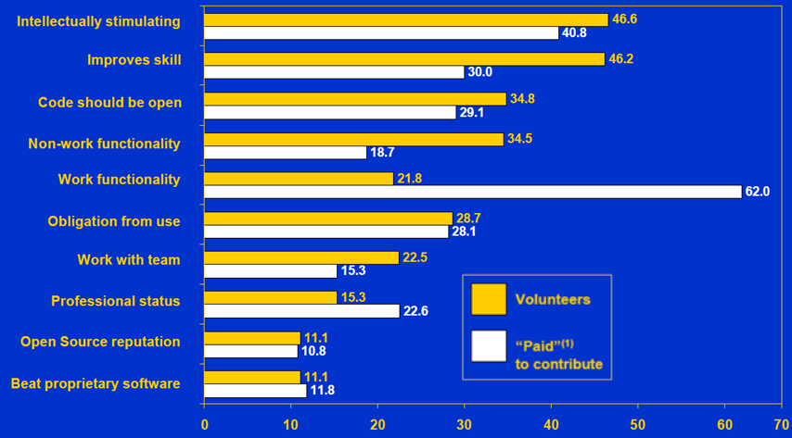
Further Motivational Factors
[Lakhani, Wolf & Bates (2002)]
Notes:
OSS programmers may participate in projects to expand their own skill base. Working on open source projects can lead to better job opportunities, higher salaries and more fulfilling jobs. Programmers can also choose learning experiences that fit their interests.

Slide 50
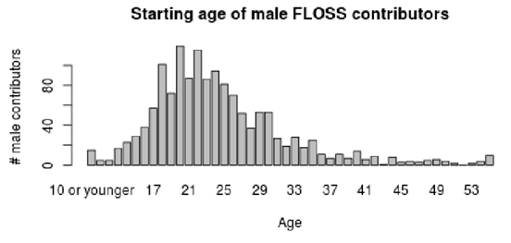
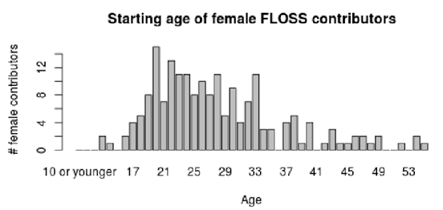
Age distribution
[Robles et al. 2014]

Slide 51
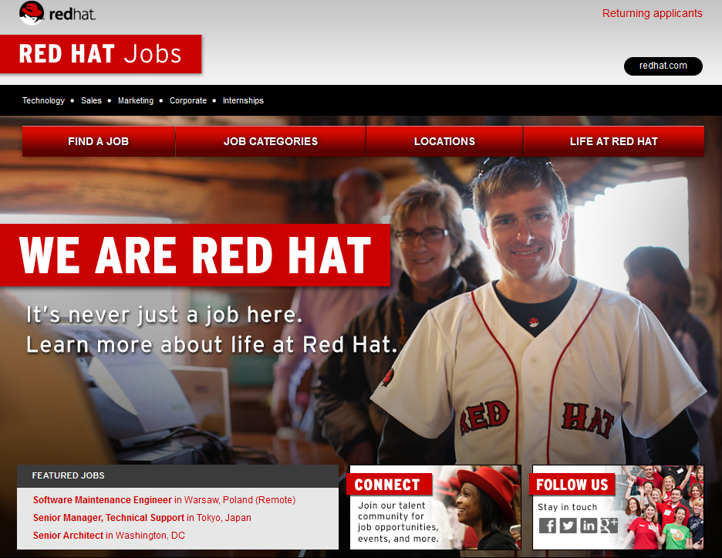
https://www.redhat.com/de/jobs?intcmp=7016000000155fjAAA
Notes:
OSS programmers may participate in projects to expand their own skill base. Working on open source projects can lead to better job opportunities, higher salaries and more fulfilling jobs. Programmers can also choose learning experiences that fit their interests.

Slide 52

Developers' Code of conduct
The Contributor Covenant, https://www.contributor-covenant.org/
a code of conduct for free/open source projects, created by Coraline Ada Ehmke
used in prominent projects including Linux, Ruby on Rails, Swift, Golang, …
Relevant signers include Google, Apple, Microsoft, Eclipse and Gitlab (https://www.contributor-covenant.org/adopters)
Coraline Ada Ehmke
By Coraline Ada Ehmke - Coraline Ada Ehmke, CC BY-SA 4.0, https://commons.wikimedia.org/w/index.php?curid=60784171

Slide 53
How is this feasible?

Slide 54
Open Source developers
(as well as often Closed Source Developers)
use Open Source.

Slide 55
Apache HTTP-Server: ~50% Market Share
Many/all of us use Open Source products:
Wordpress
Eclipse
Apple IOS
Gimp
Firefox
OpenOffice
LibreOffice
LaTeX
Notepad++
Android

Slide 56
Revenue in IT
~ 90%: Services
< 10%: Revenue of Software Licensing

Slide 57
Open Source Development
Public access to code improves the quality
Typically bugs are fixed faster
Often more secure due to multiple scrutiny
Innovation is easier – and...
Users have full control about what they get
...and many more advantages.
Read http://producingoss.org by Karl Fogel for details

Slide 58
Open Source Business
Niche Market
"highly sophisticated products that solve a specific set of problems" [Holk & Zigari 2007]
Geoinformatics?

Slide 59
Open Source Business
Niche Market
"highly sophisticated products that solve a specific set of problems" [Holk & Zigari 2007]
Consulting
Spezialized Distributions
Implementation of extensions
Geoinformatics?
Support
bug fixing
Crowd Funding
Training and Education
Service Level Agreement
Maintenance
[Kooths, Langenfurth, Kalwey 2003]
Notes:
59
Weil sich mit Verbesserungen an der Open Source-Software
keine direkten Erlöse erzielen lassen, müssen Firmen indirekt über andere Produkte
und Dienste von der Open Source-Entwicklung profitieren. Open Source-
Businessmodelle können daher als indirekte Businessmodelle bezeichnet werden,
denn Umsätze werden nicht mit dem eigentlichen Produkt erwirtschaftet, sondern
mit zusätzlichen, darauf aufbauenden Produkten und Diensten

Slide 60
Open Source is used often internally in Closed Source
Autodesk
Oracle
Esri
IBM
Google
Microsoft
HP
Adobe

Slide 61
Usage of Open Source in Closed Source
”an average product or application contains almost 700 MB of code, 22% of which is open source software … almost 80% of newly deployed code is Open Source” [1]
"44% of all code was Open Source ” [2]
"sampling continues to find that between 30 and 70% of code submitted as Internally developed is identifiably from third-parties, most often in the form of Open Source components and Commercial libraries” [3]
zit. nach Carlo Daffara (2012): Estimating the economic contribution of Open Source Software to the European economy. In: Shane Coughlan (Hrsg.) (2012) The First OpenForum Academy Conference Proceedings
[1] McQuaide, B., “Distributed Multi-Source Development with Open Source:”, LinuxCon 2010
[2] Daffara, C. “The Economic Value of Open Source Software”. Submitted presentation, TransferSummit Oxford 2010
[3] Veracode, “State of Software Security Report volume 3”, 2011

Slide 62
Open Source contributes significantly to economy
Autodesk
Oracle
Esri
IBM
Google
Microsoft
HP
Adobe

Slide 63
Contribution to to economy
2005: HP reported Linux-related revenues higher than 2.5B$ [1]
2005: IBM reports OSS-related revenues of 4.5B$ [1]
"[…] Open Source does have at least an immediate economic effect through code reuse and effort reduction […] [of] at least 114B€/year, through direct savings, reduction in project failure and improvements in code maintenance costs - equivalent to 30% of the entire software and services market. " [1]
[1] Carlo Daffara (2012): Estimating the economic contribution of Open Source Software to the European economy. In: In: Shane Coughlan (Hrsg.) (2012) The First OpenForum Academy Conference Proceedings

Slide 64
Some economic key indicators (OS in general)
Lawton and Notarfonzo state that packaged open source applications generated revenues of $1.8 billion in 2006 […]. The software division of the Software & Information Industry Association estimates that total packaged software revenues were $235 billion in 2006 […].
Our work shows that the additions to open source projects, the total project size (measured in source lines of code), the number of new open source projects, and the total number of open source projects are growing at an exponential rate. The total amount of source code and the total number of projects double about every 14 months.
RedHat: 1.8 Billion US$ a year!
[http://dirkriehle.com/publications/2008-2/the-total-growth-of-open-source/]

Slide 65
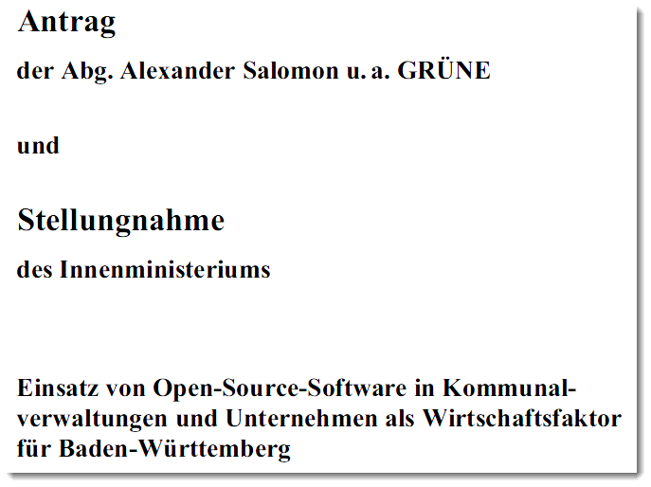
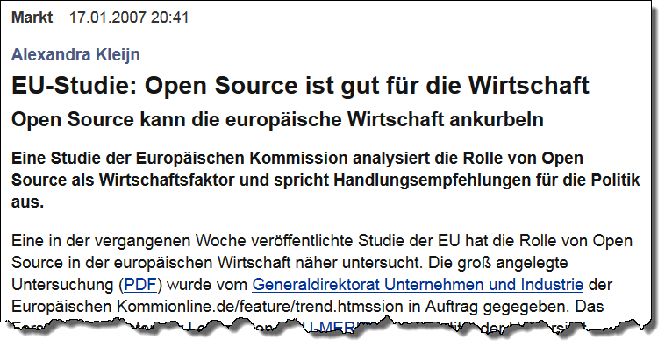
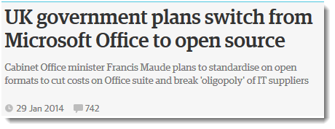
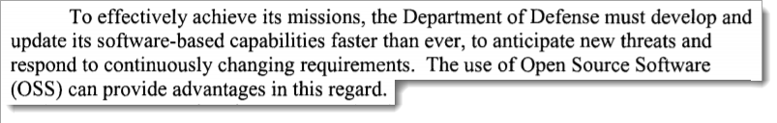
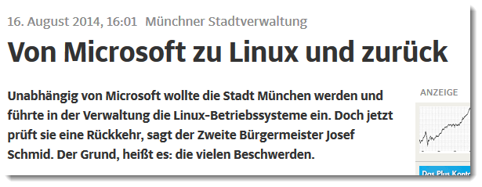
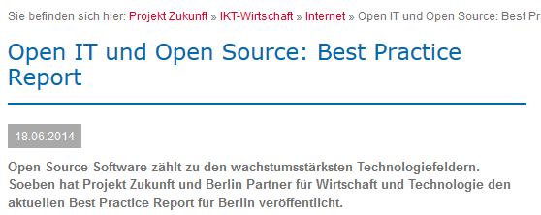
Source: a.o. http://www.heise.de/open/artikel/EU-Studie-Open-Source-ist-gut-fuer-die-Wirtschaft-222037.html
US Department of Defence (2009: Clarifying Guidance Regarding Open Source Software (OSS). https://dodcio.defense.gov/Portals/0/Documents/OSSFAQ/2009OSS.pdf [2018-10-09]

Slide 66
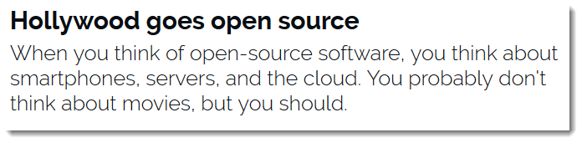
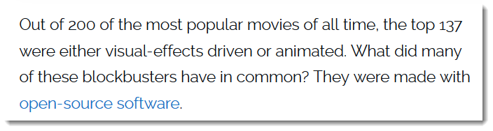
https://www.zdnet.com/article/hollywood-goes-open-source/

Slide 67

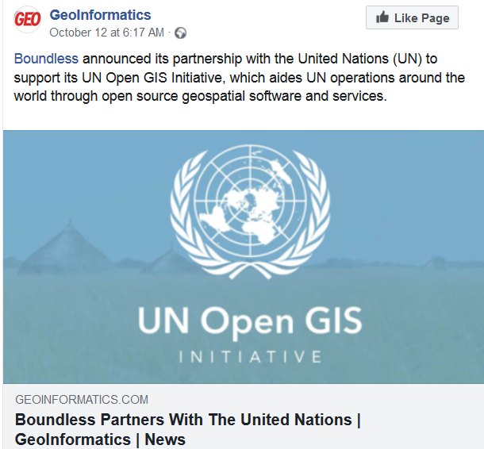
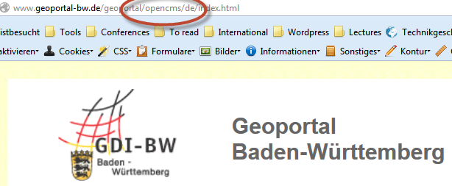
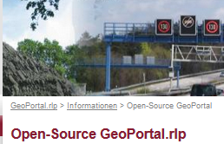
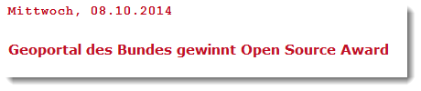
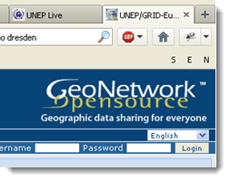
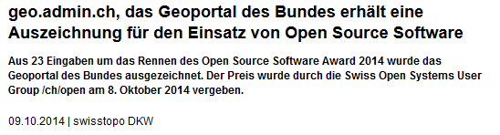


Slide 68

Gesamter IT-Sektor
Open Source-Wirtschaft
Source: M. J. Skok, http://de.slideshare.net/mjskok/2014-future-of-open-source-8th-annual-survey-results
"die Open Source-Software bietet […] keine neuen, sondern nur einen Teil der bereits auf dem kommerziellen Softwaremarkt gegebenen Geschäftsmöglichkeiten.
Diese wirken gesamtwirtschaftlich substitutiv und nicht additiv." [Kooths et al. 2003]

Slide 69

"Linux made it clear how well open source works, not just from a technical standpoint, but also from a business, commercial, and community standpoint."
Linus Torvalds, 2014
[ http://www.infoworld.com/article/2608107/linux/linus-torvalds-to-developers--to-succeed--make-it-personal.html]

Slide 70



Business modell:
"Selling additional hardware"?
http://www.apple.com/opensource/ [2018-10-11]

Slide 71

Microsoft
[1] https://www.zdnet.com/article/microsoft-open-sources-its-entire-patent-portfolio/
[2] https://www.zdnet.com/article/microsoft-open-sources-its-entire-patent-portfolio/
"We recognized open source is something that every developer can benefit from. It's not nice, it's essential. It's not just code, it's community. We don't just throw code on the website. We openly publish our roadmap, and we have 20,000 Microsoft employees on GitHub. With over 2,000 open-source projects, we're the largest open-source project supporter in the world."
Scott Guthrie, Microsoft's executive vice president of the cloud and enterprise group [2]

Slide 72
Visibility
Collaboration

Slide 73
OSGeo's Goals
Provide resources for FOSS4G projects:
  Infrastructure
  Legal frame
  Financial support
Promote free and open spatial data
Create and maintain a quality brand
Create and promote free curriculua
Promote and contribute to standards

Slide 74
OSGeo Activities
On a global scale:
  Provide mature software solutions
  Support FOSS4G, an international open source conference for geospatial application (2013: UK, 2014: USA, 2015: Korea, 2016. Germany, 2017: USA, 2018: Tansania, 2019: Romania)
Support local activities and capacities
  Local open source conference for geospatial application (i.e. FOSS4G-SEA)
  Local chapters (India, ...)
Facilitate inter-project communication
Build a solid market for businesses and users
Interface with industry and business
Support the education of domain experts not «brand-specialists»
...

Slide 75
Formal Structure
Charter Members vote
Board of 9 Directors
and President
Officers
Officers
25 Officers
Executive
Director
appoints
represent
Committees
Committees
Committees
Local
Chapters
Local
Chapters
Local
Chapters
Foundation
Projects
Local
Chapters
Local
Chapters
elected by membership
91 Charter Members
Sponsors
75/42
Notes:
75

Slide 76
Projects
Mapbender
UMN
Mapserver
QGIS
OSSIM
MapBuilder
Map Guide
OS
GRASS
GIS
gvSIG
Desktop GIS
OpenLayers
deegree
FDO
GDAL/OGR
GeoServer
Web Mapping
GEOS
GeoTools
MetaCRS
PostGIS
GeoNetwork
Bibliotheken
Metadata

Slide 77

Software using GDAL

Slide 78

GDAL: Supported Vector formats

Slide 79
Committees
Incubation
Education
Geodata
Commitees: self organise
Voluntary work
Communication by mailing lists, webinars, IRC, meetings,.
An option for you?
Website
Conference
Journal
Sysadmin
Marketing
other...
Notes:
79

Slide 80
Incubation Committee
Incubation
Education
Geodata
Website
Conference
Journal
Sysadmin
Marketing
other...
2011 Cambridge Conference
Notes:
80

Slide 81
Incubation Process
Projects can apply for inspection by the OSGeo Incubation Committee.
Project have to abide by OSGeo rules and satisfy a catalog of criteria
  Copyright, licenses, ownership
  Development process quality
  Documentation, tutorials, support
  Community
OSGeo tag is a proof of quality
More details are available on the Web:
http://wiki.osgeo.org/wiki/Incubation
Notes:
What is inspected?
Copyright, licenses, ownership
Development process quality
Documentation, tutorials, support
Community functioning

Slide 82
Incubation
Education
Geodata
Website
Conference
Journal
Sysadmin
Marketing
other...
OSGeo - Spatially Empowered Open Source
82/42
Notes:
82

Slide 83

ICA & OSGeo (& ISPRS) MoU
Nuremberg, Germany - September 27, 2011
Aims: developing on a global basis collaboration opportunities for academia, industry and government organizations in open source GIS software and data
  provide expertise and support for the establishment of Open Source Geospatial Laboratories and Research Centres across the world for supporting development of open-source geospatial software technologies, training and expertise.
  to provide support for building-up and supporting development of open source GIS teaching and training materials, joint organization of open source GIS events, workshops through the ICA network for wider participation globally etc.
https://wiki.osgeo.org/images/b/b4/Mou_ica-osgeo.jpg [2018-10-15]
See https://wiki.osgeo.org/wiki/MOU_ISPRS and
https://wiki.osgeo.org/wiki/MOU_ISPRS
Notes:
the aim of developing on a global basis collaboration opportunities for academia, industry and government organizations in open source GIS software and data. The MoU aims to provide expertise and support for the establishment of Open Source Geospatial Laboratories and Research Centres across the world for supporting development of open-source geospatial software technologies, training and expertise. In the first phase five laboratories will be established, one each in Asia, Europe, Africa, the Americas and Australasia which will act as nodes for future expansion. It also aims to provide support for building-up and supporting development of open source GIS teaching and training materials, joint organization of open source GIS events, workshops through the ICA network for wider participation globally etc.
OSGeo is a not-for-profit organization founded in 2006 whose mission is to support and promote the collaborative development of open source geospatial technologies and data.
ICA is the world authoritative body for cartography, the discipline dealing with the conception, production, dissemination and study of maps.
83

Slide 84

ICA/OSGeo Labs
Mission - "Making geospatial education and opportunities accessible to all“
  https://www.osgeo.org/initiatives/geo-for-all/ [2018-08-26]

Slide 85

OSGEO Live DVD
originally compiled by Cameron Shorter, and one of the coordinators of the OSGeo-Live Project.
a bootable DVD, based on the Xubuntu linux distribution, pre-installed and pre-configured with close to 50 of the best GeoSpatial Open Source applications along with sample datasets.
OSGeo-Live can also be run from a USB flash drive, installed into a Virtual Machine, or installed onto your hard drive.
Cameron Shorter
Source: http://cameron.shorter.net/resume.html [2018-10-15]

Slide 86
Students [Ertz, Rey, Joost 2014]
  can install Open Source Software without limit tions locally installieren and evaluate it (also in combination with Closed Software),
  can find ther own way for their further professional life,
  can read software and analyze ist algorithms,
  can analysze and understand software development processes and communication,
  can understand Open Source as part of a general "Open"movement
Universities can
  can contribute to a broad education of their students,
  can operate more economically.

Slide 87


Slide 88
OSGeo Live DVD
Desktop GIS
web mapping
Quantum GIS
Quantum GIS
MapServer
OSSIM
UMN
MapServer
GRASS GIS
OpenStreetMap
Mapnik
uDig
Geopublisher
gvSIG
deegree
GeoMajas
KOSMO
deegree GIS
ZOO Project
MapFish
GMT
MapGuide OS
GDAL/OGR
FDO
OpenLayers
GeoKettle
GeoServer
Mapbender
GeoTools
GEOS
MetaCRS
PostGIS
GeoNetwork
Viking
Application Server
SpatialLite
Libraries
Metadata
Notes:
88

Slide 89
Formal Structure
Charter Members vote
Board of 9 Directors
and President
Officers
Officers
25 Officers
Executive
Director
appoints
represent
Committees
Committees
Committees
Local
Chapters
Local
Chapters
Local
Chapters
Foundation
Projects
Local
Chapters
Local
Chapters
elected by membership
91 Charter Members
Sponsors
89/42
Notes:
89

Slide 90

Local Chapters
are the place you can connect with other OSGeo members in your country, region or language.
Local Chapter Namibia?

Slide 91
Formal Structure
Charter Members vote
Foundation Sponsorship
  Help sustain the organization
  Priority Access to Conferences and Events
  Executive and Expert Contacts
Project Sponsorship
  Fund specific functionality (ie. OpenLayers 3)
  Priority bug fixing
  Influencing future development
Board of 9 Directors
and President
Officers
Officers
25 Officers
Executive
Director
appoints
represent
Committees
Committees
Committees
Local
Chapters
Local
Chapters
Local
Chapters
Foundation
Projects
Local
Chapters
Local
Chapters
elected by membership
91 Charter Members
Sponsors
91/42
Notes:
91

Slide 92
Summary and
Outlook

Slide 93
We have heard something…
Commons and the Tragedy of Commons
Open Source Software as part of Knowledge commons
Limitless use does not decrement the resource.
However Commons need a community and a set of rules.
Intrinsic motivational factors: Freedom, Community, Technical Interest, livelihood
OSGeo Foundation as a community

Slide 94


We have to learn
See Paul Ramsey's brillant talk:
https://vimeo.com/76365035
http://www.how2map.com/2013/

Slide 95
Change is required
"Microsoft took years of internal change and deep consideration to make this fundamental change in both its business model and how it develops it software. In the end, open-source has won, and Microsoft is now a fully fledged open-source company. If they can do it, you can do it."
Steven J. Vaughan-Nichols (2018): Microsoft open-sources its patent portfolio. https://www.zdnet.com/article/microsoft-open-sources-its-entire-patent-portfolio/ [2018-10-03]

Slide 96
Use Open Source in Conjunction with Closed Source
Open Source secures your investments.

Slide 97

Open Source (and OSGeo) require our participation and our joint support of the development process.!
Partizipation comprises
      Usage,
      Education,
      Testing, Translating,
      Support of the community by hiring, financing further developments
By Alexander W. Galbraith [Public domain or Public domain], via Wikimedia Commons
https://upload.wikimedia.org/wikipedia/commons/a/ab/Barn_raising_in_Lansing.jpg

Slide 98
Companies
User
Nutzer
User
user
Nutzer
Doku-menta-tion
Organi-sation
User
Organi-sation
Trans_lation
Project
Testing
Media
Testing
Volunt. develo-per
paid develo-per
Volunt. develo-per
Volunt. develo-per
paid develo-per
Volunt. develo-per
paid develo-per
paid develo-per

Slide 99
But the ultimate success of the free software movement depends upon teaching our friends, neighbors and work colleagues about the danger of not having software freedom, about the danger of a society losing control over its computing.
https://www.fsf.org/about/ [2014-11-19]

Slide 100

A suggestion for the Youngsters: Go ahead!
https://www.forbes.com/profile/jack-laura-dangermond/?list=billionaires [2018-05-09]
Notes:
Dangermond never took outside financing, and other than a $5,000 loan from his mother in the early days, Esri never borrowed money. It has been profitable since day one.
https://www.forbes.com/sites/miguelhelft/2016/02/10/the-godfather-of-digital-maps/#4c9aa4c74da9
"We kept ownership of our company and grew to it be what it is today. It gives some sense of what American business can be. It can grow from nothing, with people's imaginations, into advanced technology that makes a difference."

Slide 101

http://georeferenced.files.wordpress.com/2014/03/openclose_flickr_leo_reynolds_cc.jpg

Slide 103
"I had some notion of applying computer mapping to my profession," he says, "but frankly I was just very excited by the technology and curious how it could be made useful."
https://www.forbes.com/sites/miguelhelft/2016/02/10/the-godfather-of-digital-maps/#4c9aa4c74da9 [2018-10-11]

Slide 104
Open vs.
Close Source

Slide 105
Closed Source Products can be discontinued.

Slide 106




http://geocoderblog.tomtom.com/ [2015-04-28]
https://developers.google.com/earth/ [2016-12-06]

Slide 107
Open Source Products can be maintained by others.

Slide 108

https://developer.yahoo.com/boss/placefinder/ [2018-04-15]
Subject: =?utf-8?Q?Mapzen=20is=20shutting=20down.=C2=A0?=
From: =?utf-8?Q?Mapzen?= <hello@mapzen.com>
To: <franz-josef.behr@hft-stuttgart.de>Date: Tue, 2 Jan 2018 17:22:06 +0000
Message-ID: <f794ed7de022235c0f3f39991.f9637fa550.20180102172129.dd14286d4c.87fa491f@mail187.atl121.mcsv.net>

Slide 109
You are exposed to economically driven
Management Decisions

Slide 110


https://www.reddit.com/r/webdev/comments/8gkm2018-0725eo/starting_google_maps_platform_arrives_with/ [2018-10-15]
https://www.sanparks.org/tourism/maps/default.php?p_id=11 [2018-10-10]

Slide 111
Bug rate is supposed to be less compared to Closed Source

Slide 112
Open Source Development
Source Code contains all functionality (and only Source Code can be modified).
Public access to code improves the quality
Typically bugs are fixed faster
Often more secure due to multiple scrutiny
Bug rate is considered equal or smaller, especially by small OS projects
Innovation is easier – and...
Users have full control about what they get
Read http://producingoss.org by Karl Fogel for details

Slide 113
Open triggers the interests of a wide community

Slide 114


http://www.telegraph.co.uk/news/2017/10/23/stephen-hawkings-phd-crashes-university-cambridge-website-made/ [2017-11-01]
From: "DIE ZEIT: CHANCEN Brief" <chancen-brief@newsletterversand.zeit.de> Reply-To: re-2FPLAD0K-2FF4R9EA-6HW5G@newsletterversand.zeit.de To: franz-josef.behr@gis-management.de Message-ID: <re-pQjX1WCpRvMvgngaGlgm4cb79AksueEGwcsMmooj0wj4JPR-2FPLAD0K-2FF4R9EA-1J0L9H@newsletterversand.zeit.de>

Slide 115
Open Source Development: The OpenLayers Example

Slide 116
Idea of problem solving,
Implementierung
Feed back from
the users
Open Source
Project
Release (publish)
the Source Code
Download, installation, usage

Slide 117
Groups involved
Users
Mailing list-Teilnehmer
Registered developers (contributors)
Project Steering Committee (7 members, http://trac.openlayers.org/wiki/SteeringCommitteeMembers)
Committee Chair
  facilitates discussion of proposals, responsible for memberships of the Project Steering Committee.
  adjudication in cases of disputes about voting.
Democratic process: Addition and removal of members from the committee, as well as selection of a Chair should be handled as a proposal to the committee.
Notes:
keeping track of who is a member of the Project Steering Committee

Slide 118
Development Process
Clear and sound rules:
Proposal → OpenLayers Developer Mailing list → Discussion and voting (at least for two working days).
Voting::
  "+1“: indicating support for the proposal and a willingness to support implementation.
  "-1“: a veto, needs clear arguemnts and alternative approaches for problem solving
  “-0”: mild rejection; “0”: abstebtion, “+0”: light favourable opinion.
Votings of the Project Steering Committee count..
Acceptance: +2 (including the proposer), no vetos (-1).
Veto → Proposal can be newly submitted for voting

Slide 119

Versioning and tracking
Code and content: in the OpenLayers Subversion (SVN) repository, http://svn.openlayers.org/
enabling worldwide development
Project management using trac
  tracking system for bugs, feature requests, version management etc (“tickets“)
  interface to Subversion
  allows wiki-like markup in descriptions and messages, creating links and seamless references between bugs, tasks,files and wiki pages.
  timeline gives historic view of the project,
Notes:
timeline showing all project events in order, making the acquisition of an overview of the project and tracking progress easy.

Slide 120



OpenLayers Subversion System
a version control system (successor of CVS)
trunk: current version of project
branches: copies of original source
tags: copies without modifications
sandbox: „playground“ for single developers
http://en.wikipedia.org/wiki/Subversion_%28software%29

Slide 121

Tracking system

Slide 122

Testing Methodology
Test.AnotherWay-Framework
more than 2100 automated tests (http://openlayers.org/blog/2007/08/23/automated-testing/)
http://openlayers.org/dev/tests/run-tests.html

